Slide 1
Hello Yellow Sensology
The purpose of sensology is to develop body and sensory awareness. It should be a relaxing session in a quiet environment. Lighting can be low (if suitable) and any sensory lights can be turned on. Your child can either lie down or sit, depending on which they find more relaxing. Shared eye contact is encouraged during these sessions and if your child does not want to touch/taste/smell etc any of the resources then that is absolutely fine! Move steadily through the powerpoint, giving your child time to explore the resources and give reactions - encourage them to express their likes and dislikes for the things they explore. Relaxing music can be played on low in the background.

Slide 2
Resources
Say hello: Mirror
Touch: Spaghetti / Pasta and a lemon
Smell: Banana and pineapple
Taste: Lemon and honey
See: yellow materials / artificial yellow flowers
Sound: Listen to the song ‘yellow submarine’
NOTE: If you want to play relaxing background music, open the music on youtube as there isn’t any music attached to the powerpoint.

Slide 3
Say hello….
Encourage each child to look at themselves in the mirror. Begin by talking to them about the parts of the body they can see in the mirror (head, eyes, nose, ears etc) and then move on to point/tap to other parts of their body such as their arms, legs, hands, feet etc.
Sing the song ‘This is Me’ (ELF learning), patting the parts of their body along with the music.
https://www.youtube.com/watch?v=QkHQ0CYwjaI

Slide 4

Touch
If appropriate for each child: introduce that we use our bodies and our hands to touch. Encourage each child to explore the feel, one at a time, of the dried pasta and the lemon.
Or, just quietly offer each of the different resources for each child to feel.
They can either explore with their hands or they can be moved on their bodies.
Resources: pasta and a lemon

Slide 5
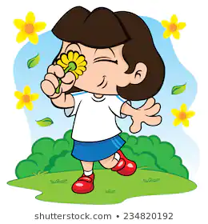
Smell
If appropriate for each child: Introduce that we use our nose to smell, indicating to each child where their nose is (or asking them to show you themselves). Encourage each child to smell the pineapple and then the banana. Always present the stronger of the scents last. Encourage each child to express likes or dislikes for the scents.
Or, you could just quietly offer each child the different scents
Resources: Banana and pineapple

Slide 6
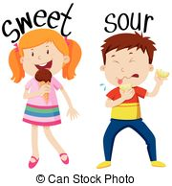
Taste - may not be applicable to all pupils. Pupils unable to taste can smell the resources or feel.
If appropriate for each child: Introduce that we use our mouth to taste, indicating to each child where their mouth is (or asking them to show you themselves). Offer each child a sweet taste and a sour taste, offering the sweet taste first. Encourage each child to express their likes and dislikes towards the food.
Or, you could just quietly offer each child the different tastes
Sweet taste: Honey
Sour taste: lemon

Slide 7

See
If appropriate for each child: Introduce that we use our eyes to see, indicating to each child where their eyes are (or asking them to show you themselves). Show each child, one at a time, the yellow materials and the yellow artificial flowers.
Or, you could just quietly show each child the different resources.
Resources: yellow materials and yellow artificial flowers

Slide 8
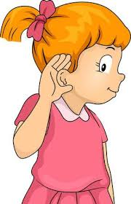
Hear
If appropriate for each child: Introduce that we use our ears to hear, indicating to each child where their ears are (or asking them to show you themselves).
Or, just play the music for each child to listen to.
Hear: Yellow Submarine Song
https://www.youtube.com/watch?v=m2uTFF_3MaA

Slide 9
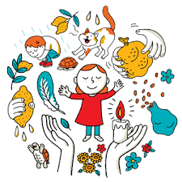
Relaxation
Relax with each child for massage and to listen to relaxing music.

