Slide 2
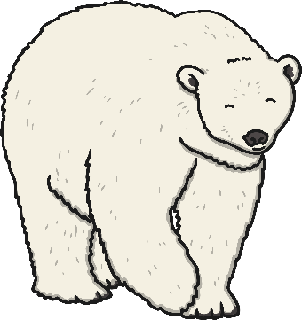
Five little polar bears,
Playing near the shore.
One tumbled in,
Then there were four.

Slide 3
Four little polar bears,
Swimming in the sea.
One chased a seal,
Then there were three.

Slide 4
Three little polar bears,
What shall we do?
One went swimming,
Then there were two.

Slide 5
Two little polar bears,
Playing in the sun.
One took a nap,
Then there was one.

Slide 6
One little polar bear,
Soon to be gone.
Ran to his mummy,
Then there were none.

