Slide 2

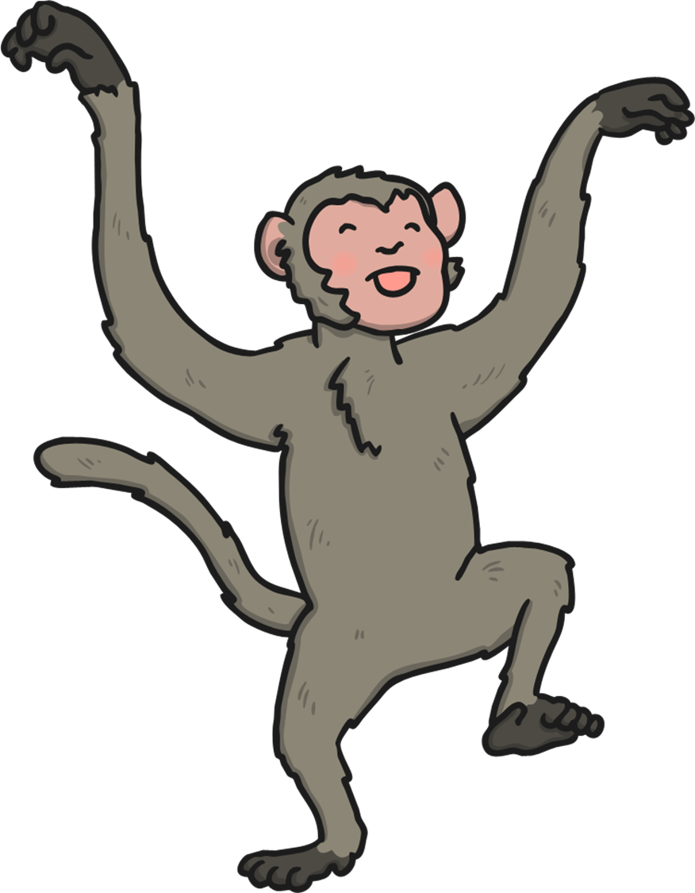
Five little monkeys swinging in a tree…
5

Slide 3

Teasing Mr Crocodile…
“You can’t catch me!”

Slide 4

Along comes Mr Crocodile, as quiet as can be…

Slide 5
SNAP!

Slide 6
Four little monkeys swinging in a tree…
4

Slide 7
Teasing Mr Crocodile…
“You can’t catch me!”

Slide 8
Along comes Mr Crocodile, as quiet as can be…

Slide 9
SNAP!

Slide 10
Three little monkeys swinging in a tree…
3

Slide 11
Teasing Mr Crocodile…
“You can’t catch me!”

Slide 12
Along comes Mr Crocodile, as quiet as can be…

Slide 13
SNAP!

Slide 14
Two little monkeys swinging in a tree…
2

Slide 15
Teasing Mr Crocodile…
“You can’t catch me!”

Slide 16
Along comes Mr Crocodile, as quiet as can be…

Slide 17
SNAP!

Slide 18
One little monkeys swinging in a tree…
1

Slide 19
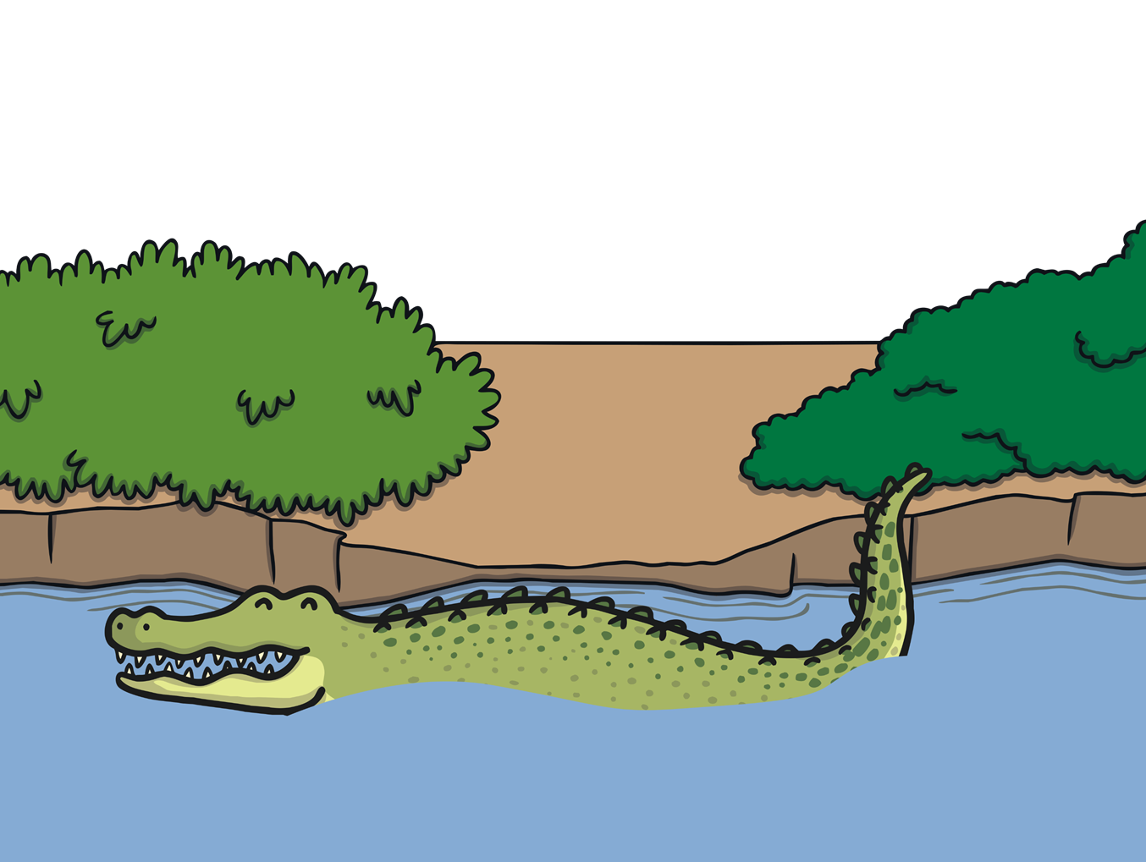
Away swims Mr Crocodile, as full as he can be!

