Slide 1
Guidance for Video/Audio in PowerPoints
1. Open the folder and copy all the files.
2. Paste the copied files into a new folder.
3. Open the PowerPoint file, enable editing and enter presentation mode (start the slide show). Go to slide 3 and the backing track will start automatically.
Please note the embedded audio may not be compatible with early versions of PowerPoint.
You may wish to delete this slide before beginning the presentation.

Slide 3
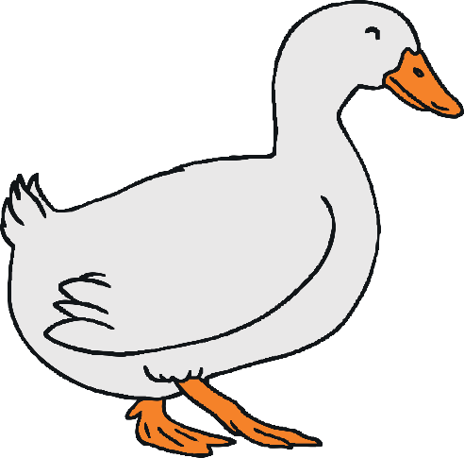
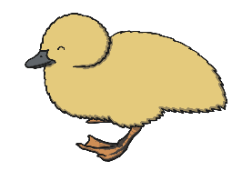
Five little ducks went swimming one day,
Over the pond and far away.
Mother Duck said ‘Quack, quack, quack, quack!’
But only four little ducks came back.

Slide 4
Four little ducks went swimming one day,
Over the pond and far away.
Mother Duck said ‘Quack, quack, quack, quack!’
But only three little ducks came back.

Slide 5
Three little ducks went swimming one day,
Over the pond and far away.
Mother Duck said ‘Quack, quack, quack, quack!’
But only two little ducks came back.

Slide 6
Two little ducks went swimming one day,
Over the pond and far away.
Mother Duck said ‘Quack, quack, quack, quack!’
But only one little duck came back.

Slide 7
One little duck went swimming one day,
Over the pond and far away.
Mother Duck said ‘Quack, quack, quack, quack!’
But none of the five little ducks came back.

Slide 8
Sad Mother Duck went swimming one day,
Over the pond and far away.
The sad Mother Duck said ‘Quack, quack, quack, quack!’
And all of the five little ducks came back!

