Slide 2
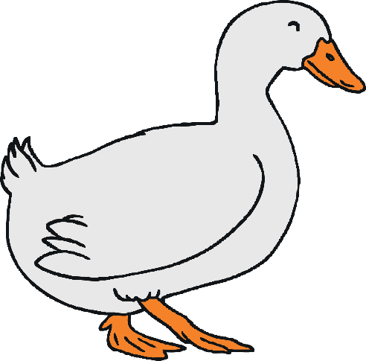
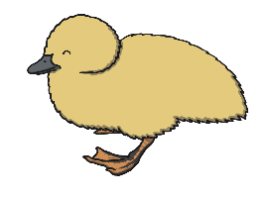
Five little ducks went swimming one day,
Over the pond and far away.
Mother Duck said ‘Quack, quack, quack, quack!’
But only four little ducks came back.

Slide 3
Four little ducks went swimming one day,
Over the pond and far away.
Mother Duck said ‘Quack, quack, quack, quack!’
But only three little ducks came back.

Slide 4
Three little ducks went swimming one day,
Over the pond and far away.
Mother Duck said ‘Quack, quack, quack, quack!’
But only two little ducks came back.

Slide 5
Two little ducks went swimming one day,
Over the pond and far away.
Mother Duck said ‘Quack, quack, quack, quack!’
But only one little duck came back.

Slide 6
One little duck went swimming one day,
Over the pond and far away.
Mother Duck said ‘Quack, quack, quack, quack!’
But none of the five little ducks came back.

Slide 7
Sad Mother Duck went swimming one day,
Over the pond and far away.
The sad Mother Duck said ‘Quack, quack, quack, quack!’
And all of the five little ducks came back!

