Slide 1
All About Me Book
Page 1 (This is me): You could use a picture of your child - encouraging your child to identify themselves and to make a choice as to which they would like to use.
Page 2 (Birthday): Write your child’s birthday with them and then encourage them to make marks using paint / pencils etc on the birthday cake.
Page 3 (eyes): Show your child themselves in the mirror and point out their eyes - either tell them the colour of their eyes or encourage them to identify, using the symbols as support, the colour. They can then make marks in that colour on the eye or stick on the symbol.
Page 4 (hair): Show your child themselves in the mirror and point out their hair - either tell them the colour of their hair or encourage them to identify, using the symbols as support, the colour. They can then make marks in that colour on the hair, stick on the symbol or stick materials in that colour.
Page 5 (my family): Use a picture of the people in your family to stick onto the page - look at the picture with your child and encourage them to identify who is in the pictures.
Page 5 (Favourite things): Encourage your child to use the symbols to identify their favourite things or use pictures of their favourite things to stick onto the page.
Page 6 (Favourite Food): Same as above, encourage your child to use the symbols to identify their favourite food or use pictures of their favourite foods to stick onto the page.

Slide 5
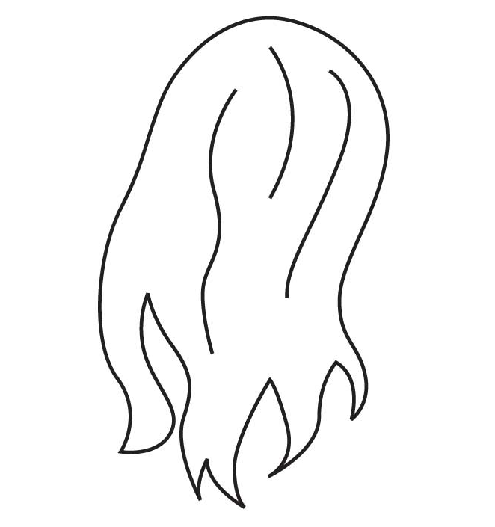

Slide 8
