Slide 1
Notes:
Drag the day of the week and the taste of the day into the box
Taste and smell the apple if available.

Slide 2
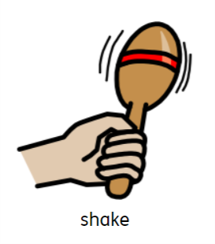
https://www.youtube.com/watch?v=YJFA5Bitv7w
Notes:
Turn the lights off and make a relaxing setting. Shake any instruments you may have or shake your body.

Slide 3
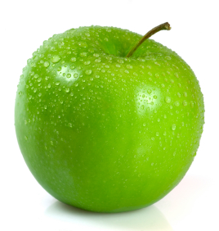
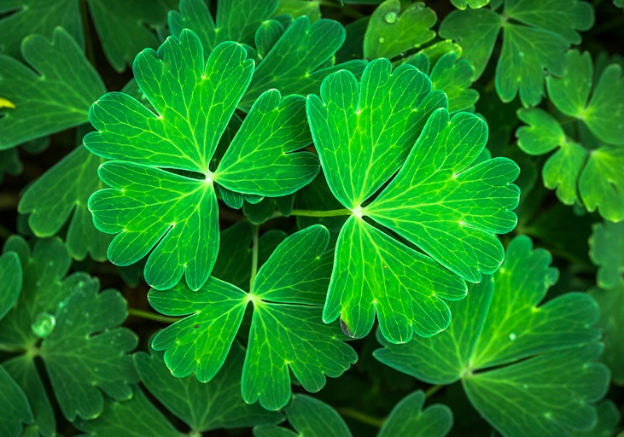
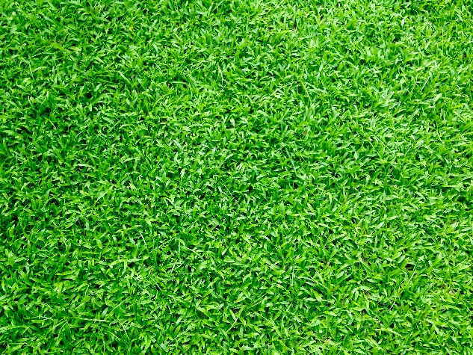
HP, TI, SO, BS and BG- Drag the red items into the box
Notes:
This slide is suitable for SO, TI, HP, BG and BS

Slide 4
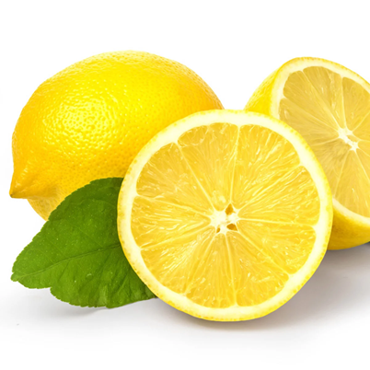
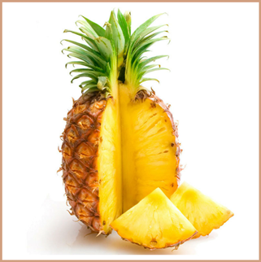
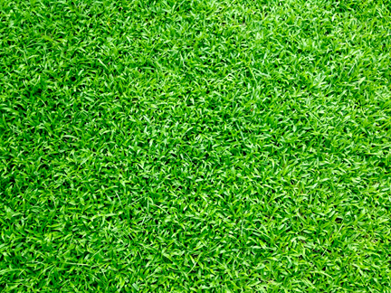
ML, JM and AM- Drag the red items into the box
Notes:
This slide is suitable for ML, JM and AM

Slide 5
Humanities- explore the garden- what’s outside? Go outside and collect some materials. Maybe some leaves, flowers or grass. Take them inside (if it is a nice day, sit outside) and create a messy play tray. You can do some leaf rubbings, make a flower collage or even explore new textures! ML can write items he can see. JM can overwrite items. If it is not possible to go outside, how about some water trays and sing ‘5 little speckled frogs’.
Notes:
Humanities

