Slide 1
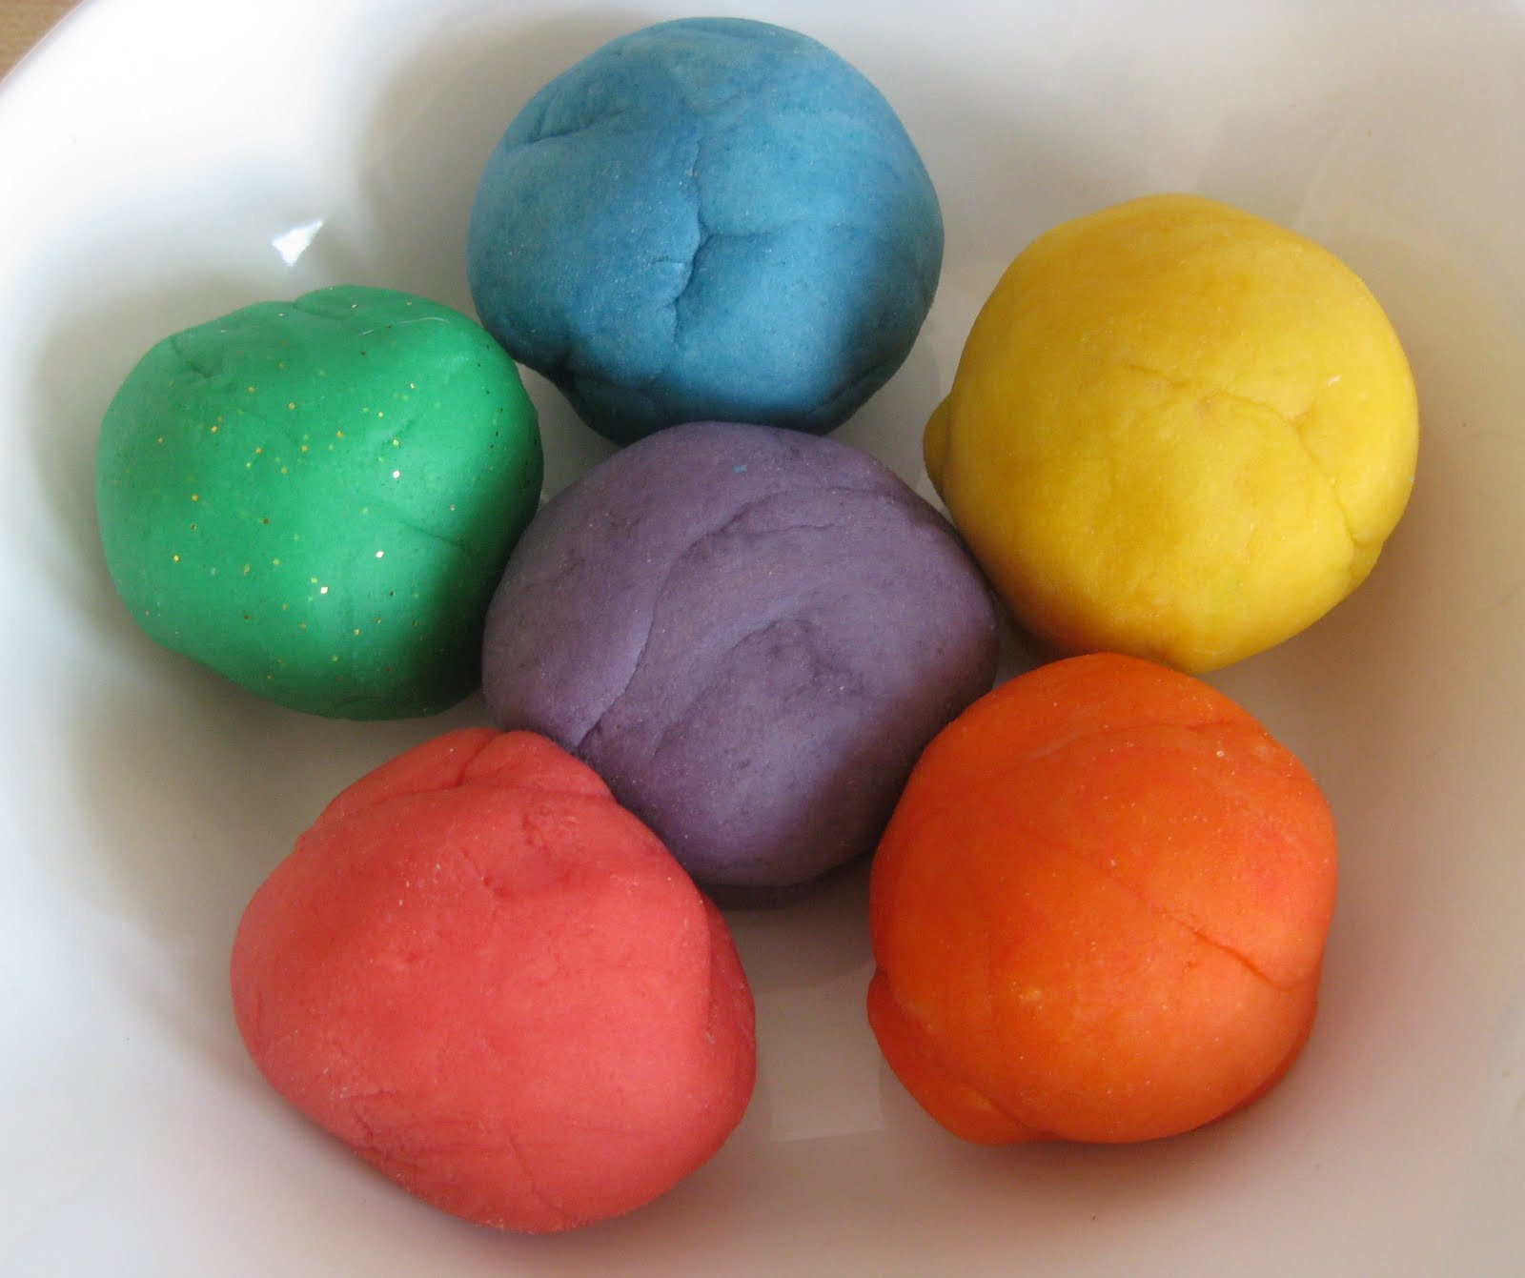
Playdough Disco

Slide 2
What to do:
The purpose of playdough disco is to develop fine motor skills through music and fun!
For each piece of music, follow the hand movements suggested on the slide - keep with the same movement until the song has finished and then move onto the next slide. The links to the songs are the youtube links on the bottom of the page (it wouldn't let me upload it with the music links attached to the page so you will have to keep switching between the powerpoint and youtube - sorry).
Have fun! Sometimes in class we turn off the lights and put on our disco lights, but this is completely up to you :)

Slide 3
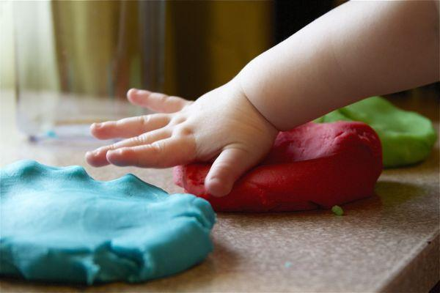
Patting dough with hands
Music: https://www.youtube.com/watch?v=j8z7UjET1Is

Slide 4
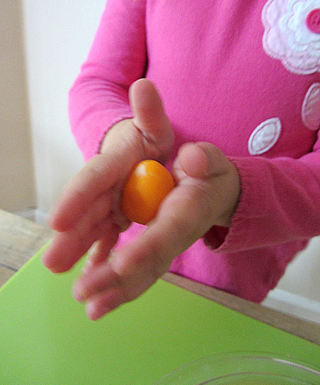
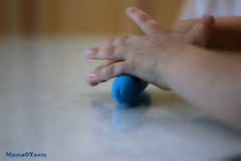
Rolling dough with hands
Music: https://www.youtube.com/watch?v=4h_ixyxQM2M

Slide 5
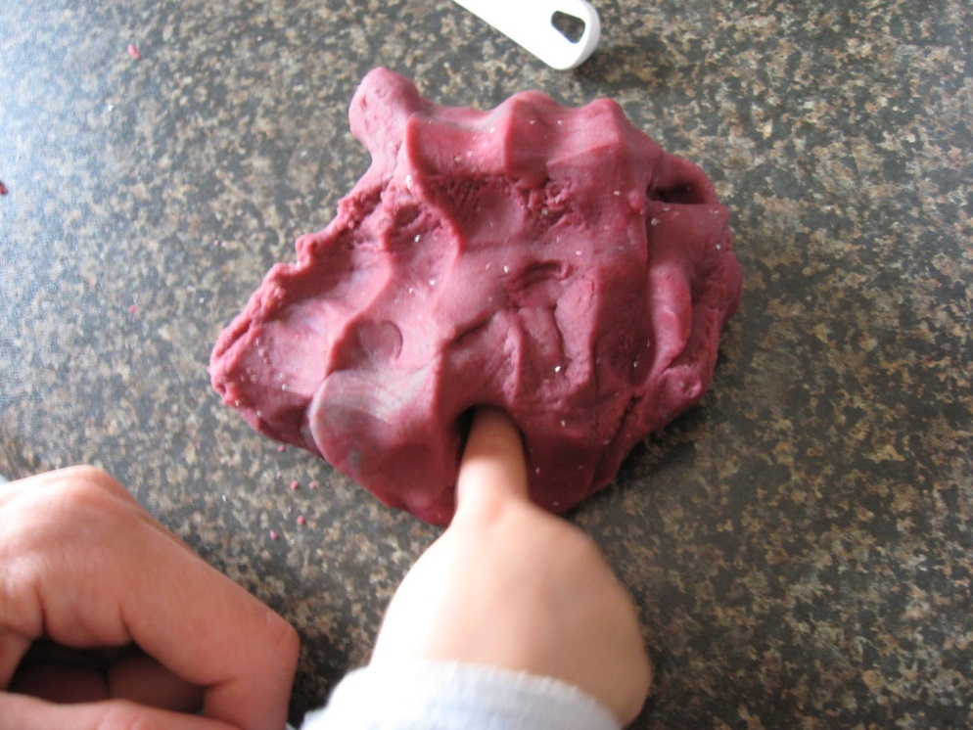
Poking dough with fingers
Music: https://www.youtube.com/watch?v=HUSGpP8FzMc

Slide 6
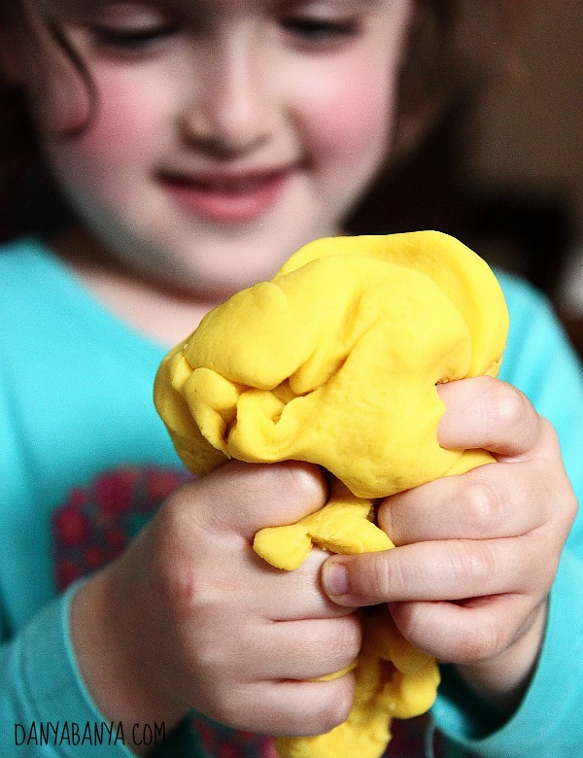
Squeezing dough with hands
Music: https://www.youtube.com/watch?v=f5ou7sjSwRI

Slide 7
Practice all your movements:
Music: https://www.youtube.com/watch?v=DrBsNhwxzgc

