Slide 1
Wales sensology
Wave Welsh flag over each child’s head.

Slide 2
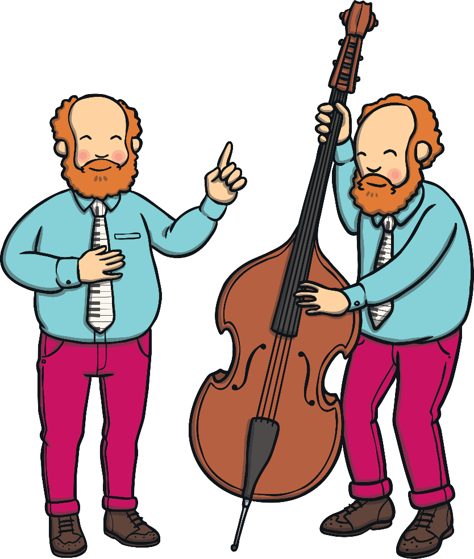
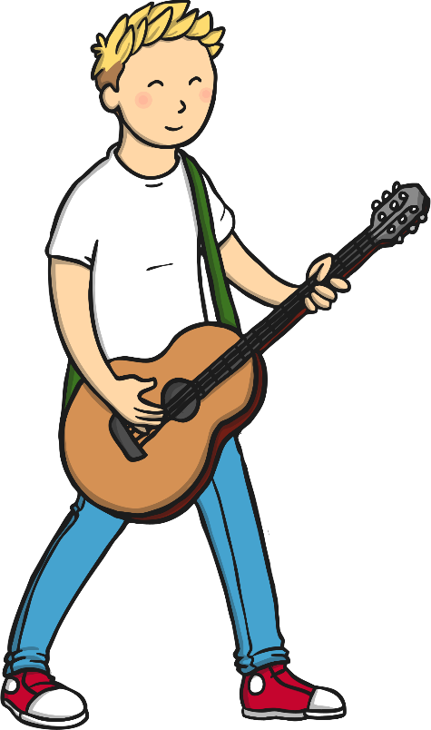
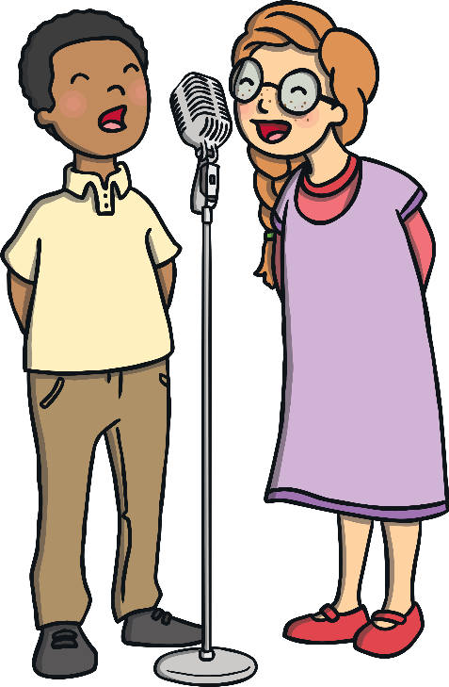
I am proud to be Welsh because…
Resource:
Listen to Welsh music and support children to dance with scarves.
…we are famous for our singers and choirs.

Slide 3
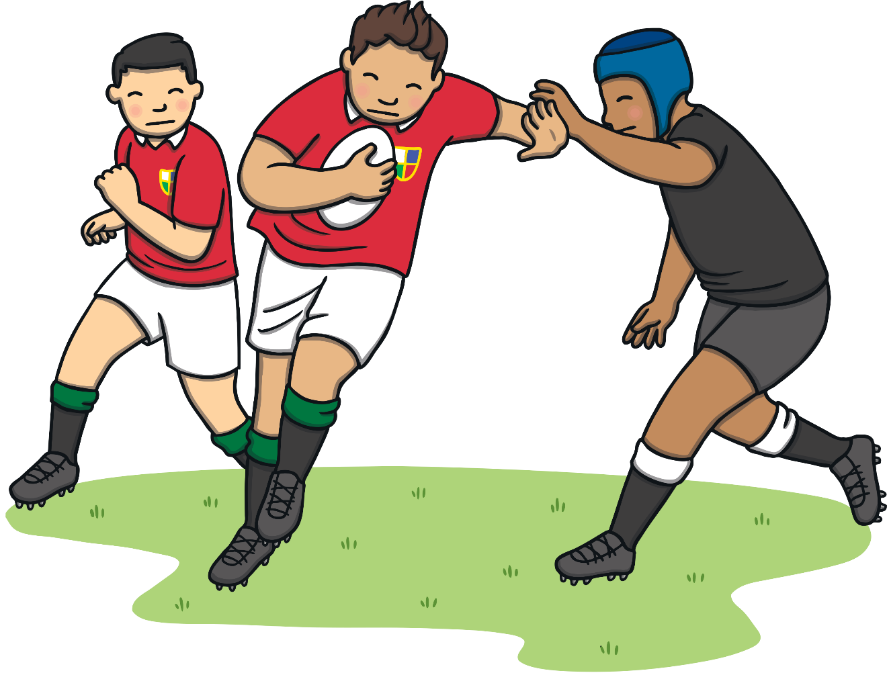
I am proud to be Welsh because…
Resources:
Children to see Welsh rugby top
See / feel: Rugby ball
…we have a world-class rugby team.

Slide 4
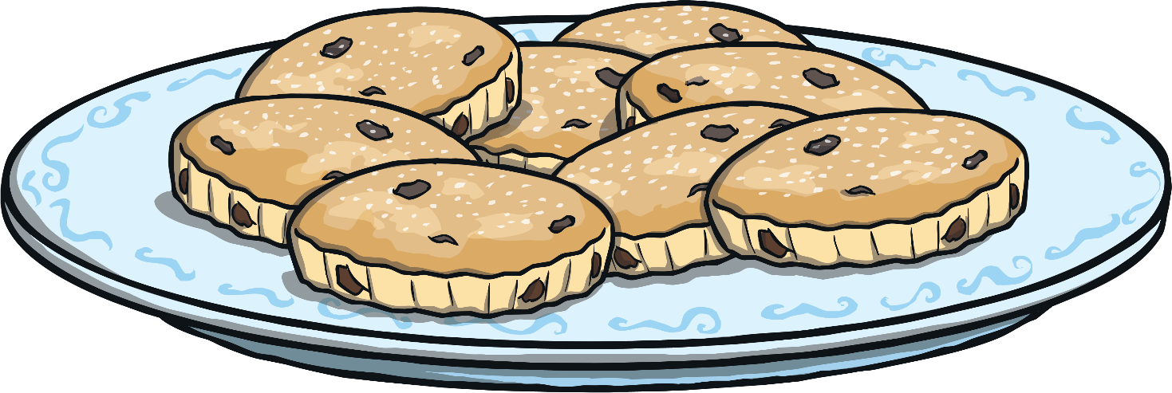
I am proud to be Welsh because…
Resources:
Welsh cakes
Mixed spice
Flour and sultana mix
Touch: Flour mix
Smell: Mixed spice
Taste: Welsh cake
…we make delicious foods! Have you tried our bara brith or Welsh cakes?

Slide 5
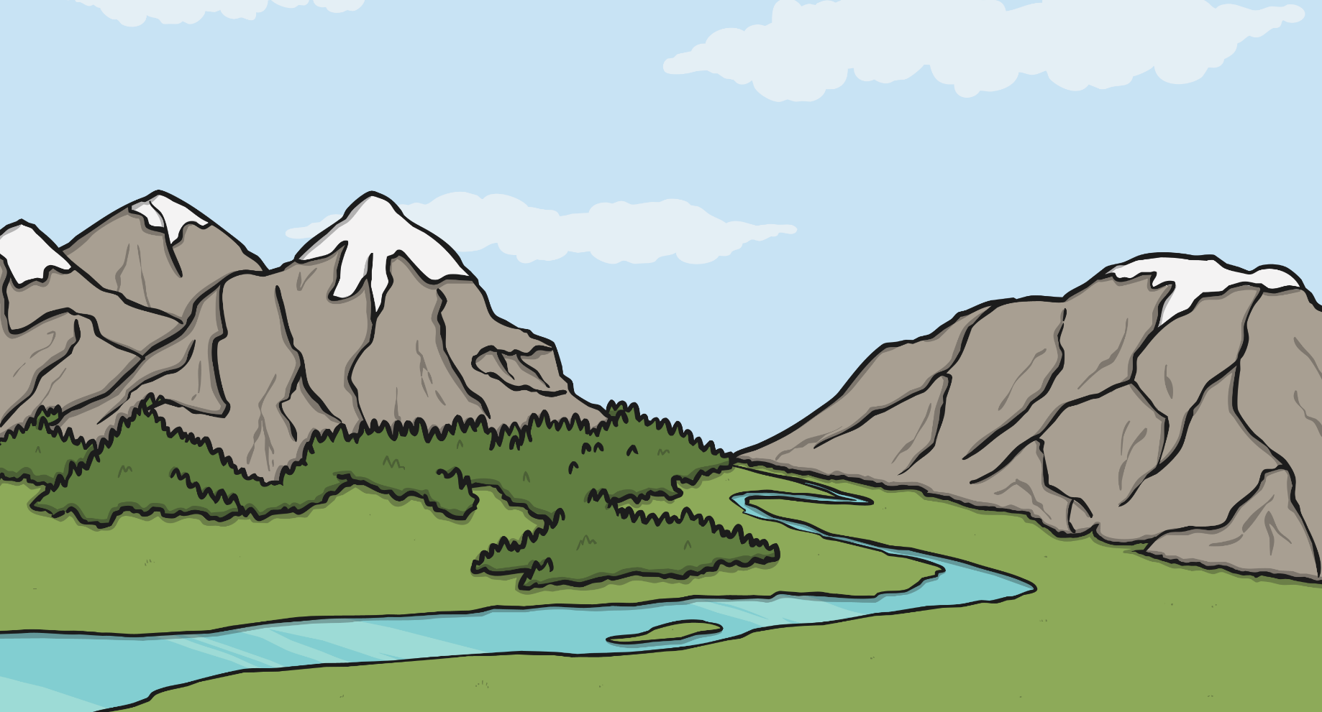
I am proud to be Welsh because…
Resources
Daffodils
Wool / Toy sheep
Children to look at and explore the feel on their bodies
…we have amazing mountains and walks. Can you see all the daffodils and sheep?

Slide 6
Relax
Welsh folk music - children to listen to music and relax.

