Slide 1
Jungle themed sensology
The purpose of sensology is to develop body and sensory awareness. It should be a relaxing session in a quiet environment. Lighting can be low (if suitable) and any sensory lights can be turned on. Your child can either lie down or sit, depending on which they find more relaxing. Shared eye contact is encouraged during these sessions and if your child does not want to touch/taste/smell etc any of the resources then that is absolutely fine! Move steadily through the powerpoint, giving your child time to explore the resources and give reactions - encourage them to express their likes and dislikes for the things they explore. Relaxing music can be played on low in the background.
The powerpoint is designed to give information to you and so there is no need for your child to be positioned so that they can see it. I’ve put a list of resources if you just wanted to print that part out and ignore the powerpoint.

Slide 2
Resources
Say hello: Mirror
Touch: mud/soil and leaves
Smell: Floral scents such as lavender and rose (you could use jams, scented candles, aromatherapy oils or room sprays for them to smell).
Taste: Fruity tastes such as strawberry jam or blackcurrant jam
See: flowers, toy jungle animals or pictures of jungle animals
Sound: animal sounds – lions, elephants, monkey, jungle

Slide 3
Say hello….
Encourage your child to look at themselves in the mirror. Begin by talking to them about the parts of the body they can see in the mirror (head, eyes, nose, ears etc) and then move on to point/tap to other parts of their body such as their arms, legs, hands, feet etc.
Sing the song ‘Body parts song for kids – this is Me!’
https://www.youtube.com/watch?v=QkHQ0CYwjaI

Slide 4
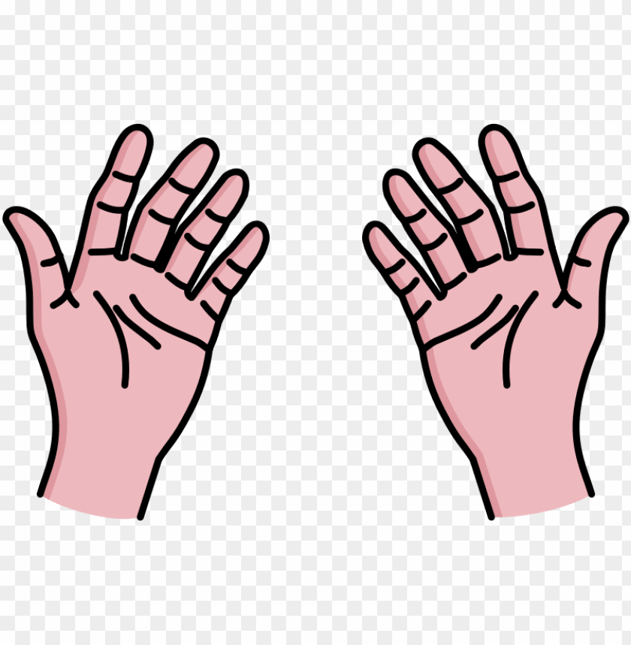
Touch
Briefly introduce that we use our bodies and our hands to touch. Encourage your child to explore the feel, one at a time, of the dry leaves and then the mud or soil.
Feel: leaves, mud/soil

Slide 5
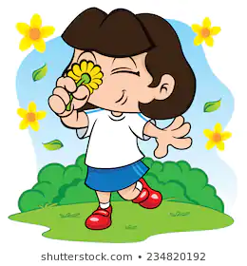
Smell
Introduce that we use our nose to smell, indicating to your child where their nose is (or asking them to show you themselves). Encourage your child to smell two different floral scents that you have available – examples are lavender and rose scents (you could use jams, scented candles, aromatherapy oils or room sprays for them to smell). Always present the stronger of the scents last. Encourage your child to express likes or dislikes for the scents.
Smell: Floral scents such as lavender and rose

Slide 6

Taste - may not be applicable to all pupils. Pupils unable to taste can smell the resources or feel.
Introduce that we use our mouth to taste, indicating to your child where their mouth is (or asking them to show you themselves). Offer your child a taste of something fruity, for example strawberry and blackcurrant jams. Encourage your child your child to express their likes and dislikes towards the food.
Taste: Fruity tastes such as strawberry and blackcurrant jam

Slide 7

See
Introduce that we use our eyes to see, indicating to your child where their eyes are (or asking them to show you themselves). Show your child a selection of jungle animals (either soft toys or pictures) – you could name the animals and tell / ask your child the colours that they can see. You can then show your child some flowers (these can be real or artificial).
See: toy animals / pictures and flowers

Slide 8
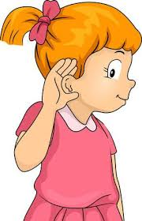
Hear
Introduce that we use our ears to hear, indicating to your child where their ears are (or asking them to show you themselves). Listen to the animal sound effects with your child.
Lion sound effect: https://www.youtube.com/watch?v=8StqowT8hME
Elephant sound effect: https://www.youtube.com/watch?v=153xbn1k2H8
Monkey sound effect: https://www.youtube.com/watch?v=yq88AqJsQUQ&t=9s
Jungle sound effects: https://www.youtube.com/watch?v=fHWhebFt_r0

Slide 9
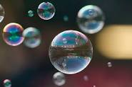
Relaxation
Relax with your child, listening to the music and perhaps giving them a massage. You could also blow bubbles for your child (if you have these available). You could also finish with the Rumble in the Jungle Story Massage.
Some ideas for relaxation music:
https://www.youtube.com/watch?v=zQtfnPTlFFE&t=9s
https://www.youtube.com/watch?v=URxC75G3nJI
https://www.youtube.com/watch?v=OTJXAUZY9t0

