Slide 1
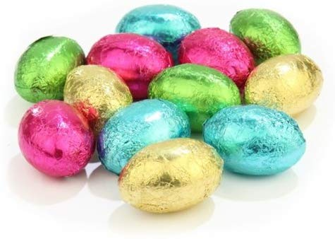
We’re going on an Easter Egg hunt!

Slide 2
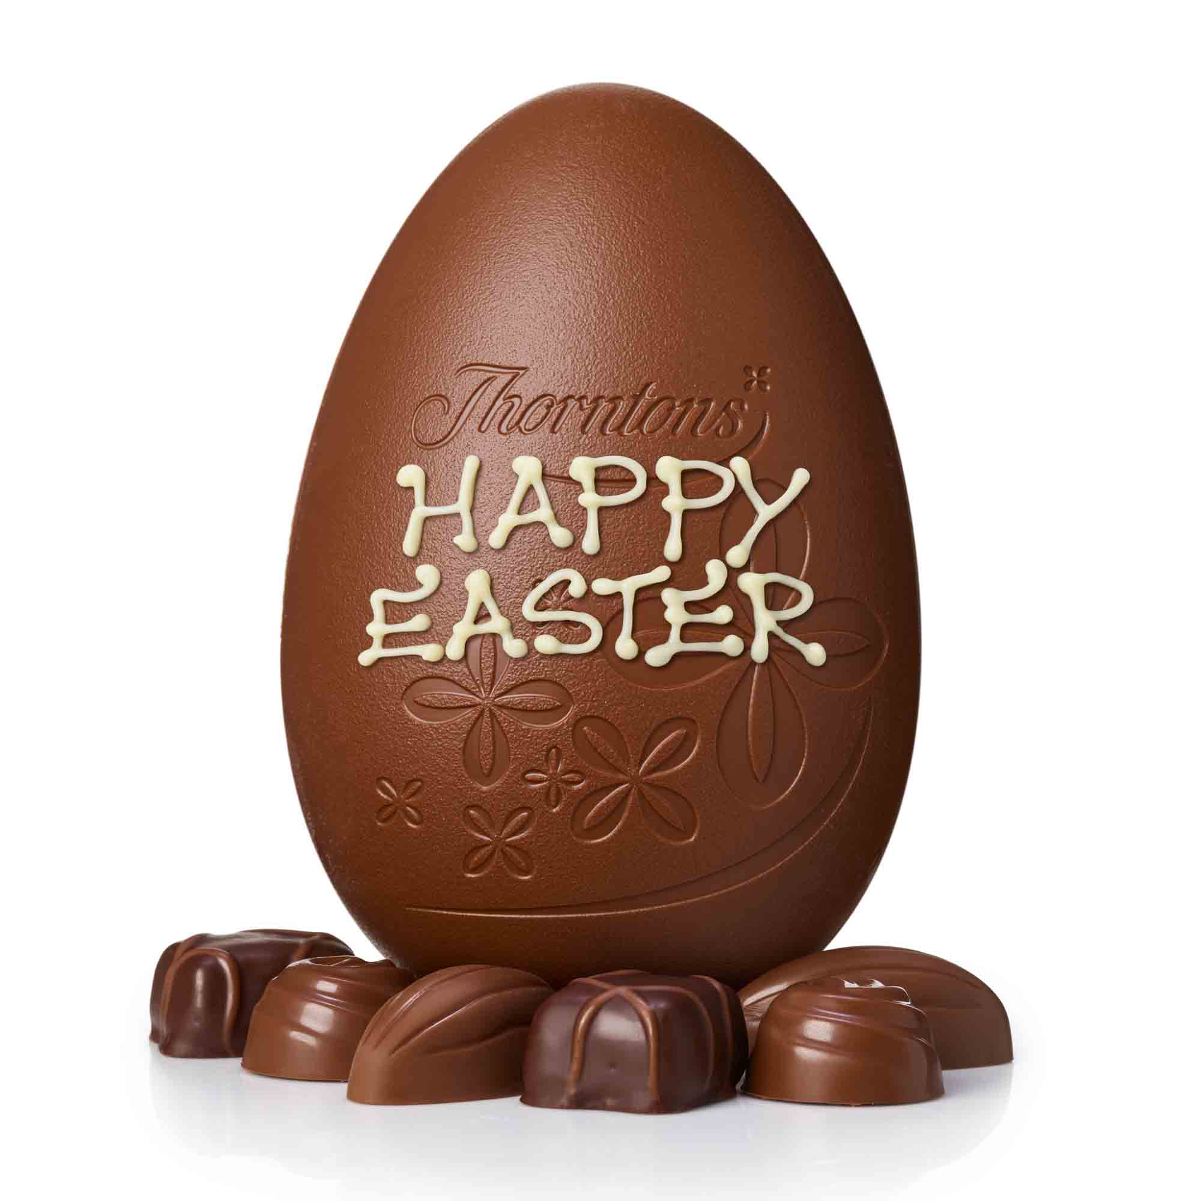
We’re going on an Easter egg hunt, we’re going to find a chocolatey one!
What a beautiful day, we’re so excited!!

Slide 3
Let’s search the garden!
Search up high
Search down low
Oh no, no Easter eggs here! Let’s move on…..
Skip, Skip, Skip, Skip…….
Resource: Artificial flowers / flower image / flower made out of tissue paper

Slide 4
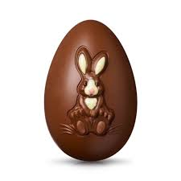
We’re going on an Easter egg hunt, we’re going to find a BIG one!
What a beautiful day, we’re so excited!!

Slide 5
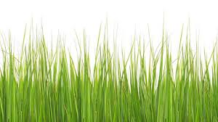
Let’s search the long grass!
Search up high
Search down low
Oh no, no Easter eggs here! Let’s move on…..
Swishy, swashy, swishy, swashy …….
Resource: Grass or green tissue paper to feel.

Slide 6
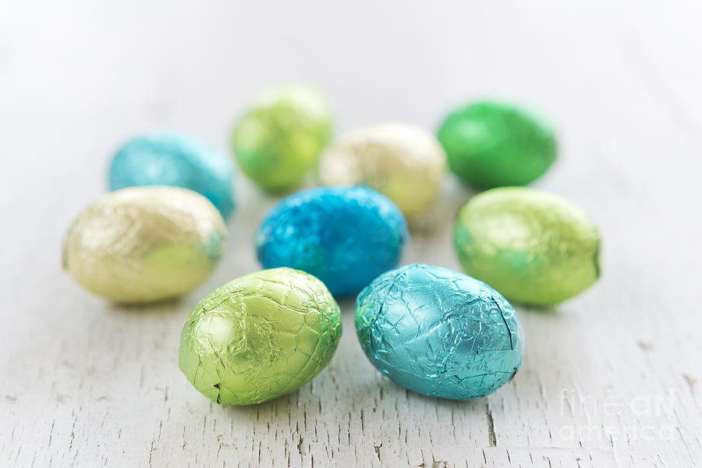
We’re going on an Easter egg hunt, we’re going to find some small ones!
What a beautiful day, we’re so excited!!

Slide 7
Let’s look in the River!
Search up high
Search down low
Oh no, no Easter eggs here! Let’s move on…..
Splishy, splashy, splishy, splashy …….
Resource: Water for your child to splash in or water spray

Slide 8
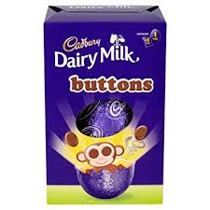
We’re going on an Easter egg hunt, we’re going to find a buttons one!
What a beautiful day, we’re so excited!!

Slide 9
Let’s look in the Forest!
Search up high
Search down low
Oh no, no Easter eggs here! Let’s move on…..
Stumble trip, Stumble trip …….
Resource: Leaves for your child to feel

Slide 10
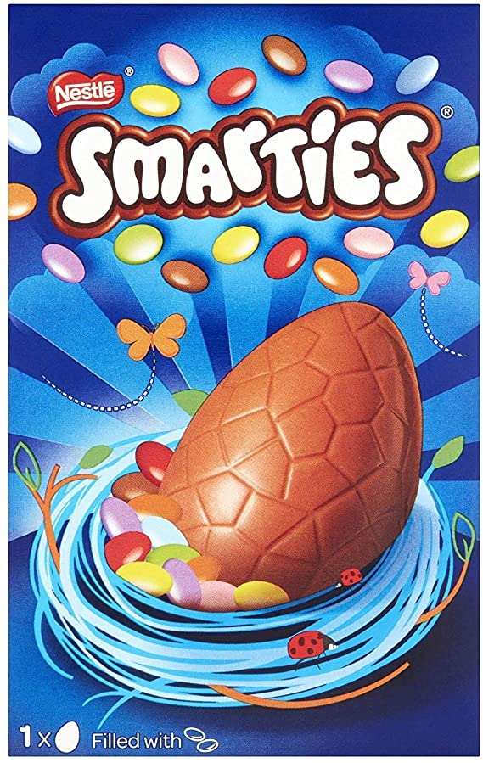
We’re going on an Easter egg hunt, we’re going to find a smarties one!
What a beautiful day, we’re so excited!!

Slide 11
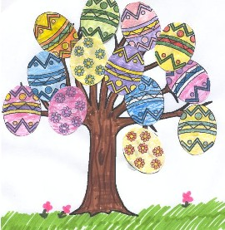
Let’s climb up the tree …… Climb, climb, climb …….
WOW!!!!!!!! Look over there!!!!!
Something egg shaped!
Shiny foil!
A creme egg!!
IT’S AN EASTER EGG!!
Resource: Easter egg, chocolate or foil for your child to feel/smell/taste

Slide 12
QUICK! Let’s go home ….. And eat it!!
Down from the tree ……. Climb, climb, climb,
Back through the forest ….. Stumble trip, stumble trip
Back through the river …. Splish, splash, splish, splash
Back through the long grass …. Swishy, swashy, swishy, swashy
Back through the garden ….. Skip, skip, skip.
Into the house, shut the door, into the kitchen……
Let’s eat our Easter egg! Yummy yummy!

