Slide 1
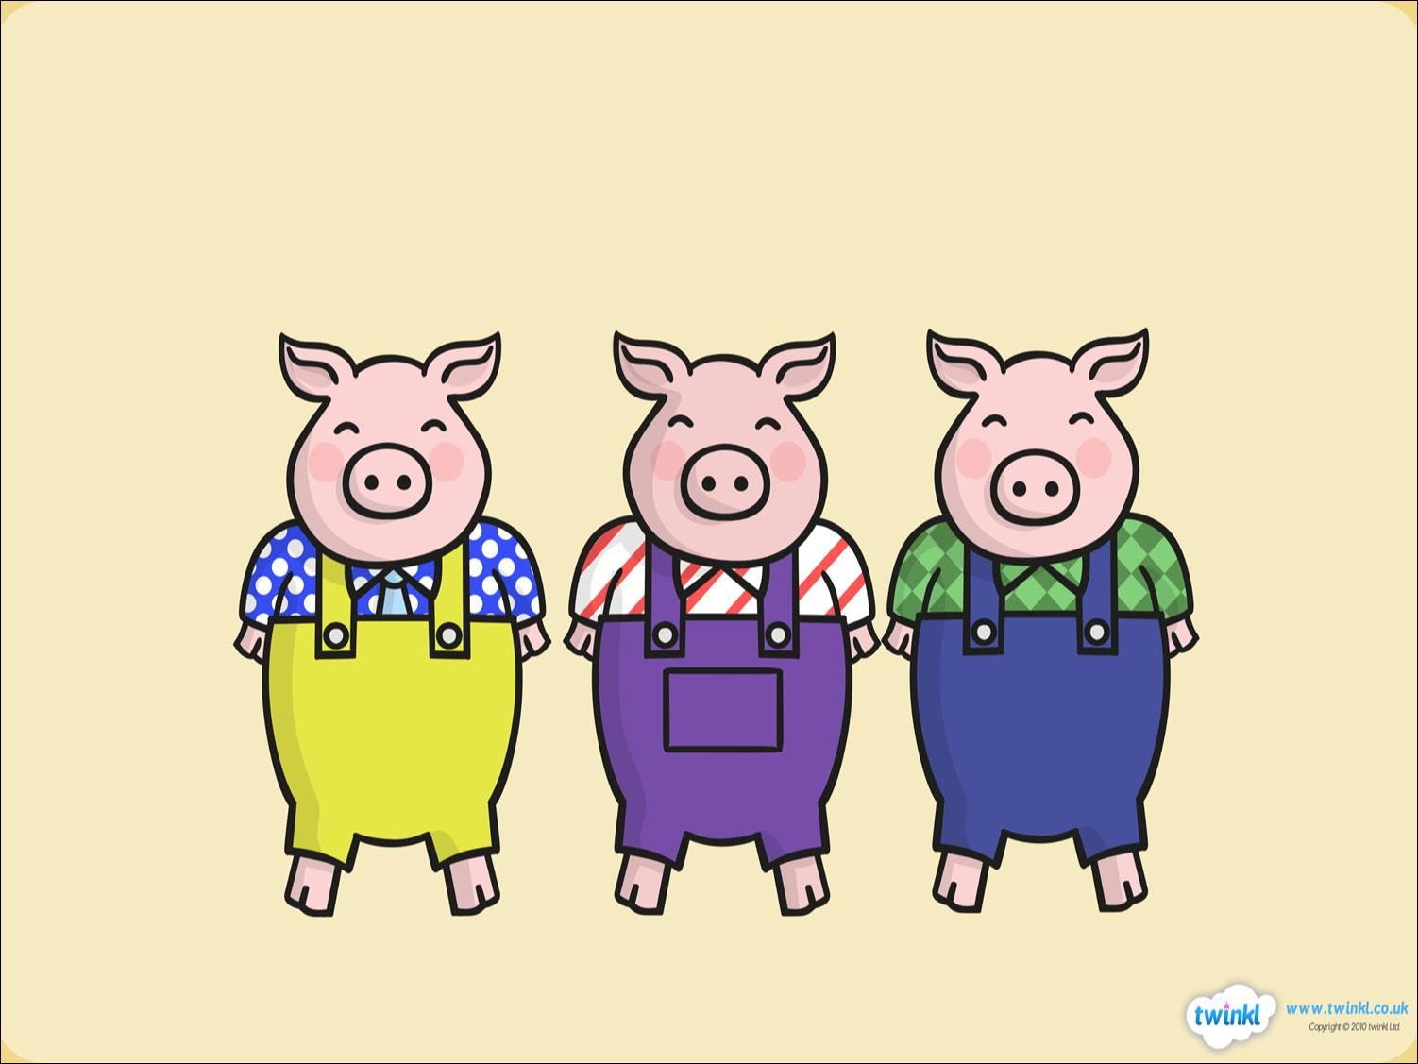


The Three Little Pigs

Slide 2
Once upon a time, there lived three little pigs.
Resource: 3 pig toys / pictures

Slide 3
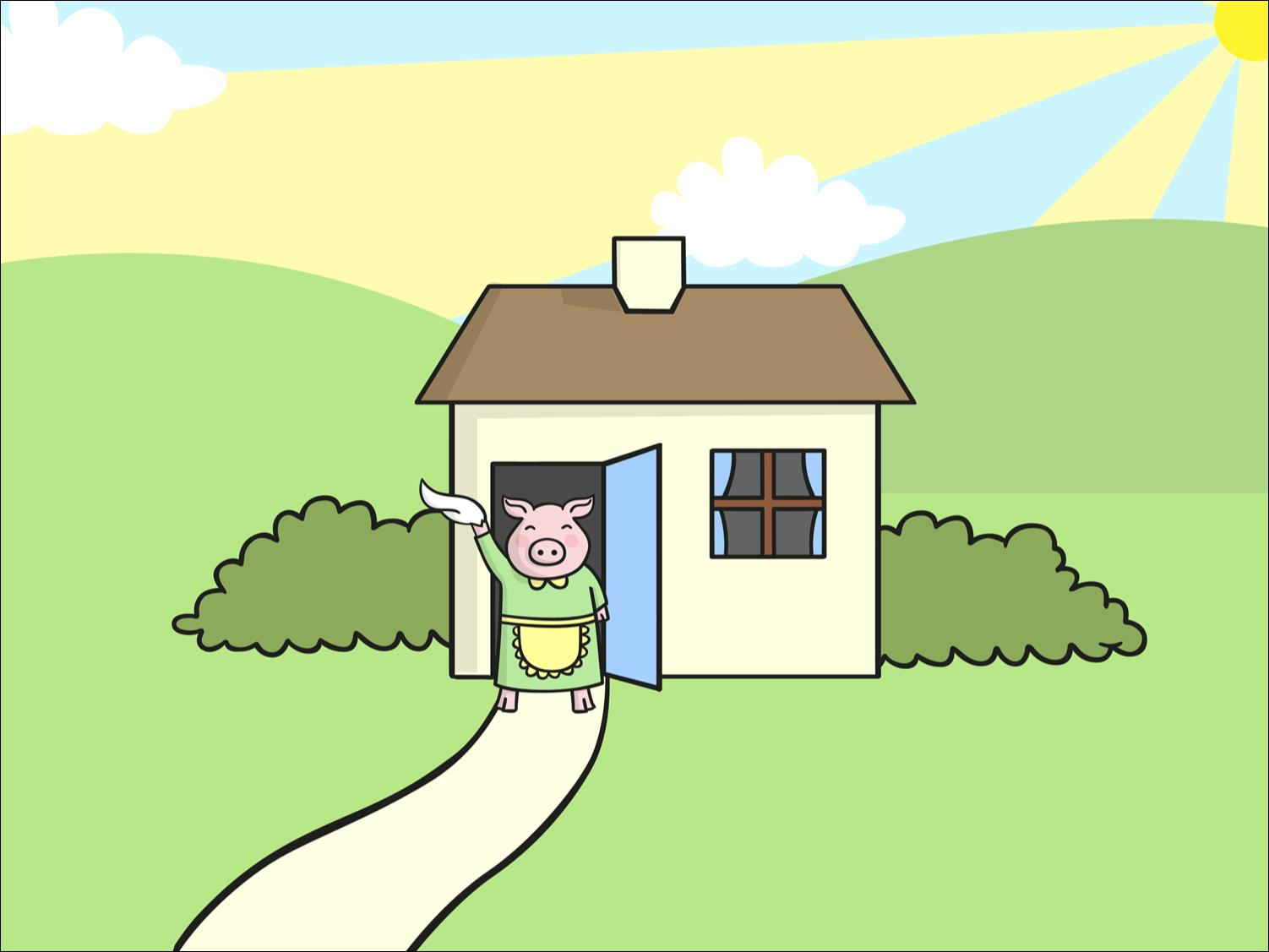
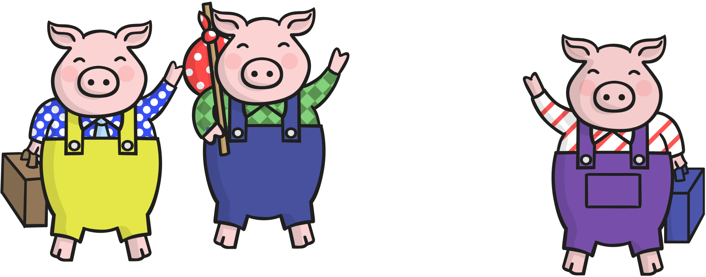

One day, they decided to leave home and build houses of their own.
Resource: 3 pig toys / pictures

Slide 4
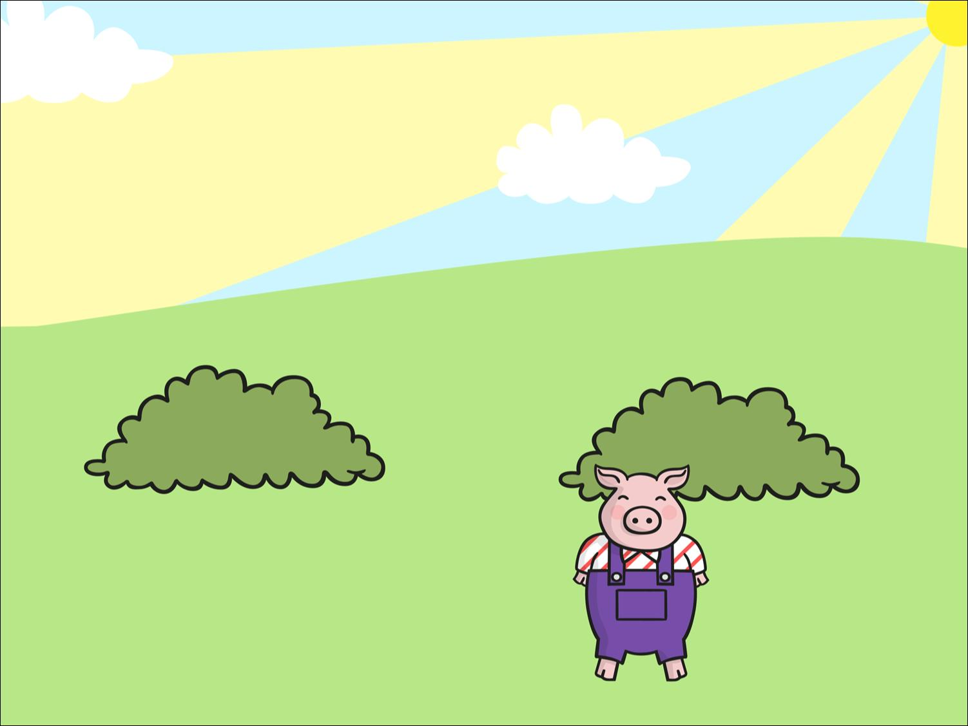
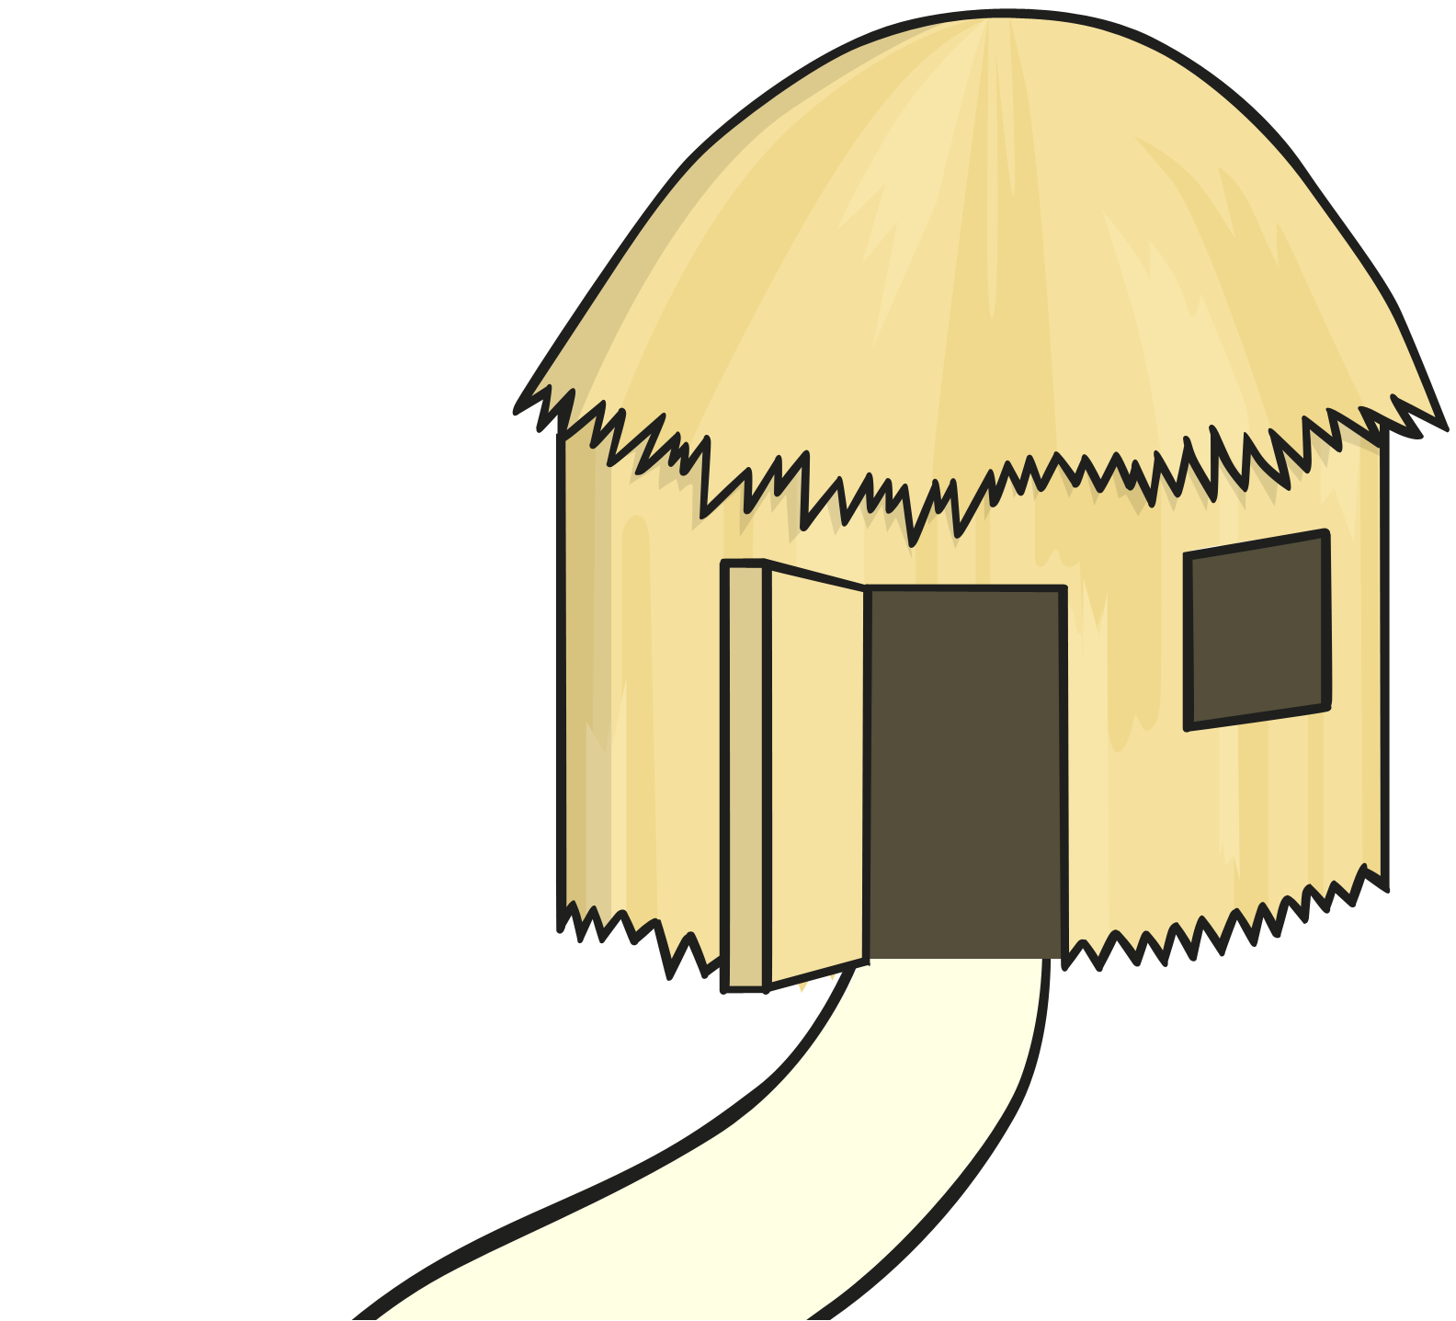
The first little pig thought that straw would make a good house.
He built the house very quickly and he was very pleased with it.
Resource: Straw

Slide 5
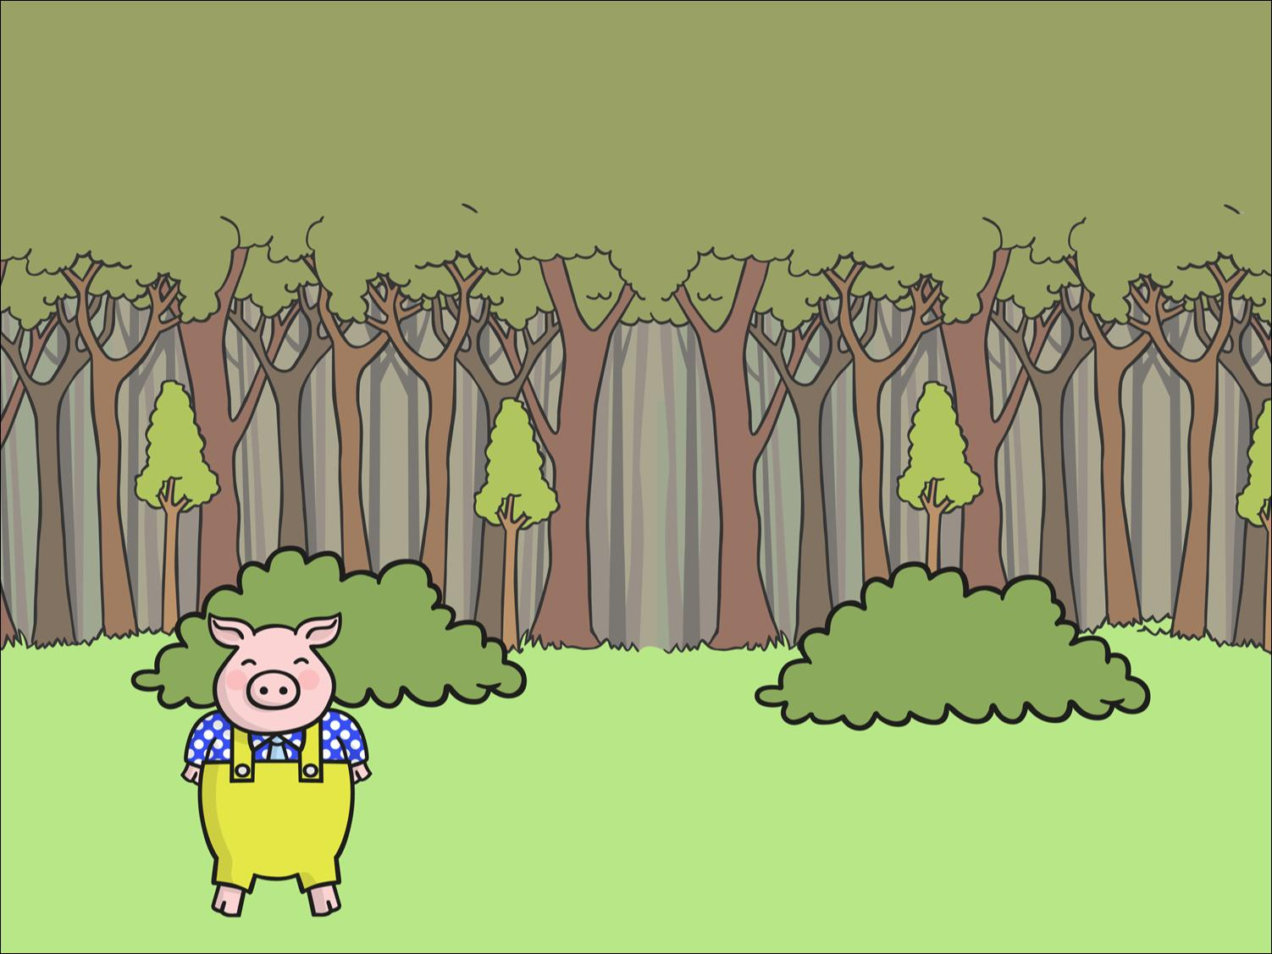
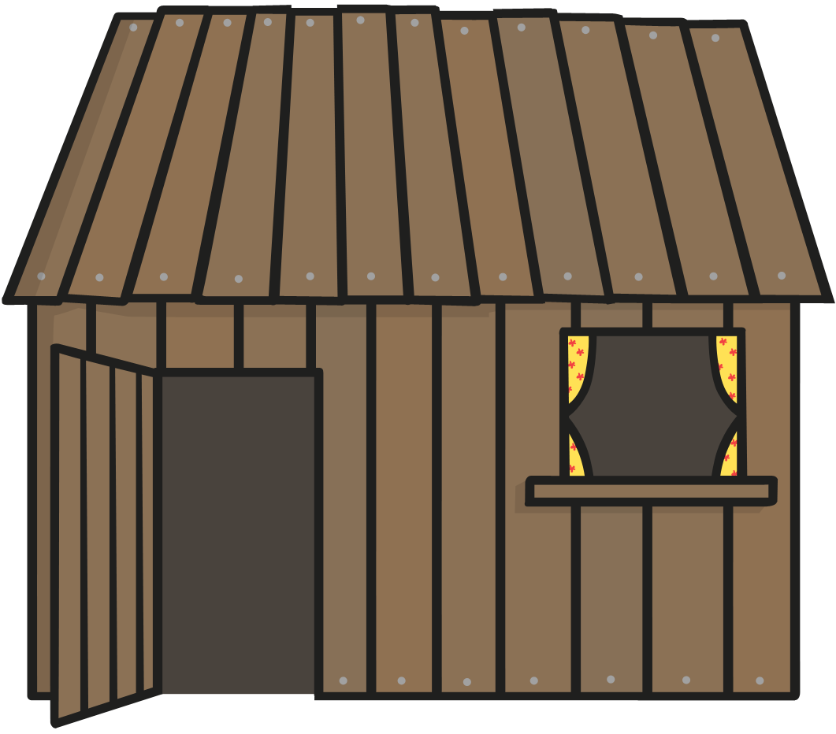
The second little pig thought that sticks would make a fine house. He built the house very quickly and he was very pleased with it.
Resource: Sticks

Slide 6
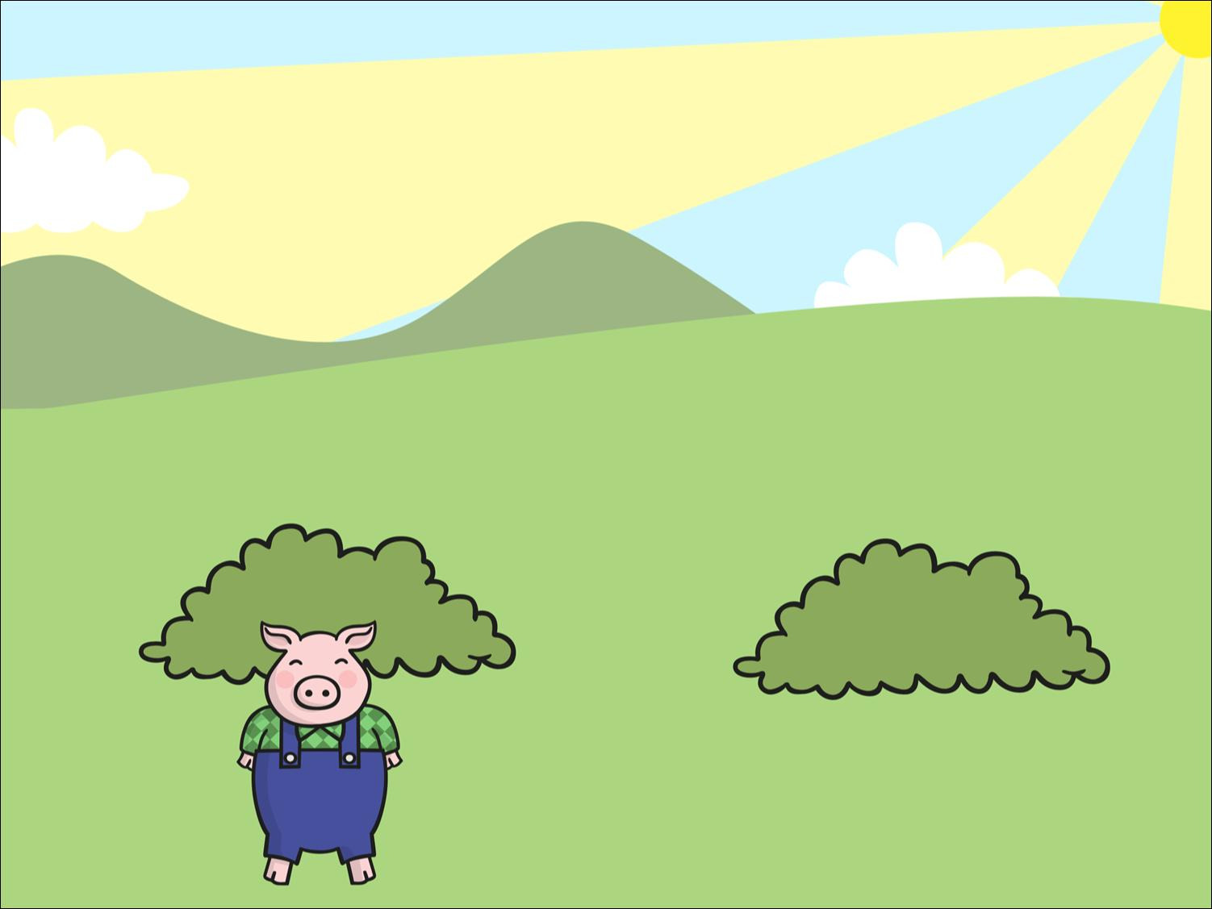
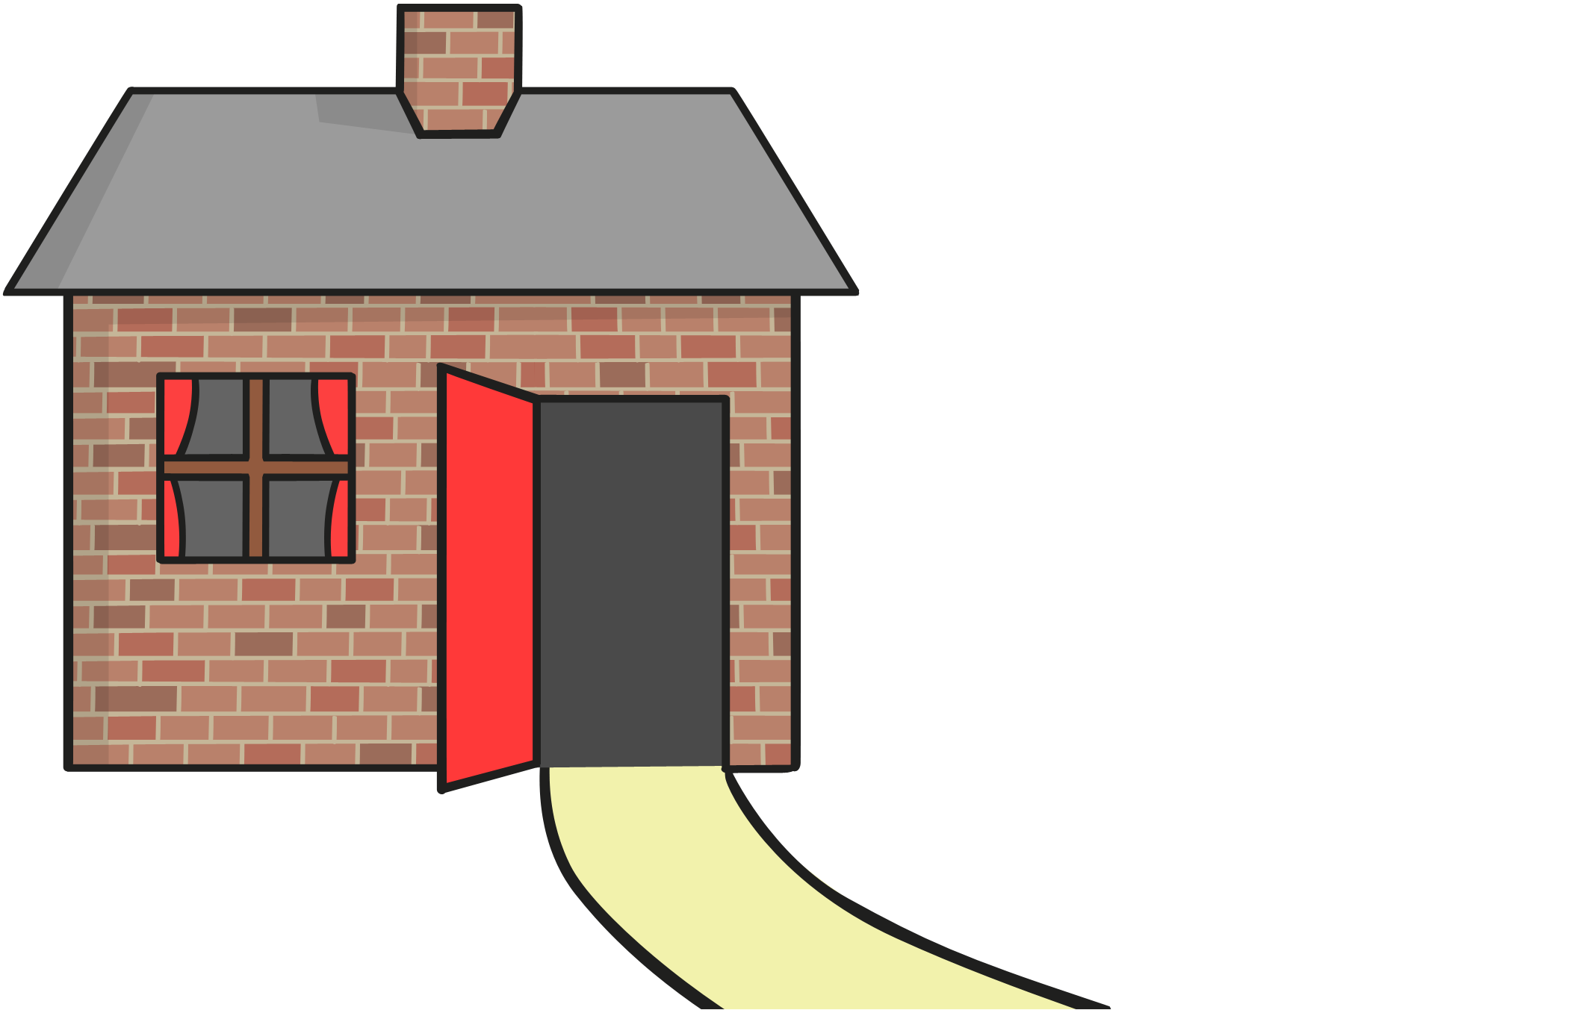
The third little pig thought that bricks would make a strong house.
It took him a long time to build the house but he was very
pleased with it.
Resource: blocks

Slide 7

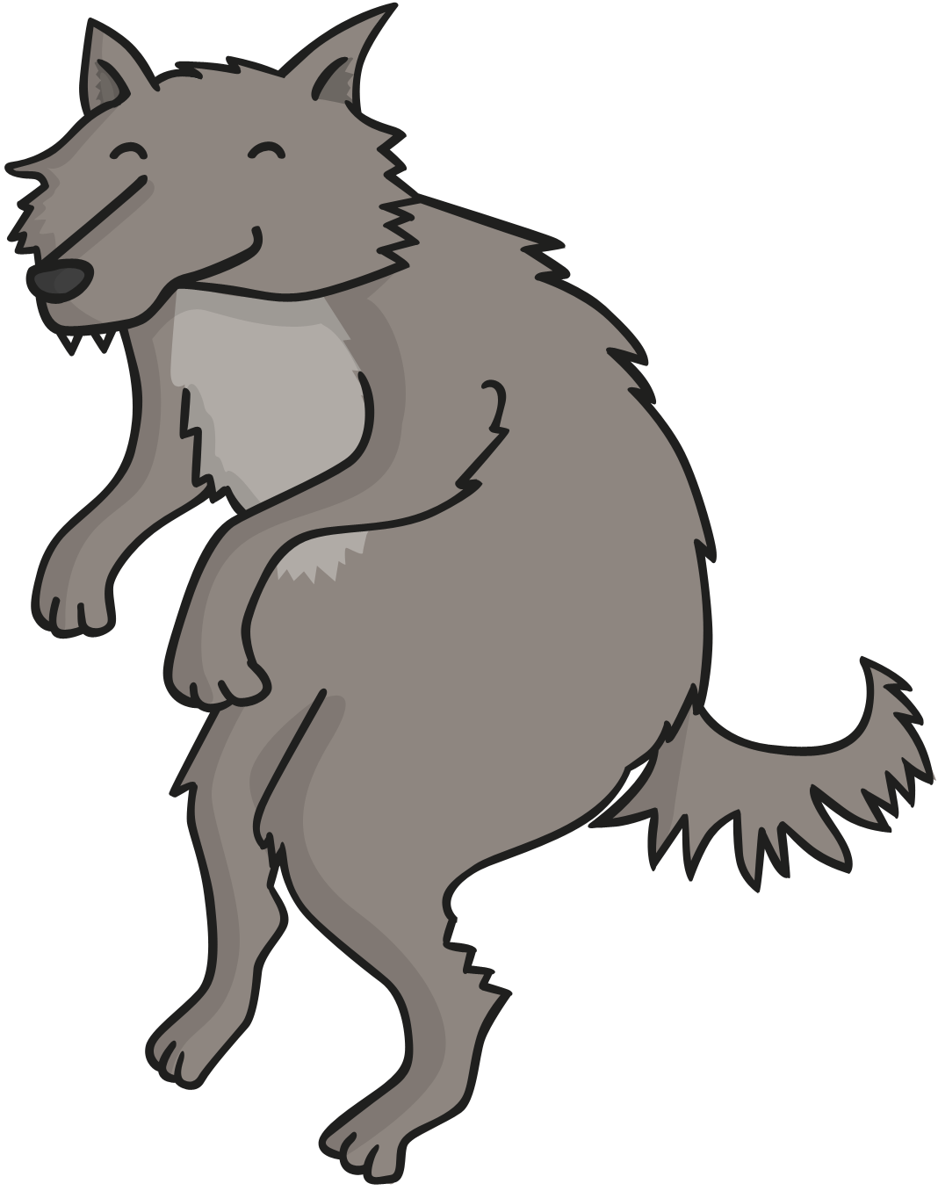
One day, a big bad wolf came along.
Resource: wolf toy or picture

Slide 8
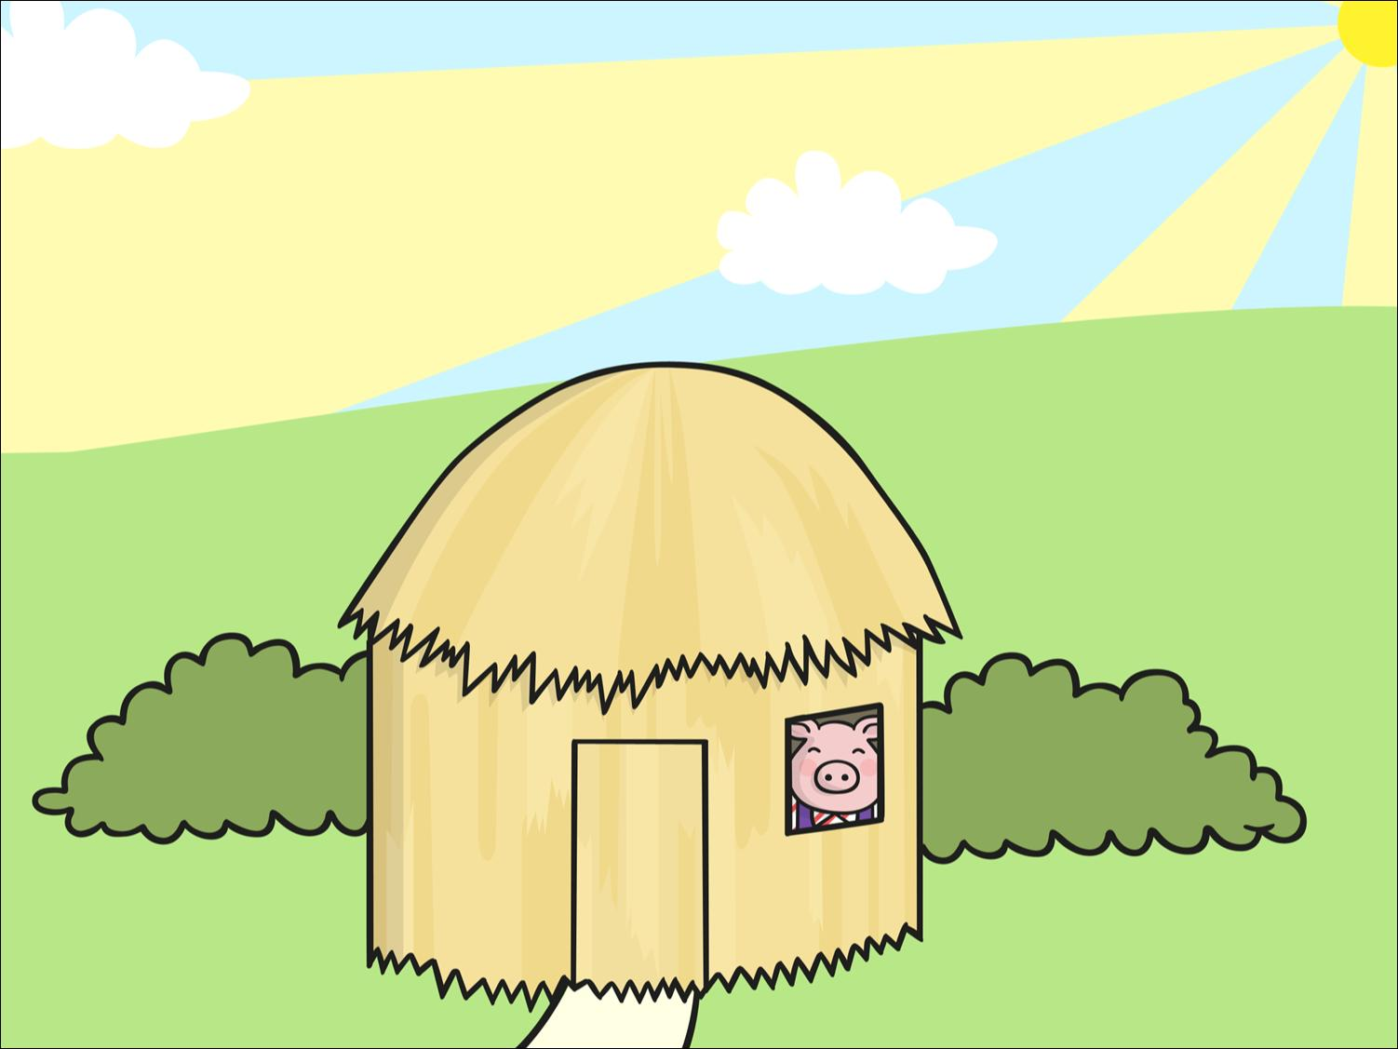
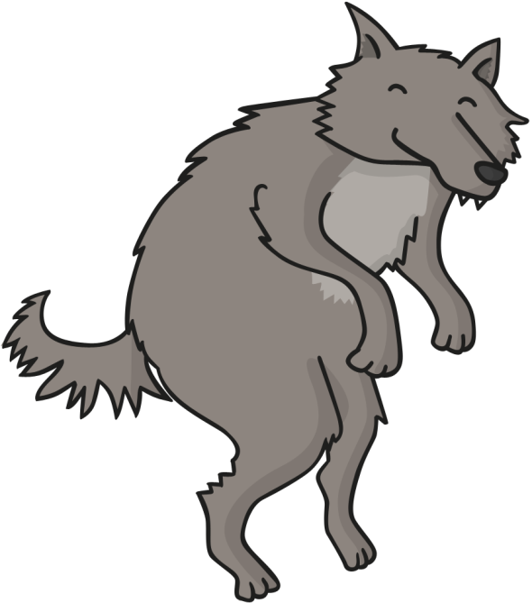
He saw the first little pig in his house of straw.
“Little pig, little pig, let me come in,” he snarled.
“Not by the hair on my chinny, chin, chin!” cried the first little pig.
Resource: Straw and pig

Slide 9
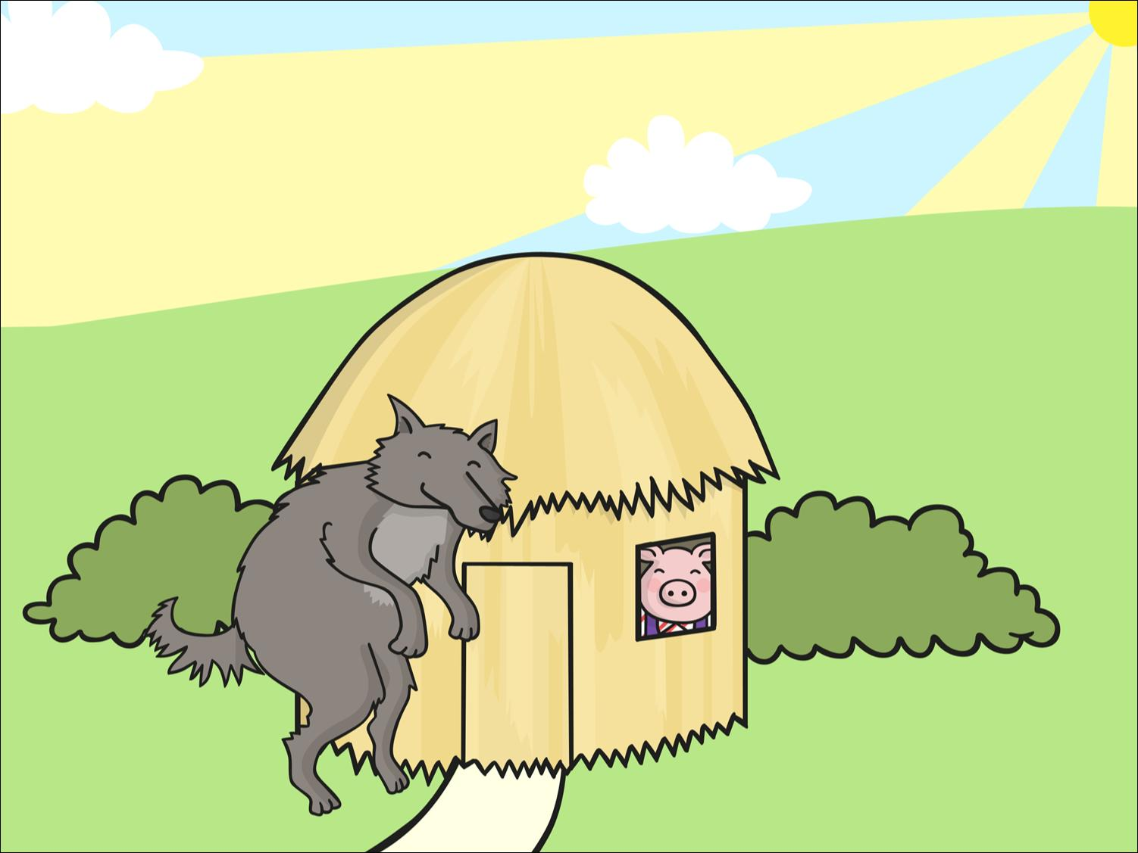
“Then I’ll huff and I’ll puff and I’ll blow your house down!” growled the big bad wolf.
Resource: Wolf

Slide 10
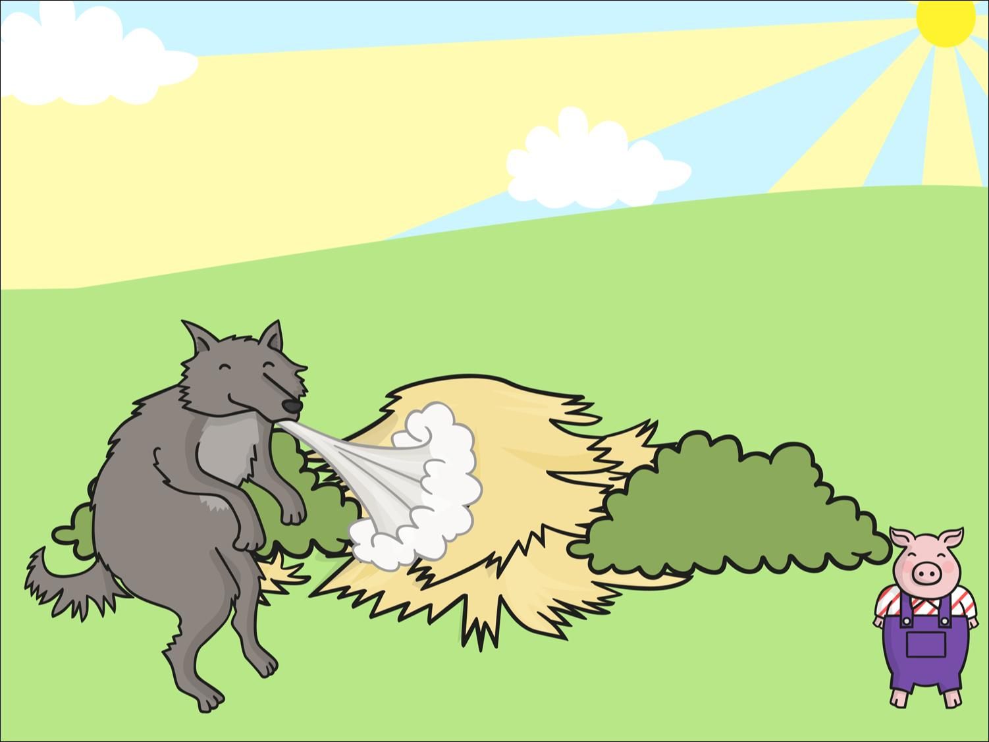


So he huffed and he puffed and he blew the house down!
The first little pig escaped and ran to join his brother in the house made of sticks.
Resource: Fan

Slide 11
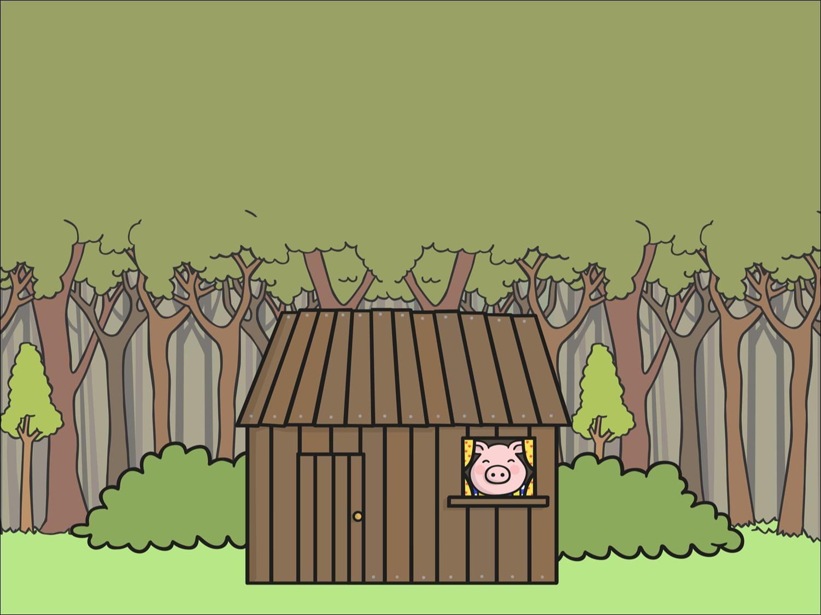
The big bad wolf followed the little pig to the house made of sticks.
“Little pig, little pig, let me come in,” he snarled.
“Not by the hair on my chinny, chin, chin!” cried the second little pig.
Resource: Sticks and pig

Slide 12
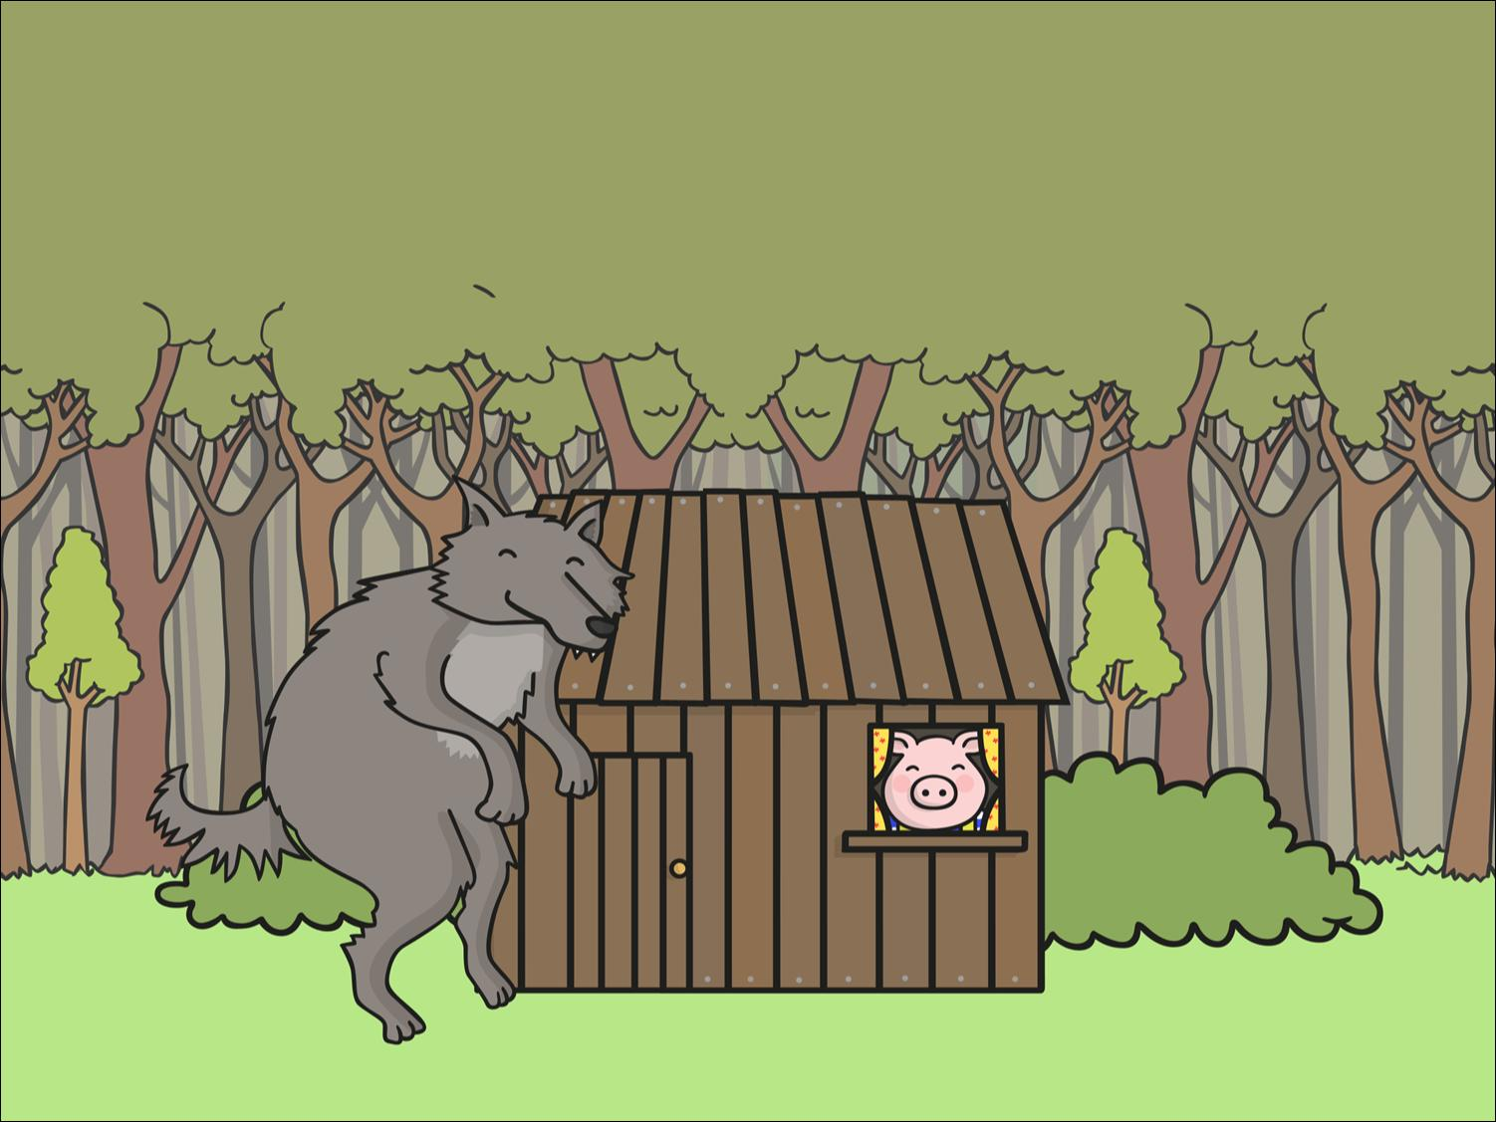
“Then I’ll huff and I’ll puff and I’ll blow your house down!” growled the big bad wolf.
Resource: Wolf

Slide 13
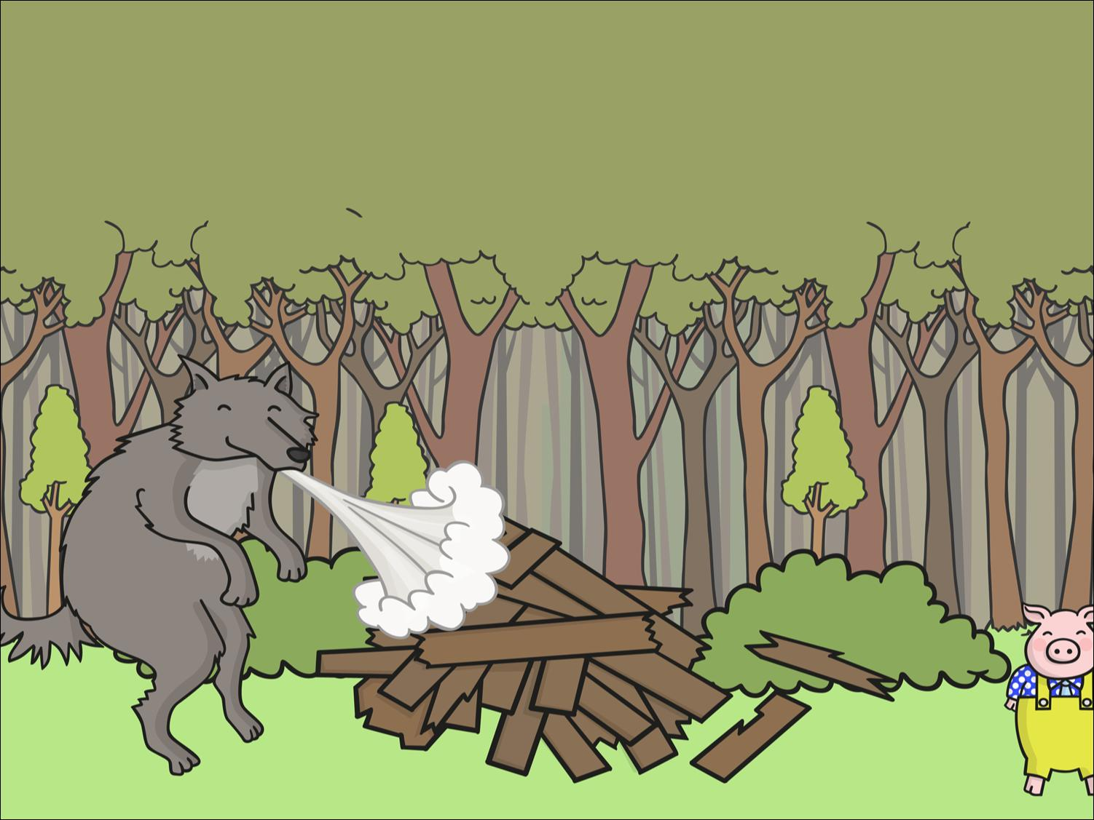
So he huffed and he puffed and he blew the house down!
The two little pigs escaped and ran to join their brother in the house made of bricks.
Resource: Fan

Slide 14
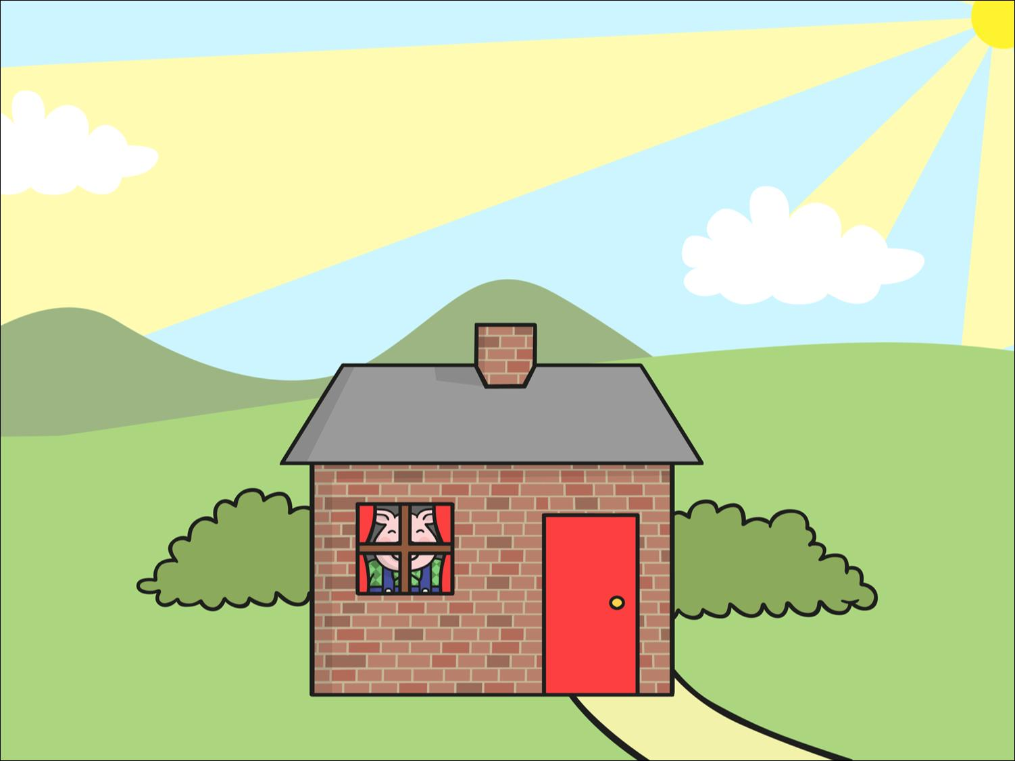
The big bad wolf followed the pigs to the house made of bricks.
“Little pig, little pig, let me come in,” he snarled.
“Not by the hair on my chinny, chin, chin!” cried the third little pig.
Resource: Blocks and pig

Slide 15
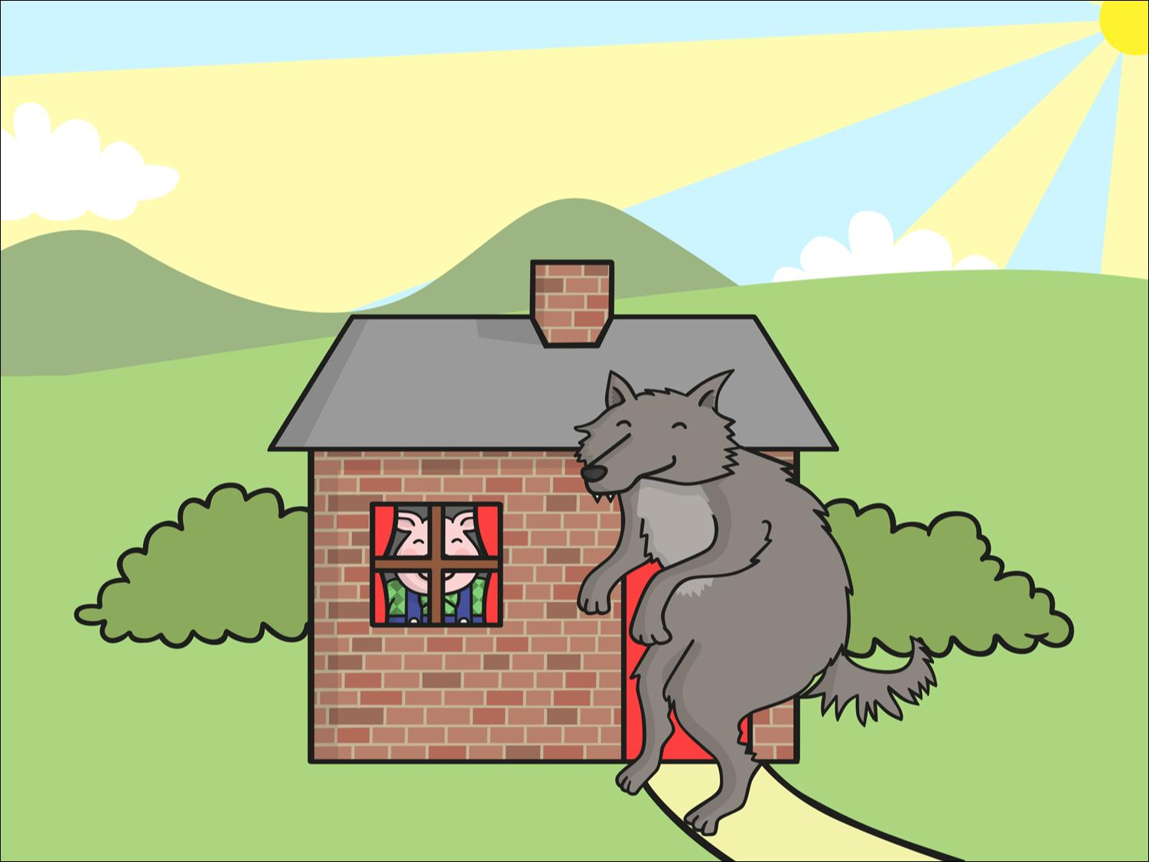
“Then I’ll huff and I’ll puff and I’ll blow your house down!” growled the big bad wolf.
Resource: Wolf

Slide 16
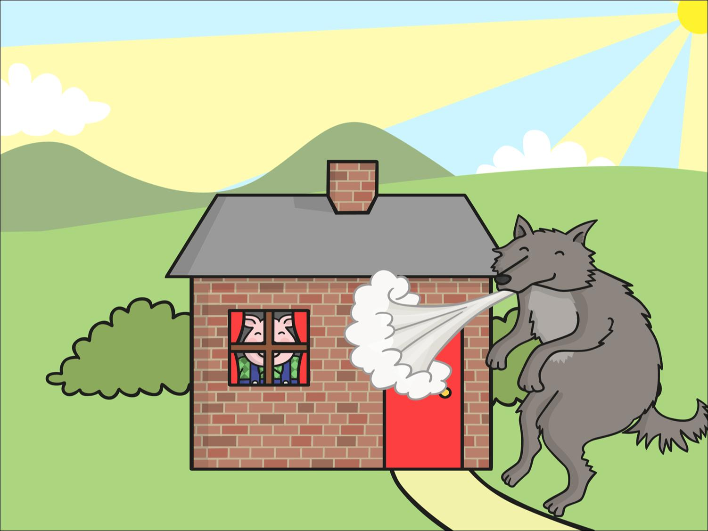
He huffed and he puffed, but the house was too strong. He could not blow it down!
Resource: Fan

Slide 17
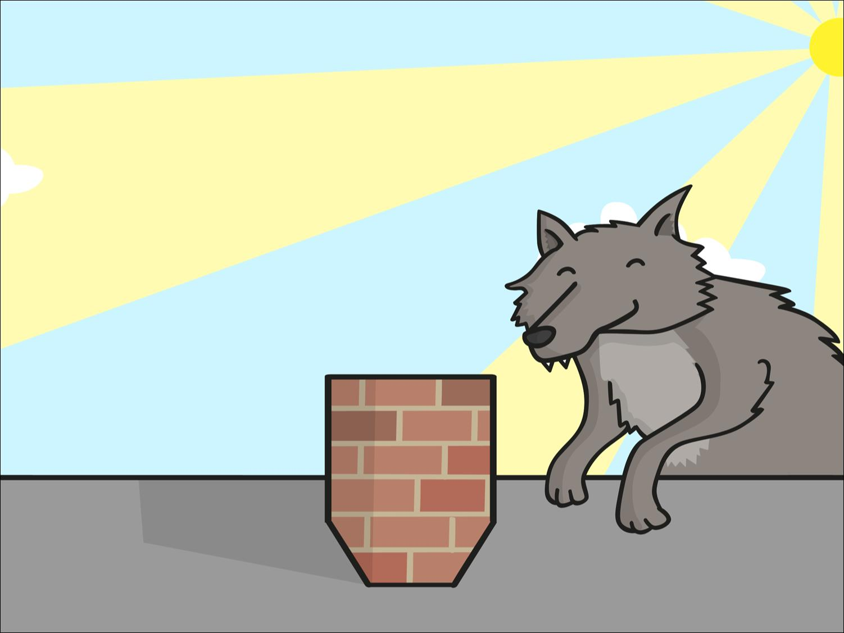
This made the big bad wolf very angry.
He climbed onto the roof of the house so he could crawl down the chimney.
Resource: Wolf

Slide 18
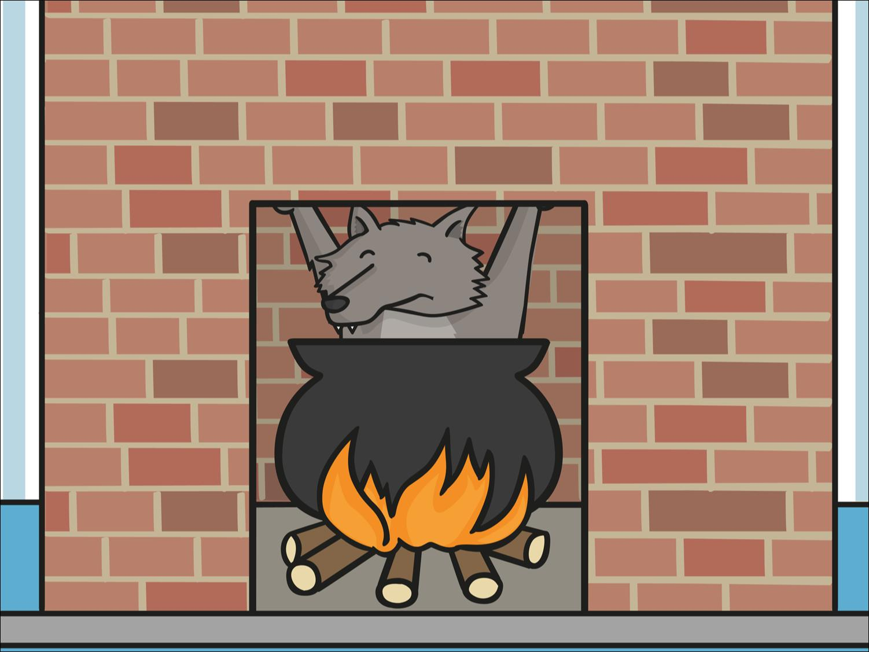
The big bad wolf was in for a big surprise!
The third little pig had been cooking a big pot of stew and SPLASH! The wolf fell right into the pot!

Slide 19

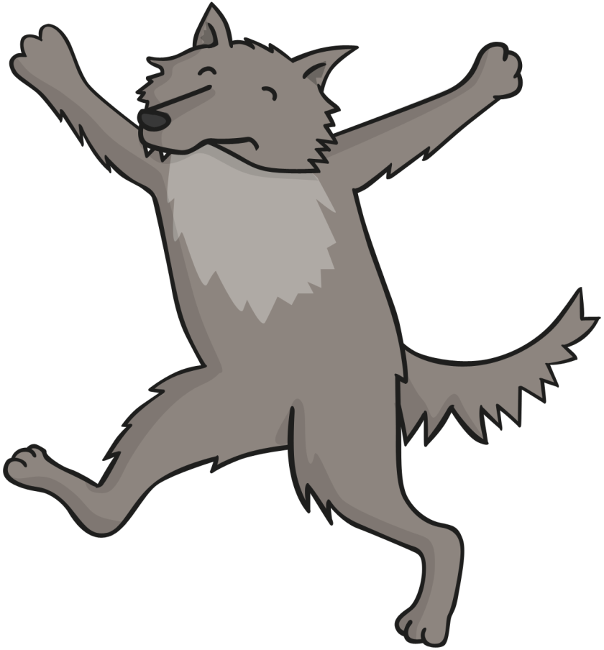
The wolf was very shocked. He jumped out of the pot and ran straight out of the house. He never came back again.

Slide 20
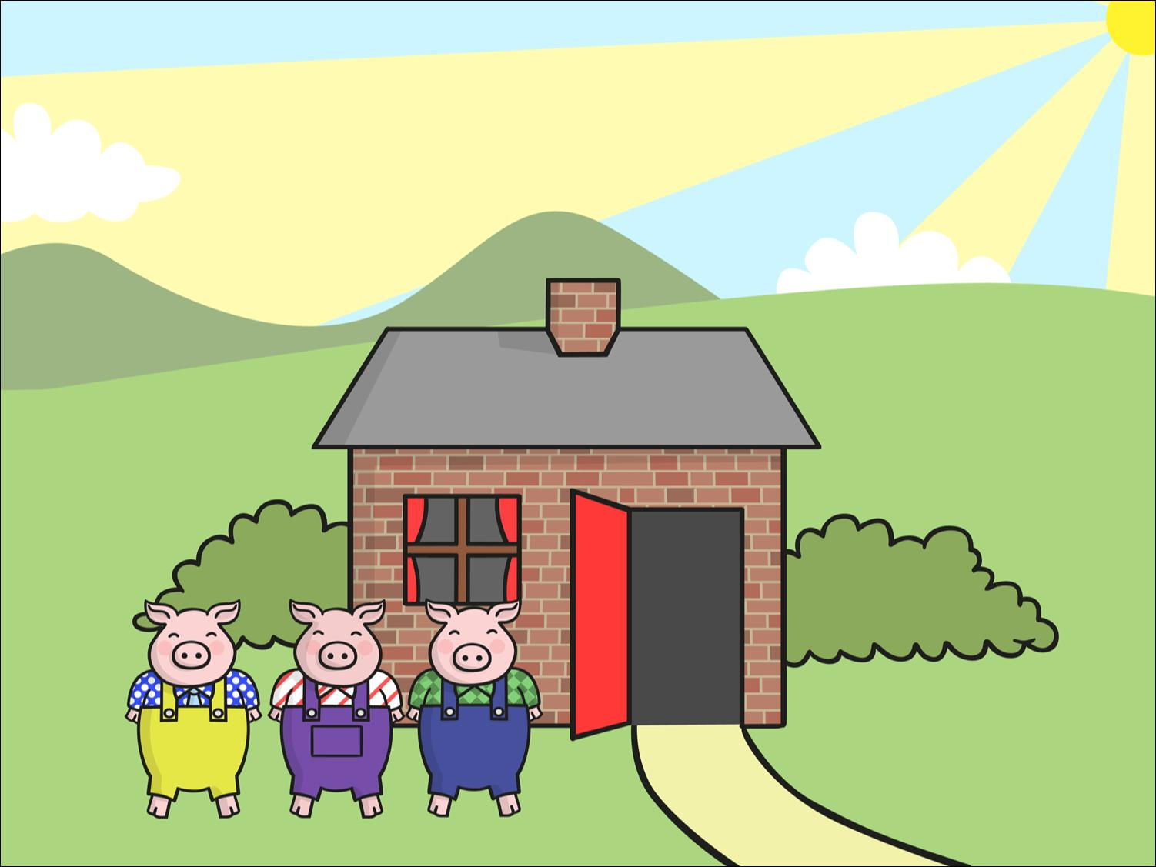
The little pigs lived happily ever after in the house made of bricks.

Slide 21



