Slide 1
Easter sensology
The purpose of sensology is to develop body and sensory awareness. It should be a relaxing session in a quiet environment. Lighting can be low (if suitable) and any sensory lights can be turned on. Your child can either lie down or sit, depending on which they find more relaxing. Shared eye contact is encouraged during these sessions and if your child does not want to touch/taste/smell etc any of the resources then that is absolutely fine! Move steadily through the powerpoint, giving your child time to explore the resources and give reactions - encourage them to express their likes and dislikes for the things they explore. Relaxing music can be played on low in the background.
The powerpoint is designed to give information to you and so there is no need for your child to be positioned so that they can see it. I’ve put a list of resources if you just wanted to print that part out and ignore the powerpoint.

Slide 2
Resources
Say hello: Mirror
Touch: Easter eggs / plastic eggs, shredded paper, feathers
Smell: Chocolate and mixed spice
Taste: Chocolate (or melted chocolate) and jam
See: Foil, shiny paper and torches. Rabbit or lamb cuddly toys can also be used.
Sound: youtube links (could also use rainmaker, umbrella and water spray if you have it available).

Slide 3
Say hello….
Encourage your child to look at themselves in the mirror. Begin by talking to them about the parts of the body they can see in the mirror (head, eyes, nose, ears etc) and then move on to point/tap to other parts of their body such as their arms, legs, hands, feet etc.
Sing Head, Shoulders, Knees and Toes with your child - patting the parts of their body along with the music. Alternatively, sing ‘One Little Finger’ with your child, following the actions with them.
Head, shoulders, knees and toes: https://www.youtube.com/watch?v=RuqvGiZi0qg
One Little Finger: https://www.youtube.com/watch?v=eBVqcTEC3zQ

Slide 4
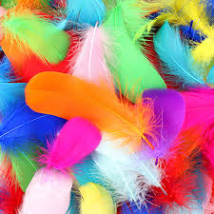
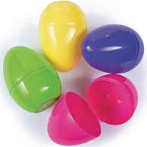

Touch
Briefly introduce that we use our bodies and our hands to touch. Encourage your child to explore the feel of plastic easter eggs, shredded paper and the feathers. They can either explore with their hands or they can be moved on their bodies.
Feel: Eggs, shredded paper, feathers

Slide 5
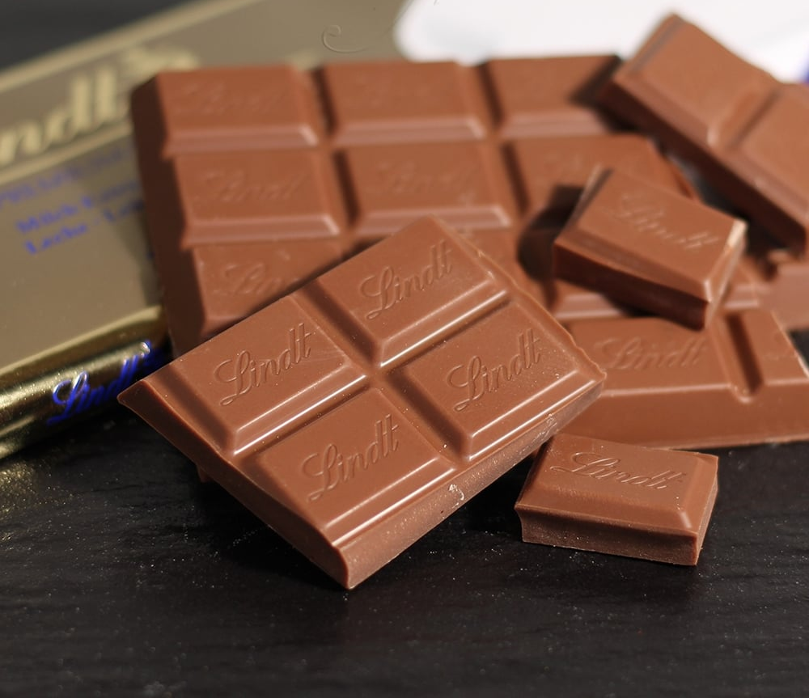

Smell
Introduce that we use our nose to smell, indicating to your child where their nose is (or asking them to show you themselves). Encourage your child to smell a piece of chocolate first and then the mixed spice (do so in this order as the mixed spice scent is much stronger :) ) Encourage your child to express likes or dislikes for the scents.
Smell: Chocolate and Mixed spice

Slide 6
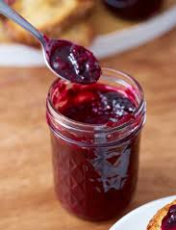
Taste - may not be applicable to all pupils. Pupils unable to taste can smell the resources or feel.
Introduce that we use our mouth to taste, indicating to your child where their mouth is (or asking them to show you themselves). Offer your child a taste of a fruit jam that you have readily available and then offer a taste of chocolate! Encourage your child your child to express their likes and dislikes towards the food.
Taste: Fruit jam and chocolate

Slide 7
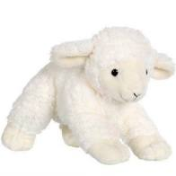
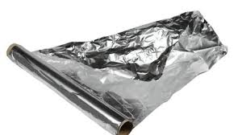
See
Introduce that we use our eyes to see, indicating to your child where their eyes are (or asking them to show you themselves). Show your child, one at a time, the eggs, shiny foil/material and (if available) the lamb/rabbit toy. A torch light could also be shined onto the foil / shiny material to create a different pattern of light for your child to track and observe.
See: Plastic eggs, foil or shiny material. Lamb or rabbit toy if available.

Slide 8
Hear
Introduce that we use our ears to hear, indicating to your child where their ears are (or asking them to show you themselves). Listen to the sound clips below with your child.
Birds tweeting - https://www.youtube.com/watch?v=rYoZgpAEkFs
Sounds of lambs - https://www.youtube.com/watch?v=8Q3OzzEp7mU
Sounds of rain - https://www.youtube.com/watch?v=J6G0EuPAoKQ
For the rain you could use a rainmaker instrument (if you have one available). Or you could open up an umbrella and hold over your child’s head, use a water spray to spray water onto the umbrella so that they can hear the sound of the water as it falls onto the umbrella.

Slide 9
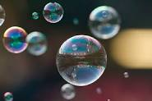
Relaxation
Relax with your child, listening to the music and perhaps giving them a massage. You could also blow bubbles for your child (if you have these available).
So ideas for relaxation music:
https://www.youtube.com/watch?v=WUXEeAXywCY&t=1489s
https://www.youtube.com/watch?v=5DiMoehAeOU&t=54s
https://www.youtube.com/watch?v=5HrkXT5Bc9E&t=1056s

