Slide 1


Five Easter
Eggs
Use eggs / card shaped eggs to support counting throughout the song

Slide 2
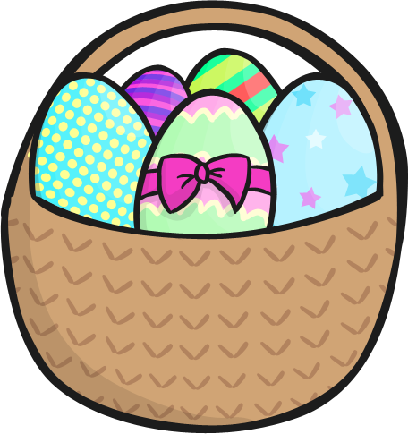
5 Easter eggs in the sweet shop
Round and fat with a ribbon on the top
Along came … with a penny one day
Bought an Easter egg and took it right away.

Slide 3
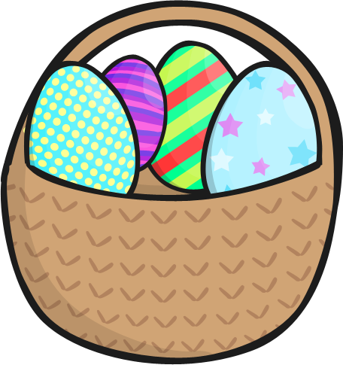
4 Easter eggs in the sweet shop
Round and fat with a ribbon on the top
Along came … with a penny one day
Bought an Easter egg and took it right away.

Slide 4
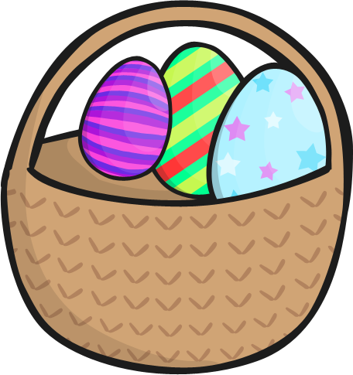
3 Easter eggs in the sweet shop
Round and fat with a ribbon on the top
Along came … with a penny one day
Bought an Easter egg and took it right away.

Slide 5
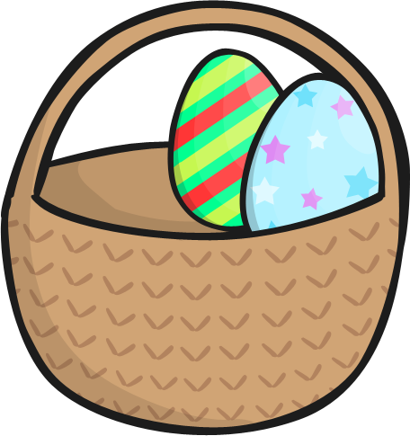
2 Easter eggs in the sweet shop
Round and fat with a ribbon on the top
Along came … with a penny one day
Bought an Easter egg and took it right away.

Slide 6
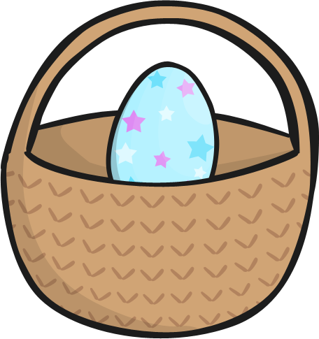
1 Easter egg in the sweet shop
Round and fat with a ribbon on the top
Along came … with a penny one day
Bought an Easter egg and took it right away.

Slide 7
The End.

