Slide 1
Spring sensology
The purpose of sensology is to develop body and sensory awareness. It should be a relaxing session in a quiet environment. Lighting can be low (if suitable) and any sensory lights can be turned on. Your child can either lie down or sit, depending on which they find more relaxing. Shared eye contact is encouraged during these sessions and if your child does not want to touch/taste/smell etc any of the resources then that is absolutely fine! Move steadily through the powerpoint, giving your child time to explore the resources and give reactions - encourage them to express their likes and dislikes for the things they explore. Relaxing music can be played on low in the background.
The powerpoint is designed to give information to you and so there is no need for your child to be positioned so that they can see it. I’ve put a list of resources if you just wanted to print that part out and ignore the powerpoint.

Slide 2
Resources
Say hello: Mirror
Touch: Ice pack/cubes, water bottle, flowers/grass/mud
Smell: Floral and fruity scents (e.g. orange, strawberry, lemon, lavender, rose, rosemary)
Taste: Jams / fruit / honey / lemon (see taste slide)
See: flashing light toys, flowers
Sound: garden sound clips on youtube

Slide 3
Say hello….
Encourage your child to look at themselves in the mirror. Begin by talking to them about the parts of the body they can see in the mirror (head, eyes, nose, ears etc) and then move on to point/tap to other parts of their body such as their arms, legs, hands, feet etc.
Sing the song ‘This is Me’ (ELF learning) with your child - patting the parts of their body along with the music. Alternatively, read the story ‘From Head to Toe’ with your child (powerpoint is on the class webpage).
https://www.youtube.com/watch?v=QkHQ0CYwjaI

Slide 4
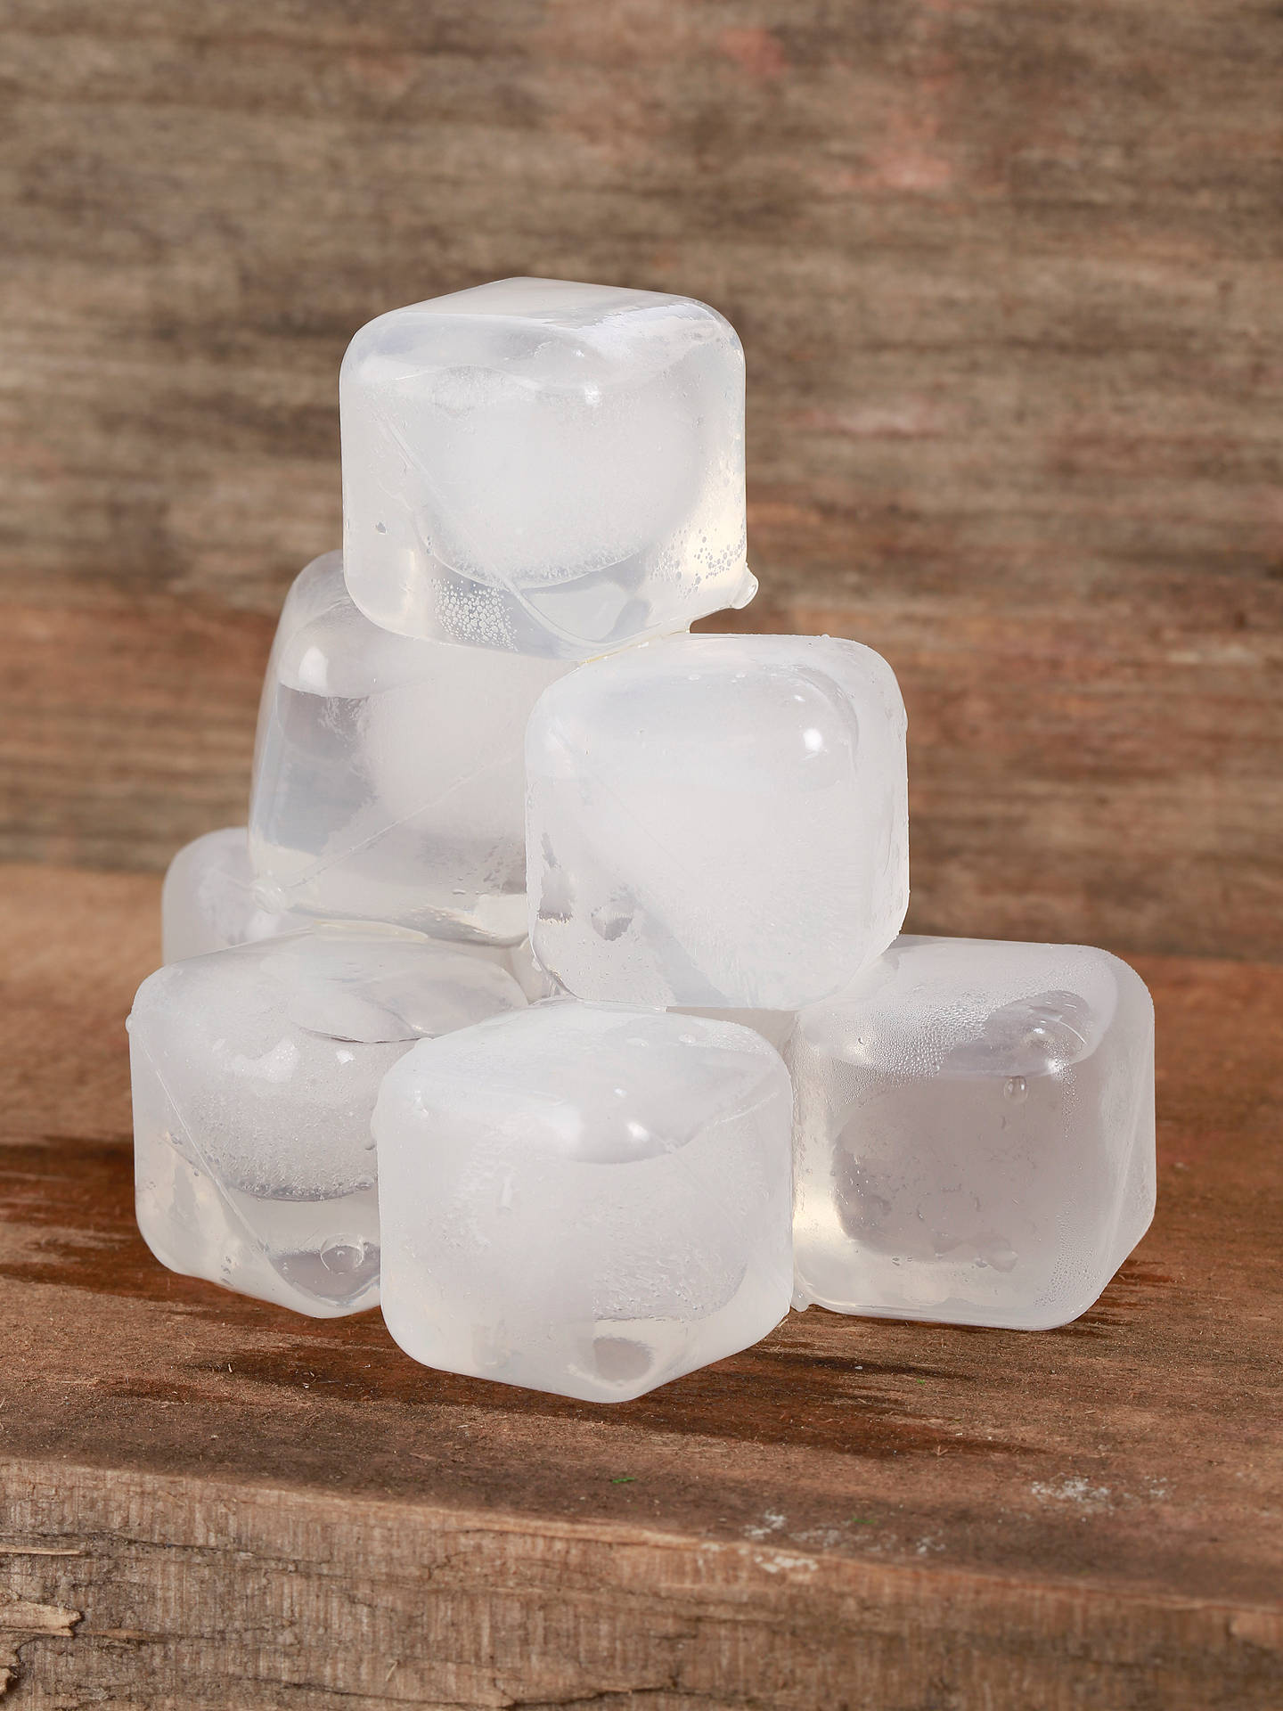
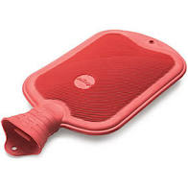
Touch
Briefly introduce that we use our bodies and our hands to touch. Encourage your child to explore the feel, one at a time, of the ice pack/ice cubes (cold), warm water bottle (hot), flowers / grass / mud.
They can either explore with their hands or they can be moved on their bodies.
Feel: ice pack/cubes, water bottle, flowers/grass/mud

Slide 5
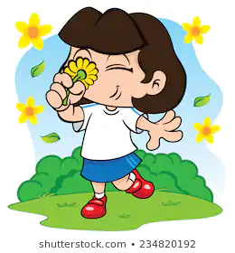
Smell
Introduce that we use our nose to smell, indicating to your child where their nose is (or asking them to show you themselves). Encourage your child to smell a fruity scent (e.g. orange, strawberry, lemon etc) and then a floral scent (e.g. lavender, rose, rosemary, floral room spray). Always present the stronger of the scents last. Encourage your child to express likes or dislikes for the scents.
Smell: Floral and fruity scents (e.g. orange, strawberry, lemon, lavender, rose, rosemary)

Slide 6
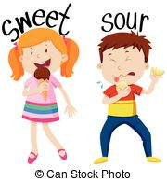
Taste - may not be applicable to all pupils. Pupils unable to taste can smell the resources or feel.
Introduce that we use our mouth to taste, indicating to your child where their mouth is (or asking them to show you themselves). Offer your child a sweet taste and a sour taste, offering the sweet taste first. Encourage your child your child to express their likes and dislikes towards the food.
Sweet taste examples: honey, fruit jams, marshmallows, chocolate spread
Sour taste examples: lemon, lime, tomato ketchup

Slide 7
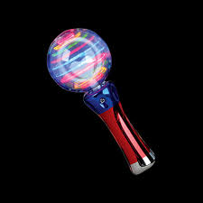
See
Introduce that we use our eyes to see, indicating to your child where their eyes are (or asking them to show you themselves). Show your child, one at a time, light up flashing toys and flowers.
See: Light up toys, flowers

Slide 8
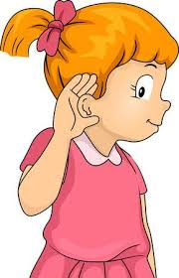
Hear
Introduce that we use our ears to hear, indicating to your child where their ears are (or asking them to show you themselves). Listen to the garden sound clips below with your child.
https://www.youtube.com/watch?v=qz54e2LWonM

Slide 9
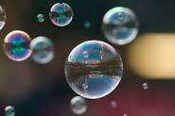
Relaxation
Relax with your child, listening to the music and perhaps giving them a massage. You could also blow bubbles for your child (if you have these available).
Some ideas for relaxation music:
https://www.youtube.com/watch?v=sfe3MUMdWKQ
https://www.youtube.com/watch?v=bgV2_mHyzbQ&t=3248s
https://www.youtube.com/watch?v=ghd-Fckttus

