Slide 1
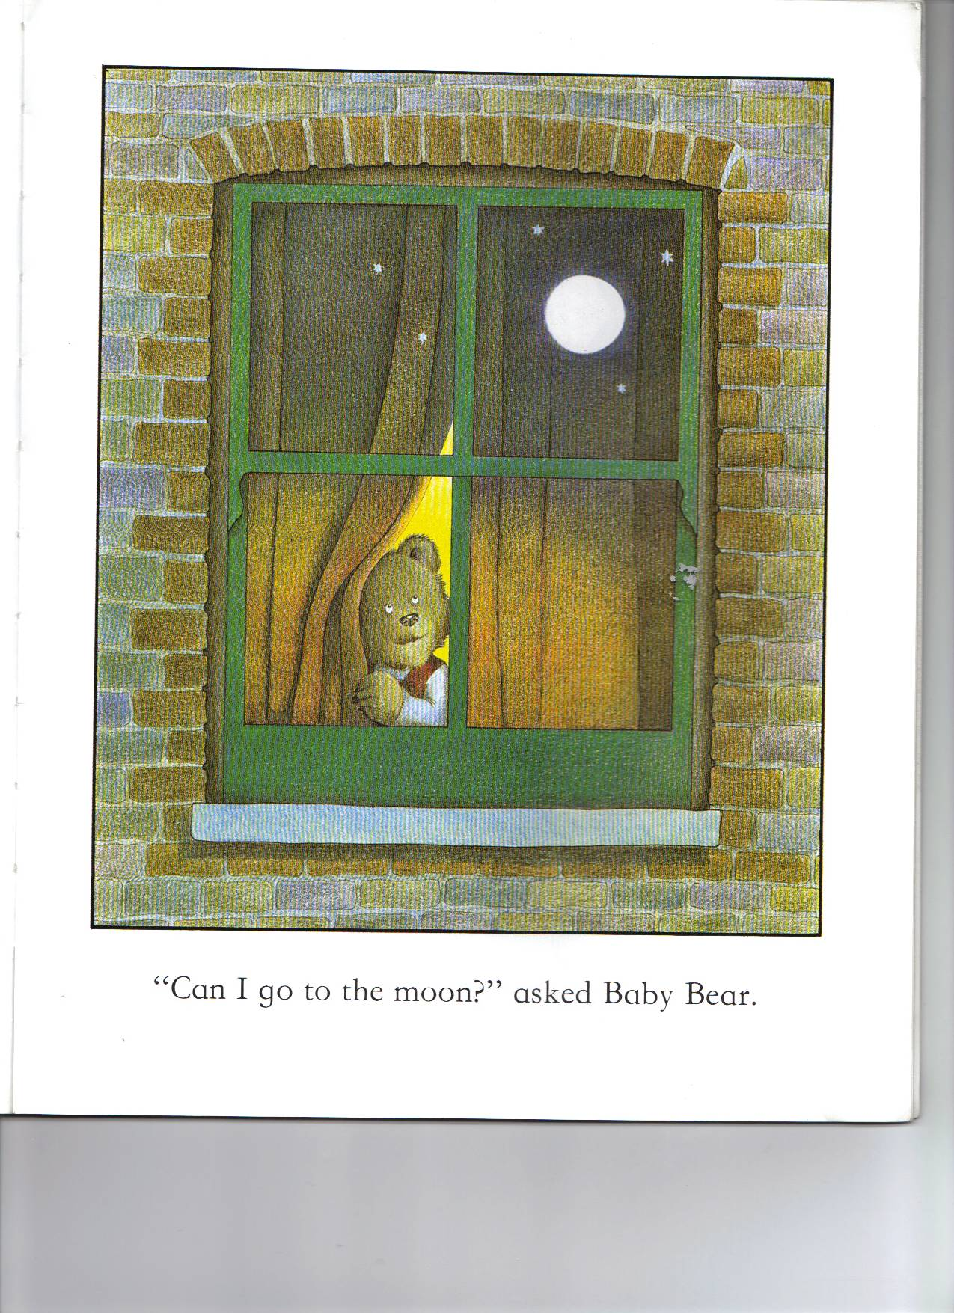
Moon: Silver foil circle

Slide 2
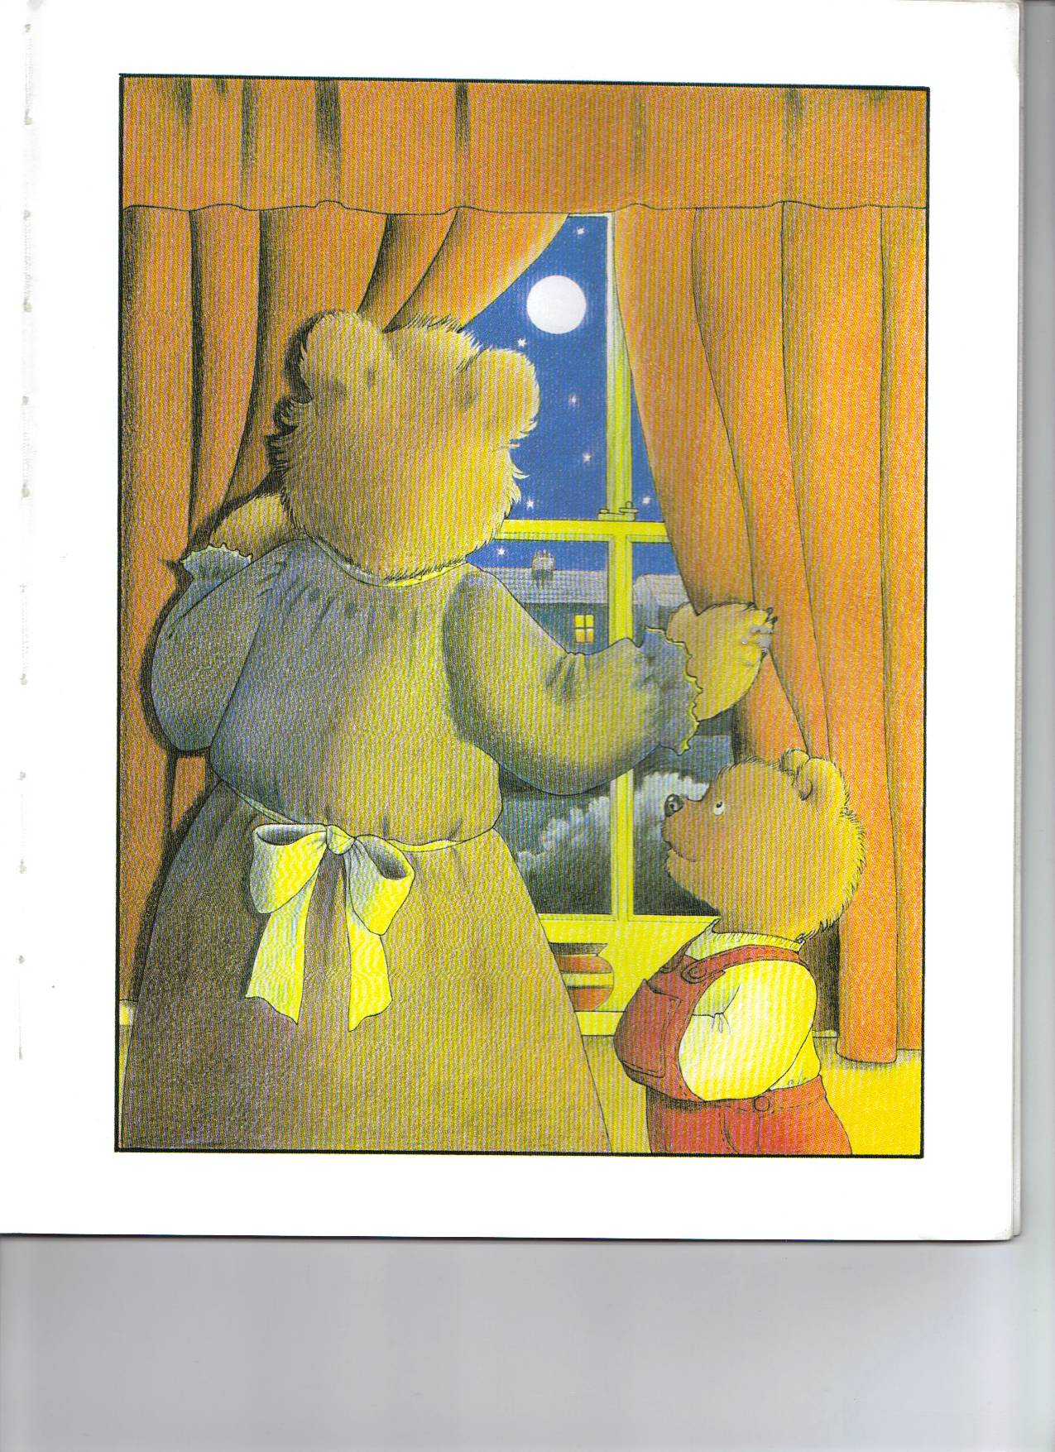
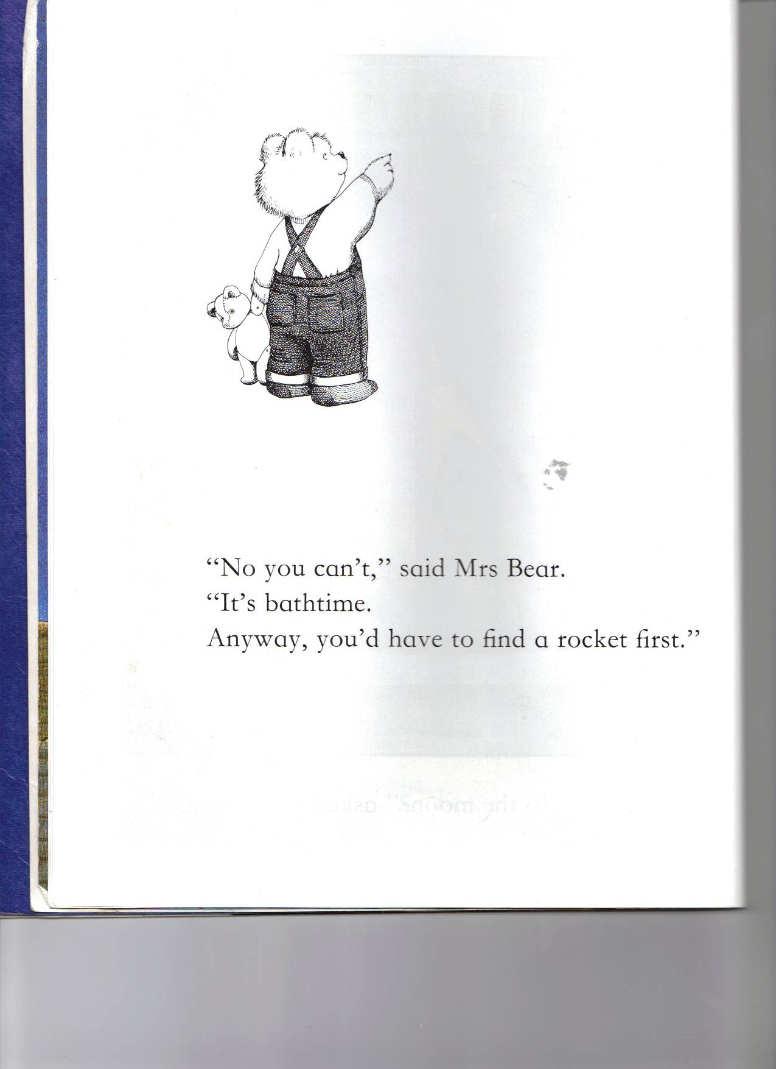

Slide 3
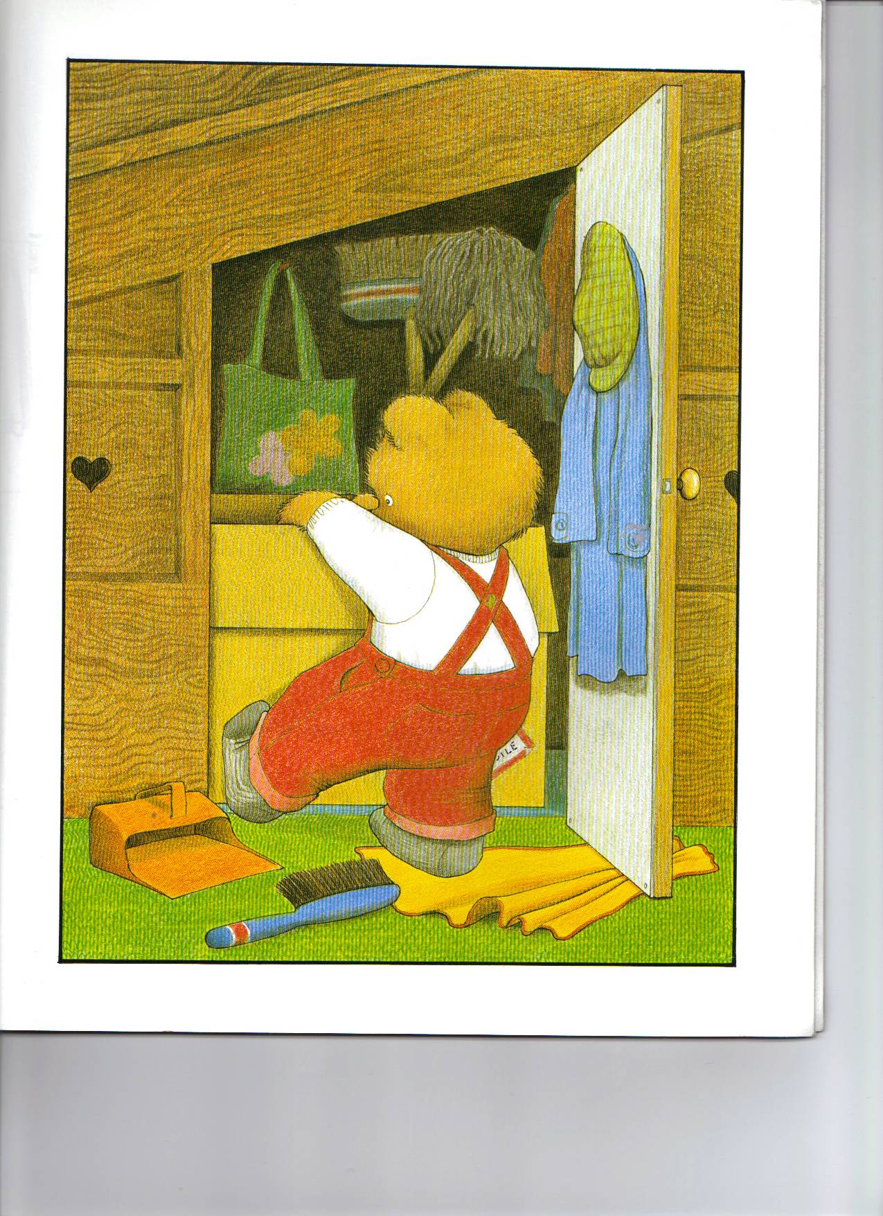
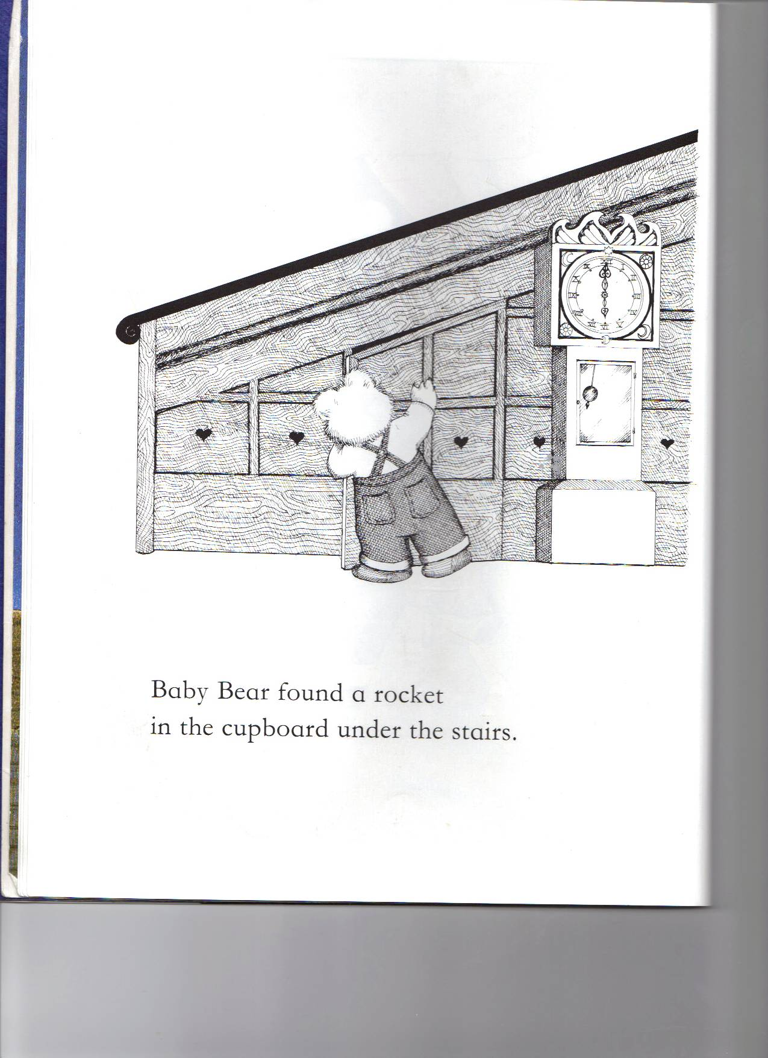
Cardboard tube rocket

Slide 4
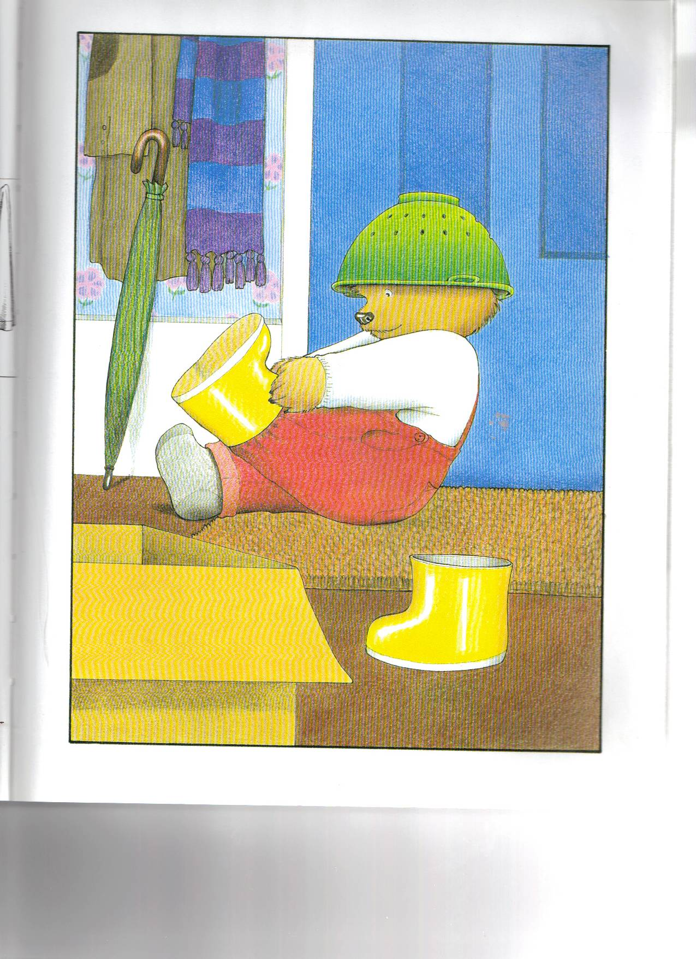
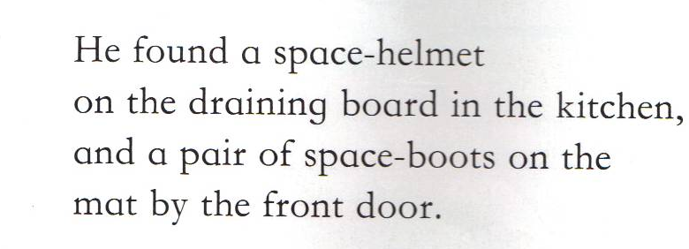
Colander and card boots

Slide 5
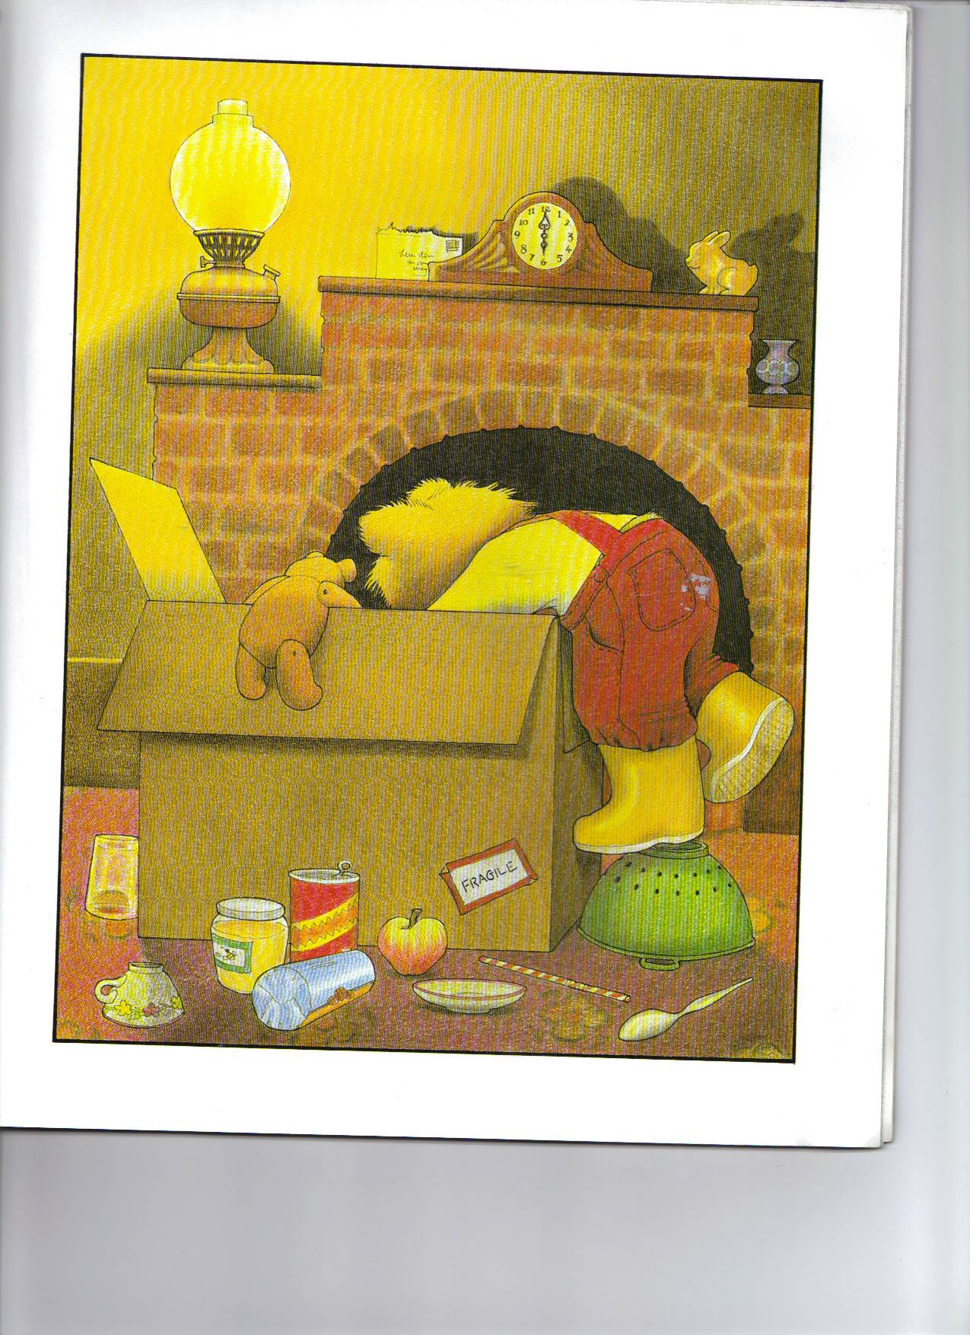
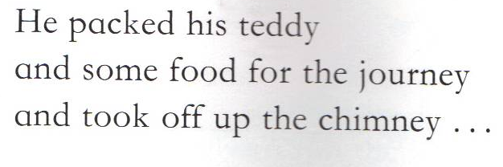
Teddy

Slide 6
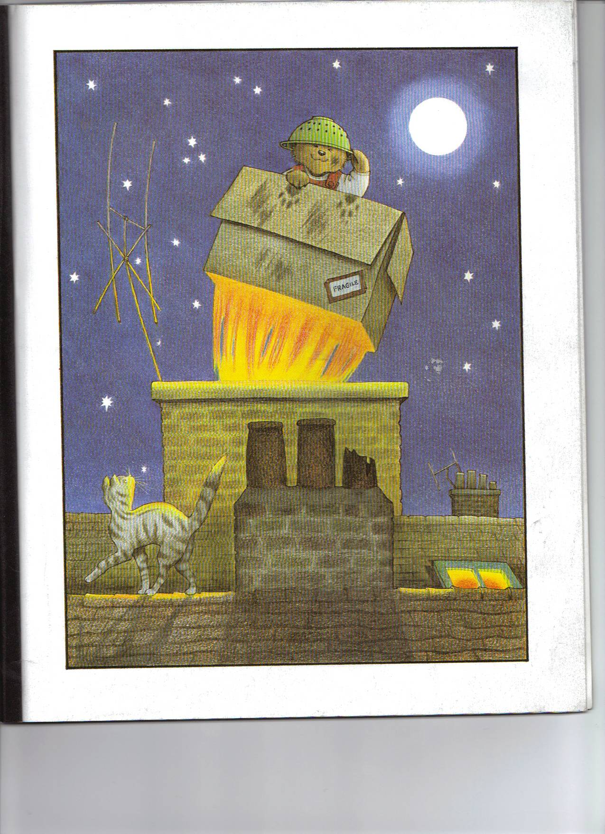
…..WHOOSH! Out into the night.

Slide 7
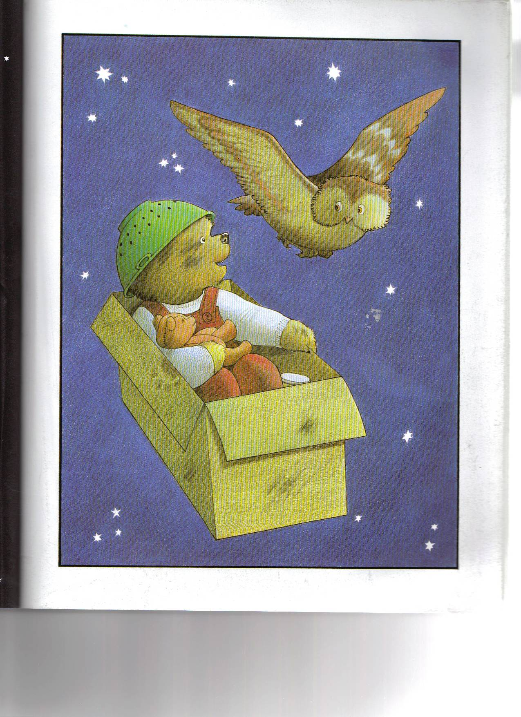
Owl teddy
An owl flew past. “That’s a smart rocket,” he said. “Where are you off to?” “The moon,” said Baby Bear.
“Would you like to come too?” “Yes please,” said owl.

Slide 8
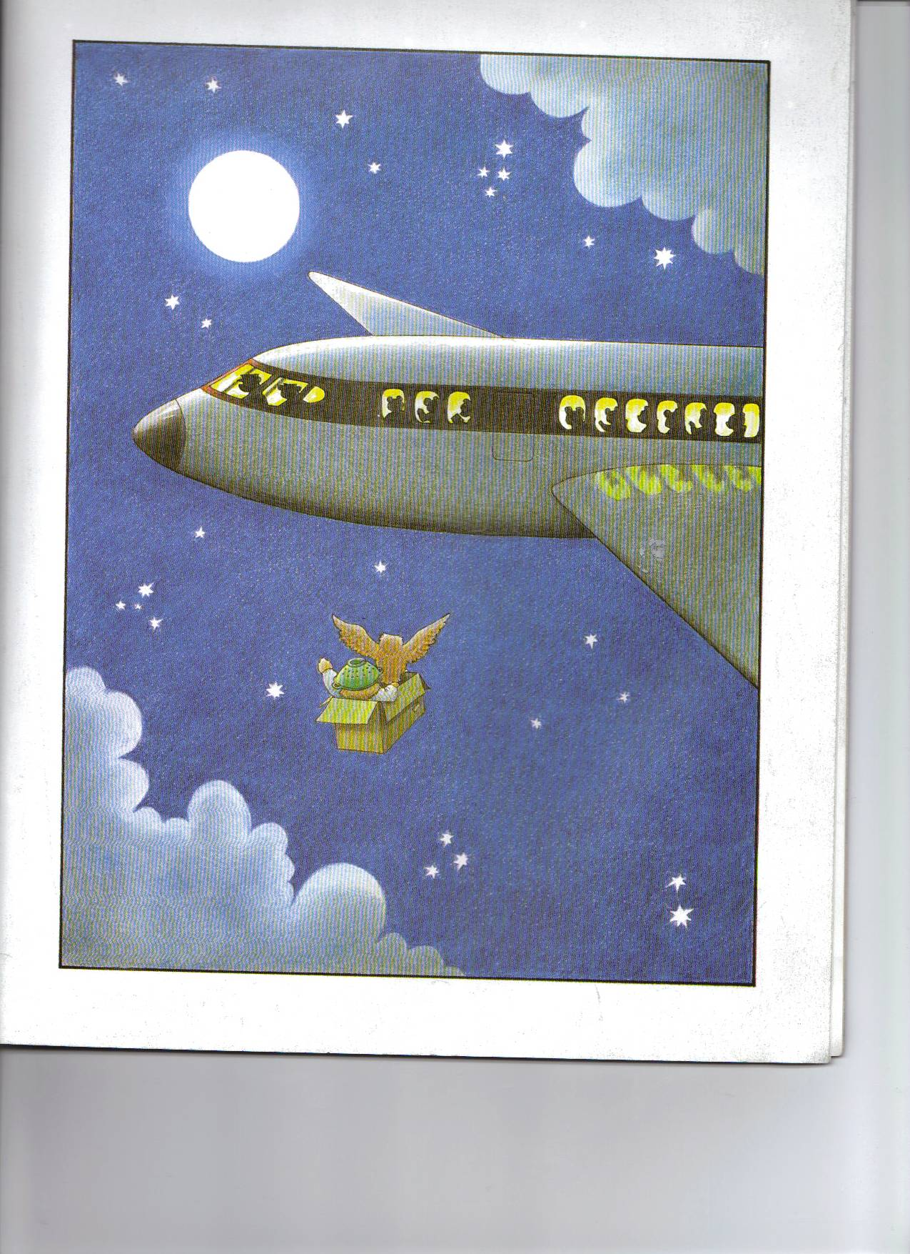
An airplane roared out of the clouds. Baby Bear waved and some of the passengers waved back.
Airplane

Slide 9
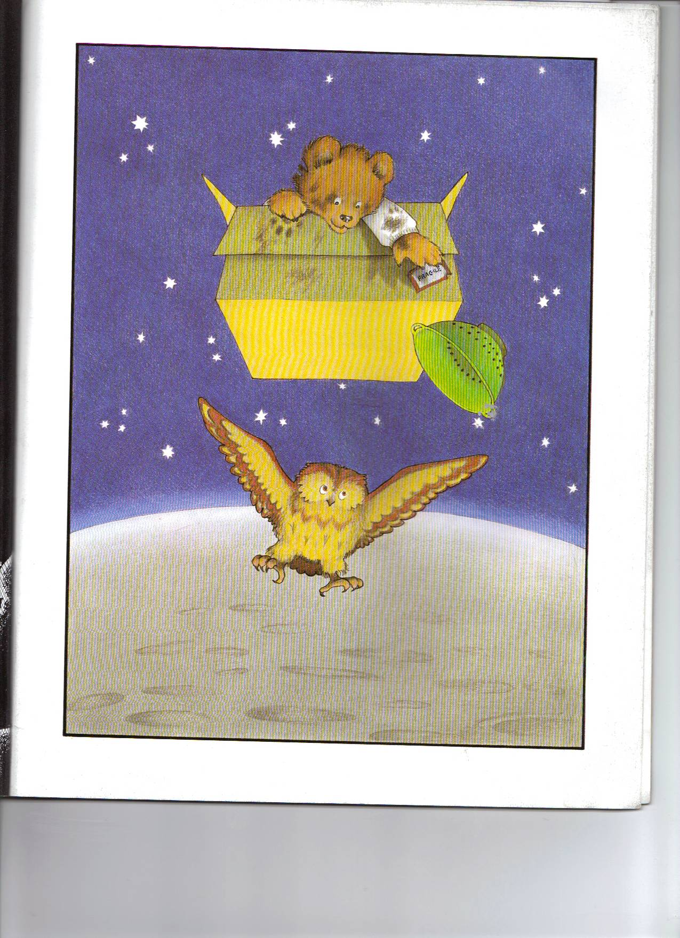
On and on they flew, up and up, above the clouds, past millions of stars till at last they landed on the moon.
Starry black material

Slide 10
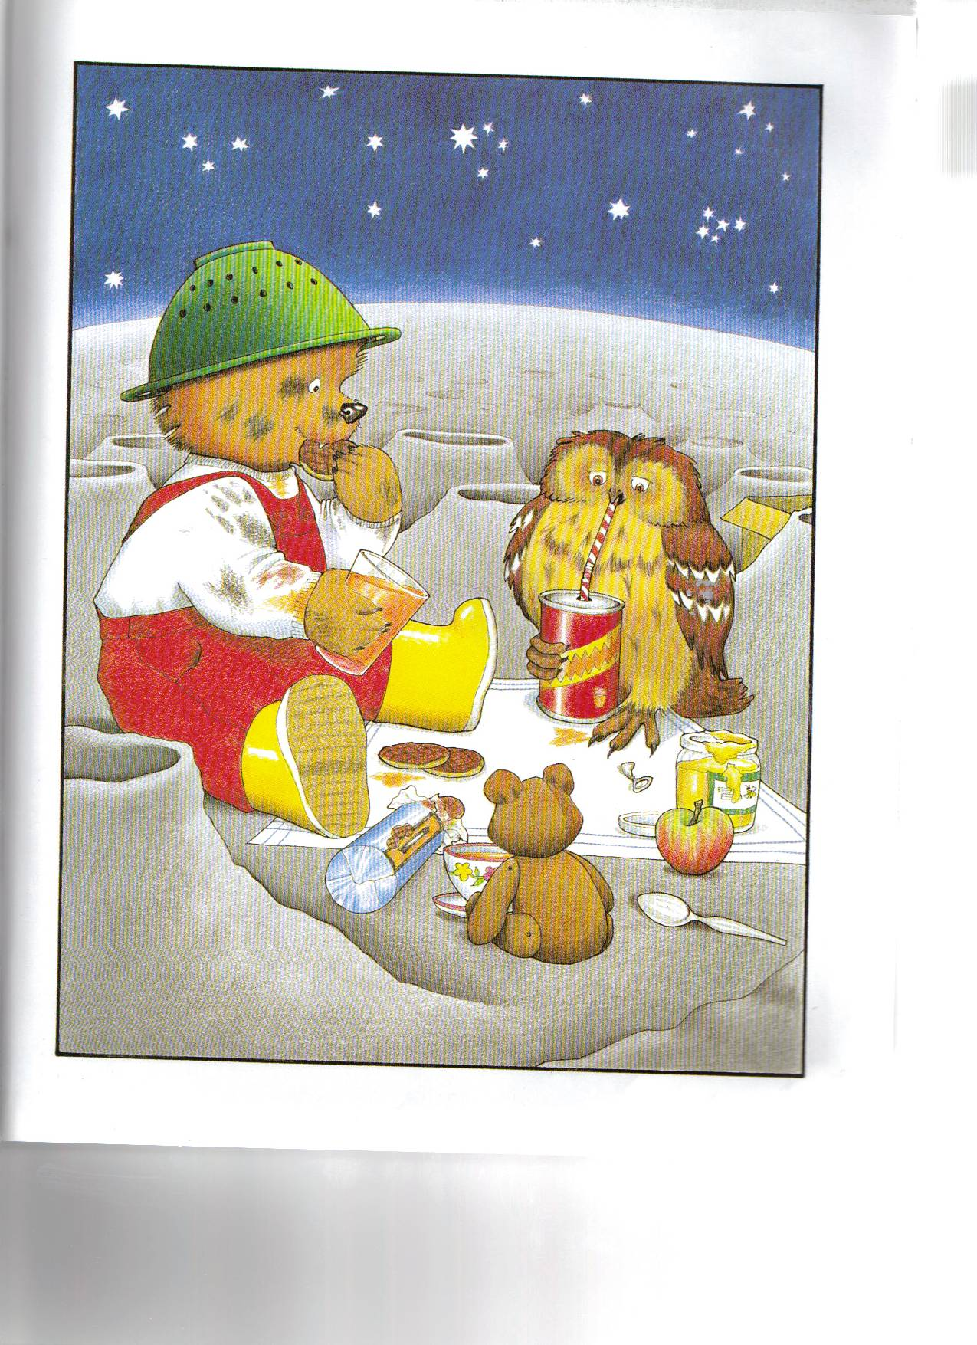
“There’s nobody here,” said Baby Bear. “There are no trees,” said the owl. “It’s a bit boring,” said Baby Bear. “Shall we have a picnic?” “What a good idea,” said the owl.
Moon: Silver foil circle

Slide 11
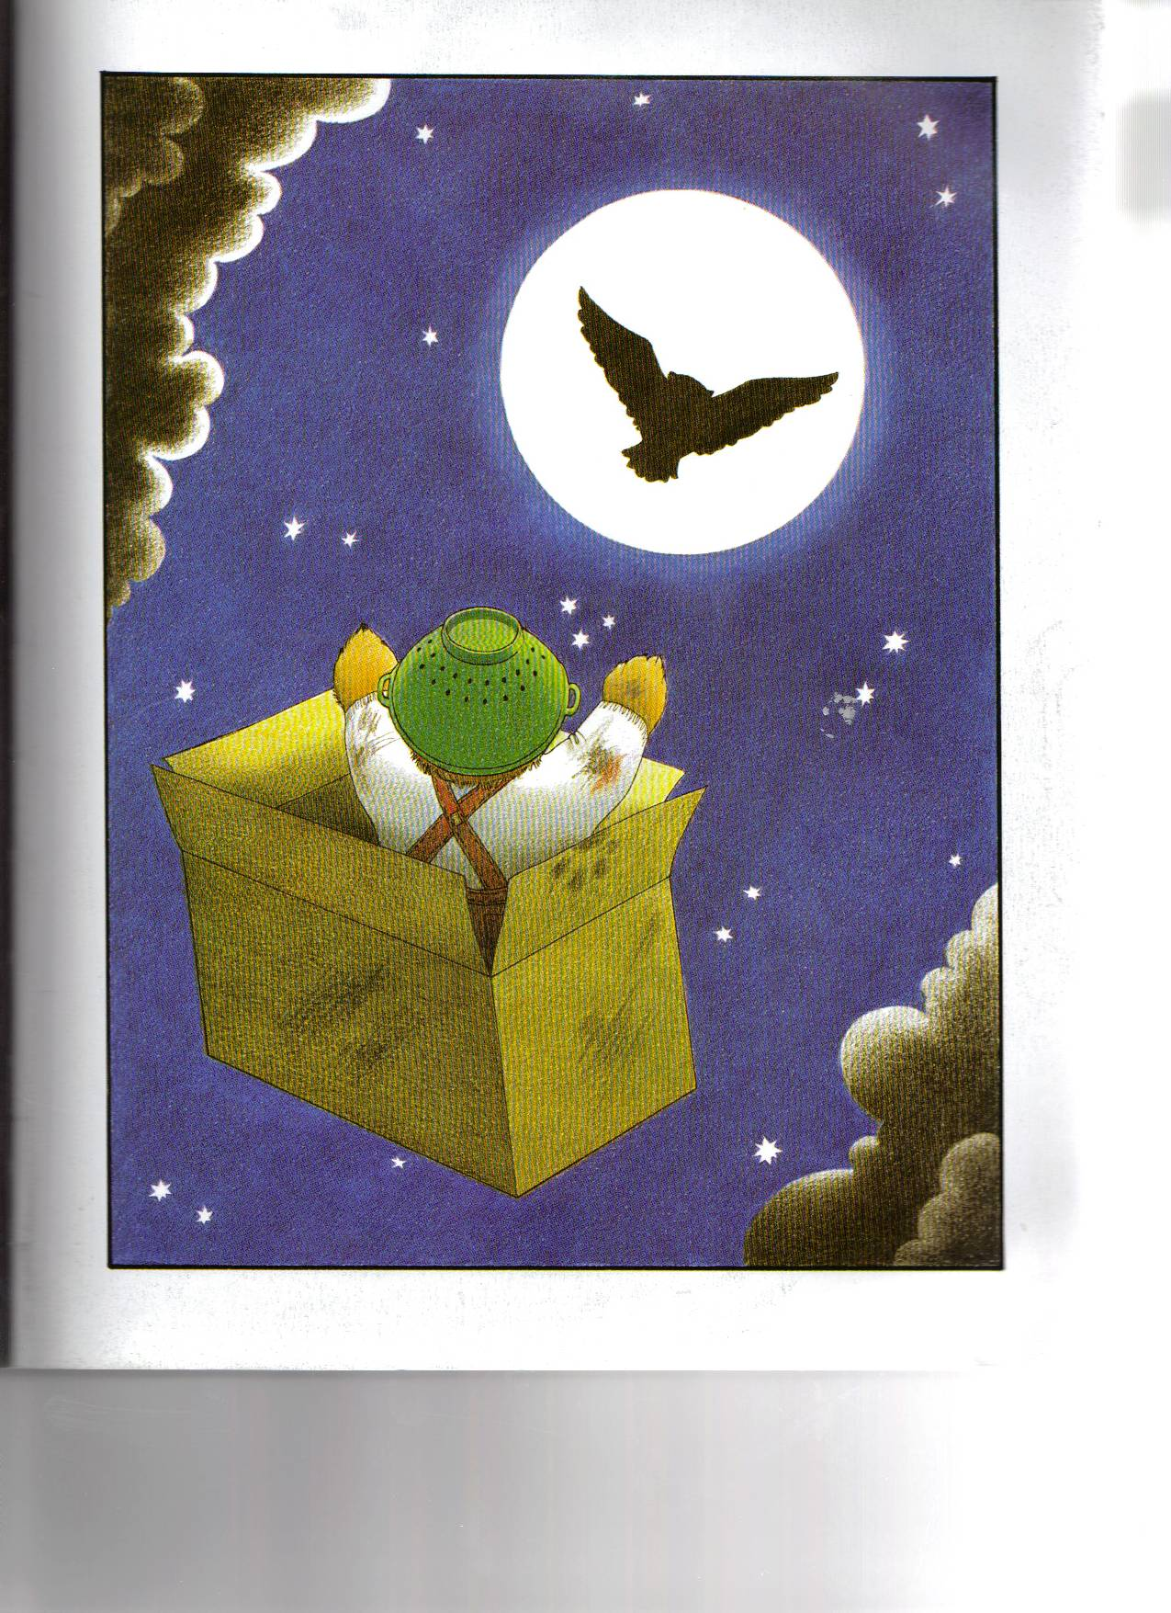
Owl teddy
“We’d better go,” said Baby Bear. “My bath must be ready now.” Off they went, down and down. The owl got out and flew away. “Goodbye,” he said. “It was so nice to meet you.”

Slide 12
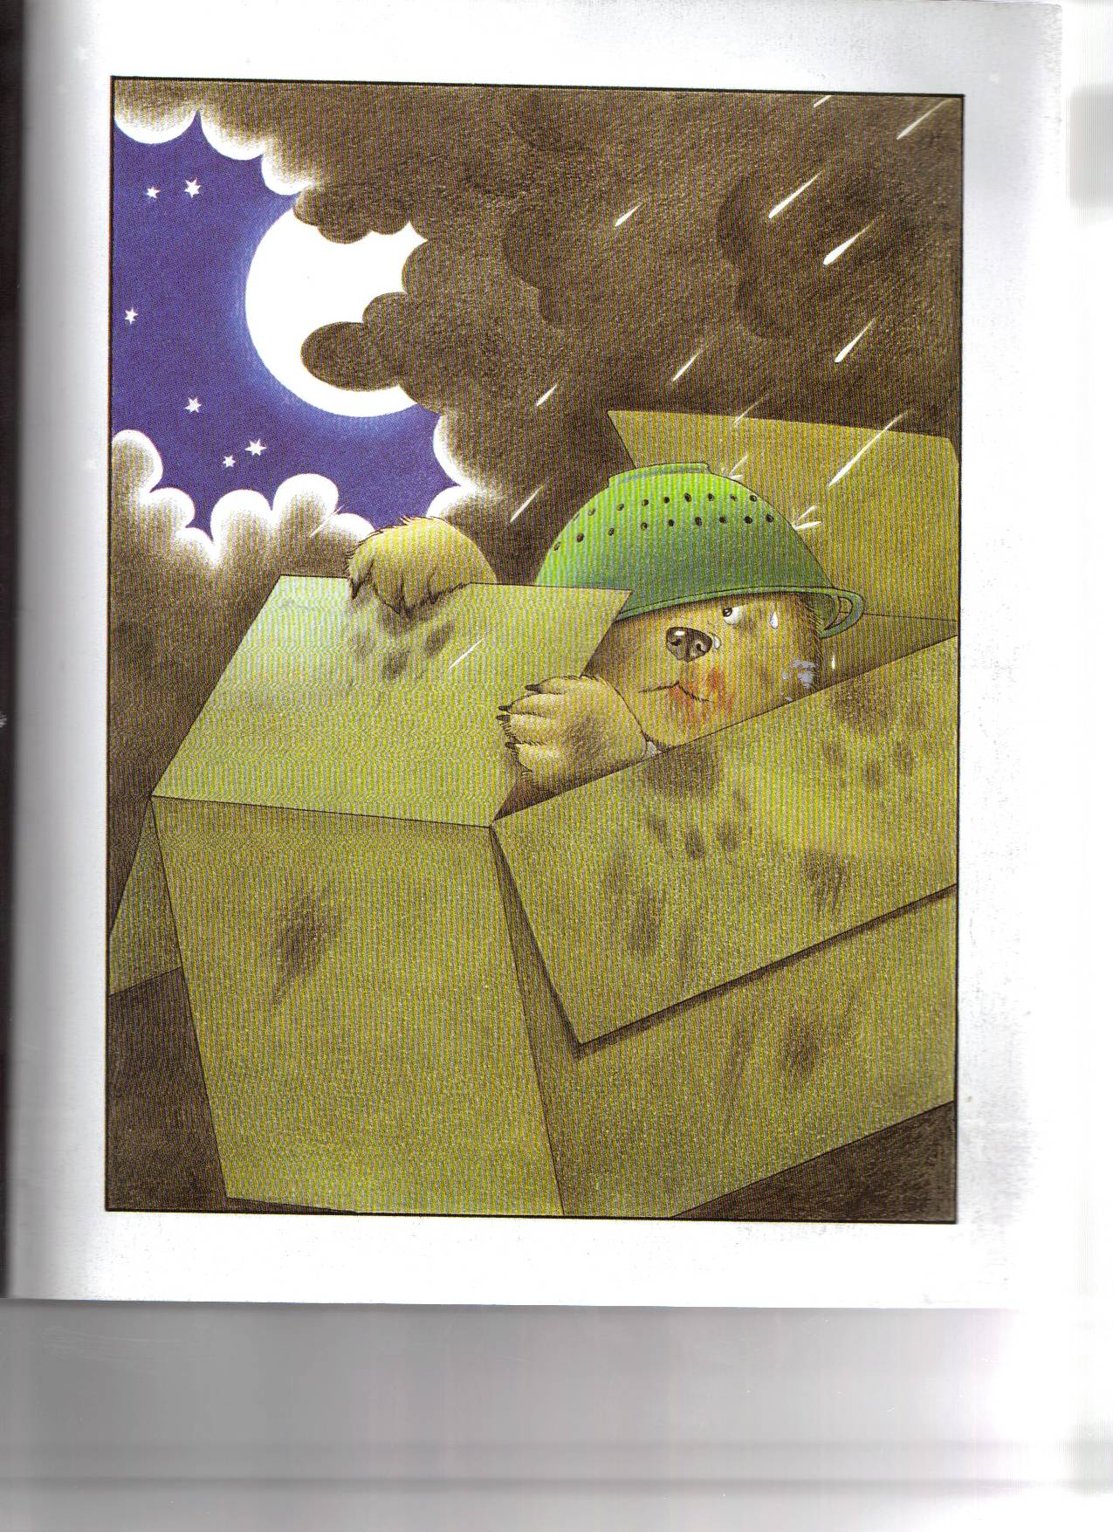
Water spray
It rained and the rain dripped through Baby Bear’s helmet.

Slide 13
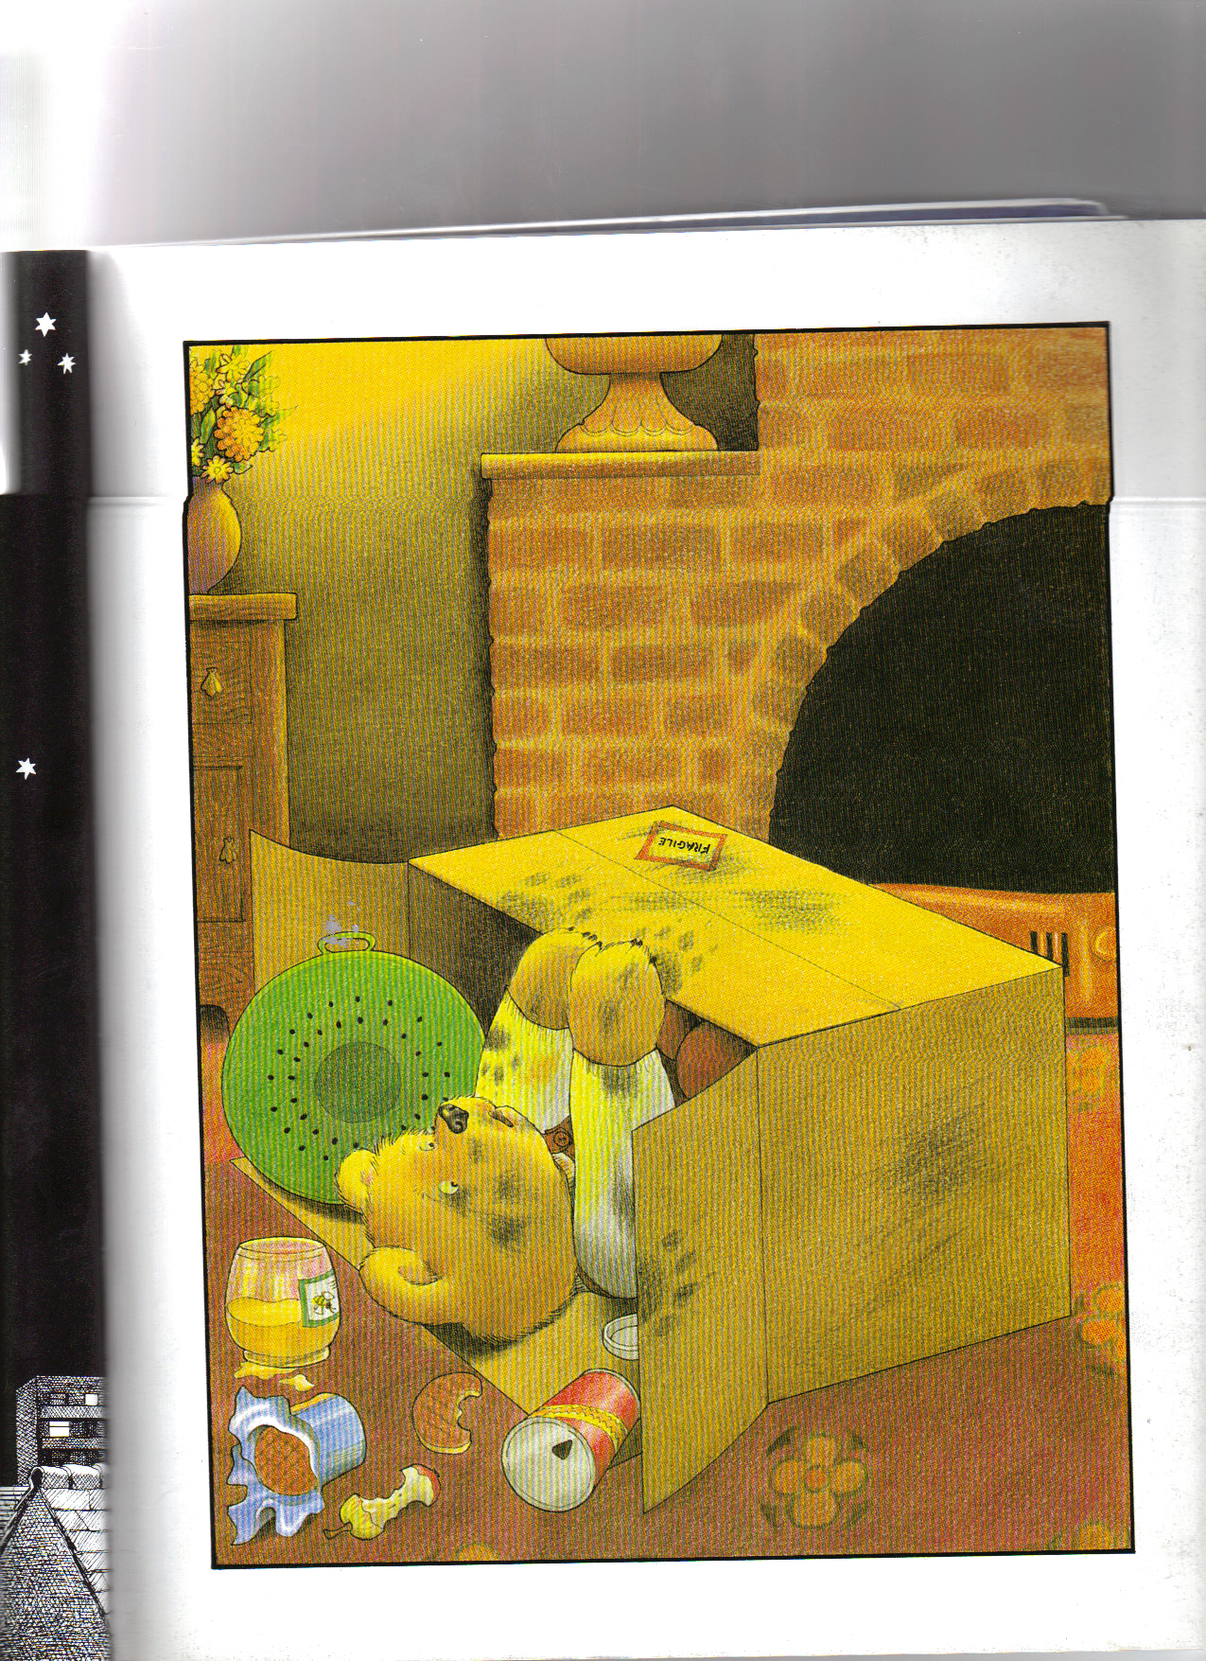
Home went Baby Bear. Back down the chimney and on to the living room carpet with a BUMP!

Slide 14
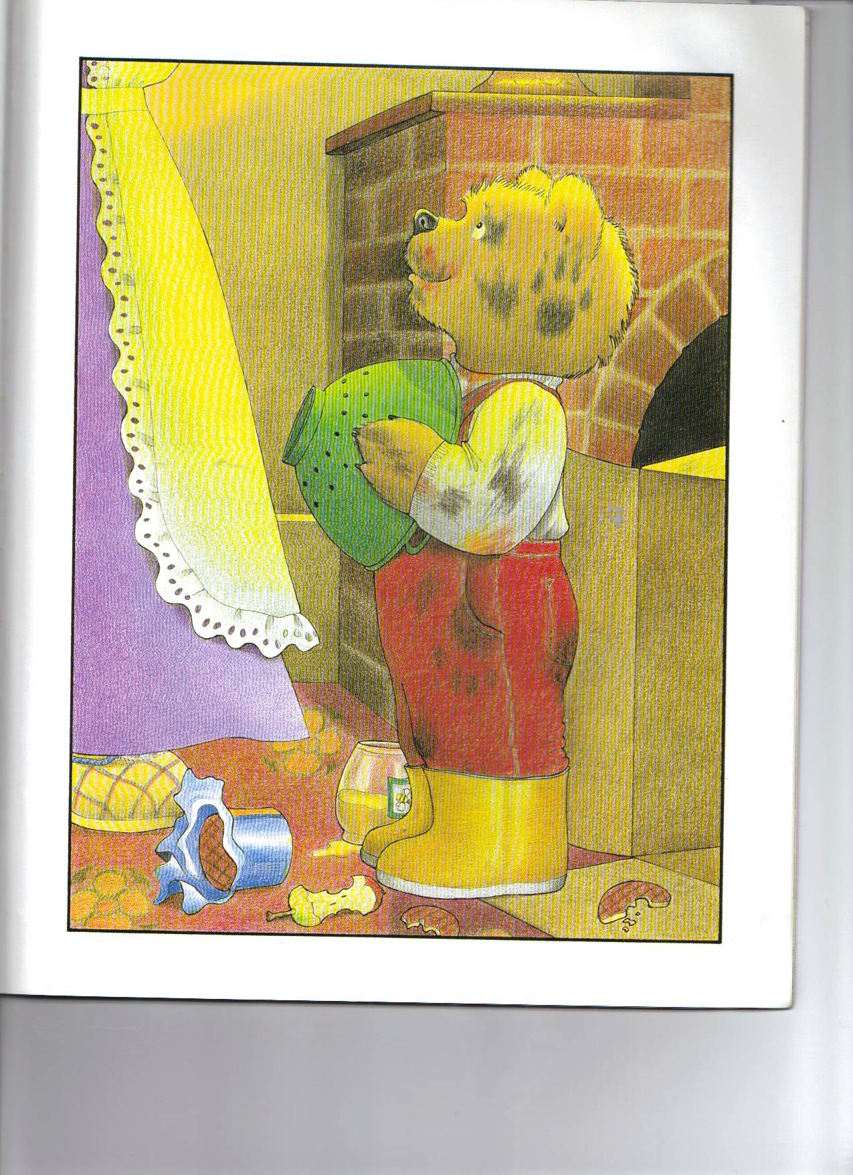
Mrs Bear came into the room. “Look at the state of you!” she gasped as she led him away to the bathroom. “Why, you look as if you’ve been up the chimney.”

Slide 15
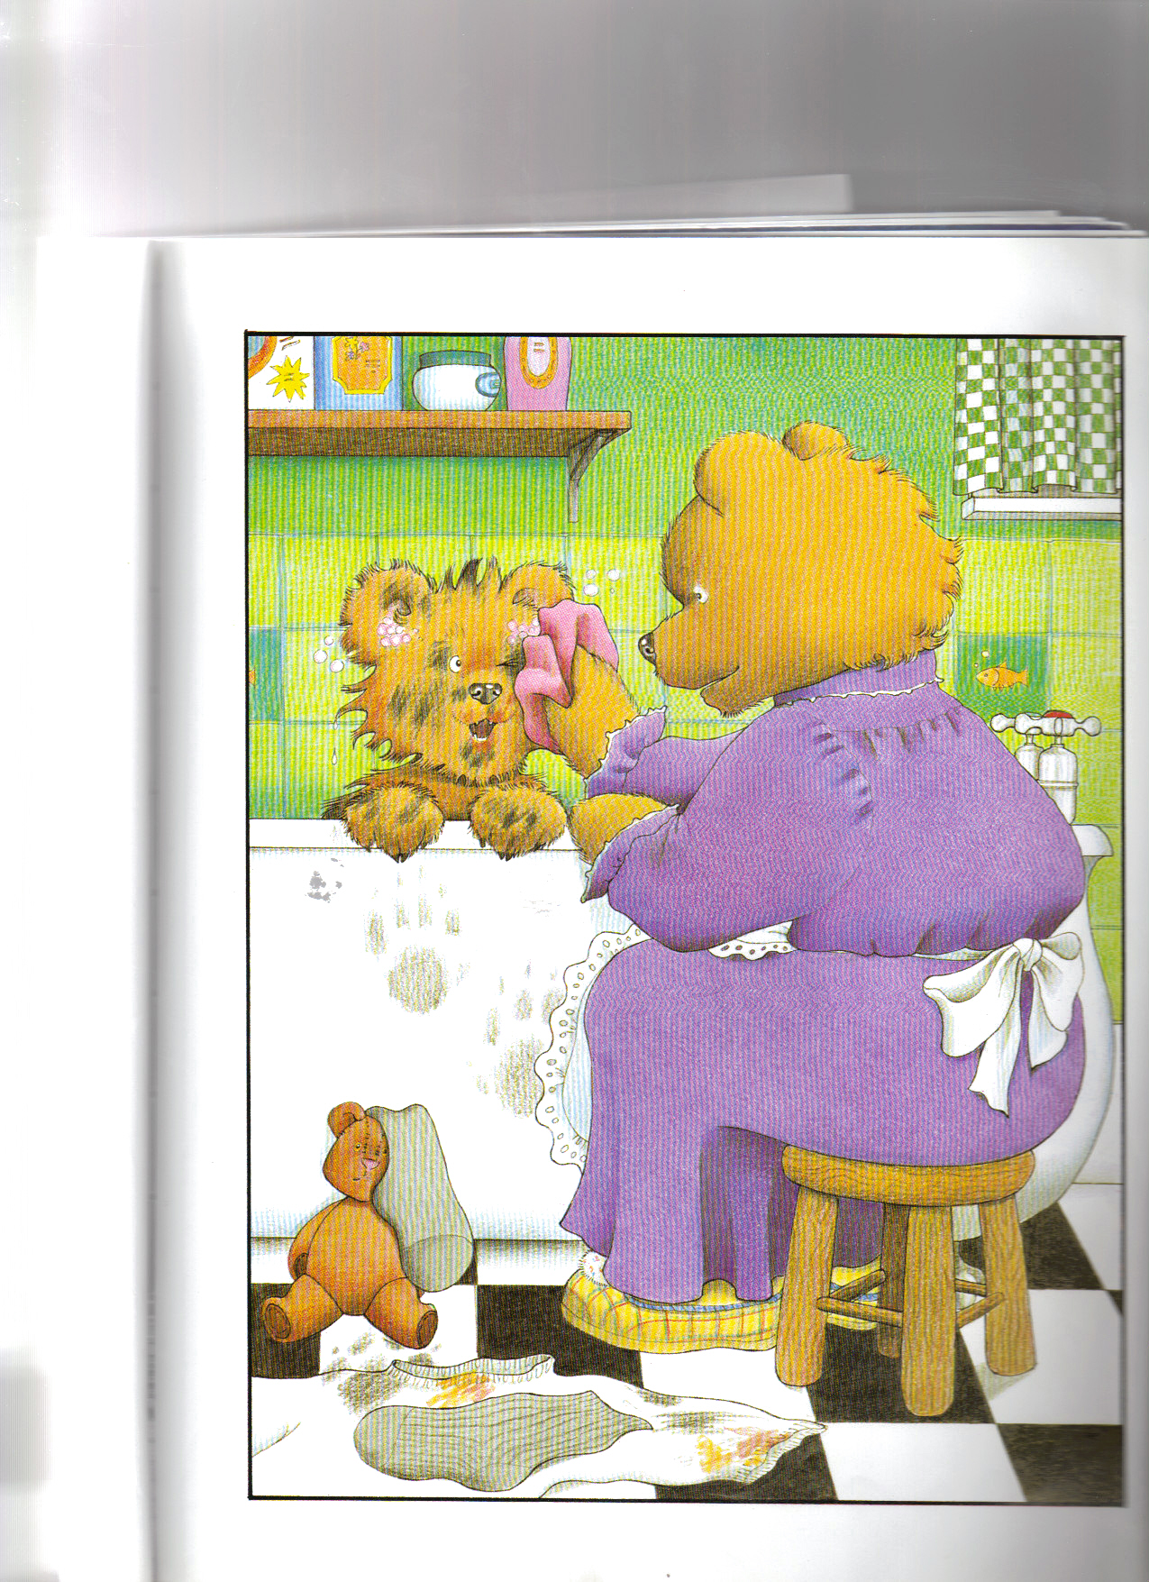
“As a matter of fact,” said Baby Bear, “I have been up the chimney. I found a rocket and went to visit the moon.” Mrs Bear laughed. “You and your stories,” she said. “Whatever next?”

