Slide 1
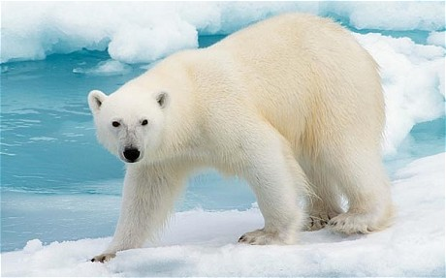

Slide 2
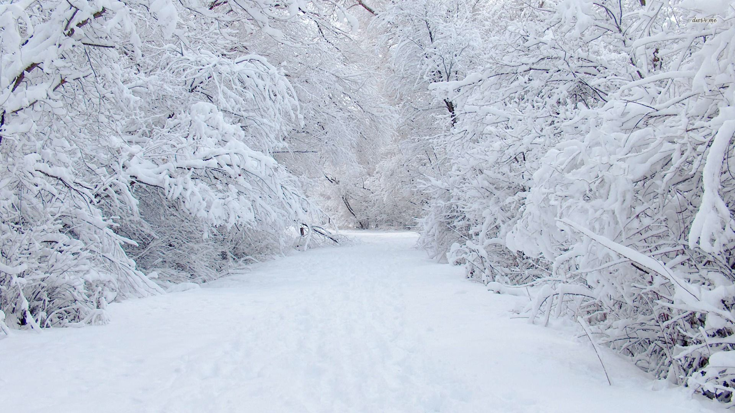
We’re going on a polar bear hunt
We’re going on a polar bear hunt
We’re going to catch a big one
I’m not scared
Uh-ho
Snow
Deep crunchy snow
We can’t go over it, we can’t go under it, we’ll have to go through it.
..
Tramp stamp crunch, tramp stamp crunch
Instruments/resources: shakers, wrappers/cellophane to crunch, cotton wool to feel

Slide 3
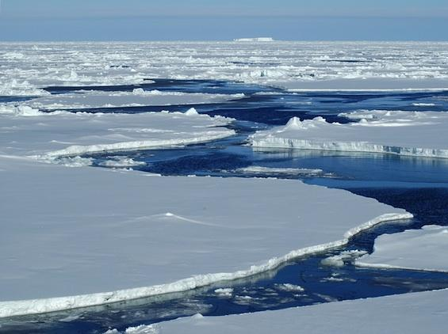
We’re going on a polar bear hunt
We’re going on a polar bear hunt
We’re going to catch a big one
I’m not scared
Uh-ho
Ice
Cold sharp ice
We can’t go over it, we can’t go under it, we’ll have to go through it.
Snap slip brrr, snap slip brrr
Resources: ice cubes

Slide 4
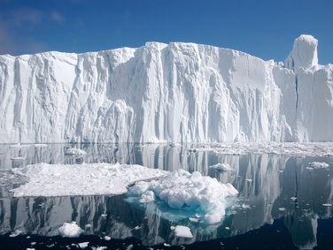
We’re going on a polar bear hunt
We’re going on a polar bear hunt
We’re going to catch a big one
I’m not scared
Uh-ho
Water
Freezing cold water
We can’t go over it, we can’t go under it, we’ll have to go through it.
Splash thrash ahh Splash thrash ahh
Instrument/resources: water spray, hand bells

Slide 5
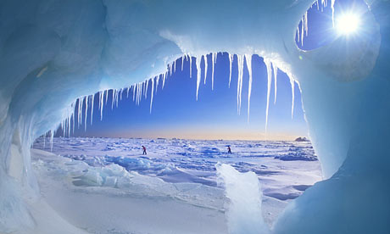
We’re going on a polar bear hunt
We’re going on a polar bear hunt
We’re going to catch a big one
I’m not scared
Uh-ho
An ice cave
We can’t go over it, we can’t go under it, we’ll have to go through it.
Shhh tiptoe Shh tiptoe
Instrument/resources: LIGHTS OUT, torch, dark material

Slide 6
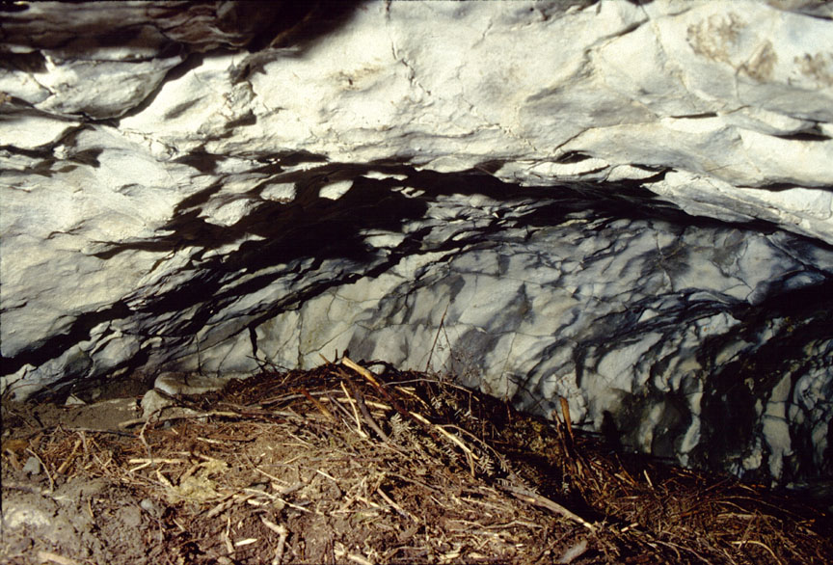
Grrrrr
What’s that??

Slide 7
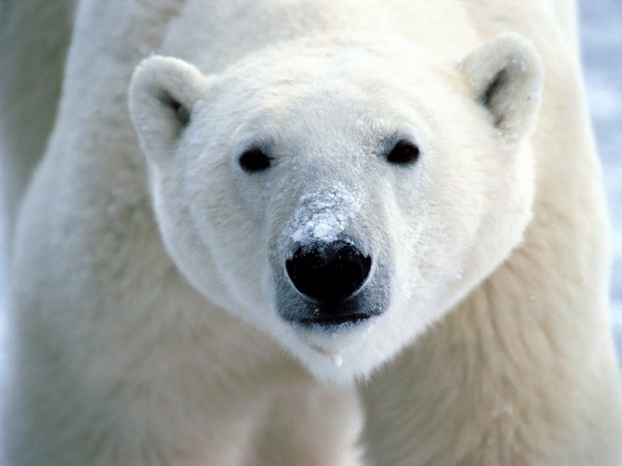
It’s a polar bear! ARGHH!

Slide 8
Back out the ice cave
Shh tiptoe Shh tiptoe
Back through the water
Splash thrash ahhh Splash thrash ahhh
Back over the ice
Snap slip brrrr snap slip brrrr
Back through the snow
Tramp stamp crunch Tramp stamp crunch
And through the front door
Up the stairs
And back into bed!
Phew!

Slide 9
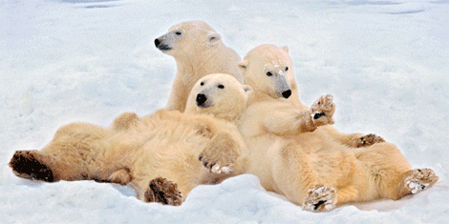
Lay down and relax.

