Slide 1

“Wow!” said the Owl.

Slide 2

At night, when we are feeling tired and ready for bed, owls are just waking up.

Slide 3
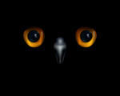
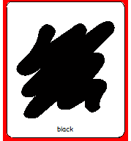
Owls live in a night-time world. They have eyes that can see in the dark.

Slide 4
But this little owl was a curious owl.
Instead of staying awake all night, as little owls are supposed to do, she took a long nap and woke up just before dawn.

Slide 5
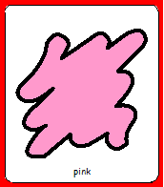
“Wow!” said the owl.
She couldn’t believe her eyes! The sky was a warm and wonderful pink.

Slide 6
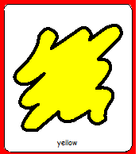
‘Wow!’ said the owl, as the yellow sun shone through the morning mist.

Slide 7
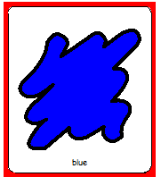
‘Wow!” said the owl, as white fluffy clouds floated across the bright blue sky.

Slide 8
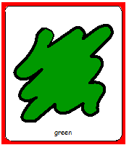
‘Wow!’ said the owl, when she saw that the leaves on her tree were green.

Slide 9
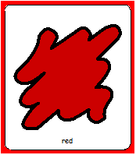
‘Wow!’ said the owl, as the pretty red butterflies flew by.

Slide 10

She watched them land on the bright orange flowers, which opened up in the warm sunshine.

Slide 11
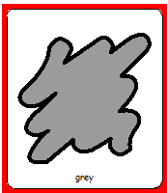
Up in the sky the clouds turned grey and it started to rain.
But the sun was still shining.

Slide 12
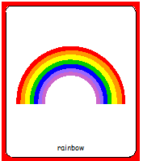
‘Wow!’ said the owl, as a beautiful rainbow filled the sky with colour.

Slide 13
The little owl sat happily in her tree and watched as the sun went down…..
….. And the moon came up.
The daytime is full of beautiful colours, she thought.

Slide 14
But, ‘Wow!’ said the owl. ‘The night time stars are the most beautiful of all’.
Too excited to sleep, the little owl stayed awake all night long, just like little owls are supposed to do.

