Slide 2
Some days are yellow. Some are blue.
On different days I’m different too.
You’d be surprised how many ways
I change on different coloured days.

Slide 3
On bright red days how good it feels to be a horse and kick my heels!

Slide 4
On other days I’m other things.
On bright blue days I flap my wings

Slide 5
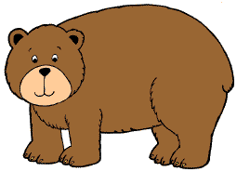
Some days, of course, feel sort of brown.
Then I feel slow and low, low down.

Slide 6
Then comes a yellow day and Weeeeeee!
I am a busy, buzzy bee!

Slide 7
Grey day… everything is grey. I watch.
But nothing moves today.

Slide 8
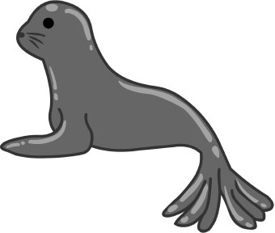
Then all of a sudden I’m a circus seal!
On my orange days that’s how I feel.

Slide 9
Green days. Deep deep in the sea,
cool and quiet fish. That’s me.

Slide 10
On purple days I’m sad.
I groan. I drag my tail. I walk alone.

Slide 11
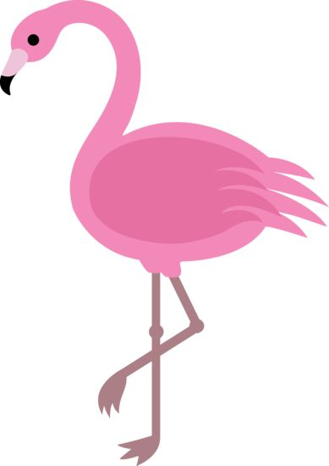
But when my days are happy pink,
It’s great to jump and just not think!

Slide 12
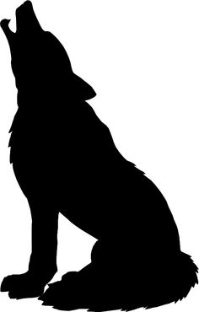
Then come my black days. Mad and loud.
I howl. I growl at every cloud.

Slide 13
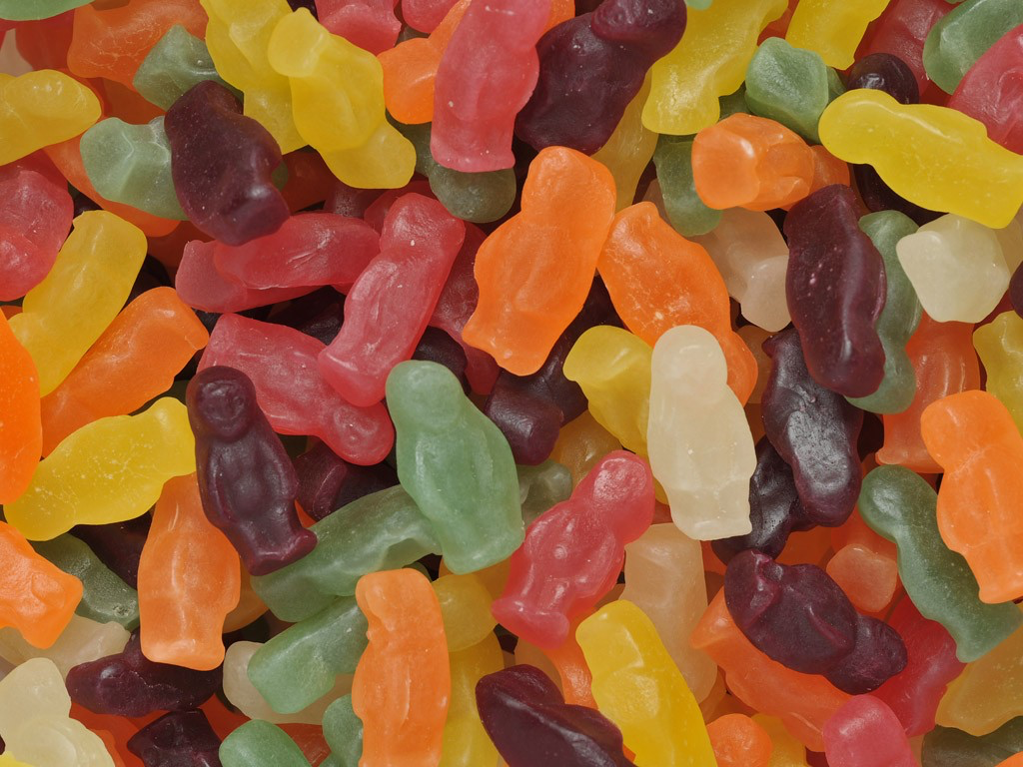
Then comes a mixed-up day. And WHAM!
I don’t know who or what I am!

Slide 14
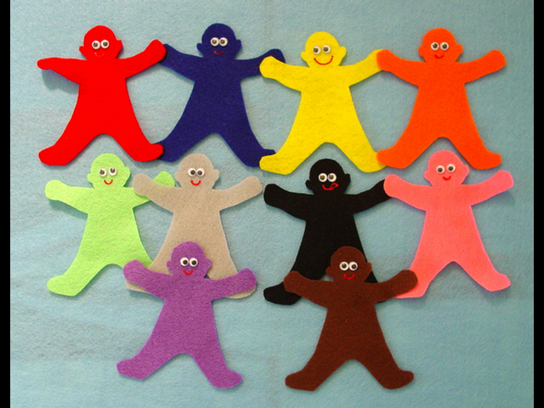
But it all turns out all right, you see.
And I go back to being… me!

