Slide 1
Bear Hunt themed Sensory Pack

Slide 2
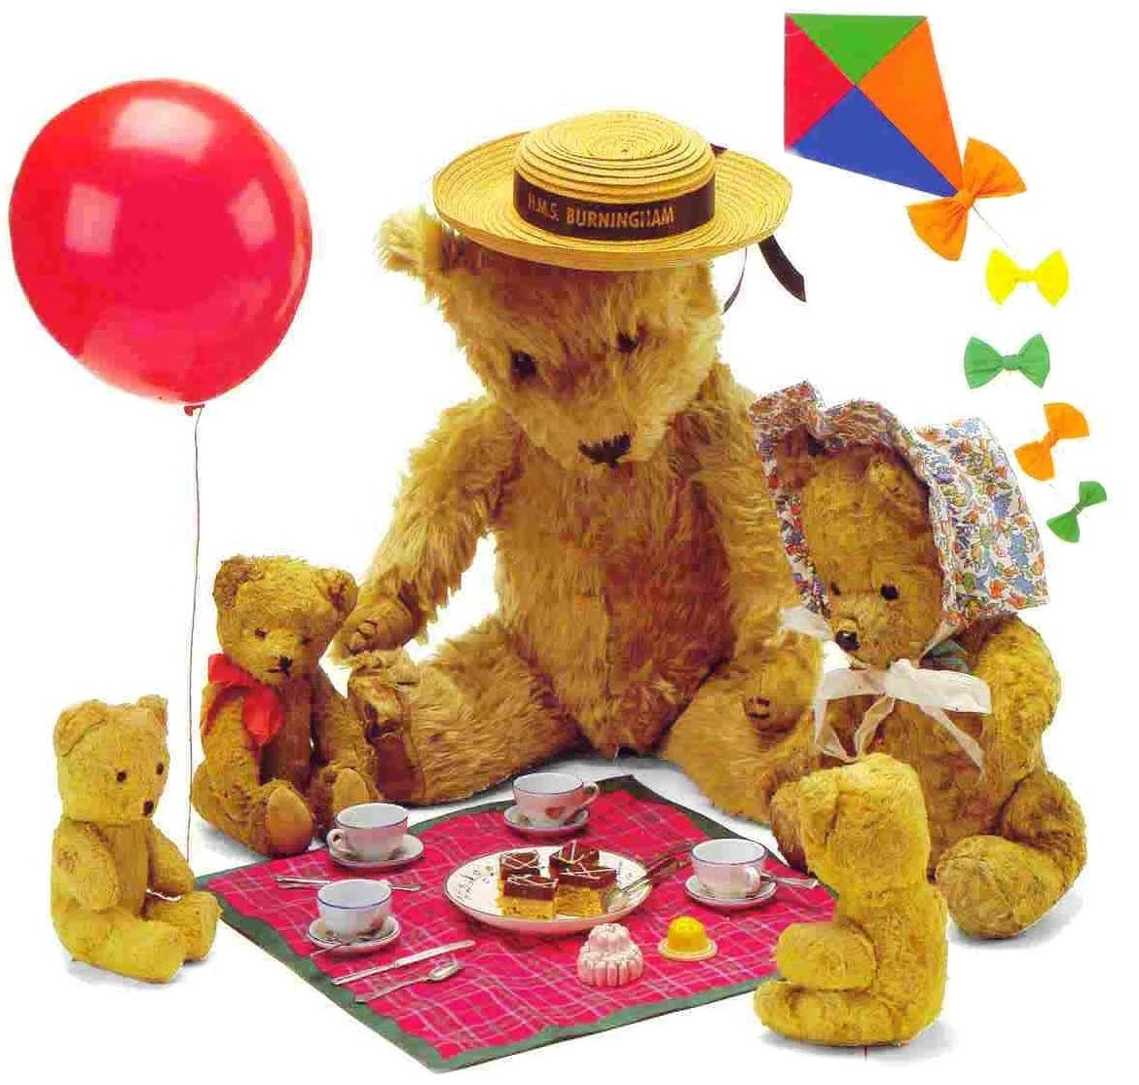
Teddy Bear’s Picnic
Resources
Green mops / shredded tissue paper or green sponges to be moved over your child’s body.

Slide 3
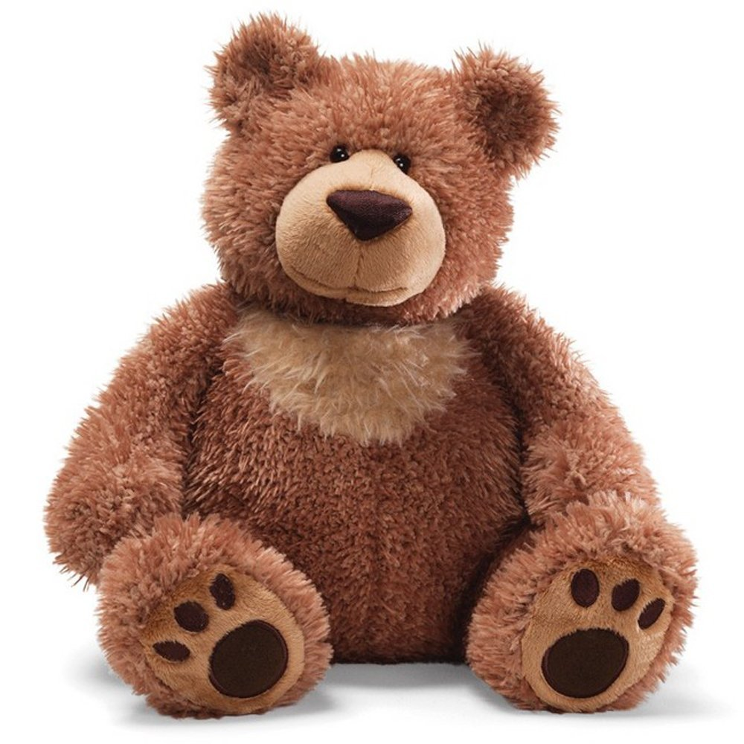
My Teddy Bear
Resources
Furry material – move over child’s body to go with song.

Slide 4
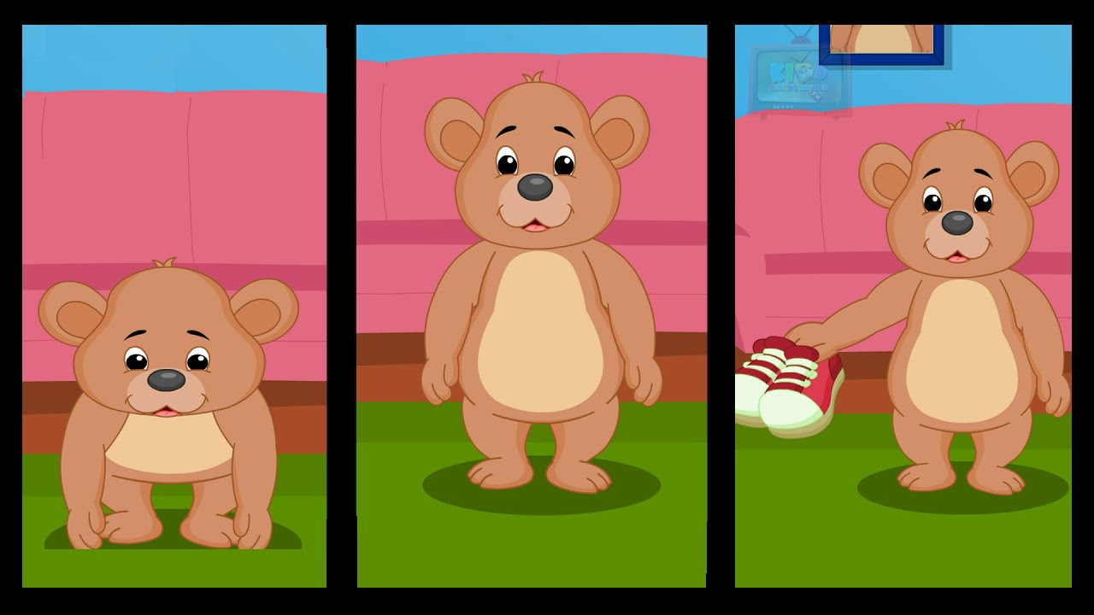
Teddy Bear turn around
Resources
Massage rollers – use massage rollers or hands and move over your child’s body.

Slide 5
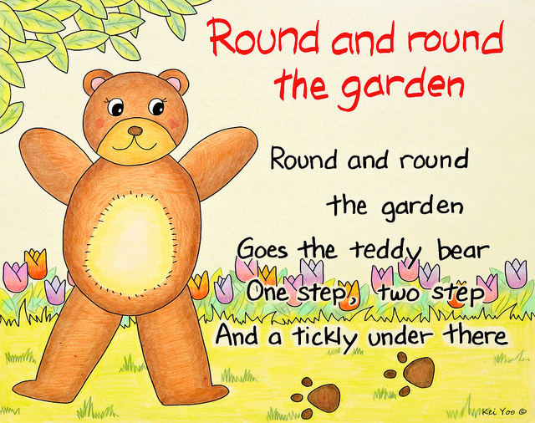
Round and round the garden
Resources
Circle movements / actions to song.

Slide 6
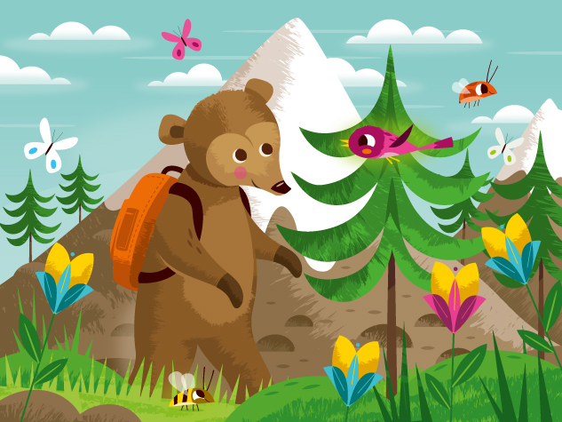
The bear went over the mountain
Resources
Walking hand movements on body.

