Slide 1
Sensory play ideas
Dosbarth Oren

Slide 2
Benefits of sensory play
Develops all five senses in pupils
It is a hands on, practical approach to learning about the world we live in
It can be calming
Encourages focus and engagement
Supports the development of motor skills
A great opportunity for play! It can support intensive interaction skills

Slide 3
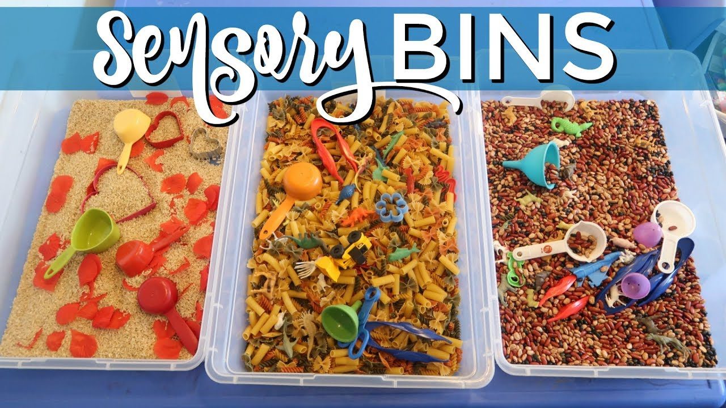
Sensory bins
A sensory bin is a large container filled with a child’s favourite sensory material, e.g. sand. They usually have other items placed in them, e.g. scoops with sand and buckets.
They work great for any topic.
‘Watch us Grow’ sensory bin
Fill the tray with soil
Add some small scoops
Add some flowerpots and flower bulbs
Add a spray bottle of water
Allow the pupil opportunity to explore the materials independently initially.
Begin to model how to make a flower! Opportunity for play and language skills, intensive interaction and motor skills.

Slide 4
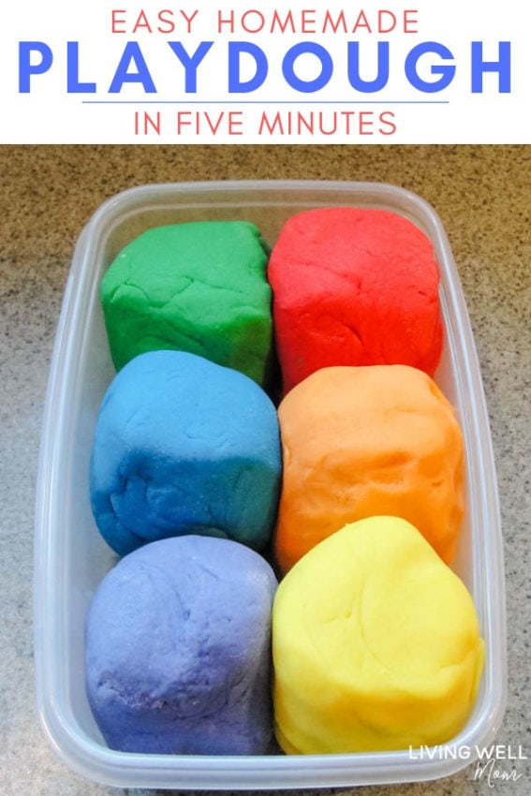
Homemade Playdough
2x cups of flour
1x cup of salt
1x cup of water
Food colouring
Mix the salt with the water. Add some food colouring. Slowly add some flour and mix. Repeat until you have a nice dough. Remove from the bowl and use your hands!

Slide 5
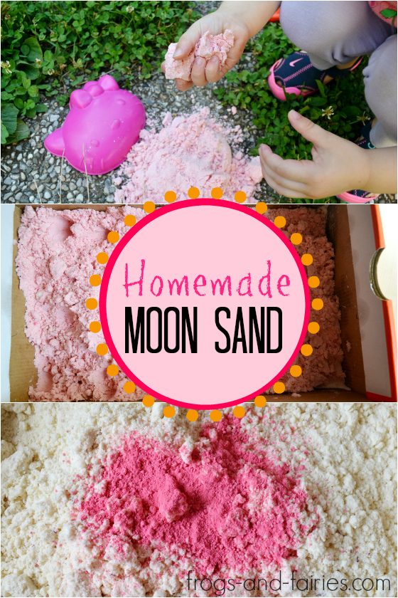
Homemade Moon Sand
8x cups of flour
1x cup of baby oil
Food colouring
Mix the flour with the oil. Add a generous amount of food colouring. Mix altogether and place in a sensory bin. Add items to relate to a theme.

Slide 6
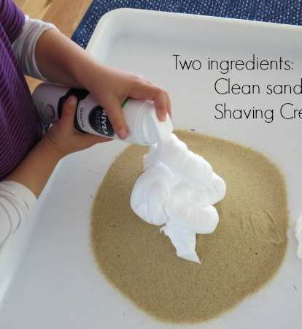
Sand Foam
Foam
Sand
Mix foam with enough sand (however much you would like). Add to a sensory bin with items related to topic.

Slide 7
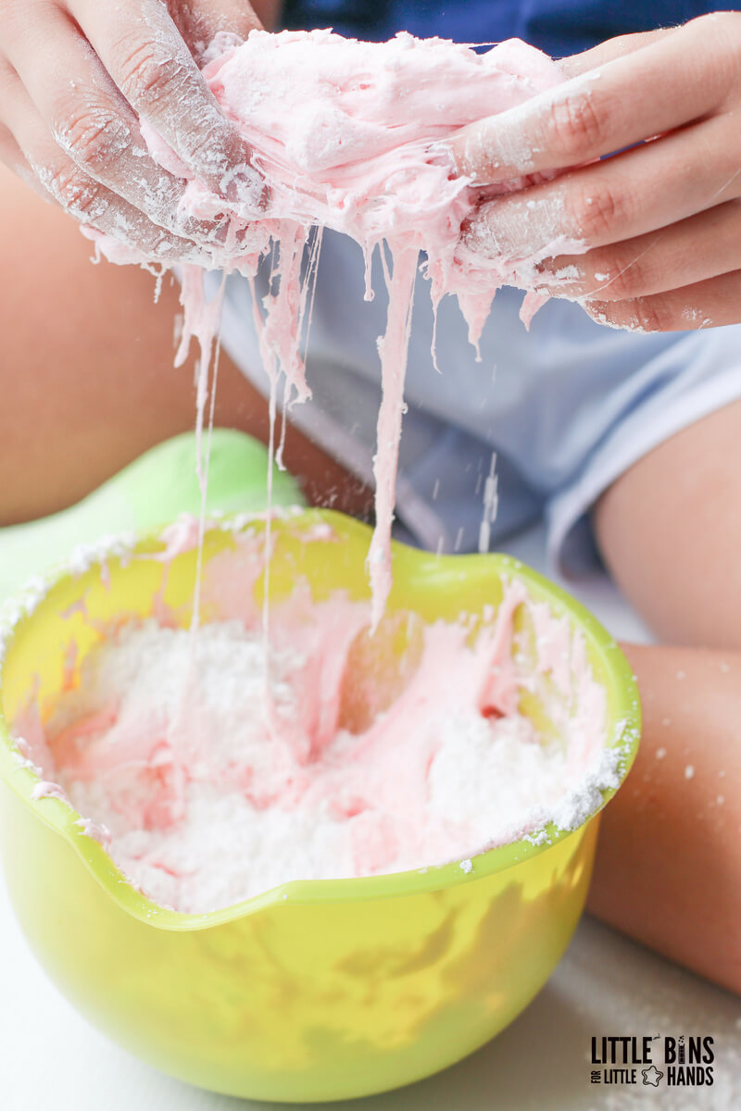
Homemade Marshmallow Slime (taste safe)
Jumbo marshmallows
Powdered sugar
Cooking oil (as needed)
Microwave the marshmallows until melted. Add powdered sugar (a spoon at a time) to the mixture until there is a stretchy texture. To minimise the stickiness, add a drop of cooking oil.

Slide 8
Dry play ideas
Sand tray
Cereals- porige oats, Weetabix, rice krispies…
Pasta/spaghetti
Rice
Flour, cocoa powder, icing sugar, jelly powder

Slide 9
Wet Play ideas
Jelly cubes or smashed up
Rice pudding
Wet sand, soil, grass etc
Water trays
Dry cereals mixed with milk or water
Chocolate pudding
Syrups
Ice cream with sauces, sprinkles etc
Foam, shaving foam, cream

Slide 10
Useful websites
https://littlebinsforlittlehands.com/kids-sensory-play-ideas/
https://www.learning4kids.net/list-of-sensory-play-ideas/
https://www.earlyyearscareers.com/eyc/enabling-environment/15-messy-play-ideas-for-under-2s/
https://www.pinterest.co.uk/iowafarmerswife/messy-play/

