Slide 1
Autumn Sensology

Slide 2
Resources
Say hello: Mirror
Touch: fans, leaves, pine cones, conkers
Smell: Cinnamon and apple sauce
Taste: Apple sauce and caramel sauce
See: Light up toys, toy hedgehogs / squirrels / birds
Sound: crunching leaves, rainmakers

Slide 3
Say hello….
Encourage each child to look at themselves in the mirror. Begin by talking to them about the parts of the body they can see in the mirror (head, eyes, nose, ears etc) and then move on to point/tap to other parts of their body such as their arms, legs, hands, feet etc.
Sing the song ‘This is me’ – support each child to pat each part of their body
https://www.youtube.com/watch?v=QkHQ0CYwjaI

Slide 4
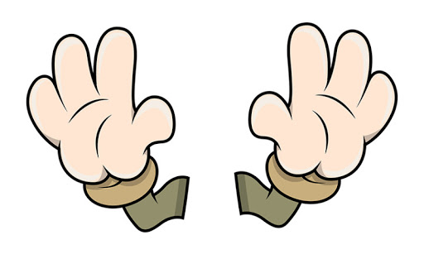
Touch
Briefly introduce that we use our bodies and our hands to touch. Encourage each child to explore the feel, one at a time, the wind on their body from the fan, the pinecones, leaves and conkers.
Feel: fan, pinecones, leaves and conkers

Slide 5
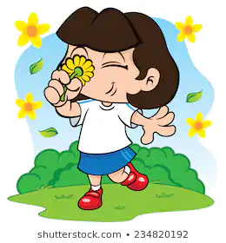
Smell
Introduce that we use our nose to smell, indicating to each child where their nose is (or asking them to show you themselves). Encourage each child to smell the cinnamon and apple sauce. Always present the stronger of the scents last. Encourage each child to express likes or dislikes for the scents.
Smell: Cinnamon and apple sauce

Slide 6
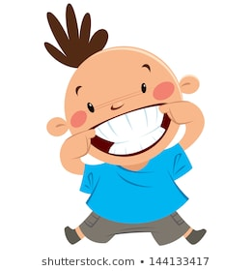
Taste - may not be applicable to all pupils. Pupils unable to taste can smell the resources or feel.
Introduce that we use our mouth to taste, indicating to each child where their mouth is (or asking them to show you themselves). Offer a taste the apple sauce and the caramel sauce. Encourage each child to express their likes and dislikes towards the food.
Taste: Apple Sauce and Caramel Sauce

Slide 7
See
Introduce that we use our eyes to see, indicating to your child where their eyes are (or asking them to show you themselves). Show each child the flashing light toys and toy hedgehog / squirrels / birds.
See: light toys, hedgehog, squirrels, bird toys

Slide 8
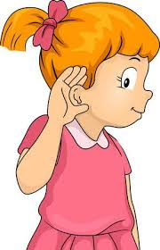
Hear
Introduce that we use our ears to hear, indicating to each child where their ears are (or asking them to show you themselves). Listen to the sound of the rainmaker and the youtube clip of the tractor.
Tractor sound effect: https://www.youtube.com/watch?v=n12yxqOQgC0
Rain sound effect: https://www.youtube.com/watch?v=J6G0EuPAoKQ

Slide 9
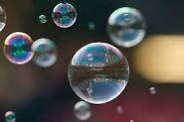
Relaxation
Relax with each child, listening to the music and giving them a massage. Blow bubbles or move parachute over the children’s heads.
https://www.youtube.com/watch?v=4fddGrDV2gw

