Slide 1










Notes:
Drag the day of the week and the taste of the day into the box
Taste and smell the blueberries if available.

Slide 2
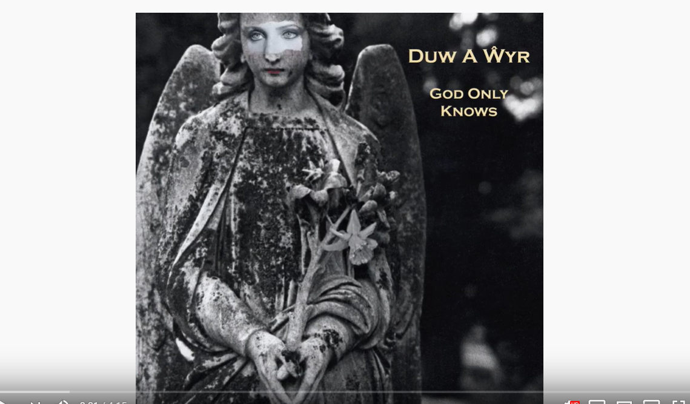

https://www.youtube.com/watch?v=TmB6ZN8EjqE
Notes:
Turn the lights off and make a relaxing setting. Stretch parts of the body to the song. You could also stretch items such as playdough.

Slide 3

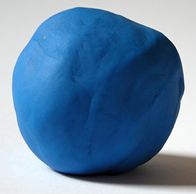

HP, TI, SO, BS and BG- Drag the red items into the box
Notes:
This slide is suitable for SO, TI, HP, BG and BS

Slide 4



ML, JM and AM- Drag the red items into the box
Notes:
This slide is suitable for ML, JM and AM

Slide 5
Expressive Arts- Messy play
In the home packs, messy play items were provided. You can use these now. Hide some items in the messy play for the pupils to find.
Playdough was also provided.
You could refer to the activity lesson plan on Ty Gwyn website for ideas of what to do now (based on pupil's targets).
Notes:
Humanities

Slide 6
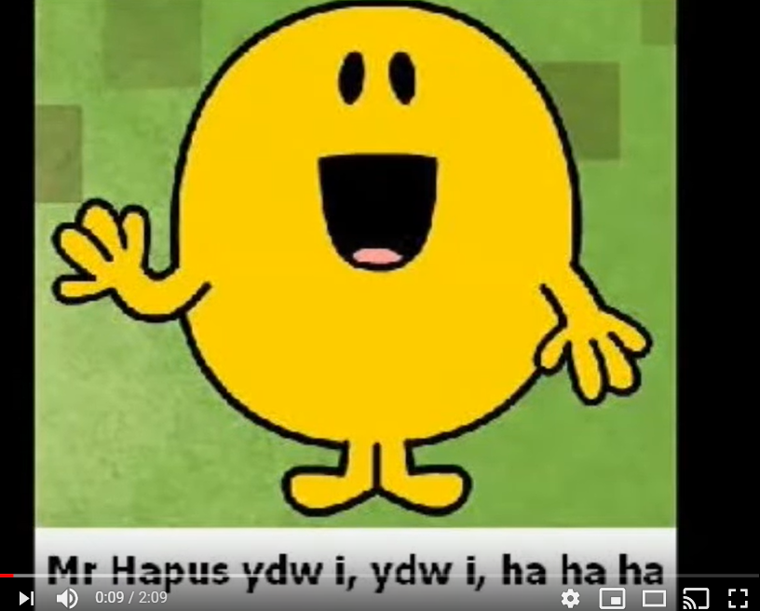
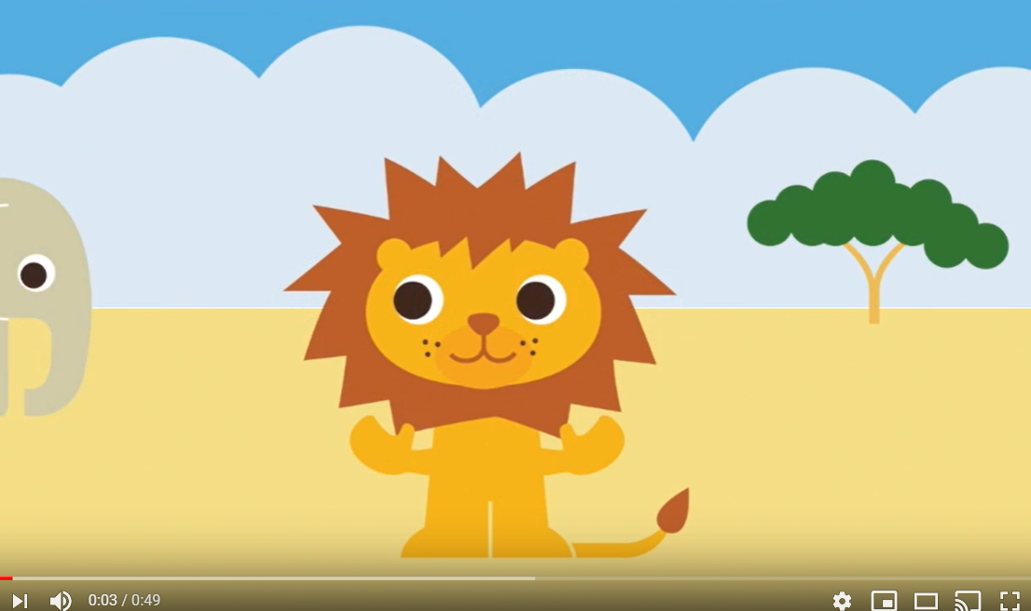
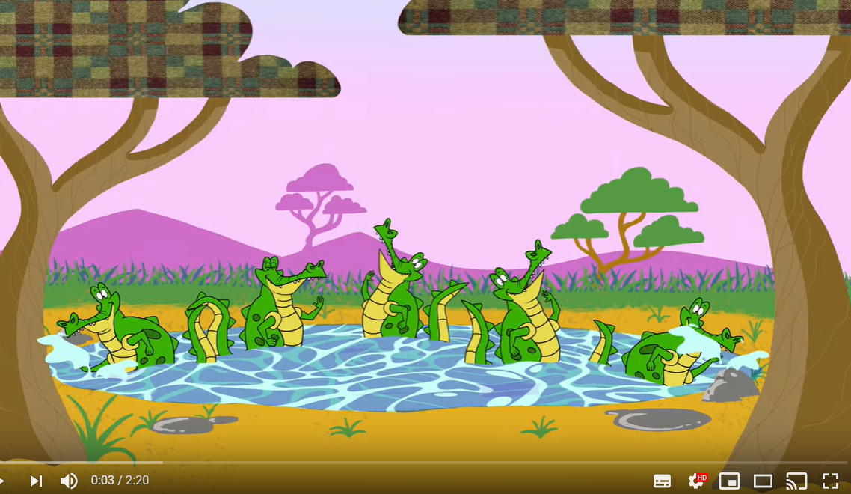
Welsh- here are some Welsh music clips we enjoy in school
https://www.youtube.com/watch?v=-aw59C-89P8
https://www.youtube.com/watch?v=vn_hrOAKTaM
https://www.youtube.com/watch?v=_NtlwwGlUFI

