Slide 1
DISNEY WORKOUT
@CoachRowntree23

Slide 2
DASH sprint on the spot

Slide 3
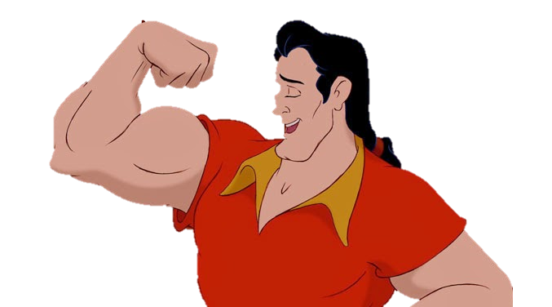
GASTON punches

Slide 4
DORY just keep swimming

Slide 5
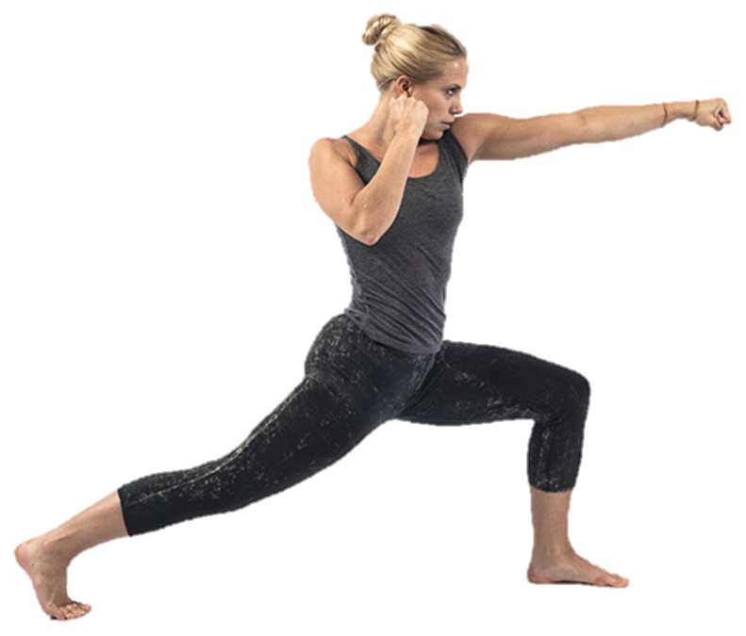
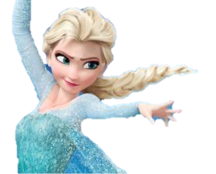
ELSA ice blasts

Slide 6
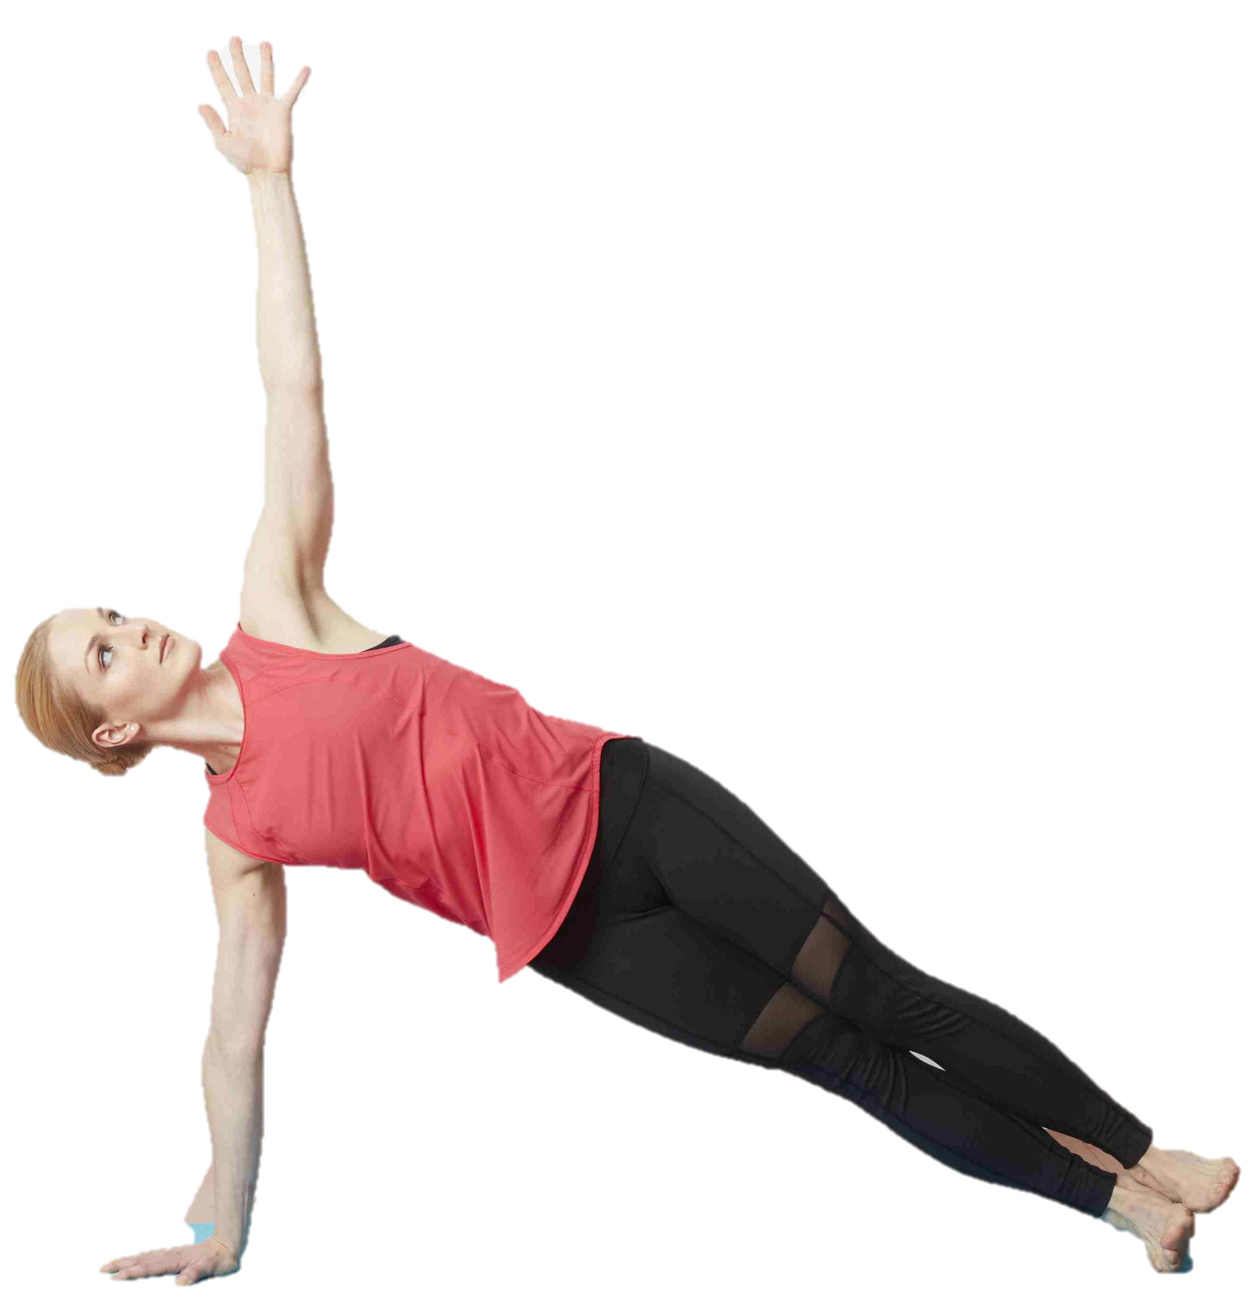
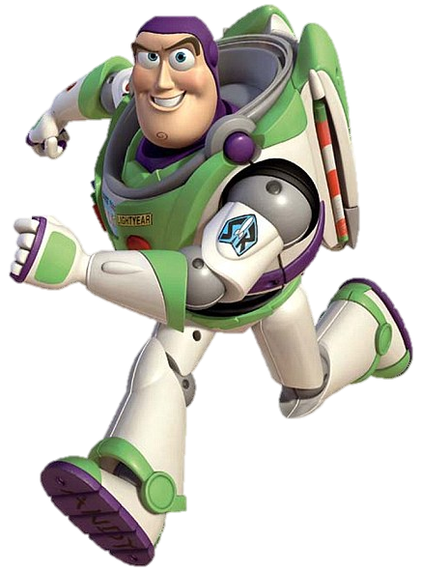
BUZZ wings out

Slide 7
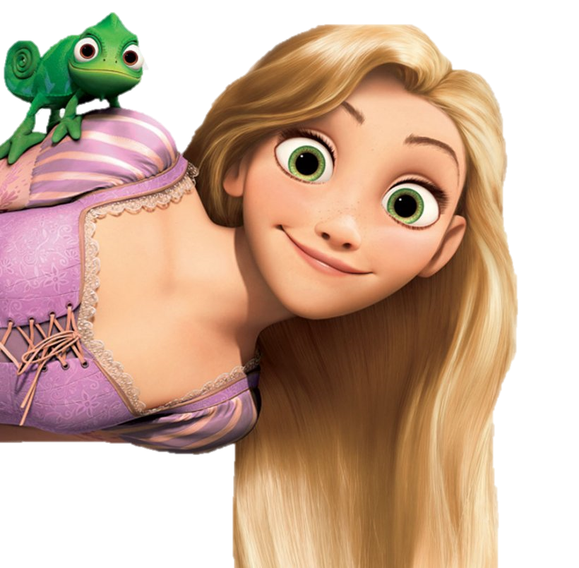
RAPUNZEL tower climbers

Slide 8
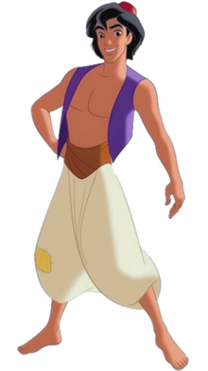
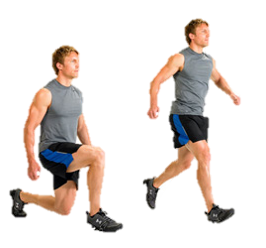
ALADDIN lunge jumping

Slide 9
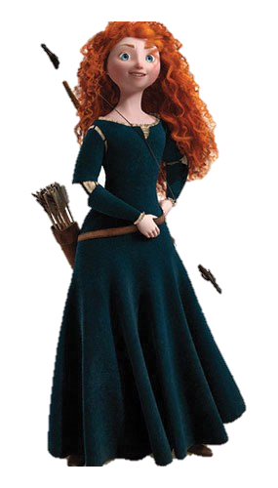
MERIDA archers

Slide 10
MULAN chops

Slide 11
OLAF warm hugs

Slide 12
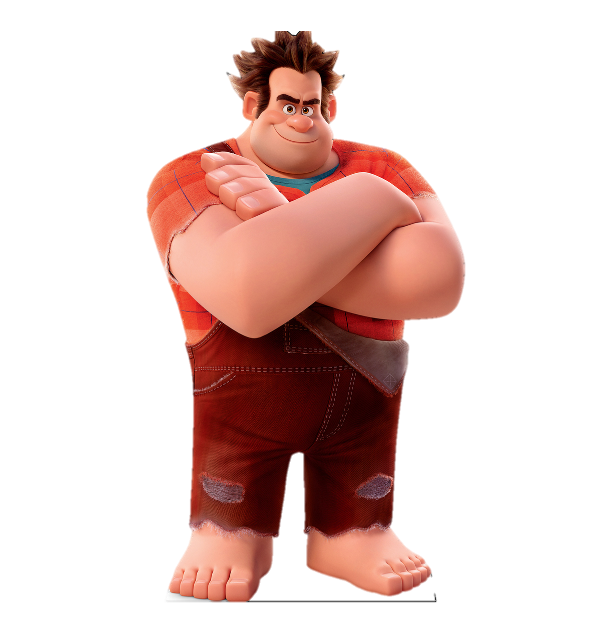
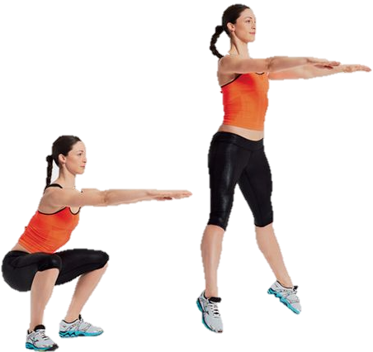
WRECK IT RALPH squat jumps

Slide 13
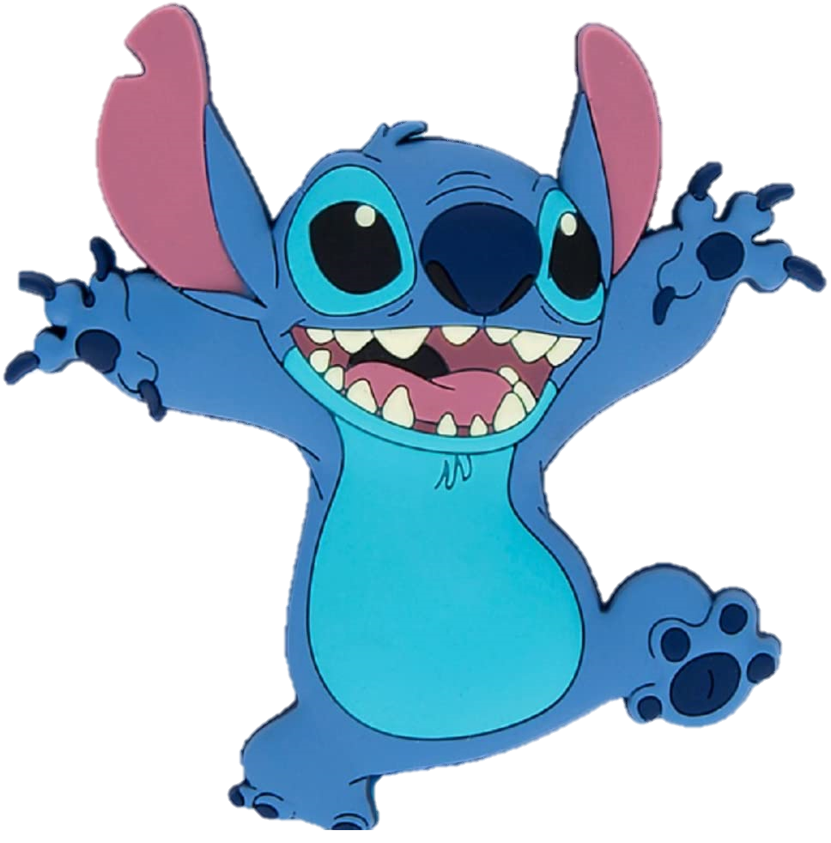
STITCH dog crawls

Slide 14
CINDERELLA clean the floor

Slide 15
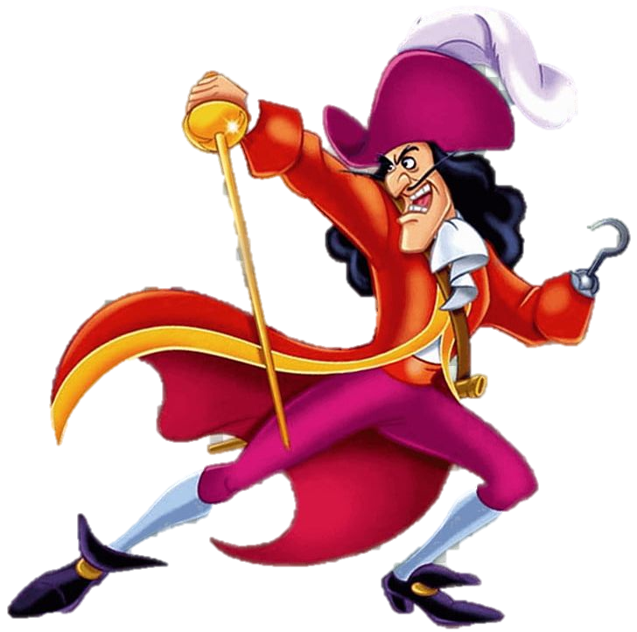
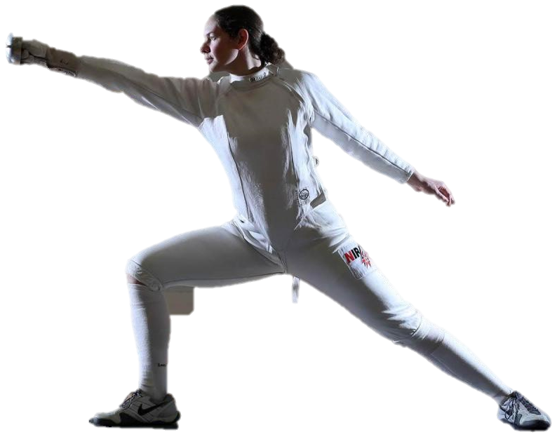
CAPTAIN HOOK en garde

