Slide 1
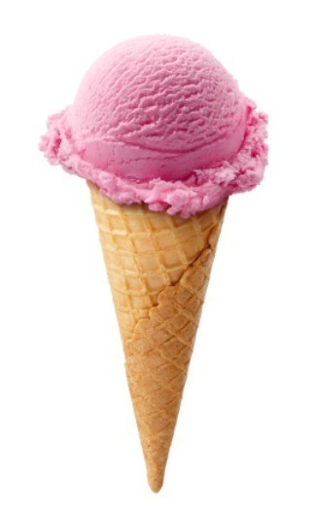
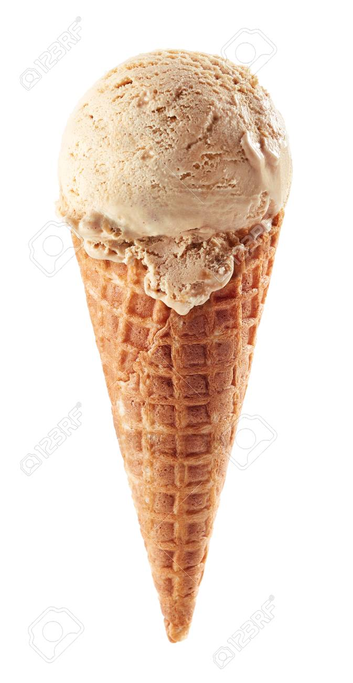
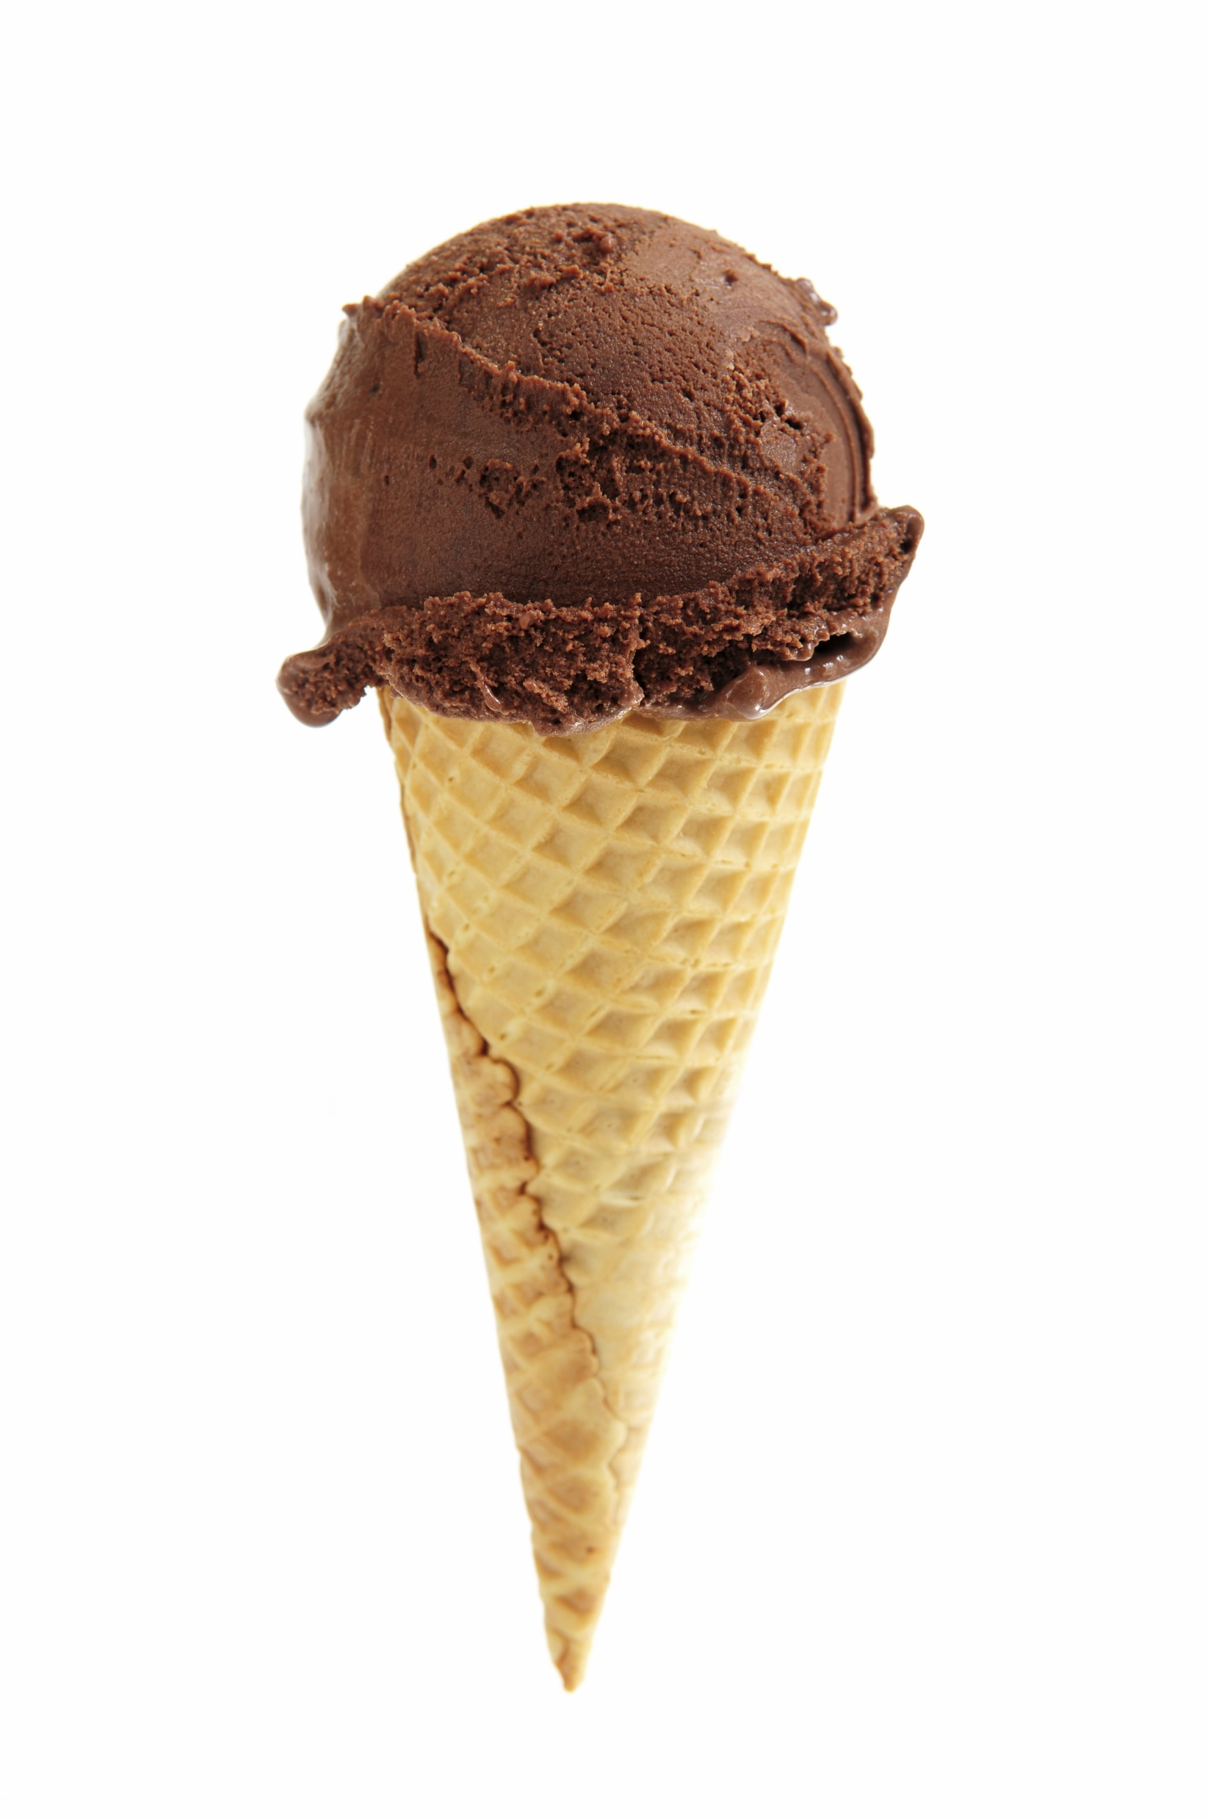
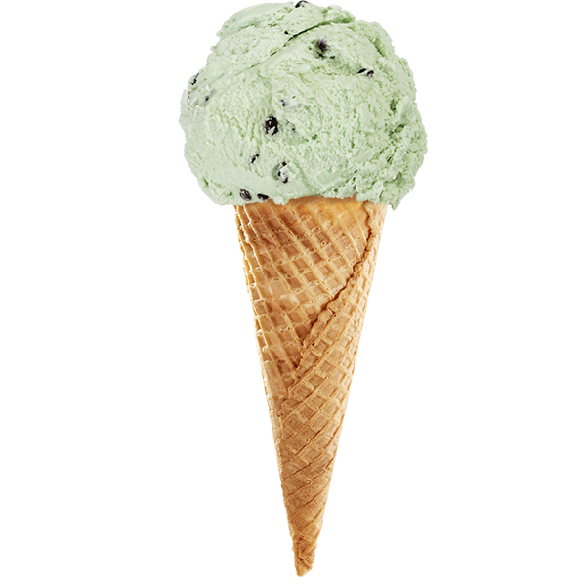
5 Big Ice Creams Song

Slide 2
5

Slide 3
5 big ice creams with sprinkles on the top 5 big ice creams with sprinkles on the top and if someone comes and takes one and gobbles it all up There’ll be how many ice creams standing in the shop?

Slide 4
4

Slide 5
4 big ice creams with sprinkles on the top 4 big ice creams with sprinkles on the top and if someone comes and takes one and gobbles it all up There’ll be how many ice creams standing in the shop?

Slide 6
3

Slide 7
3 big ice creams with sprinkles on the top 3 big ice creams with sprinkles on the top and if someone comes and takes one and gobbles it all up There’ll be how many ice creams standing in the shop?

Slide 8
2

Slide 9
2 big ice creams with sprinkles on the top 2 big ice creams with sprinkles on the top and if someone comes and takes one and gobbles it all up There’ll be how many ice creams standing in the shop?

Slide 10
1

Slide 11
1 big ice creams with sprinkles on the top 1 big ice creams with sprinkles on the top and if someone comes and takes one and gobbles it all up There’ll be how many ice creams standing in the shop?

Slide 12
0

