Slide 2
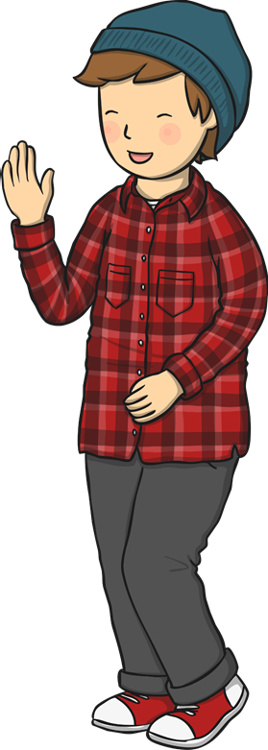
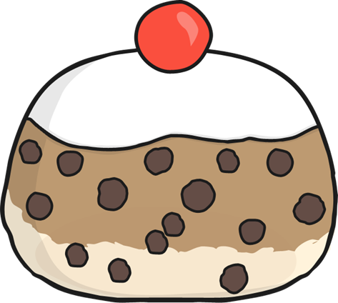
5
Five currant buns in a baker’s shop,
Sweet and sticky with a cherry on the top.
Along came a boy with a penny one day,
Bought a currant bun and took it away.

Slide 3
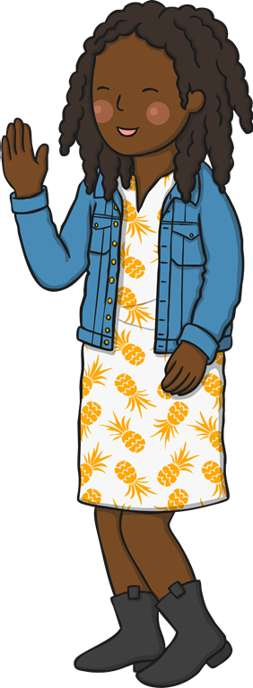
4
Four currant buns in a baker’s shop,
Sweet and sticky with a cherry on the top.
Along came a girl with a penny one day,
Bought a currant bun and took it away.

Slide 4
3
Three currant buns in a baker’s shop,
Sweet and sticky with a cherry on the top.
Along came a boy with a penny one day,
Bought a currant bun and took it away.

Slide 5
2
Two currant buns in a baker’s shop,
Sweet and sticky with a cherry on the top.
Along came a girl with a penny one day,
Bought a currant bun and took it away.

Slide 6
1
One currant bun in a baker’s shop,
Sweet and sticky with a cherry on the top.
Along came a boy with a penny one day,
Bought a currant bun and took it away.

