Slide 1
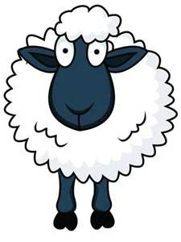
5 Little Sheep Song
To the tune of ‘10 green bottles’

Slide 2
5

Slide 3
5 little sheep, running in a field,
5 little sheep running in a field, but if one little sheep get’s lost one day
There’ll be how many sheep running in the field?

Slide 4
4

Slide 5
4 little sheep,
running in a field,
4 little sheep
running in a field,
but if one little sheep get’s lost one day
There’ll be how many sheep
running in the field?

Slide 6
3

Slide 7
3 little sheep,
running in a field,
3 little sheep
running in a field,
but if one little sheep get’s lost one day
There’ll be how many sheep
running in the field?

Slide 8
2

Slide 9
2 little sheep,
running in a field,
2 little sheep
running in a field,
but if one little sheep get’s lost one day
There’ll be how many sheep
running in the field?

Slide 10
1

Slide 11
1 little sheep,
running in a field,
1 little sheep
running in a field,
but that little sheep needs to have a rest
So one little sheep
Goes back to the barn.

