Slide 1
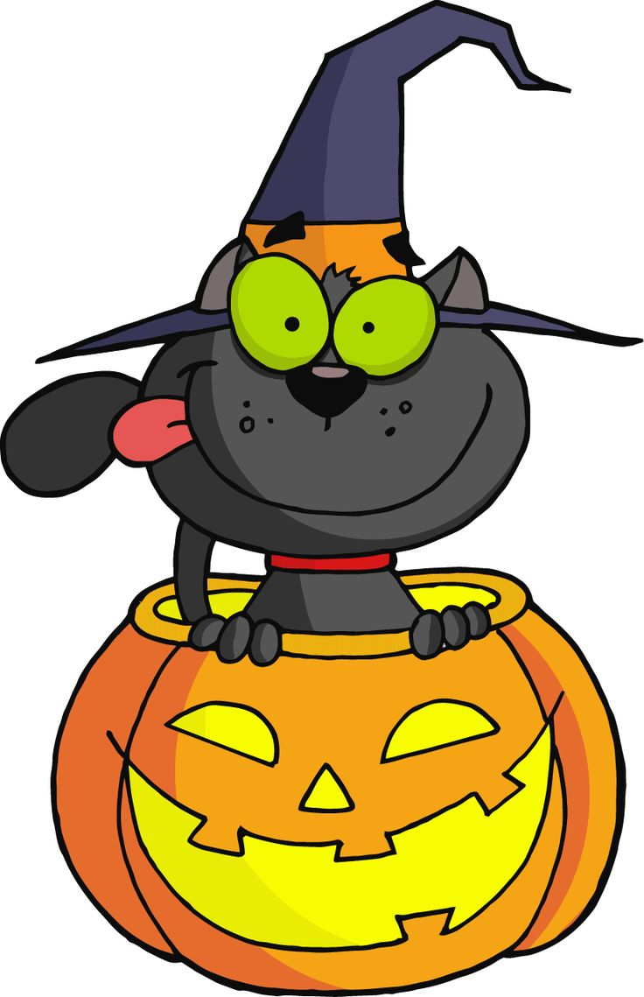
Halloween Sensory Pack

Slide 2
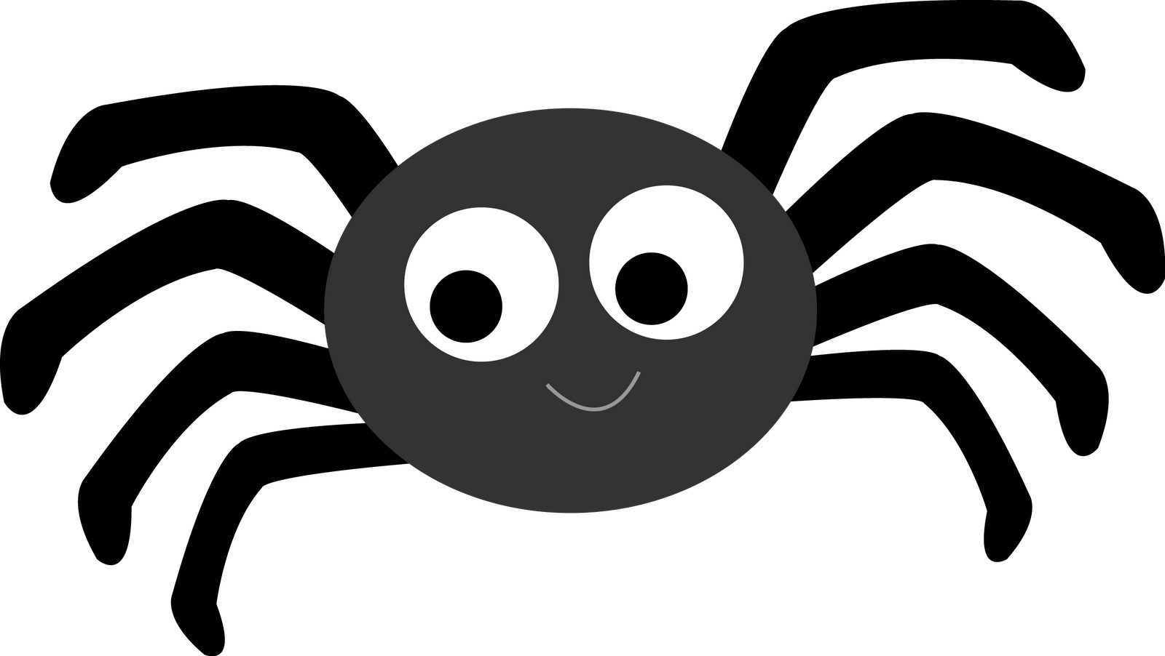
Moving spiders over body

Slide 3
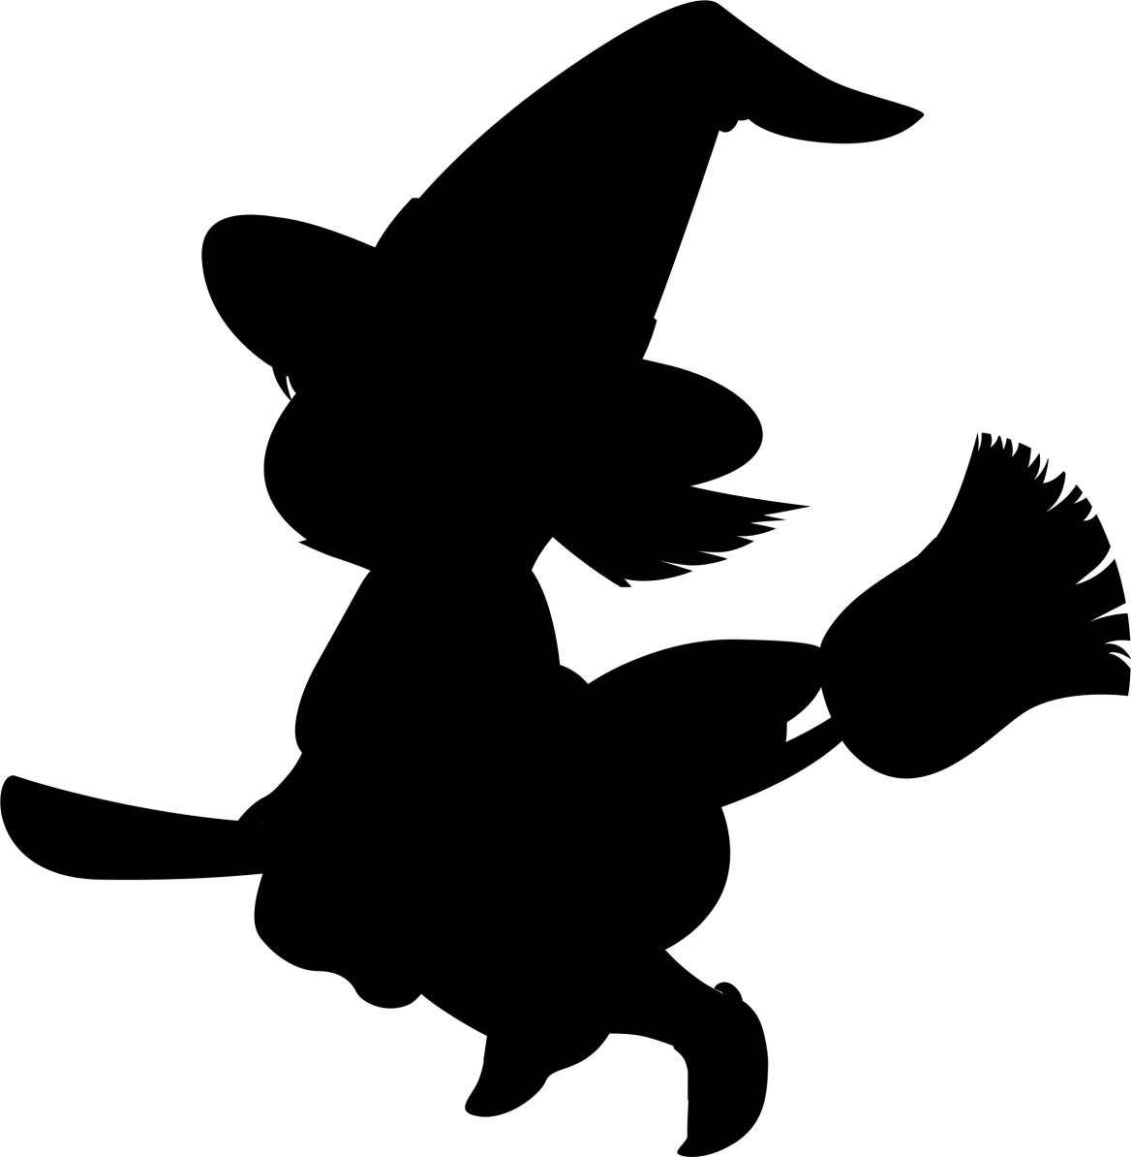
Dancing with multi-coloured materials.

Slide 4
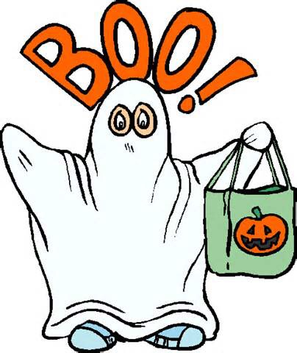
Draping foil blankets over body.

Slide 5
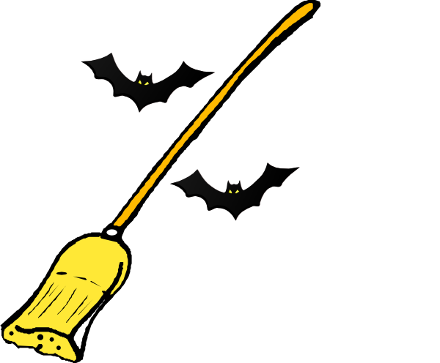
Brushing with pastry brushes

Slide 6
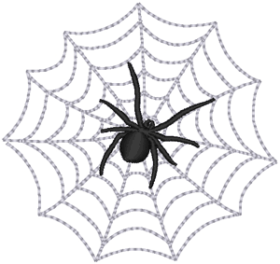
Cobweb material over body.

