Slide 1
Notes:
Drag the day of the week and the taste of the day into the box
Taste and smell the orange if available.

Slide 2
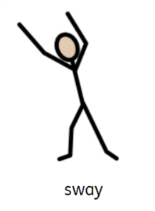
https://www.youtube.com/watch?v=DXq-XdyGehk
Notes:
Turn the lights off and make a relaxing setting. Sway body/hands.

Slide 3
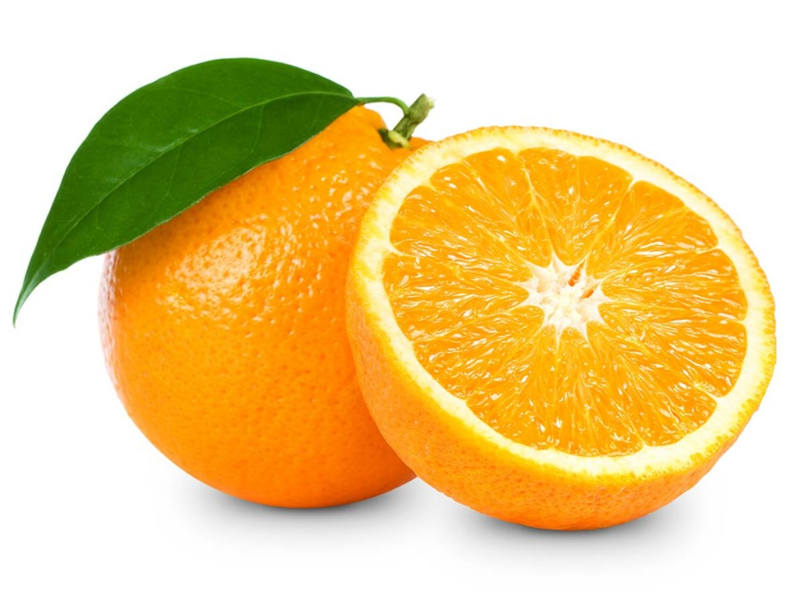
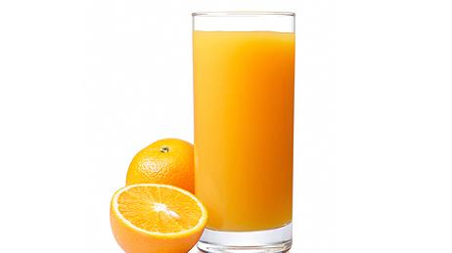
HP, TI, SO, BS and BG- Drag the red items into the box
Notes:
This slide is suitable for SO, TI, HP, BG and BS

Slide 4
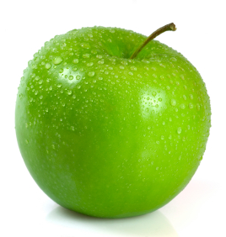
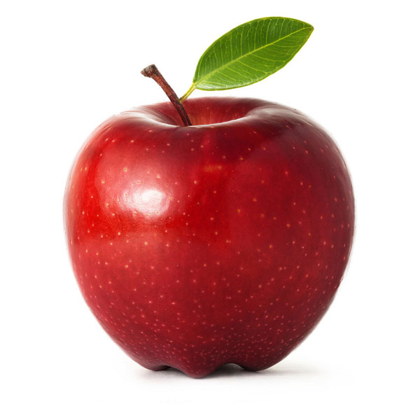
ML, AM and JM- Drag the red items into the box

Slide 5
Literacy Open up paint pad- time to do some mark making (use Orange paint) (Literacy) ML- write 'Tuesday' JM- overwrite 'Tuesday' All other pupils to freely mark make
Notes:
Languages, Literacy & Communication

