Slide 1
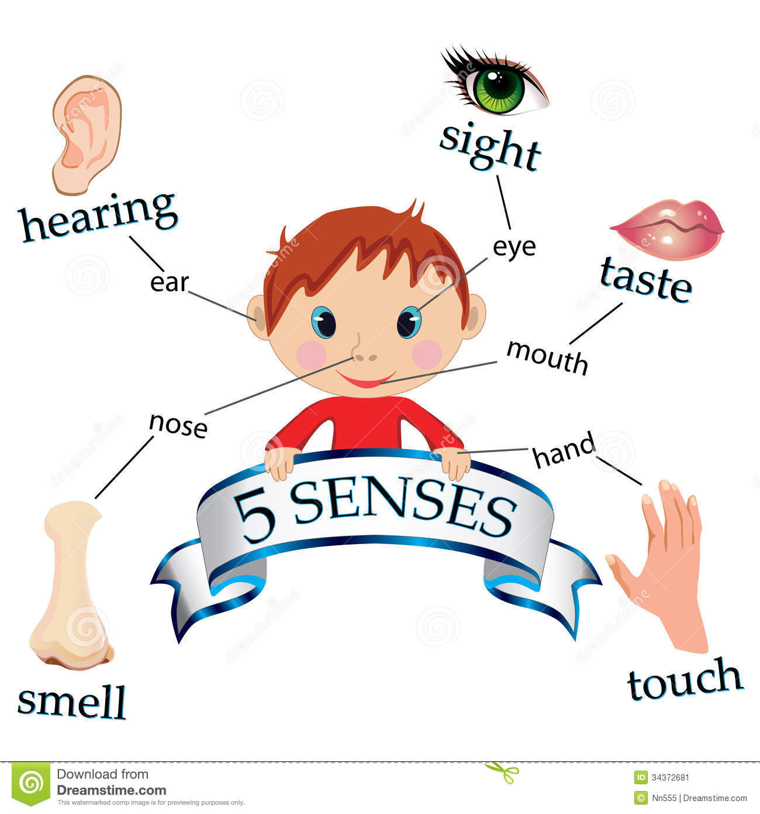
All About Me Sensology

Slide 2
Resources
Say hello: Mirror
Touch: Feathers and sponges
Smell: Vanilla and peppermint
Taste: strawberry jam and lemon
See: Brightly coloured materials
Sound: laughing and whistling

Slide 3

Say hello….
Encourage each child to look at themselves in the mirror. Begin by talking to them about the parts of the body they can see in the mirror (head, eyes, nose, ears etc) and then move on to point/tap to other parts of their body such as their arms, legs, hands, feet etc.
Sing the song ‘This is me’ – support each child to pat each part of their body
https://www.youtube.com/watch?v=QkHQ0CYwjaI

Slide 4
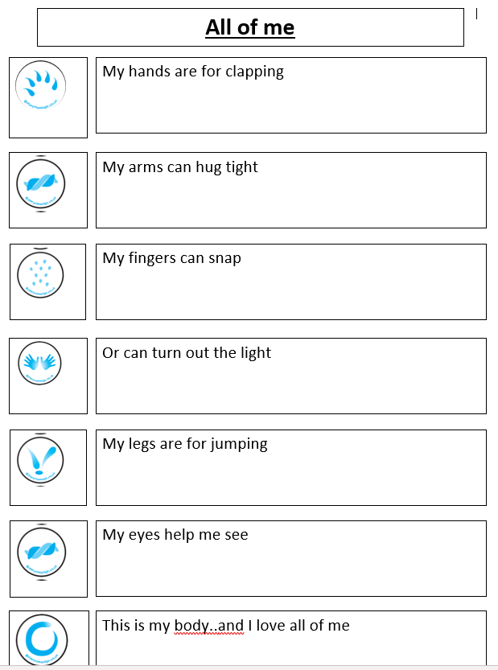
Story Massage:

Slide 5
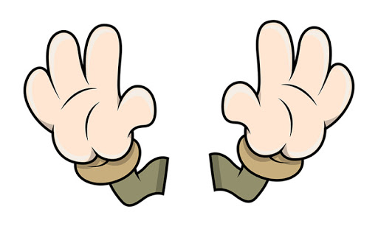
Touch
Briefly introduce that we use our bodies and our hands to touch. Encourage each child to explore the feel, one at a time, of the feathers and the sponges on their body.
Feel: Feathers and sponges

Slide 6
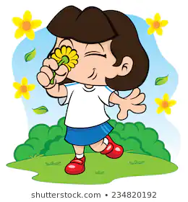
Smell
Introduce that we use our nose to smell, indicating to each child where their nose is (or asking them to show you themselves). Encourage each child to smell the vanilla and the peppermint. Always present the stronger of the scents last. Encourage each child to express likes or dislikes for the scents.
Smell: vanilla and peppermint

Slide 7
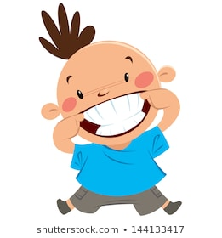
Taste - may not be applicable to all pupils. Pupils unable to taste can smell the resources or feel.
Introduce that we use our mouth to taste, indicating to each child where their mouth is (or asking them to show you themselves). Offer a taste of the strawberry jam and the lemon. Encourage each child to express their likes and dislikes towards the food.
Taste: strawberry jam and lemon

Slide 8

See
Introduce that we use our eyes to see, indicating to your child where their eyes are (or asking them to show you themselves). Show each child the brightly coloured materials and the flashing light balls.
See: bright materials, flashing light balls.

Slide 9
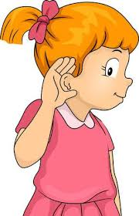
Hear
Introduce that we use our ears to hear, indicating to each child where their ears are (or asking them to show you themselves). Listen to the sound of laughter and whistling.
Laughing: https://www.youtube.com/watch?v=3TWpPrcl0WY
Whistling: https://www.youtube.com/watch?v=MJ2IKEFo0uo

Slide 10
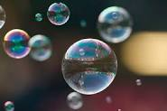
Relaxation
Relax with each child, listening to the music and giving them a massage. Blow bubbles or move parachute over the children’s heads.
https://www.youtube.com/watch?v=BiDzDzLFuHM

