Slide 1
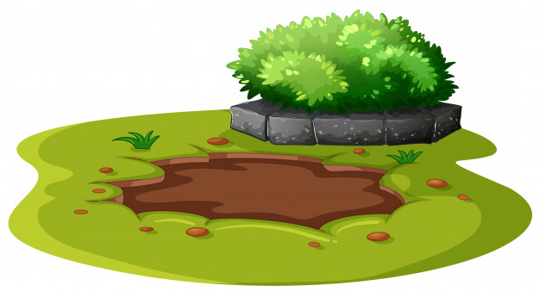
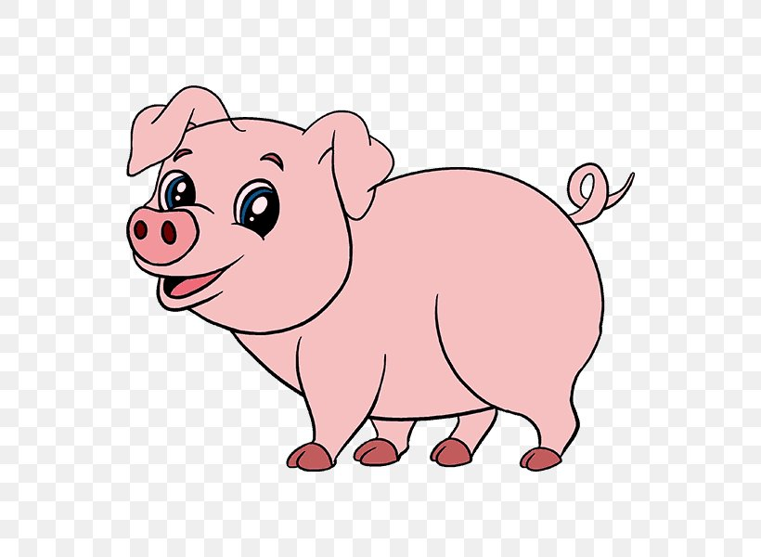
5 Little Pigs Song
To the tune of ‘10 green bottles’

Slide 2
5

Slide 3
5 little pigs rolling in the mud,
5 little pigs rolling in the mud, but if one little pig decides to have a nap,
There’ll be how many pigs rolling in the mud?

Slide 4
4

Slide 5
4 little pigs rolling in the mud,
4 little pigs rolling in the mud, but if one little pig decides to have a nap,
There’ll be how many pigs rolling in the mud?

Slide 6
3

Slide 7
3 little pigs rolling in the mud,
3 little pigs rolling in the mud, but if one little pig decides to have a nap,
There’ll be how many pigs rolling in the mud?

Slide 8
2

Slide 9
2 little pigs rolling in the mud,
2 little pigs rolling in the mud, but if one little pig decides to have a nap,
There’ll be how many pigs rolling in the mud?

Slide 10
1

Slide 11
1 little pig rolling in the mud,
1 little pig rolling in the mud, and 1 little pig started to feel tired, so 1 little pig went home to it’s sty.

