Slide 1
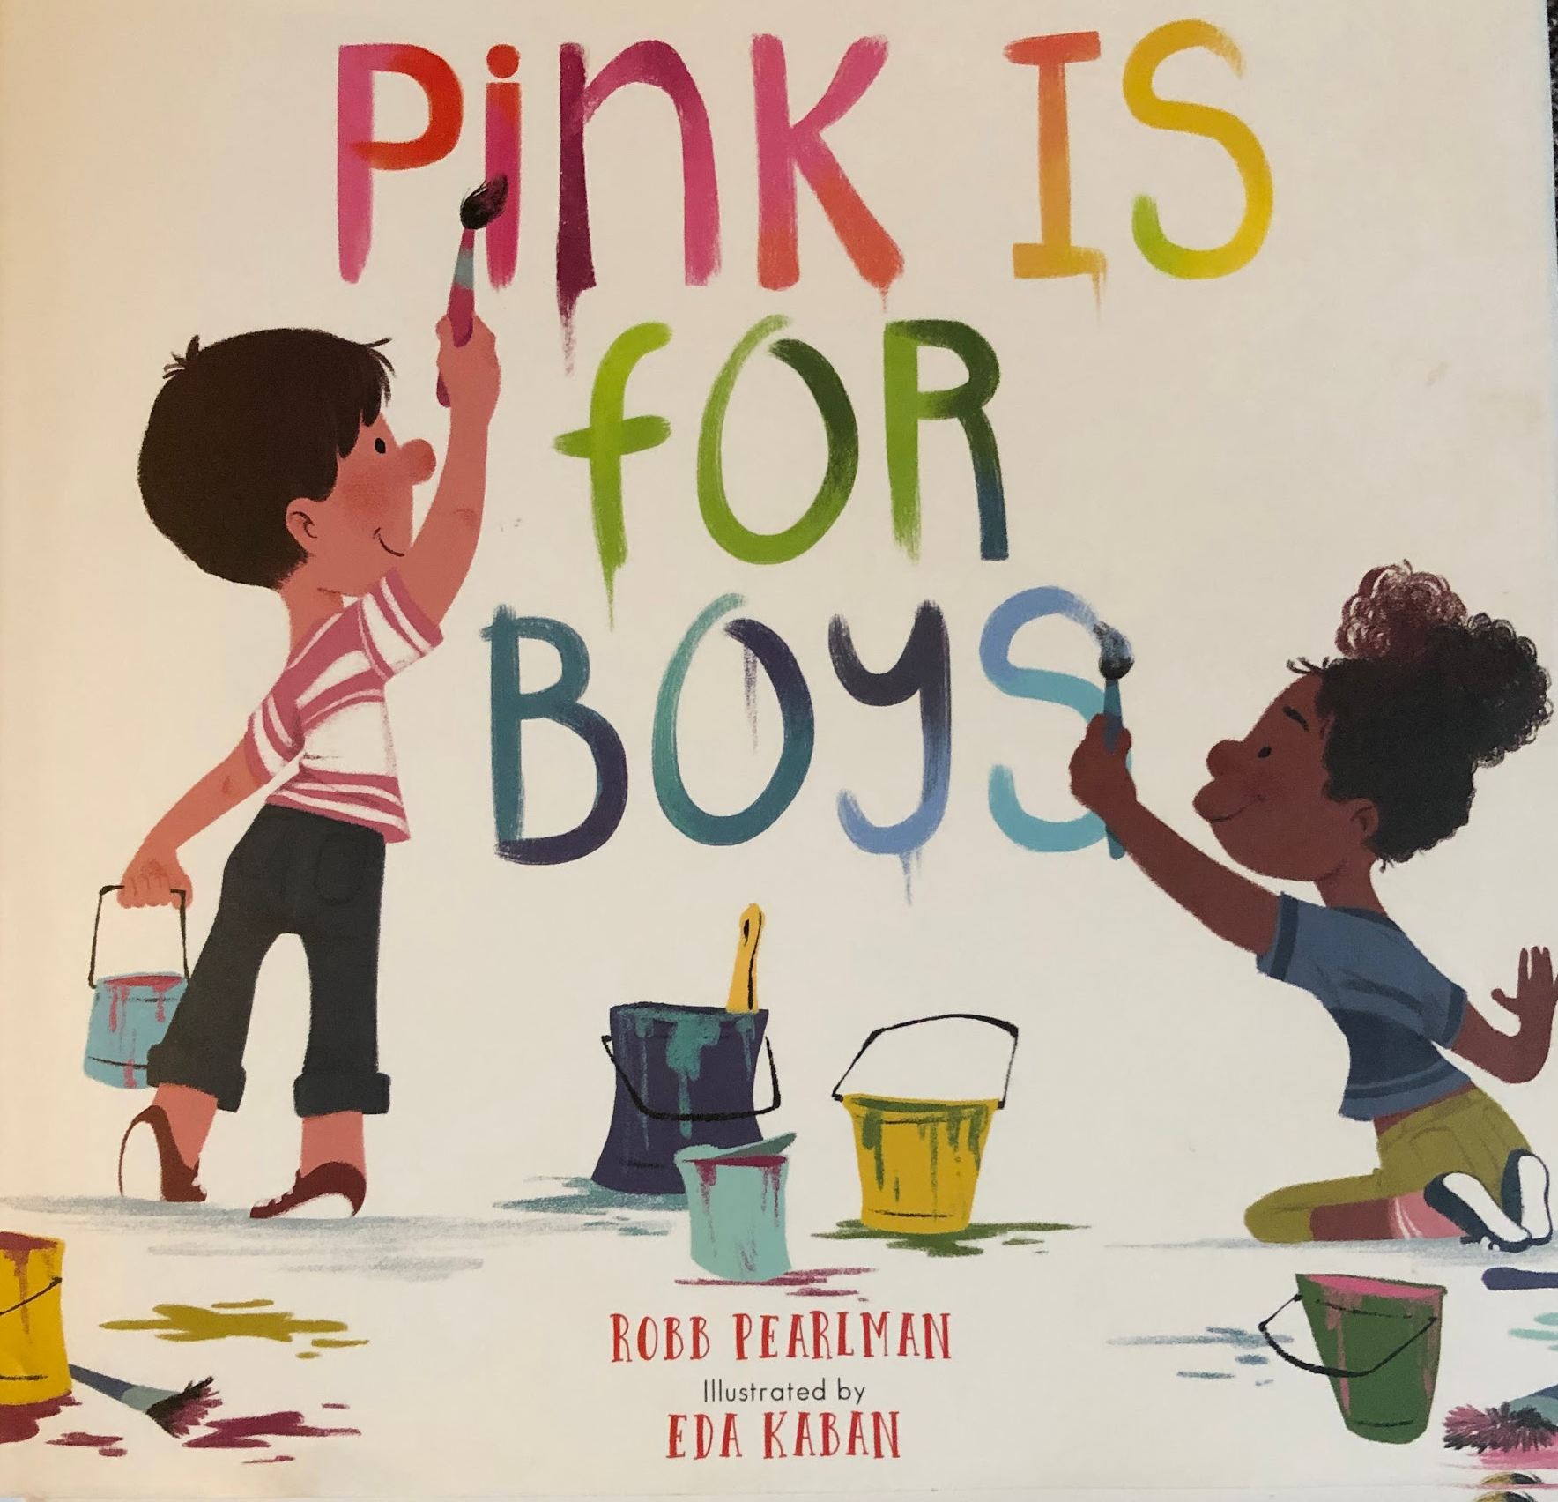

Slide 2
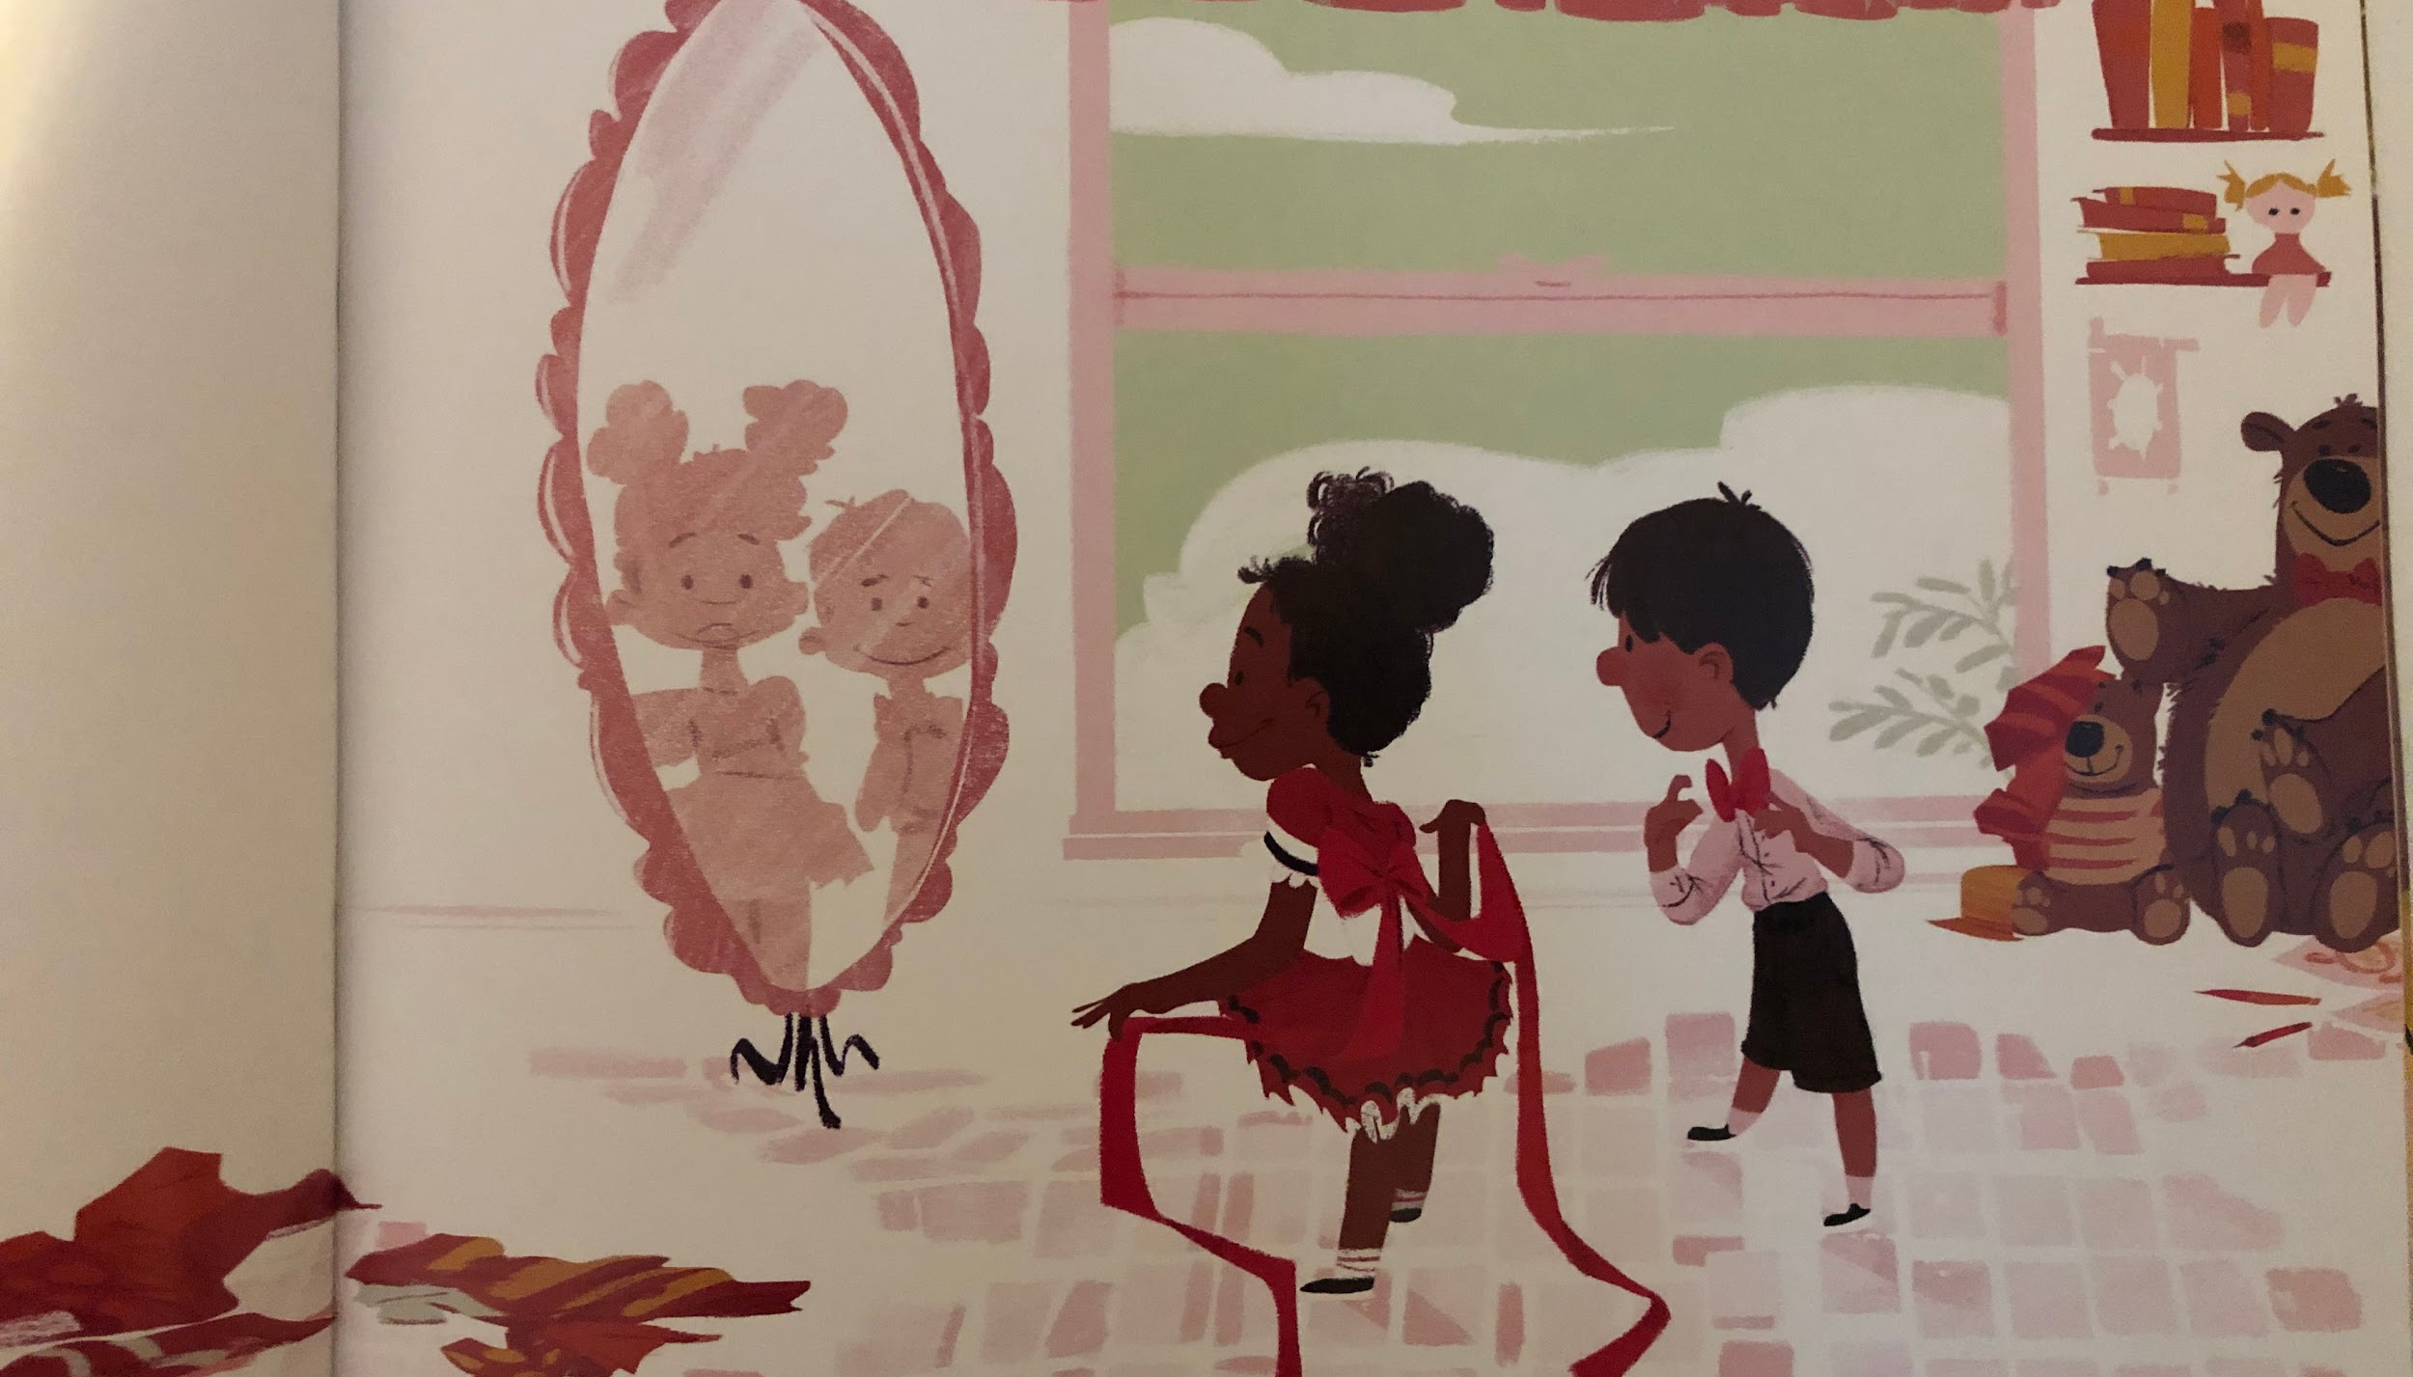
Pink is for boys. And girls.

Slide 3
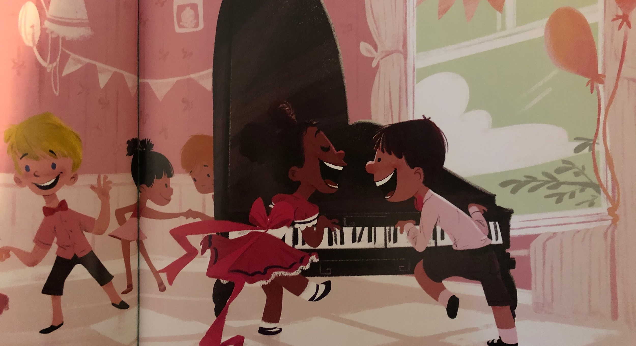
And bows on fancy clothes.

Slide 4
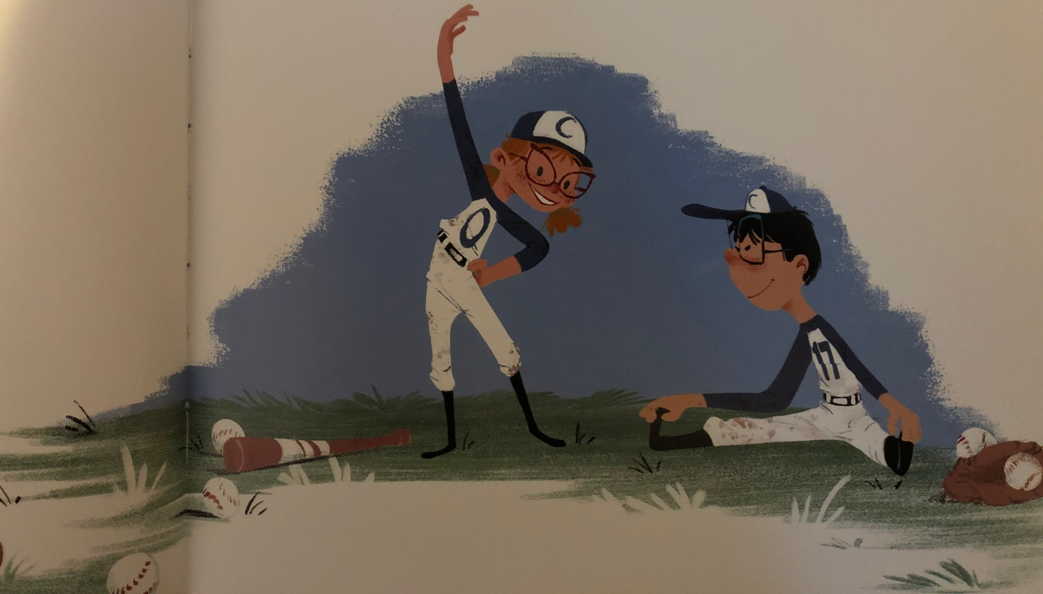
Blue is for girls. And boys..

Slide 5
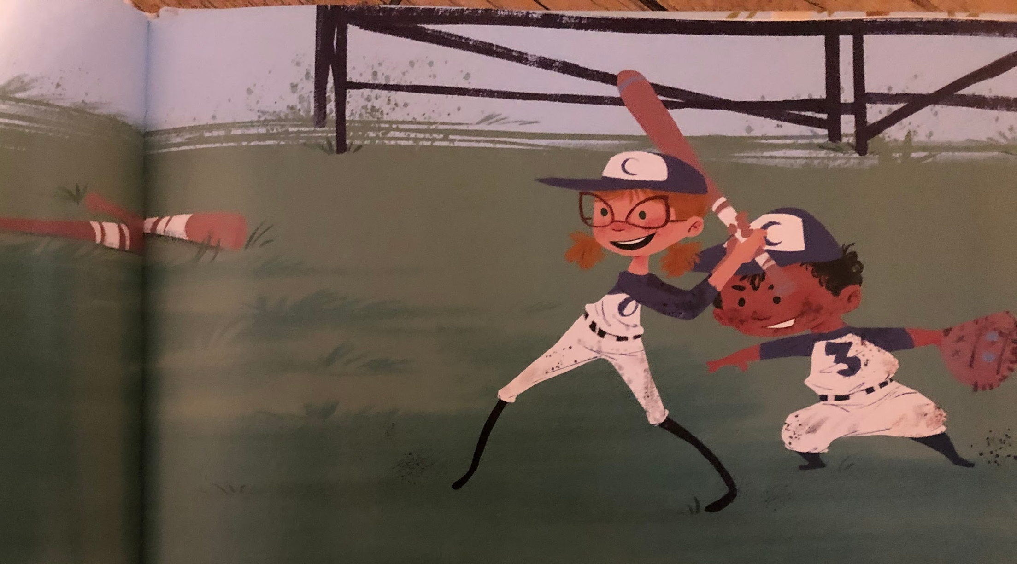
And uniforms on a team.

Slide 6
Yellow is for boys. And girls.

Slide 7
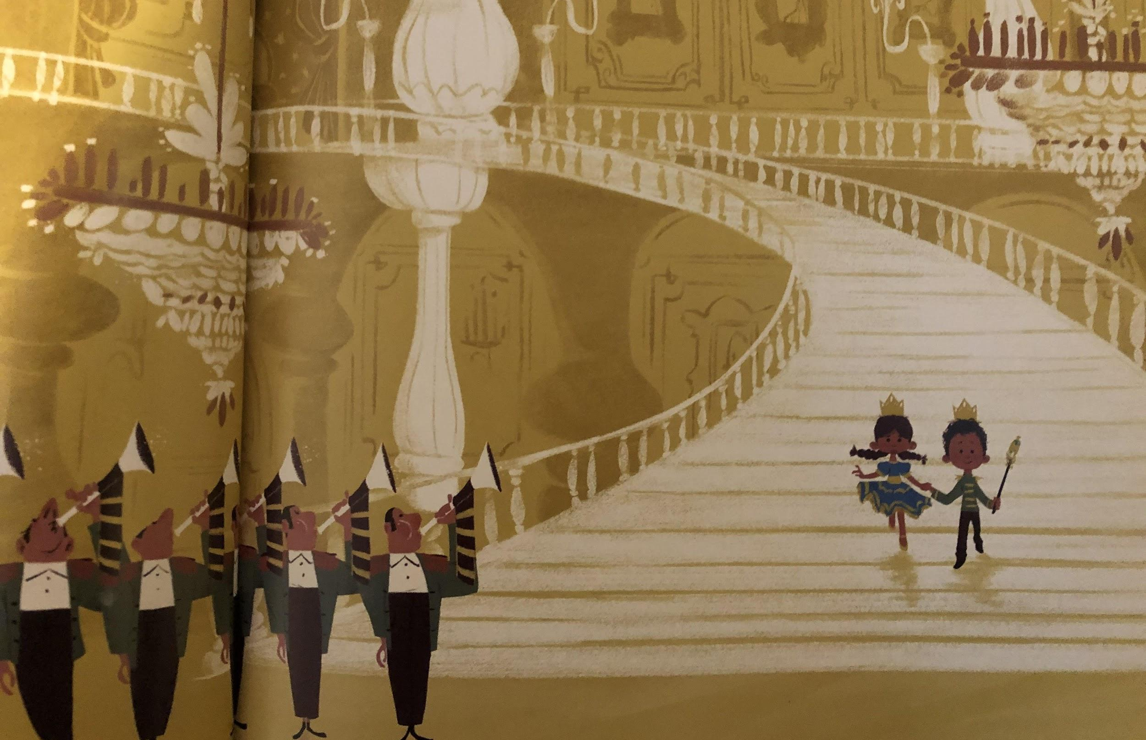
And a crown to wear.

Slide 8
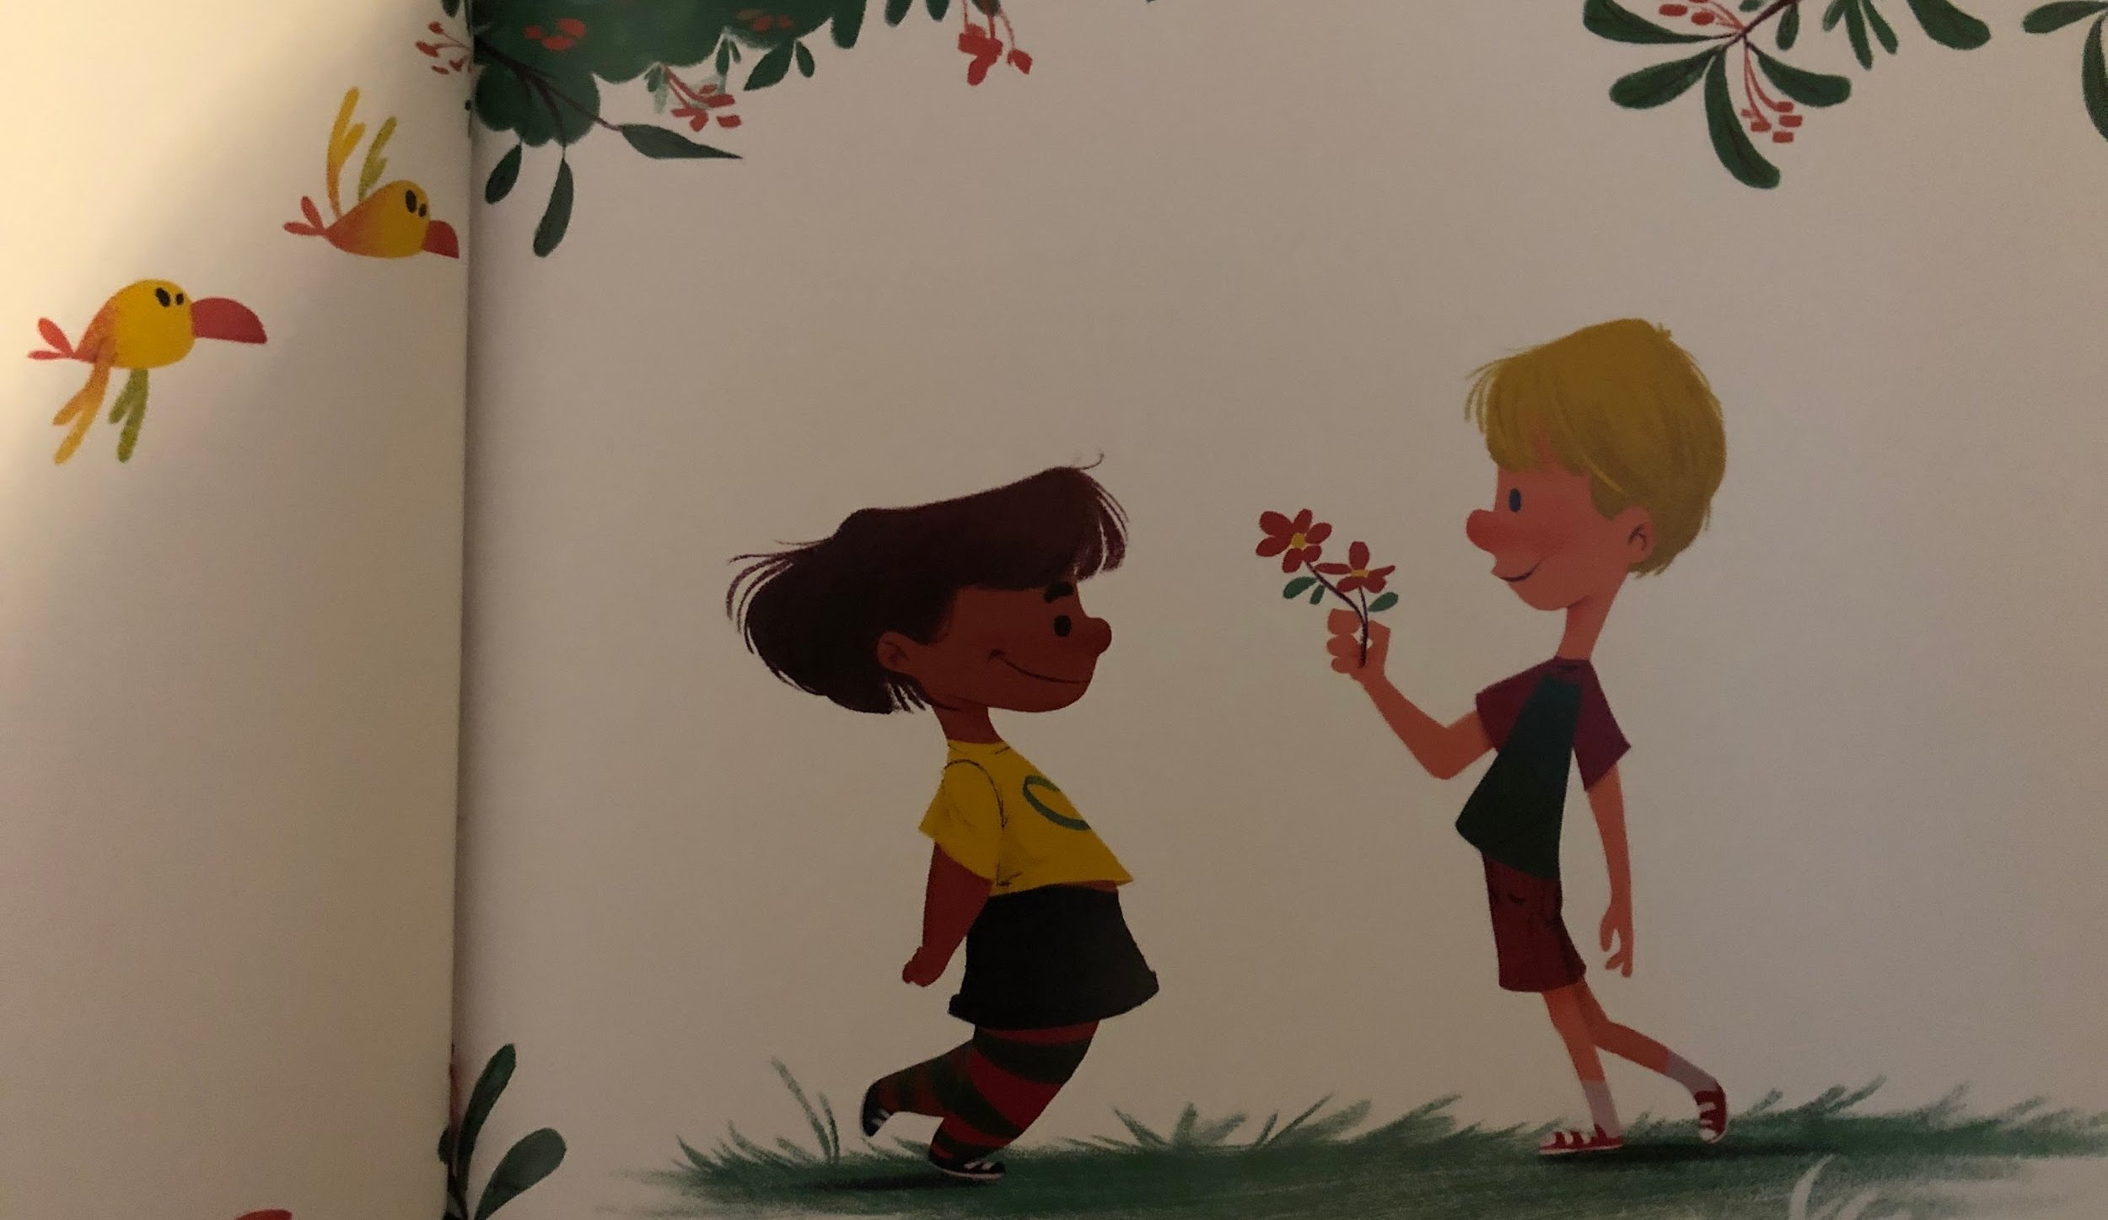
Green is for girls. And boys.

Slide 9
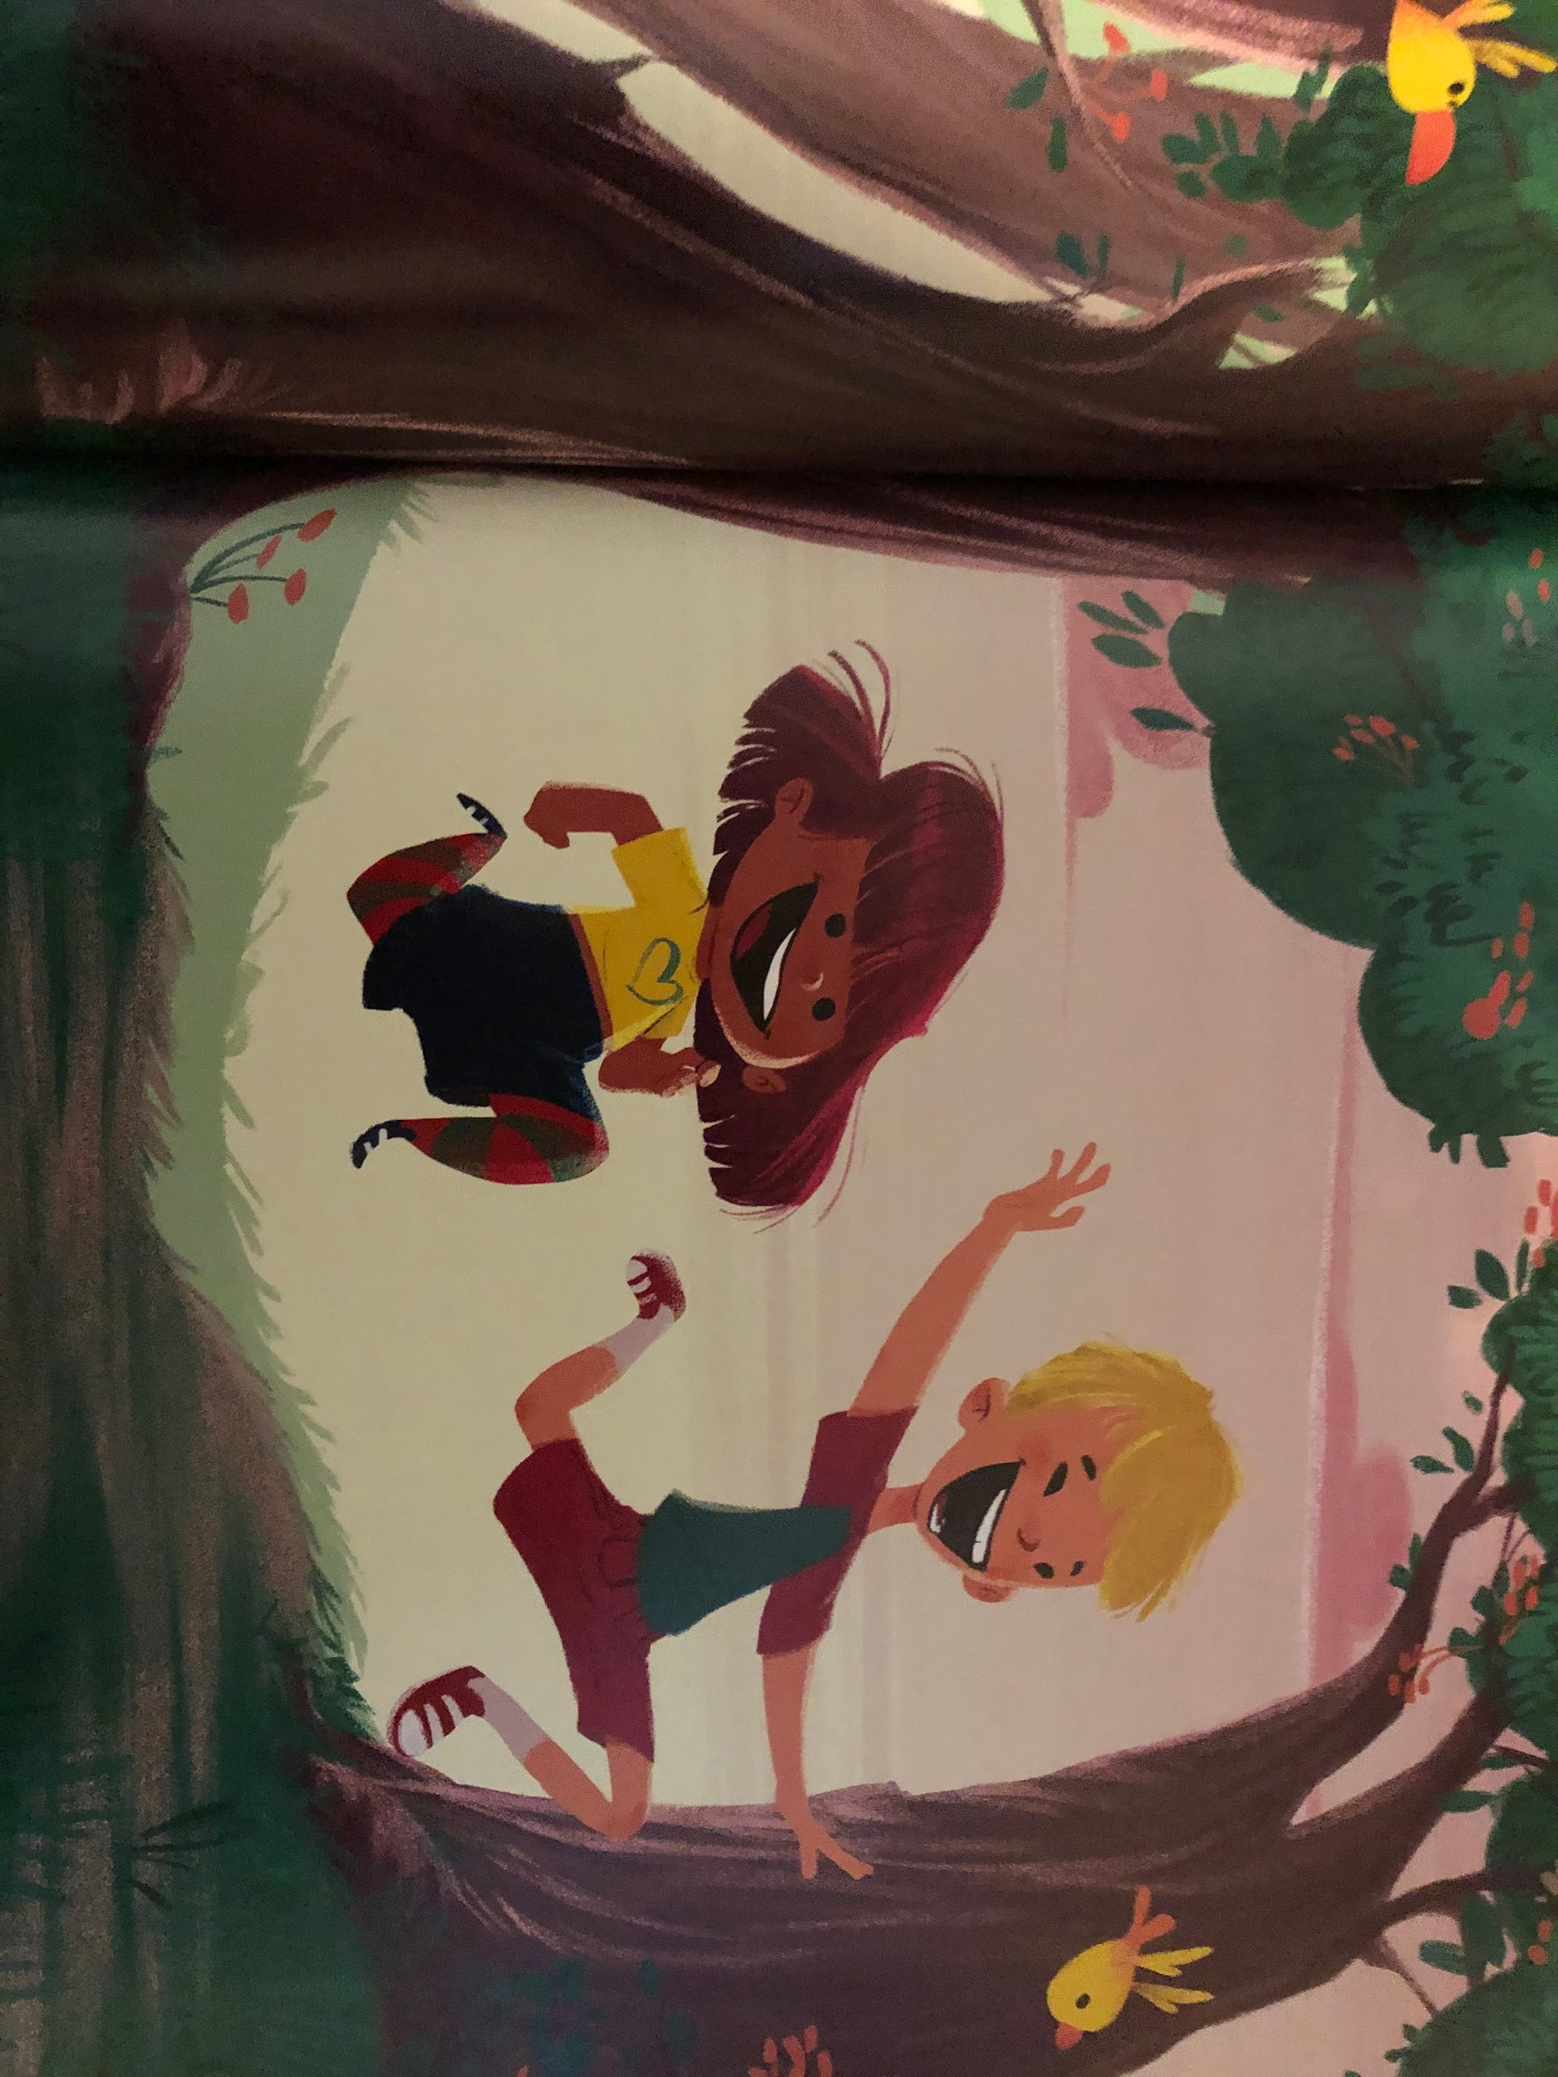
And grass to run on.

Slide 10
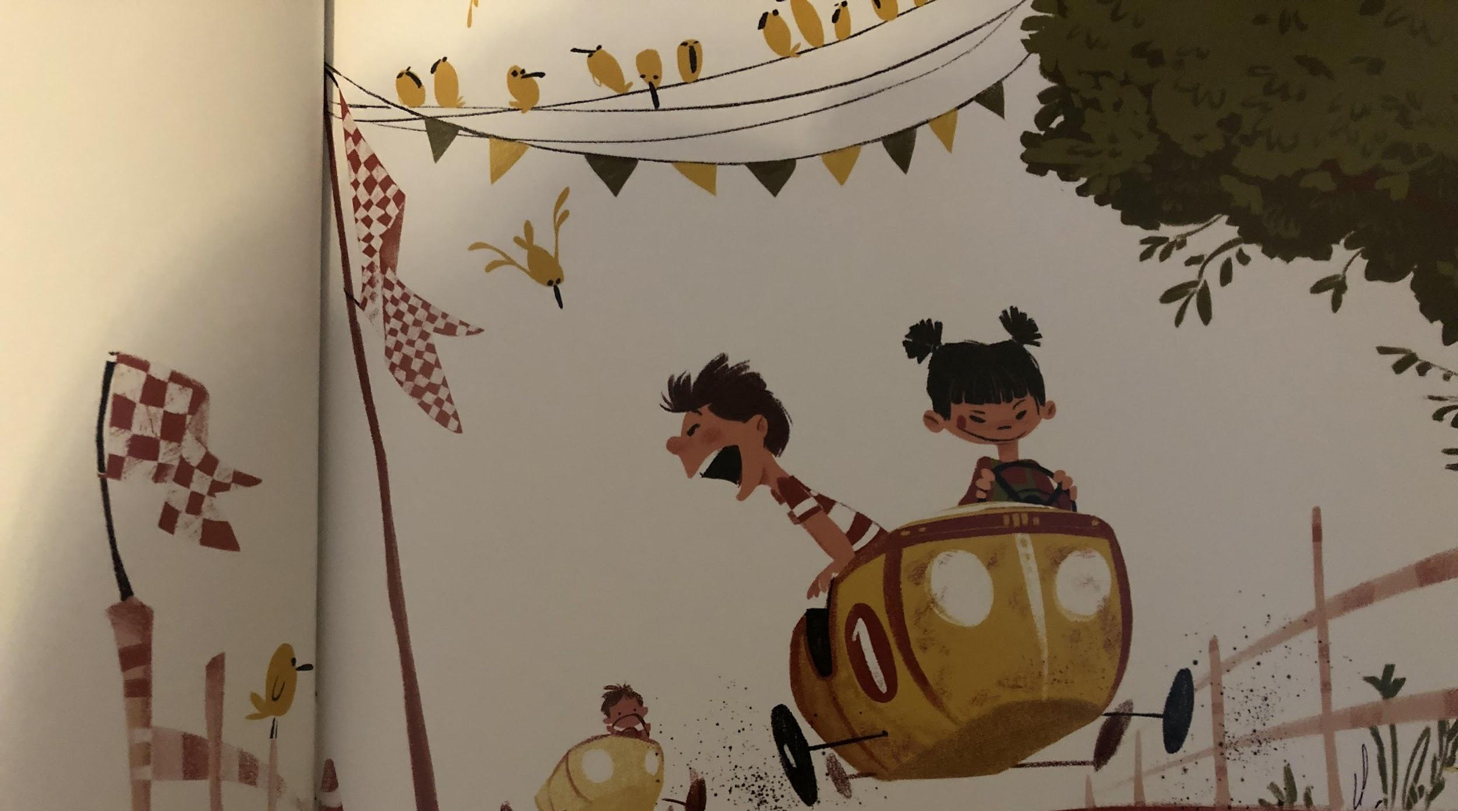
Red is for boys. And girls.

Slide 11
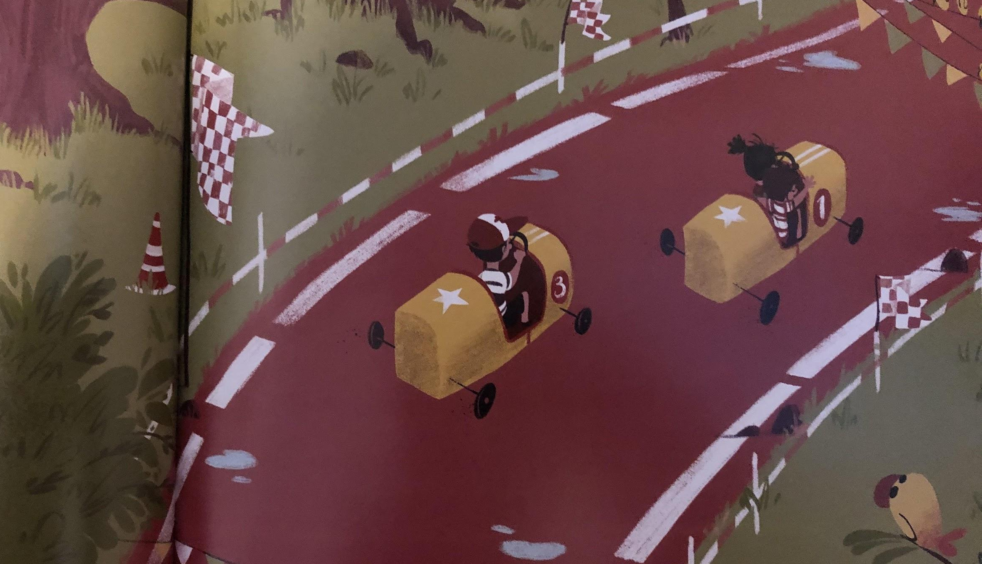
And cars racing along the track.

Slide 12
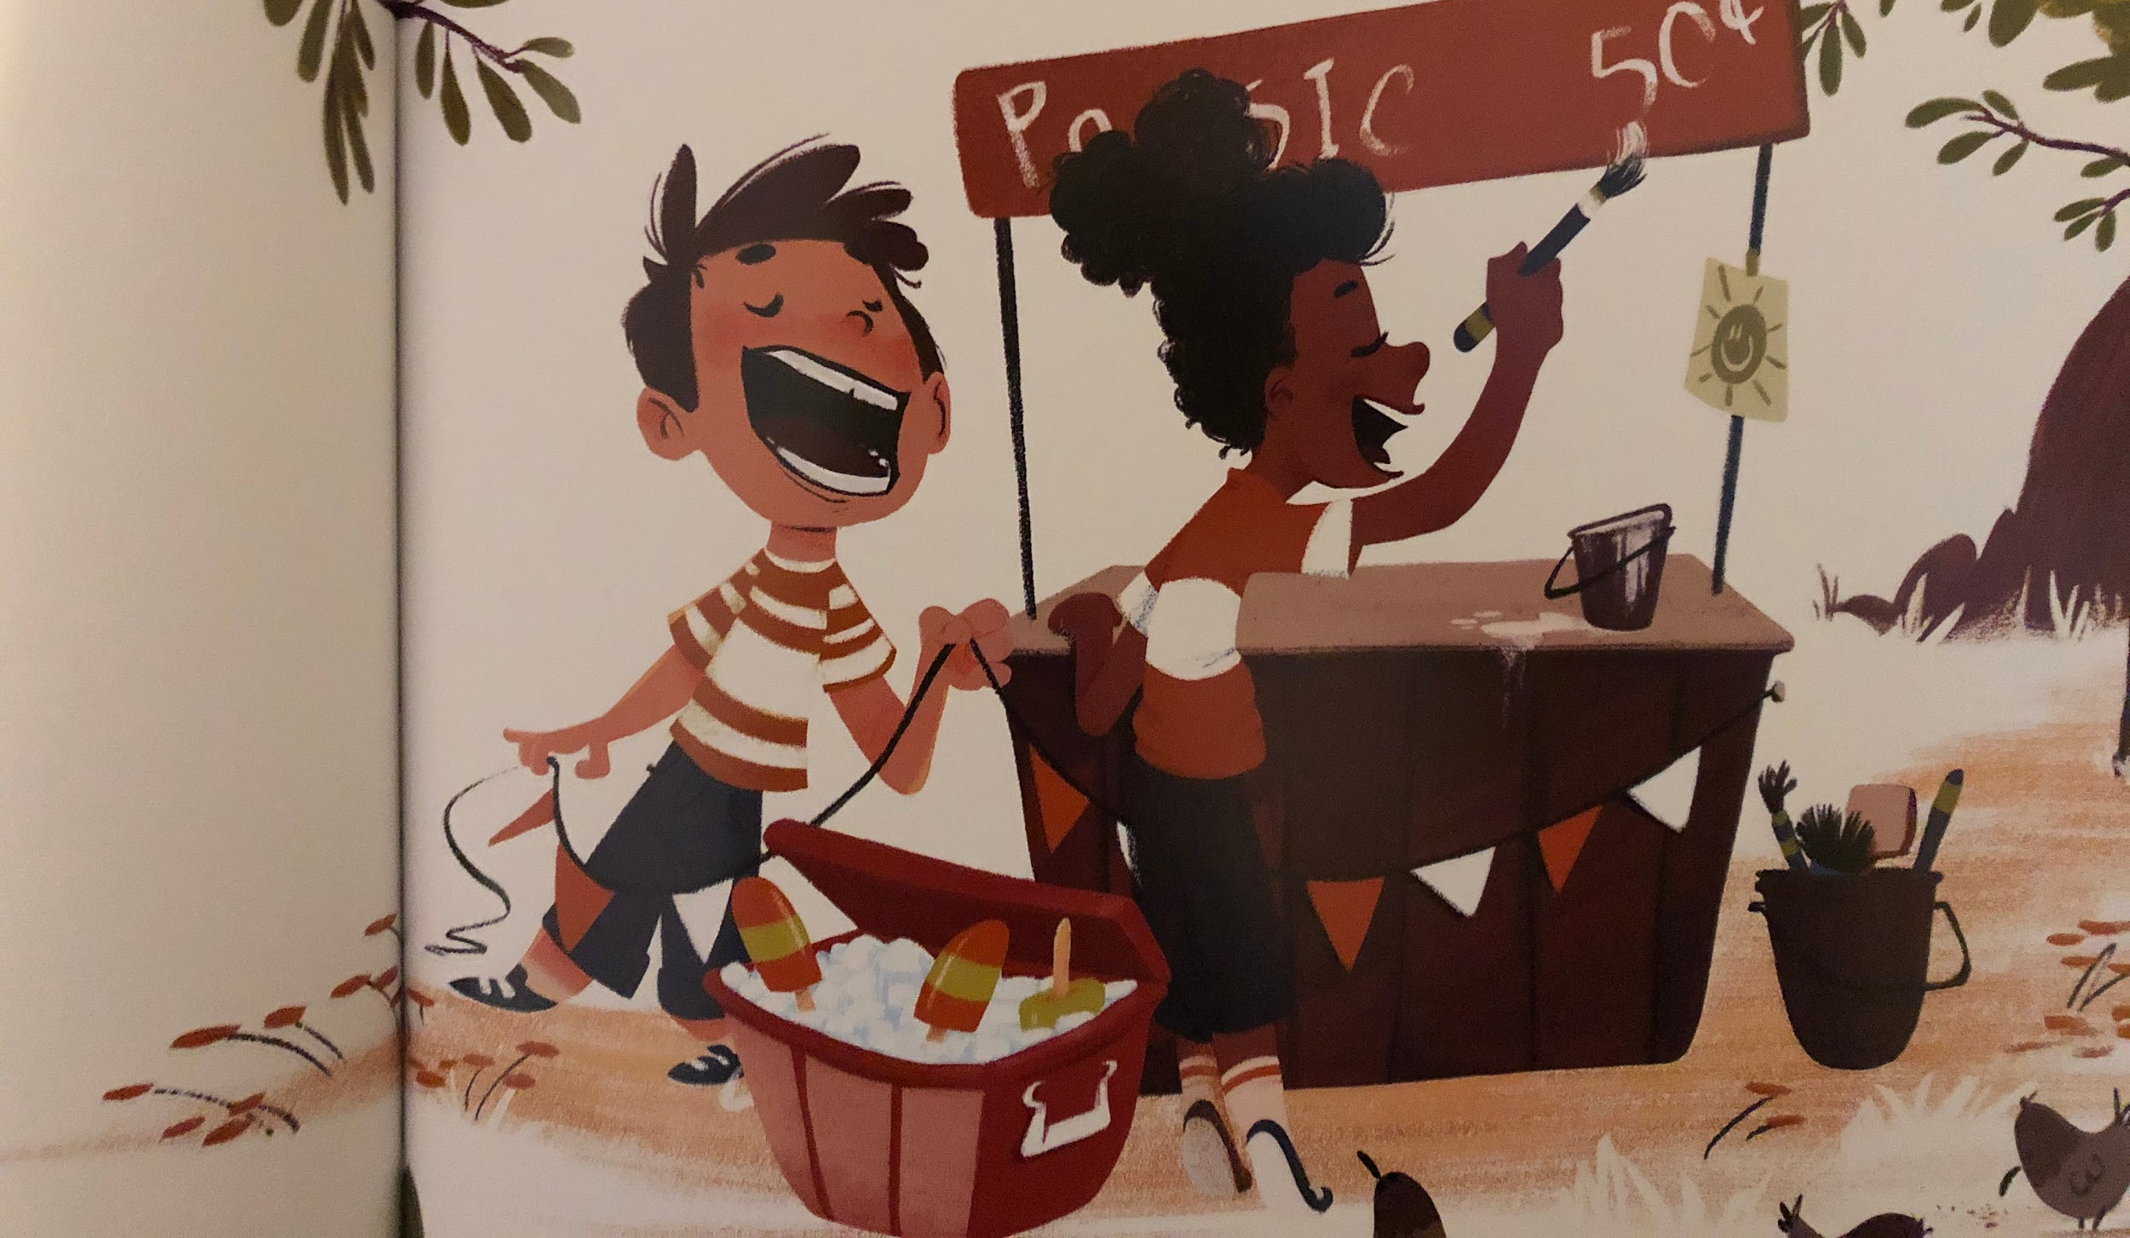
Orange is for girls. And boys..

Slide 13
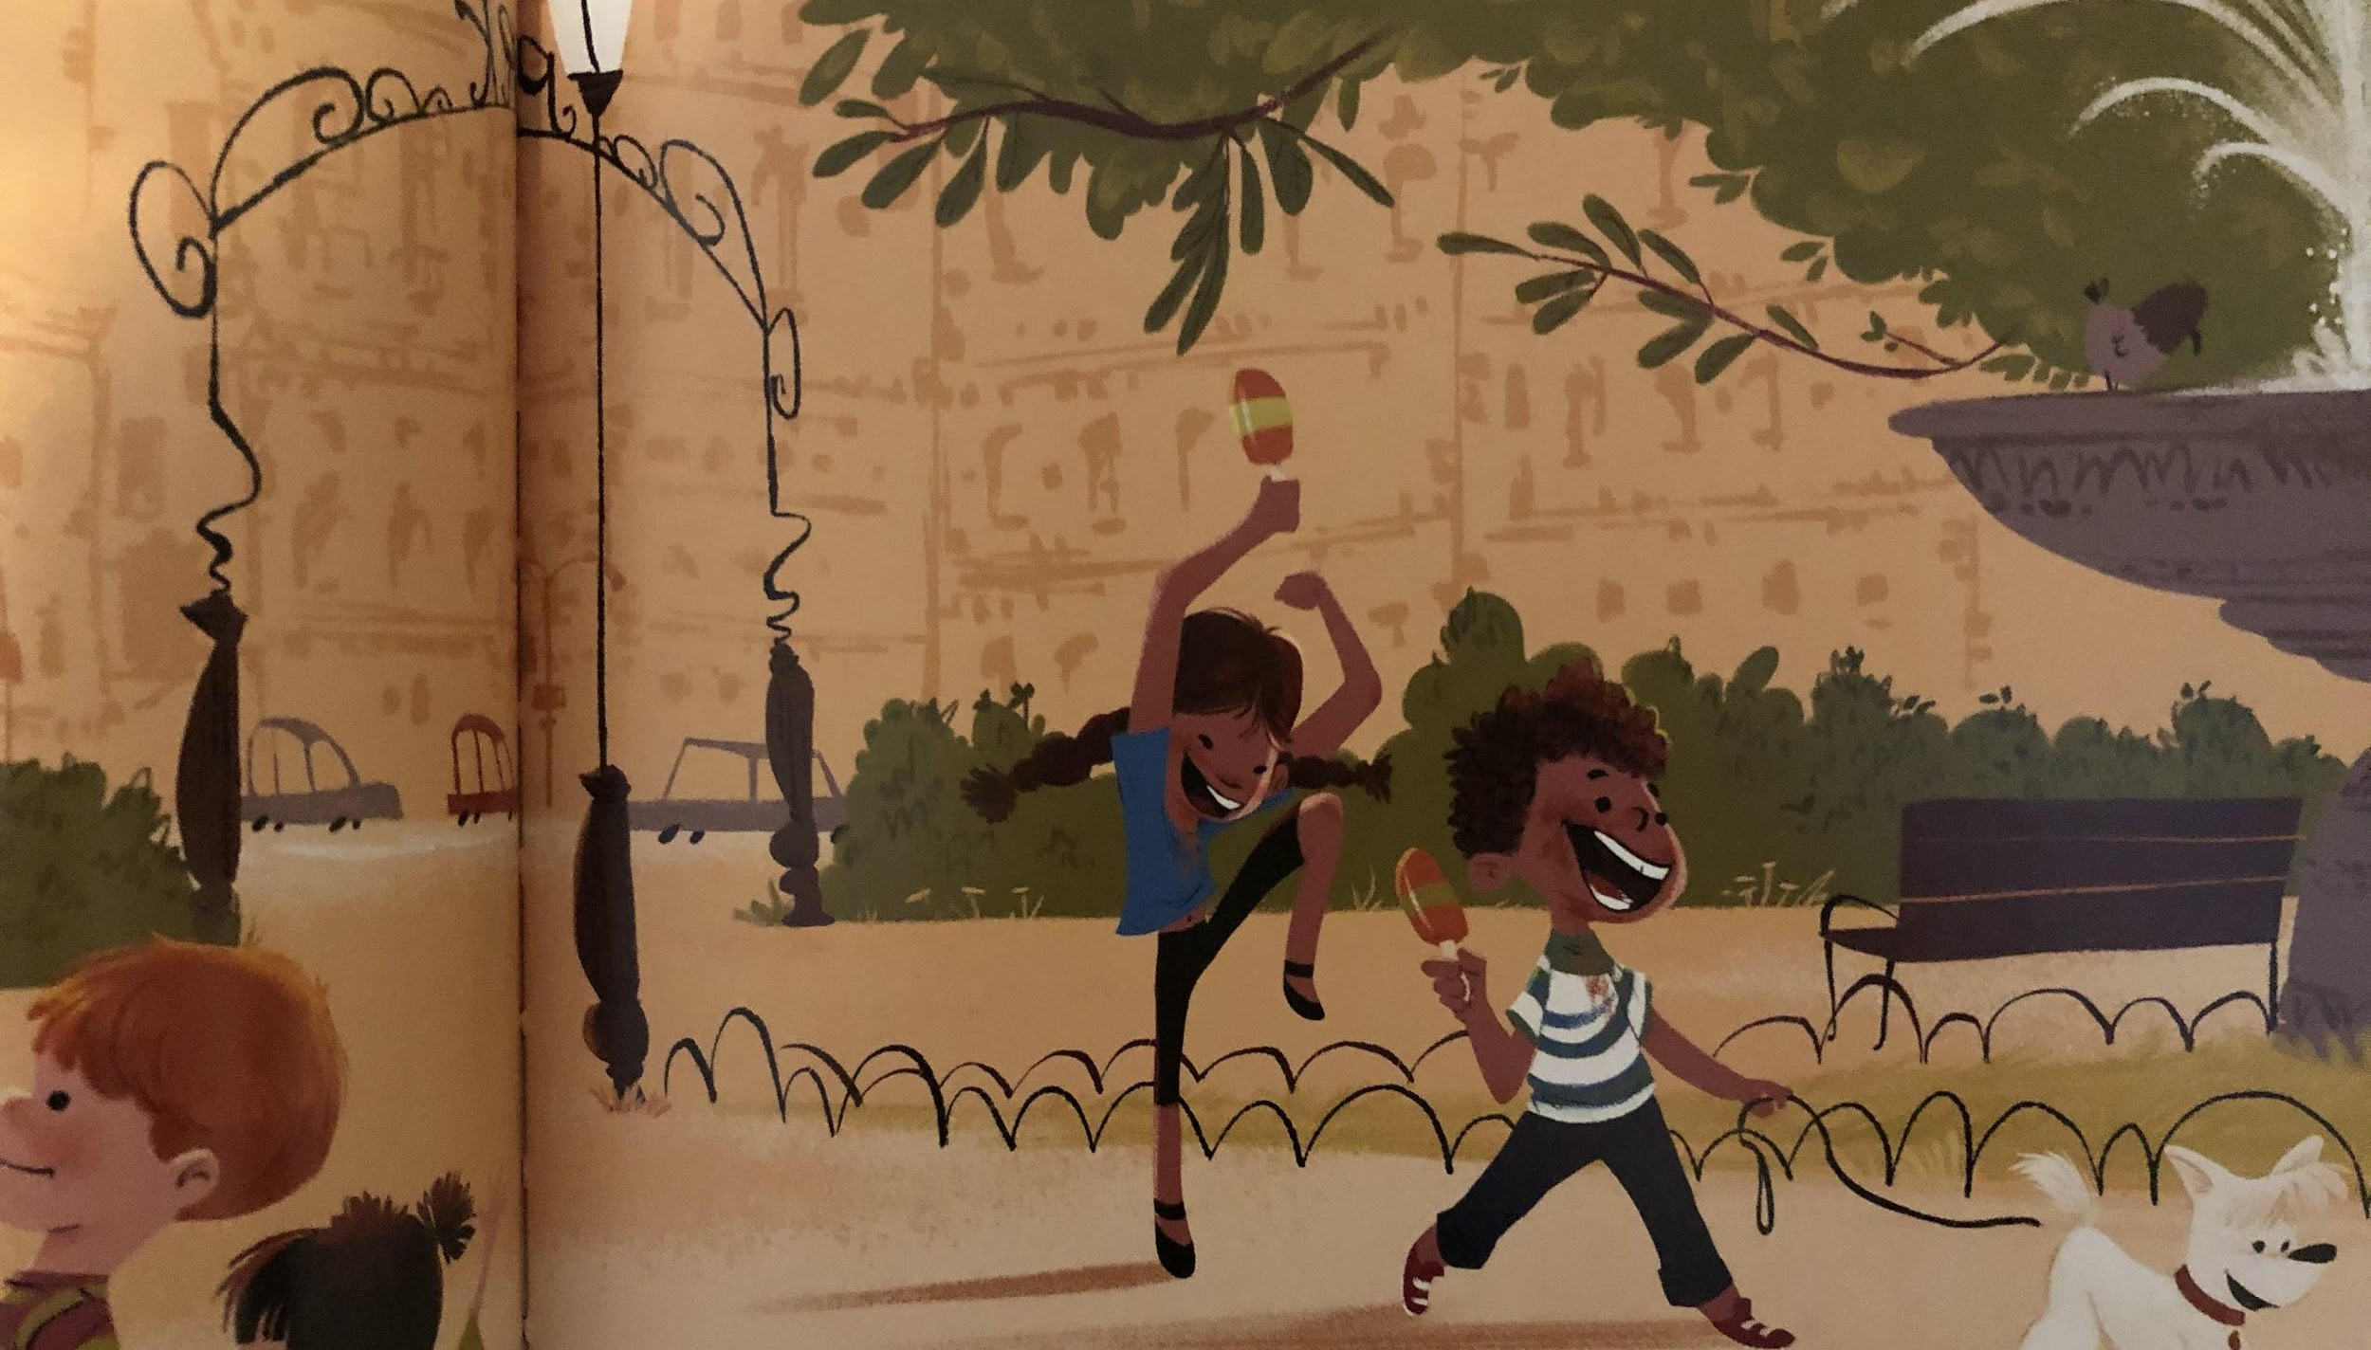
And lollies dribbling down sticky chins.

Slide 14
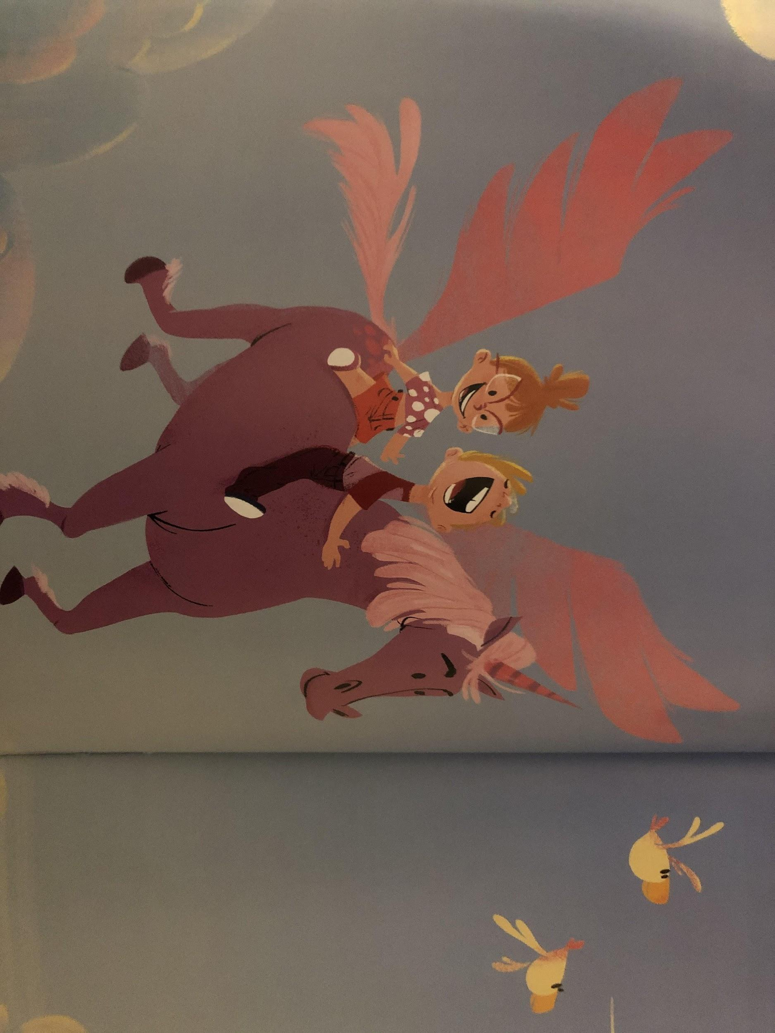
Purple is for boys. And girls.. And unicorns!

Slide 15
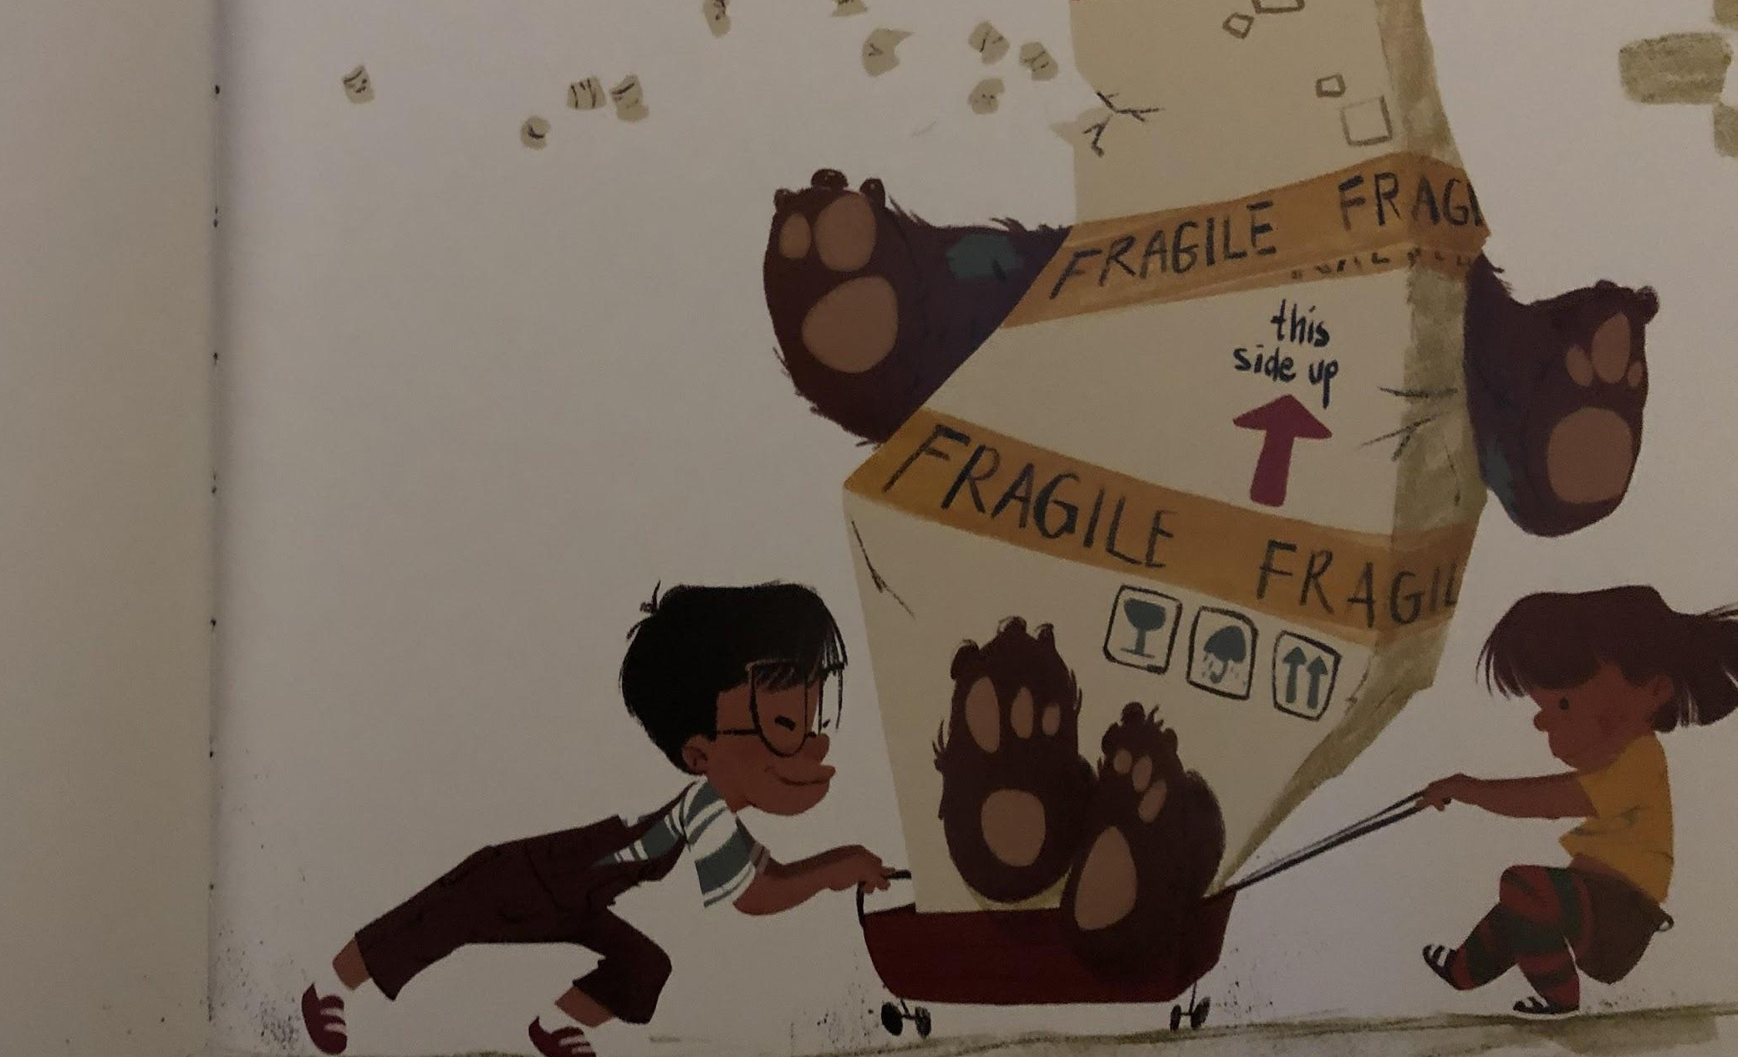
Brown is for girls. And boys.

Slide 16
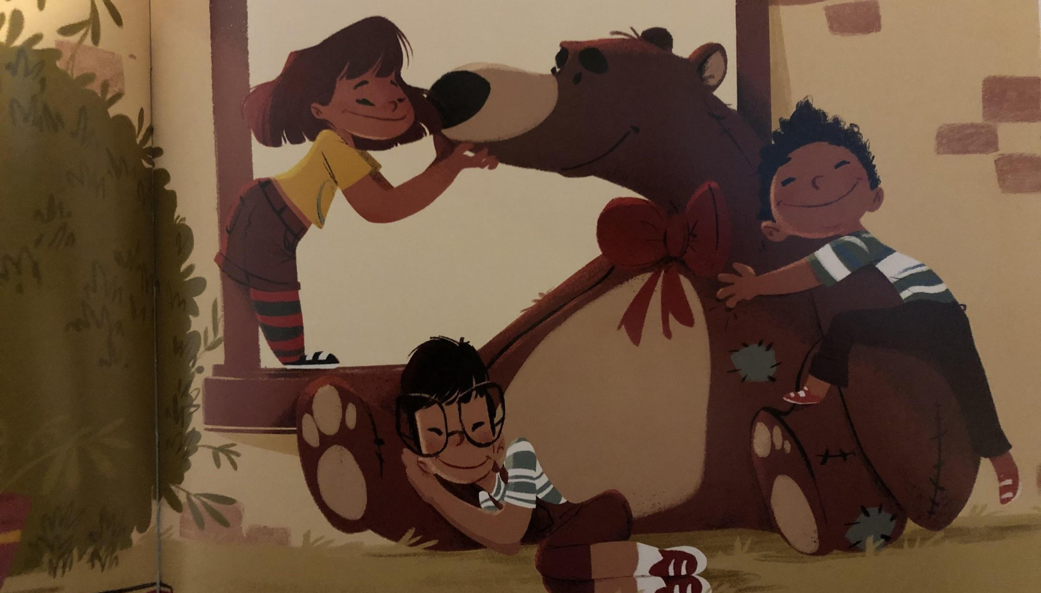
And teddy bears to cuddle.

Slide 17
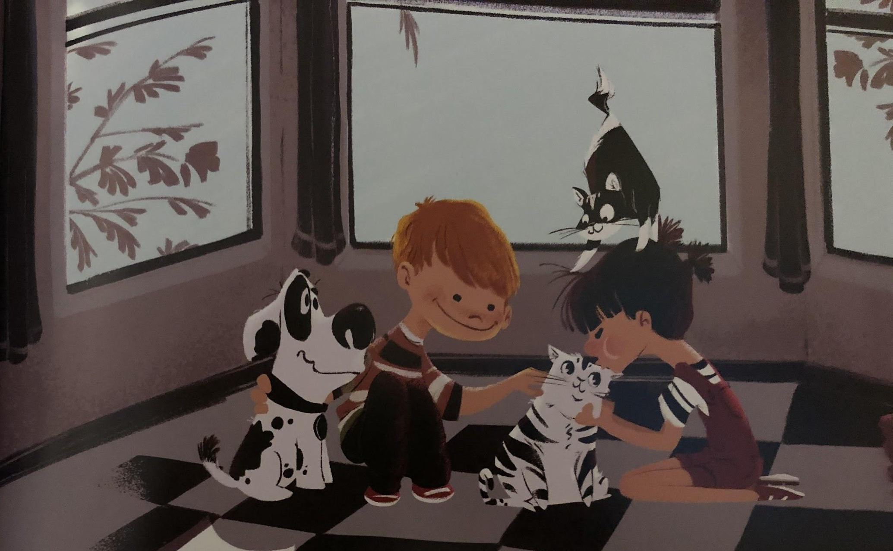
Black and white are for boys and girls. And puppies and kittens to pet.

Slide 18
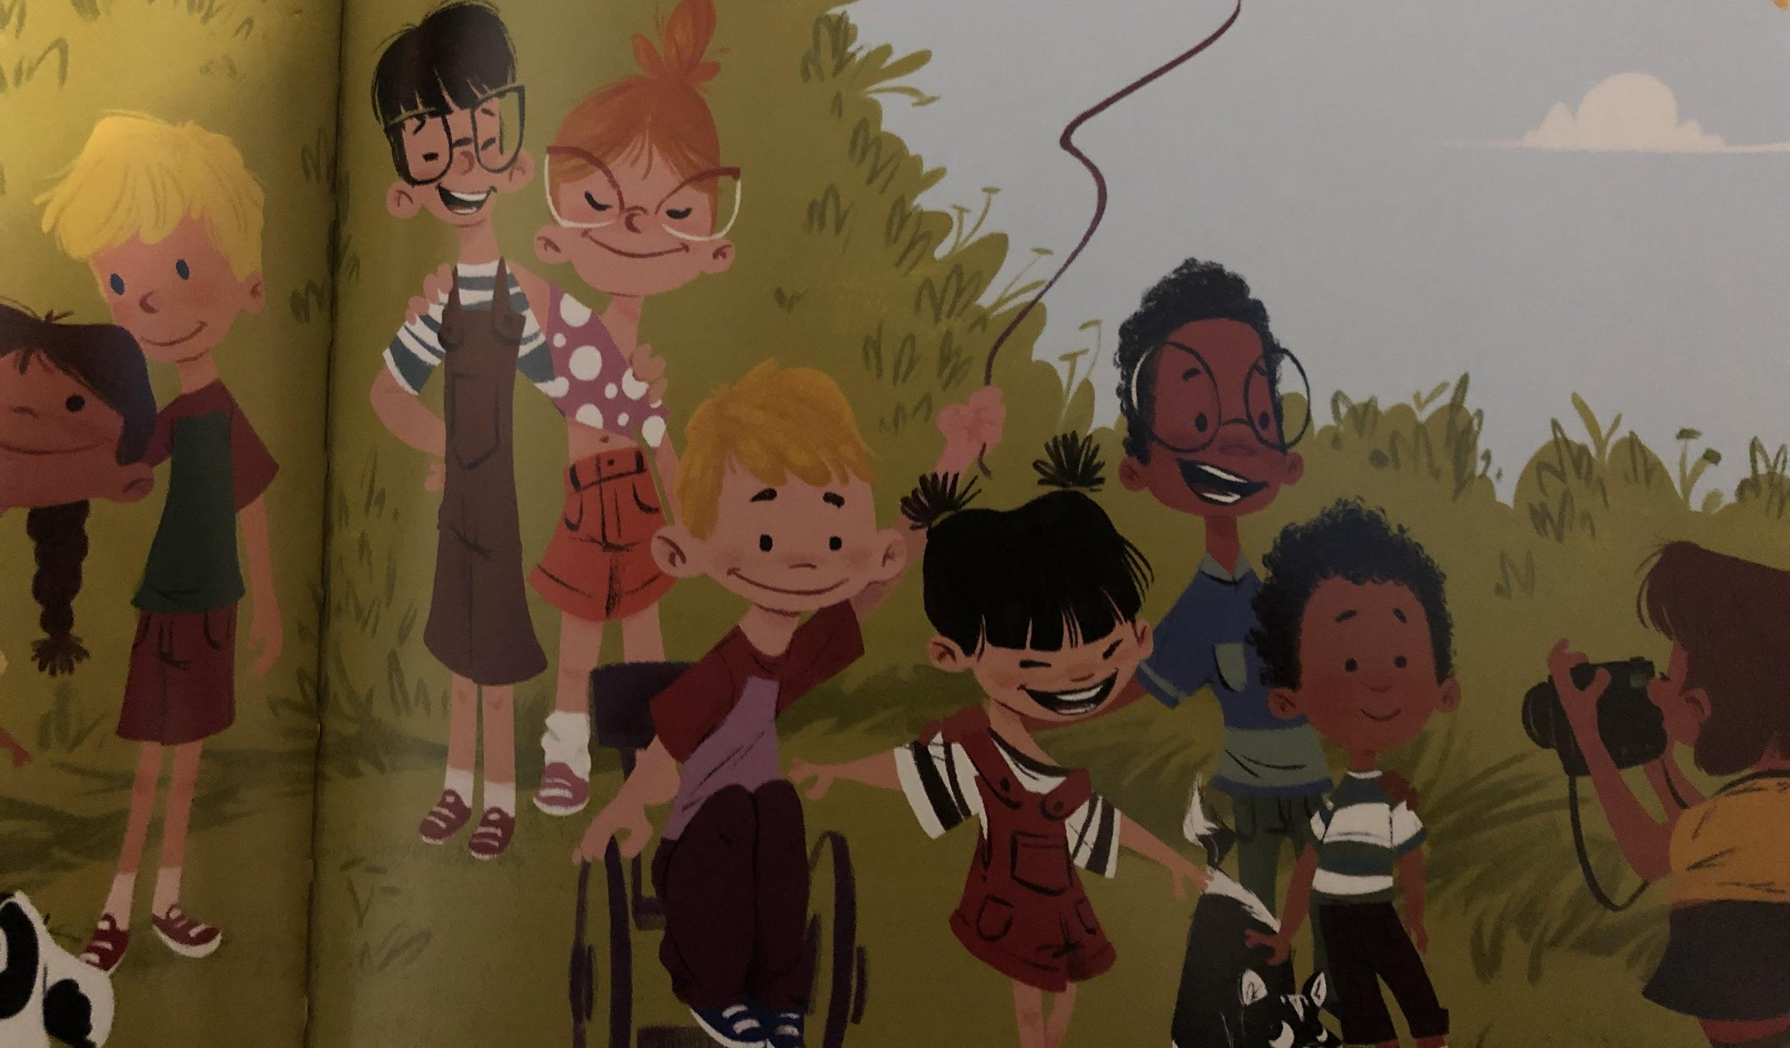
All the colours are for EVERYONE! Girls and boys.
And flowers. And butterflies. And rainbows in the sky.

