Slide 1
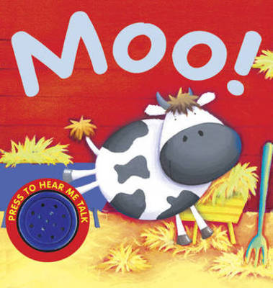

Slide 2
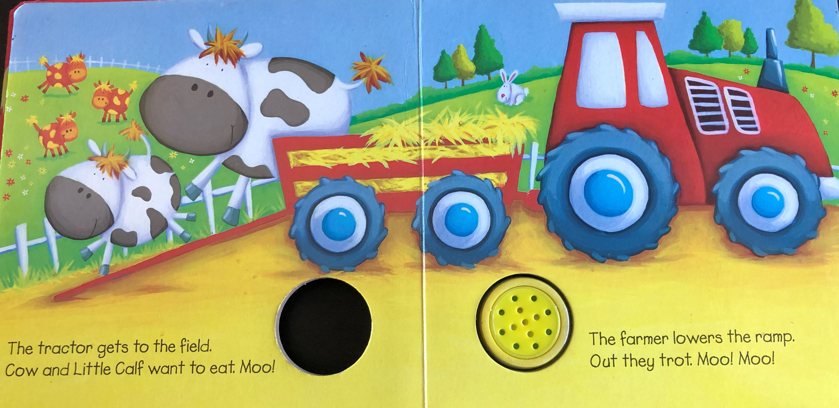
Resource: Cow toy, tractor and grass

Slide 3
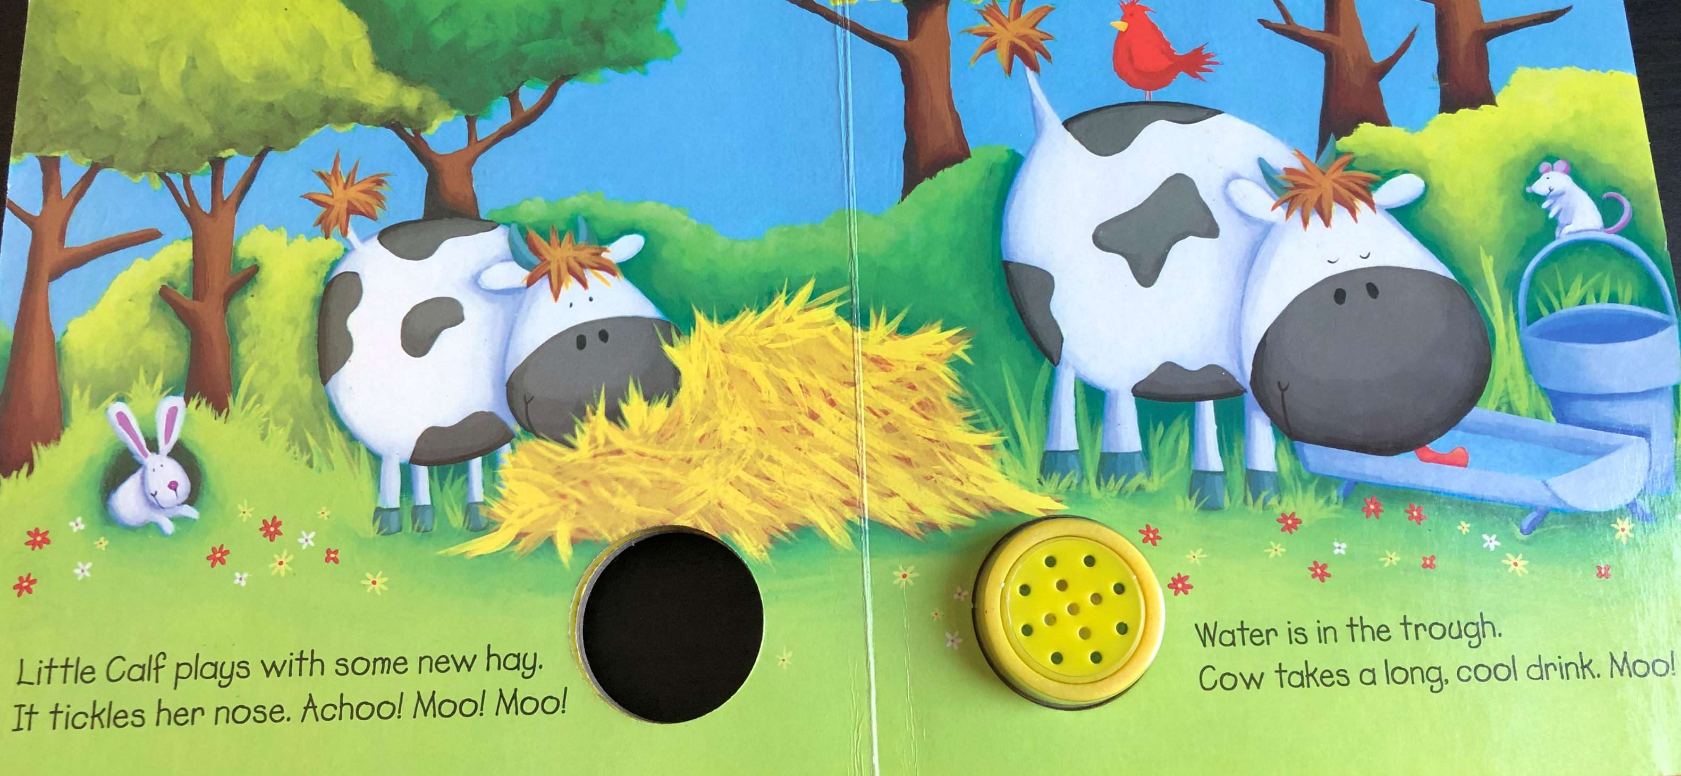
Resource: hay/straw, sneezing sound. Water in a bowl.

Slide 4
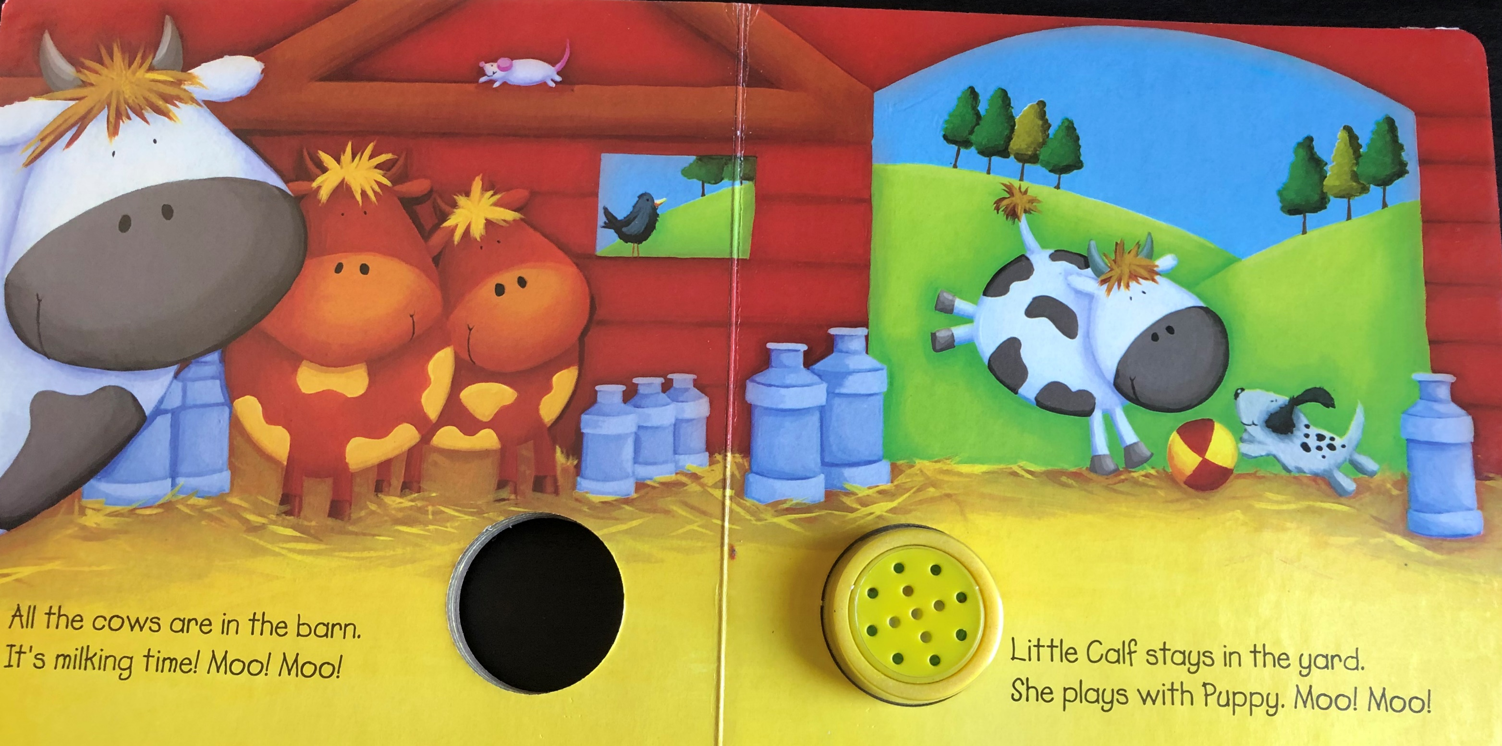
Resource: Milk to feel / smell

Slide 5
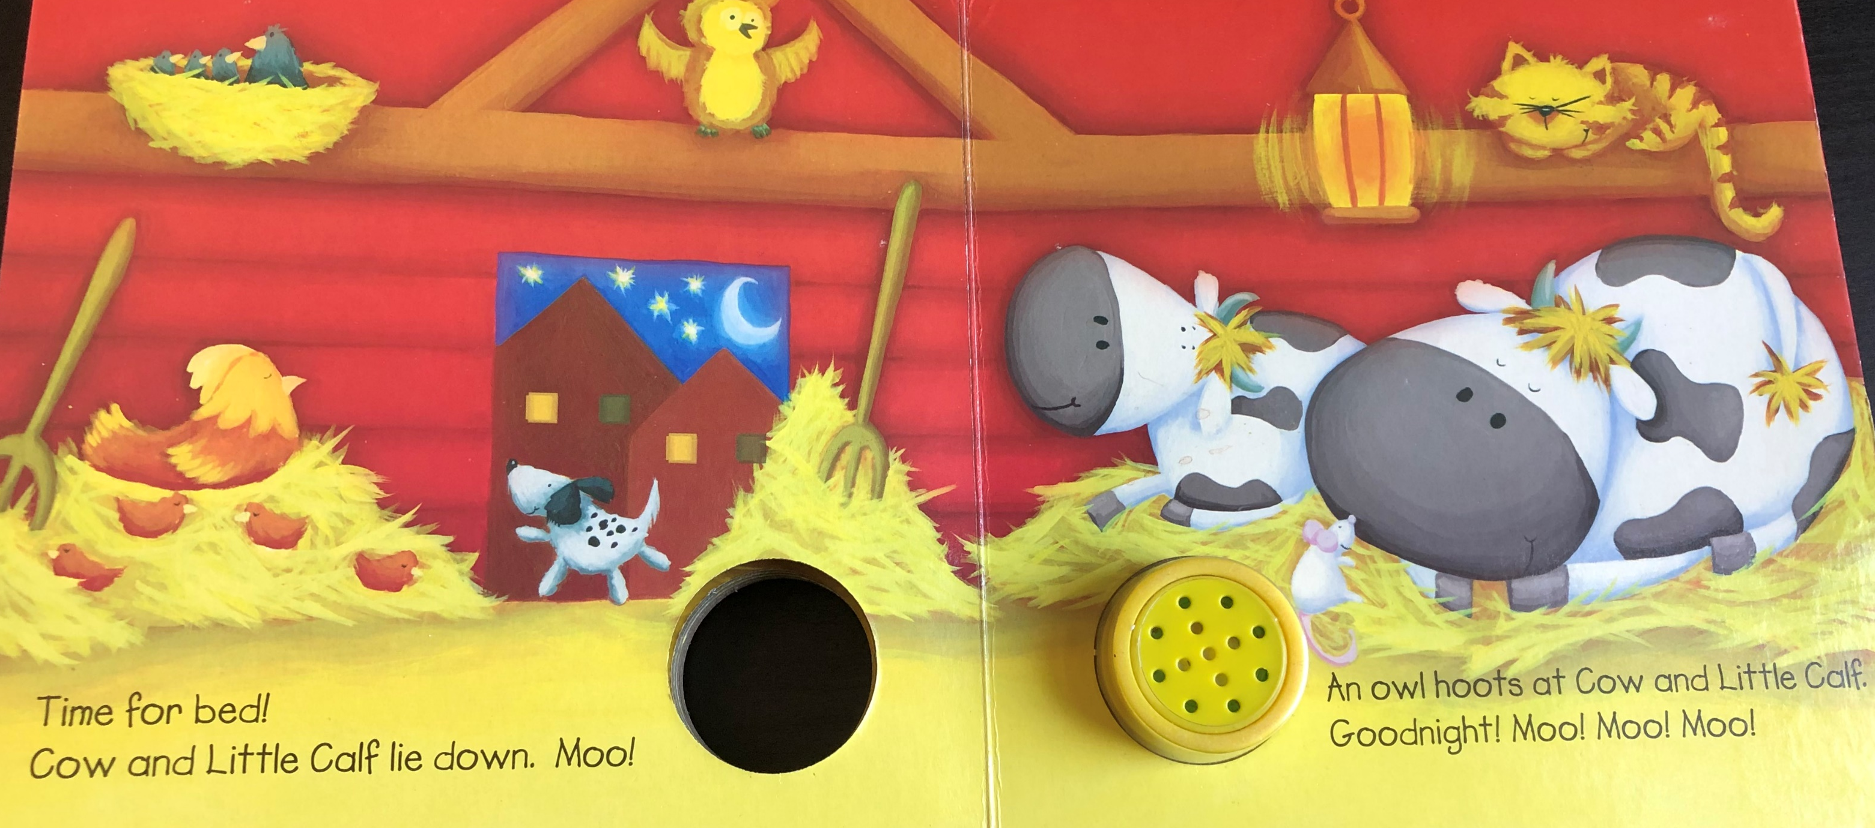
Resource: owl hooting sound

