Slide 1
Summer sensology
The purpose of sensology is to develop body and sensory awareness. It should be a relaxing session in a quiet environment. Lighting can be low (if suitable) and any sensory lights can be turned on. Your child can either lie down or sit, depending on which they find more relaxing. Shared eye contact is encouraged during these sessions and if your child does not want to touch/taste/smell etc any of the resources then that is absolutely fine! Move steadily through the powerpoint, giving your child time to explore the resources and give reactions - encourage them to express their likes and dislikes for the things they explore. Relaxing music can be played on low in the background.
The powerpoint is designed to give information to you and so there is no need for your child to be positioned so that they can see it. I’ve put a list of resources if you just wanted to print that part out and ignore the powerpoint.

Slide 2
Resources
Say hello: Mirror
Touch: Sand and water
Smell: Suncream and vinegar
Taste: Ice cream
See: Orange cellophane and a torch (or orange card), shells
Sound: seagull sounds / sound of the sea

Slide 3
Say hello….
Encourage your child to look at themselves in the mirror. Begin by talking to them about the parts of the body they can see in the mirror (head, eyes, nose, ears etc) and then move on to point/tap to other parts of their body such as their arms, legs, hands, feet etc.
Sing the song ‘Mr Sun’ with your child, making circular movements over their body with your hand.
https://www.youtube.com/watch?v=hlzvrEfyL2Y&list=RDmVhh0oATqBI&index=3

Slide 4
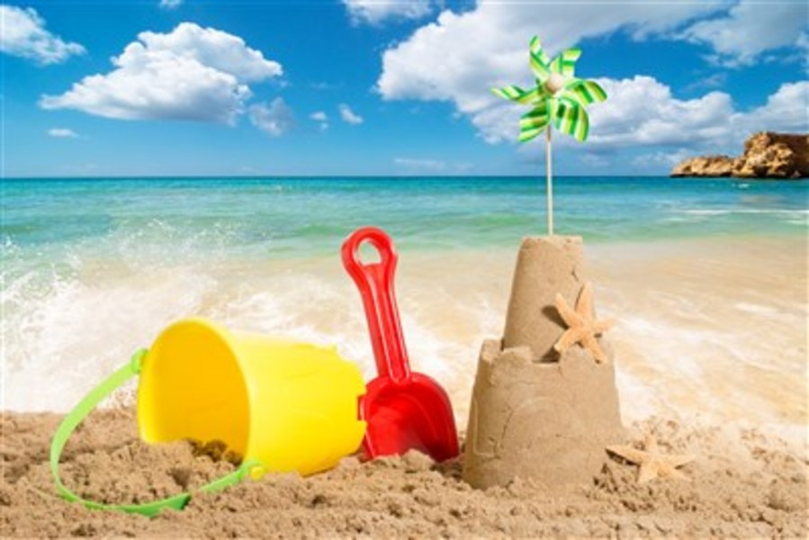
Touch
Briefly introduce that we use our bodies and our hands to touch. Encourage your child to explore the feel, one at a time, of the dry sand and then water in a bowl. You could use a bucket and spade if you have one available.
Feel: Sand and water

Slide 5
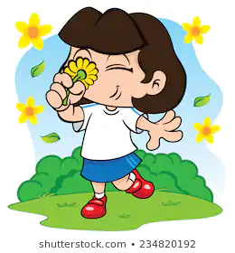
Smell
Introduce that we use our nose to smell, indicating to your child where their nose is (or asking them to show you themselves). Encourage your child to smell the suncream and then some vinegar (place vinegar onto cotton wool or a tissue before offering the smell). Always present the stronger of the scents last. Encourage your child to express likes or dislikes for the scents.
Smell: Sun cream and vinegar

Slide 6
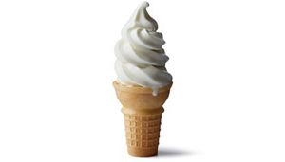
Taste - may not be applicable to all pupils. Pupils unable to taste can smell the resources or feel.
Introduce that we use our mouth to taste, indicating to your child where their mouth is (or asking them to show you themselves). Offer your child a taste of the ice cream (you can offer different flavours if you wish). Encourage your child your child to express their likes and dislikes towards the food.
Taste: Ice cream

Slide 7
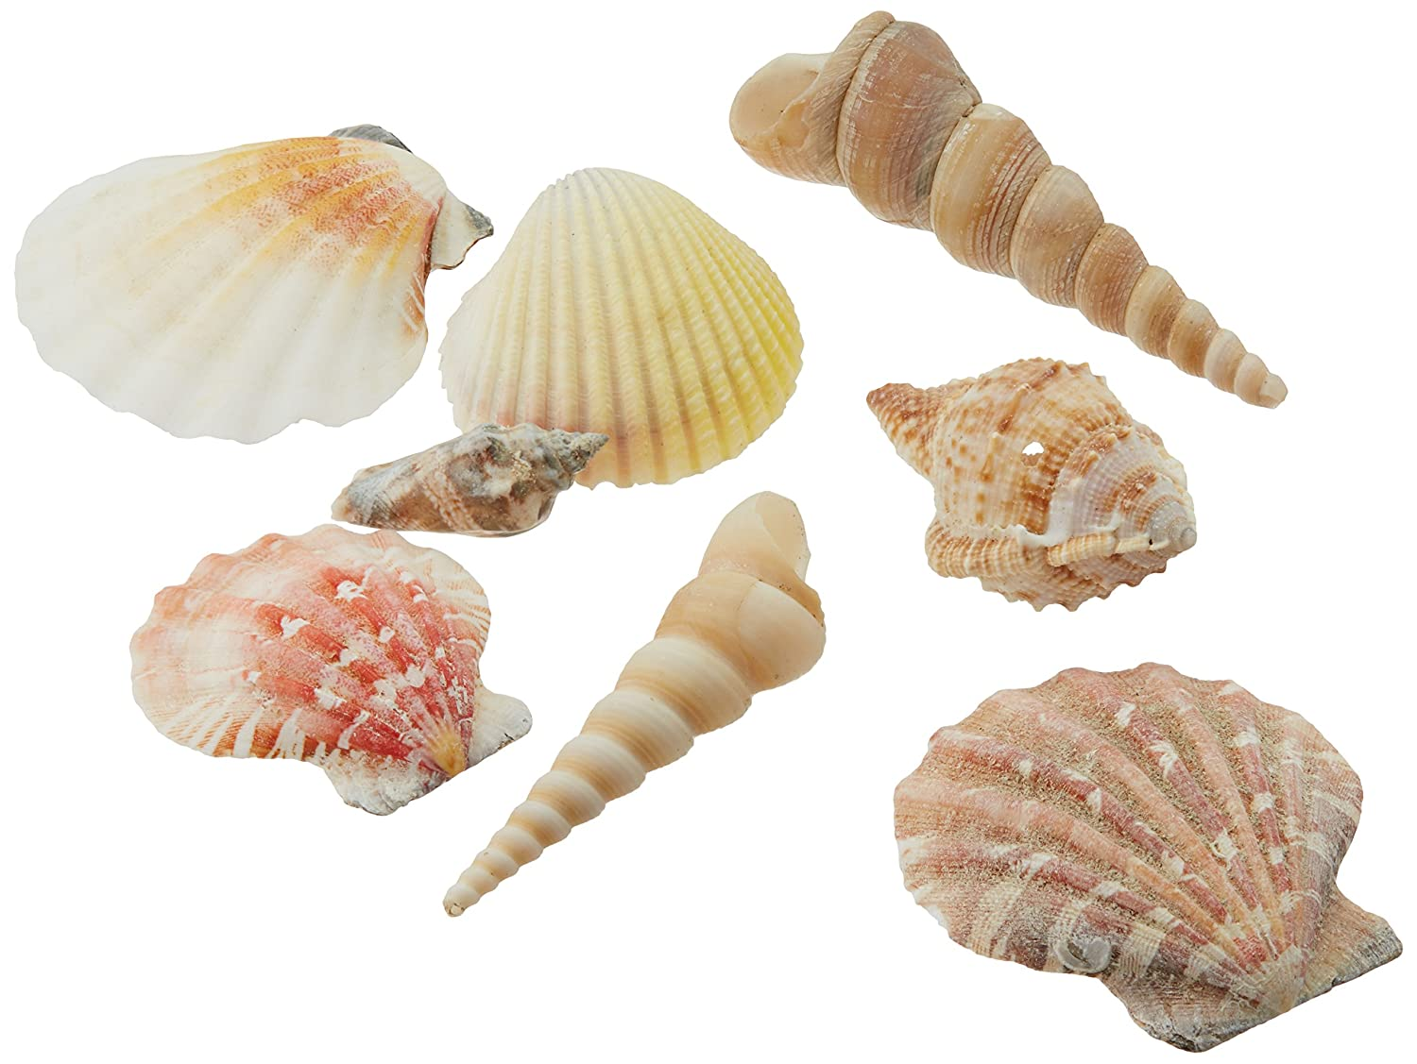
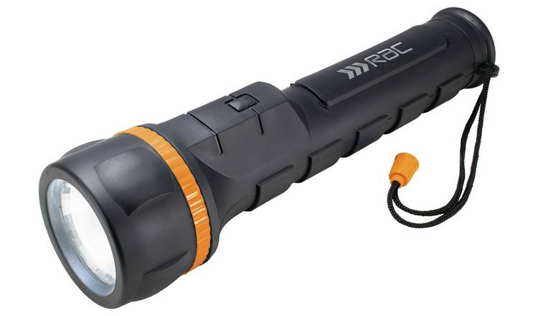
See
Introduce that we use our eyes to see, indicating to your child where their eyes are (or asking them to show you themselves). Show your child either a piece of orange cellophane or card – shine a torch either through the cellophane or onto the card for your child to track. You can also show your child a selection of different shells if you have these available.
See: orange cellophane/card, a torch and shells

Slide 8
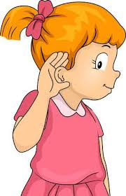
Hear
Introduce that we use our ears to hear, indicating to your child where their ears are (or asking them to show you themselves). Listen to the airplane and beach themed sound effects with your child.
Airplane: https://www.youtube.com/watch?v=sXANrP1738A
Seagulls: https://www.youtube.com/watch?v=dpndP-cBE60
Sea: https://www.youtube.com/watch?v=f77SKdyn-1Y&t=249s

Slide 9
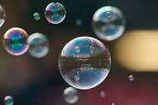
Relaxation
Relax with your child, listening to the music and perhaps giving them a massage. You could also blow bubbles for your child (if you have these available).
Some ideas for relaxation music:
https://www.youtube.com/watch?v=UN6O1i7qmV0
https://www.youtube.com/watch?v=HfrvPOmXFOE
https://www.youtube.com/watch?v=DGIXT7ce3vQ&t=85s

