Slide 1
Self help and independence skills/activities.

Slide 2
Washing up
Important point for success.
Make it part of a routine.
Make instructions clear and consistent.
Make it fun.
Build up the level of independence gradually.
Set a timer (see video)

Slide 3
Washing clothes
Important point for success.
Make it part of a routine.
Make instructions clear and consistent.
Make it fun.
Build up the level of independence gradually.
It can be turned into a sorting activities also. (colours, socks (pairs)

Slide 4
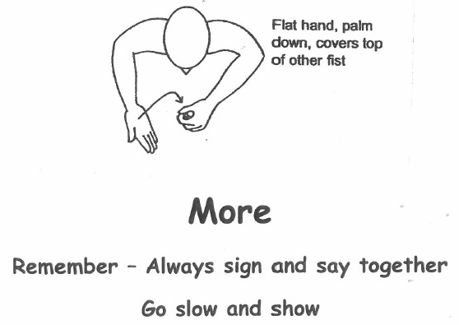
Brushing teeth
Important point for success.
Show your child everything you're doing (getting the tooth brush – getting the toothpaste – adding the tooth paste).
Model the expectations of the activity.
Allow for breaks. Split it into 4 parts – bottom left – bottom right – top left – top right.
Give clear, simple instructions.
Use the Makaton sign for “more” before starting a new part.
Use gestural prompt to encourage
Hand over hand support is encouraged.

Slide 5
Putting on clothes and shoes
Important point for success.
Make it part of a routine.
Make it step by step.
Lay clothes out in order.
Model each step.
Be patient in showing how clothes go in.
It’s a labour of love, be consistent and complete multiple times a day.

