Slide 1
iPads and tablets
Educational apps you can download.

Slide 2
https://www.educationalappstore.com/app/free-apps-for-kids

Slide 3
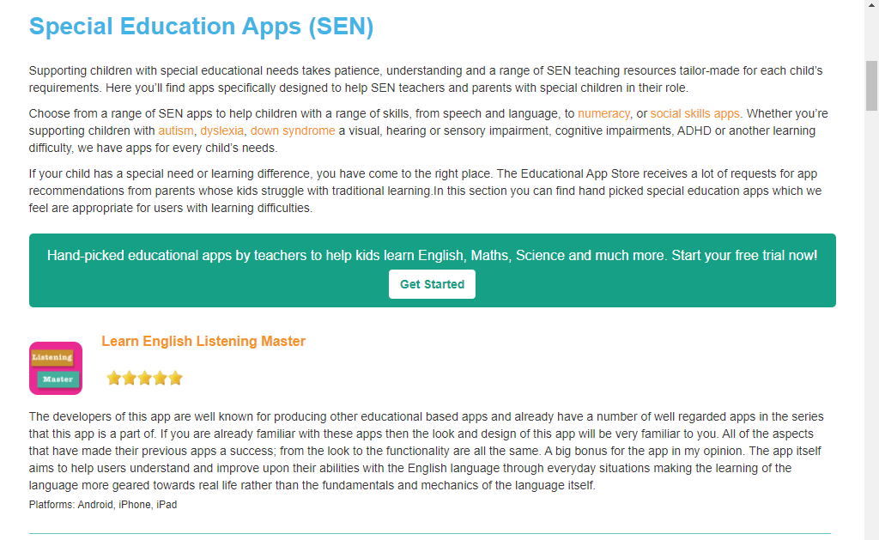

Slide 4
https://www.autismparentingmagazine.com/best-autism-apps/

Slide 5
Proloquo2Go
Speak up with symbol-based AAC
Not being able to speak isn’t the same as having nothing to say. Children, teens and adults who can’t speak can use this Augmentative and Alternative Communication (AAC) app for iOS as a daily communication tool and to build language skills. From the first time someone opens the app, a few taps are all it takes to start talking to the world.

Slide 6
Todo Visual Schedule
Children with Autism: A visual schedule is a wearable picture-based scheduler designed with children and adults with autism in mind.

