Slide 1
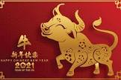
Chinese New Year
The Year of the Ox
2021

Slide 2
Chinese New Year
Chinese New Year is a festival that celebrates the start of a new year in the Chinese calendar. It is sometimes called Lunar New Year, as it is celebrated in other countries as well as China.

Slide 3
Chinese New Year
A long time ago, in China, the Jade Emperor decided that there should be a way to measure time. He invited all the animals to compete in a race across the river. The first 12 animals to cross the river would be rewarded by having a year named after them.
The position they came in the race would decide the order of the years. The rat won the race so the first year was named after him.

Slide 4
Chinese New Year
Each new year is named after an animal.

Slide 5
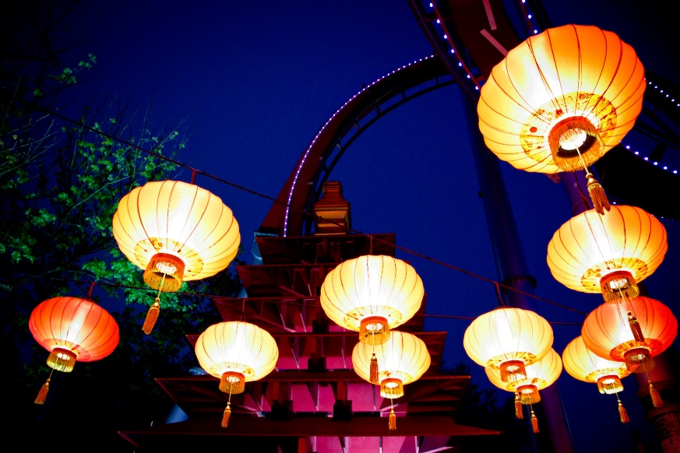
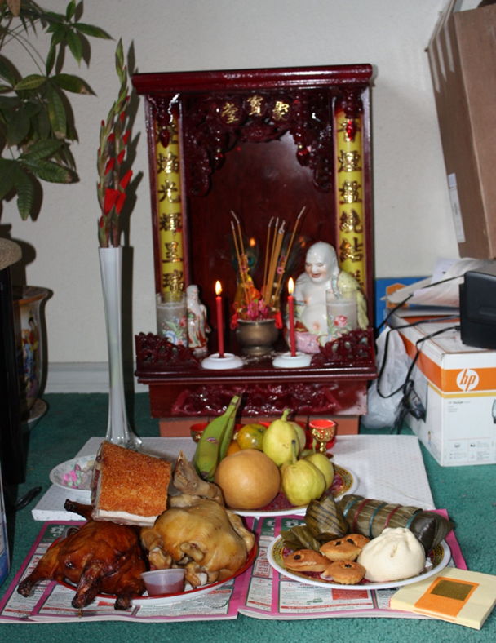
How is Chinese New Year celebrated?
Lots of food is eaten!
Lanterns Are Lit

Slide 6
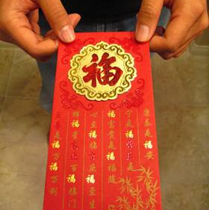
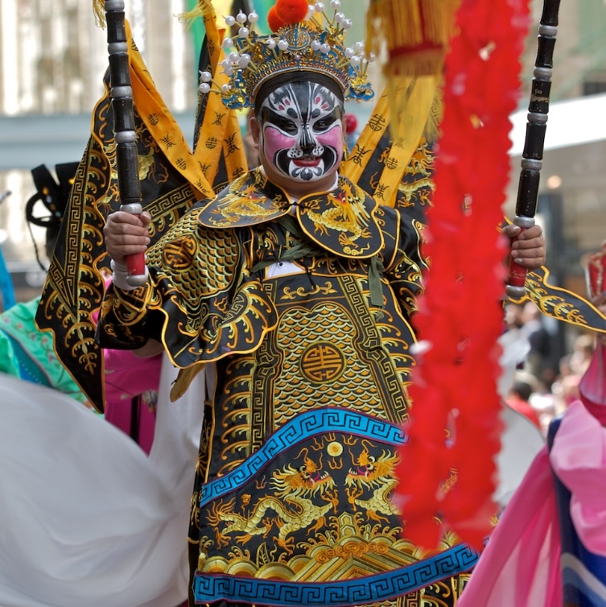
Lucky red envelopes are given out during Chinese New Year!
Chinese love the colour red and believe it is a lucky colour.
Lots of music and dancing happens during Chinese New Year!

Slide 7
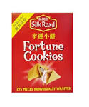
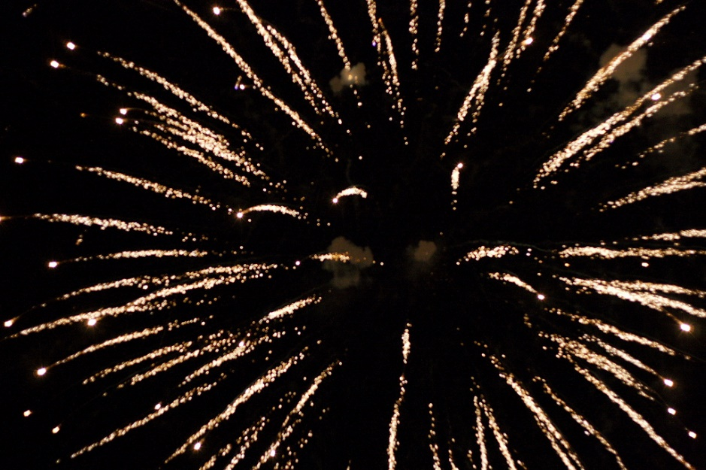
Chinese fortune cookies symbolise good luck!
Firecrackers are a Chinese tradition that are used to scare away evil spirits!

Slide 8
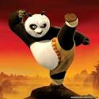
Why not have a dance Kung Fu style…
Gung hay fat choy!
新年快乐

