Slide 2
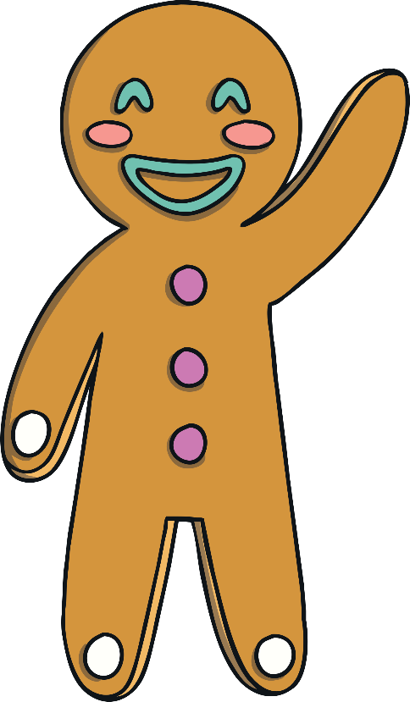
Name that story!
A biscuit runs away and is chased by lots of people and animals. He tries to cross over a river with the help of a sneaky fox.
It’s The Gingerbread Man!
Can you tell me anything else about the story?

Slide 3
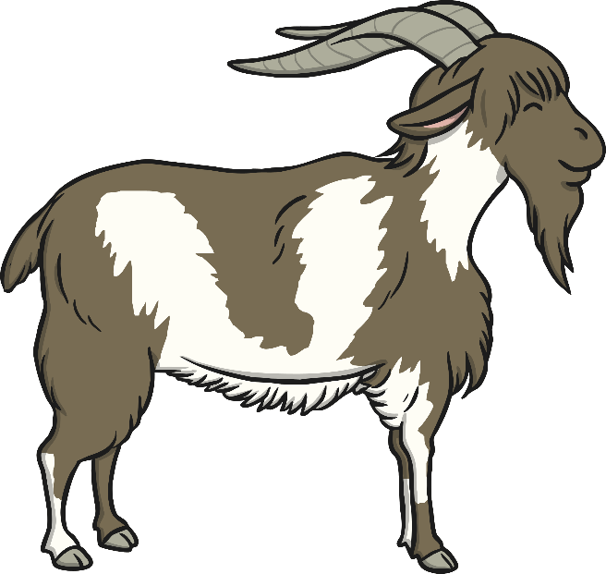
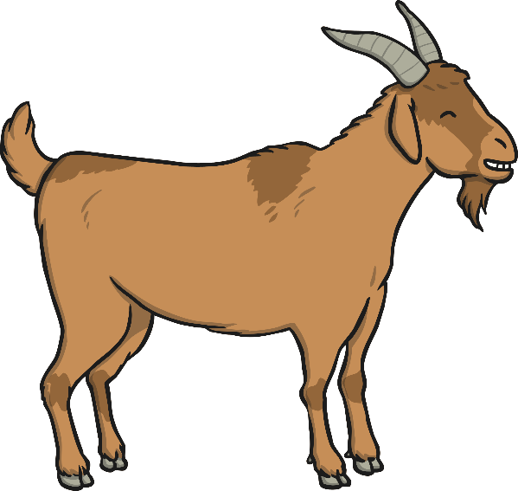
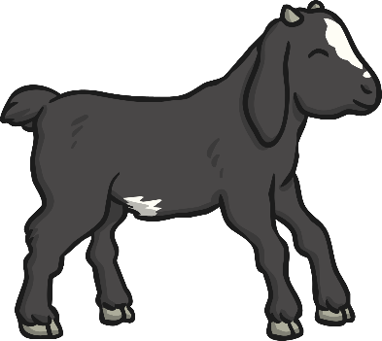
Name that story!
Some hungry goats want some grass to eat and decide to cross over a little bridge.
It’s The Three Billy Goats Gruff!
Can you tell me anything else about the story?

Slide 4
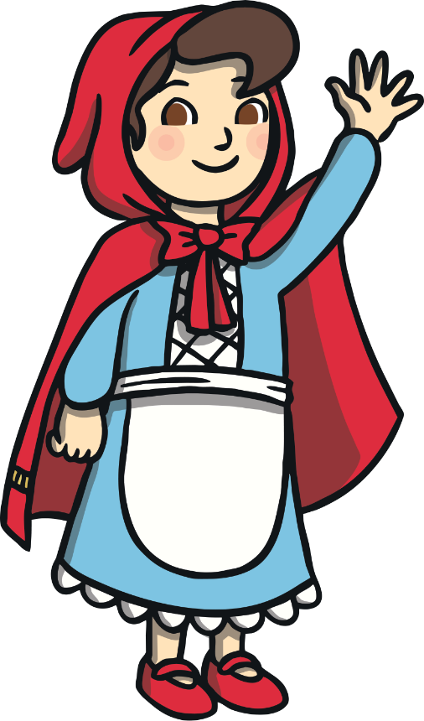
Name that story!
A little girl visits her grandma who looks rather different. She seems to have furry ears, big eyes and a long nose!
It’s Little Red Riding Hood!
Can you tell me anything else about the story?

Slide 5
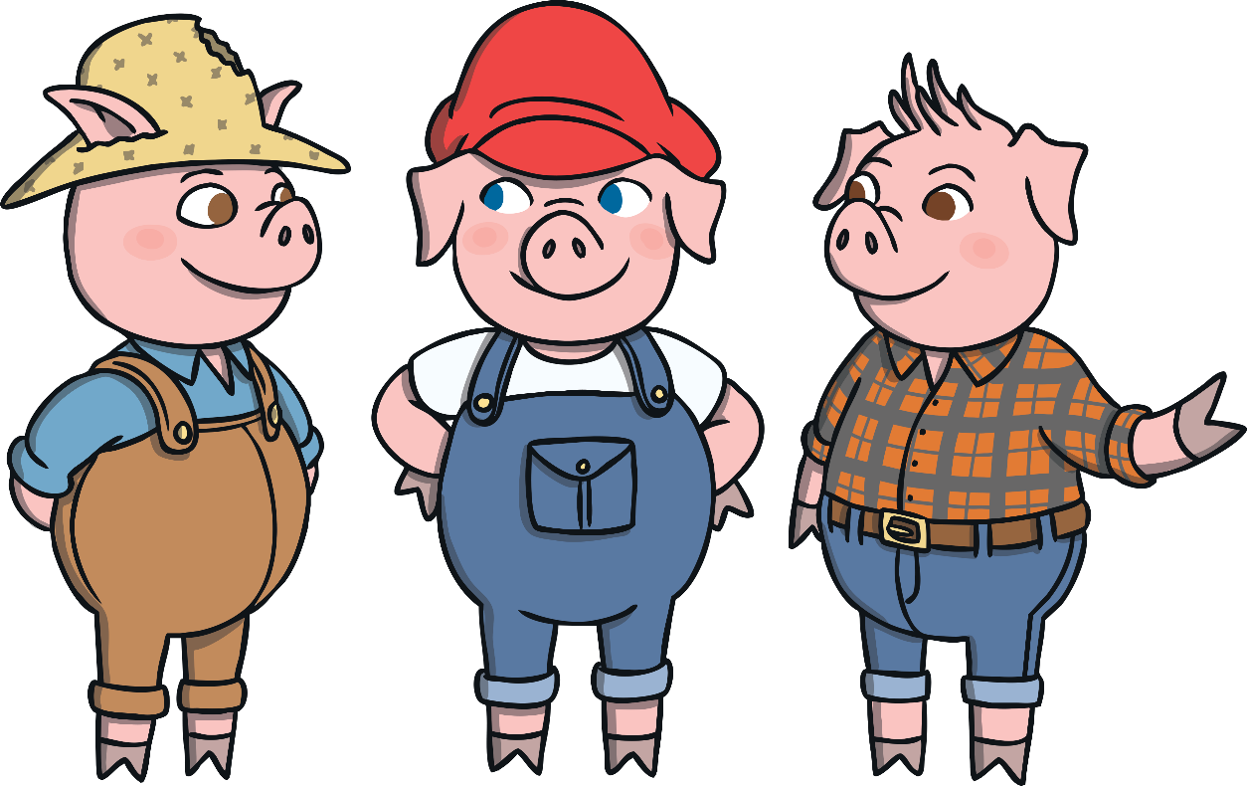

Name that story!
When some pigs leave home, they decide to build their own houses but a wolf pays them a visit!
It’s The Three Little Pigs!
Can you tell me anything else about the story?

Slide 6
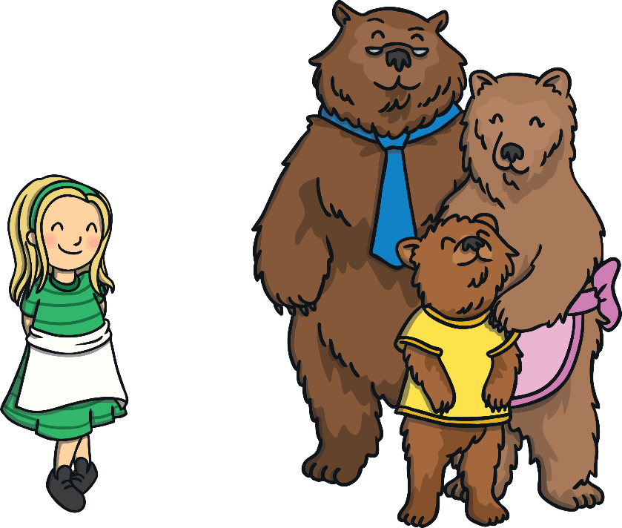
Name that story!
A little girl goes into a cottage she finds in the woods. She eats some food, breaks a chair and goes to sleep in a little bed. Then the homeowners come back!
It’s Goldilocks and the Three Bears!
Can you tell me anything else about the story?

Slide 7
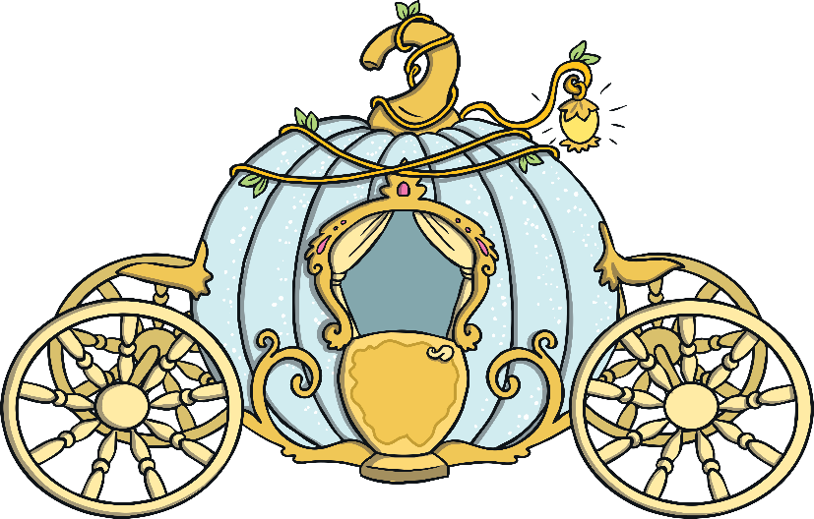
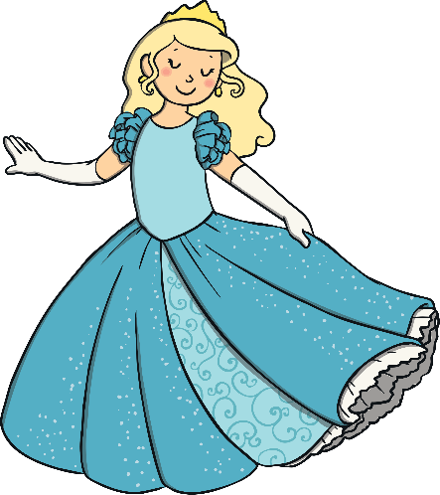
Name that story!
A girl leaves a prince’s palace at midnight but drops a glass slipper.
It’s Cinderella!
Can you tell me anything else about the story?

Slide 8
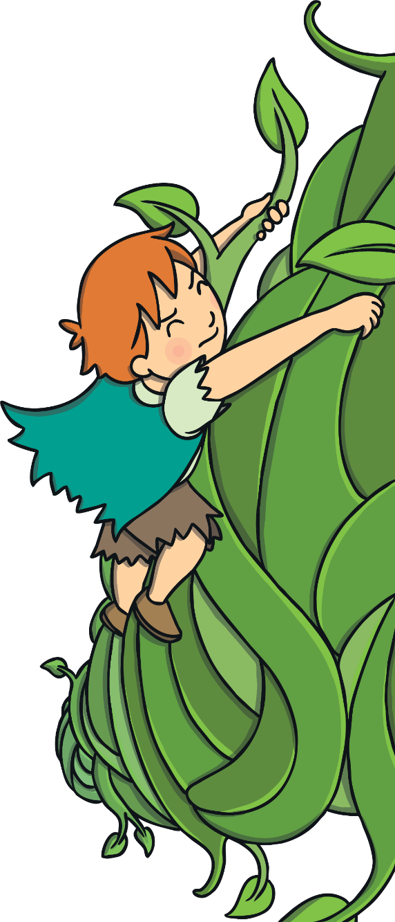
Name that story!
A little boy grows an enormous beanstalk, finds a giant’s castle and a rather special goose.
It’s Jack and the Beanstalk!
Can you tell me anything else about the story?

Slide 9
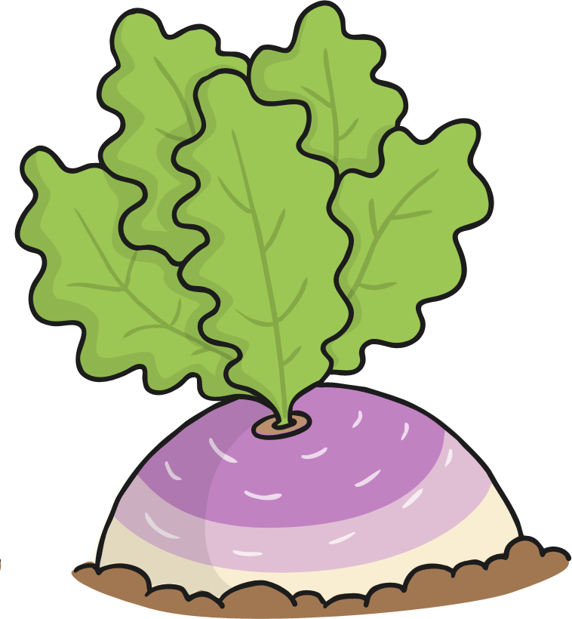
Name that story!
A man grows an enormous vegetable but needs lots of help to pull it up!
It’s The Enormous Turnip!
Can you tell me anything else about the story?

Slide 10
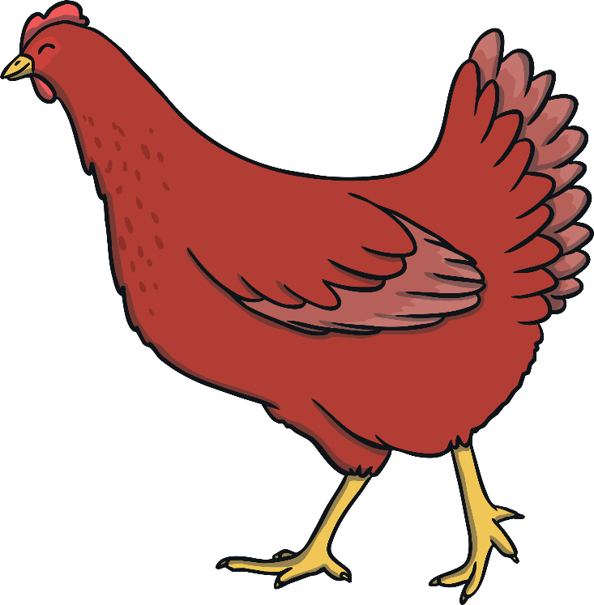
Name that story!
A little hen plants and grows some wheat, grinds some flour and makes a loaf of bread without any help from the other animals until it is time for the bread to be eaten.
It’s The Little Red Hen!
Can you tell me anything else about the story?

Slide 11



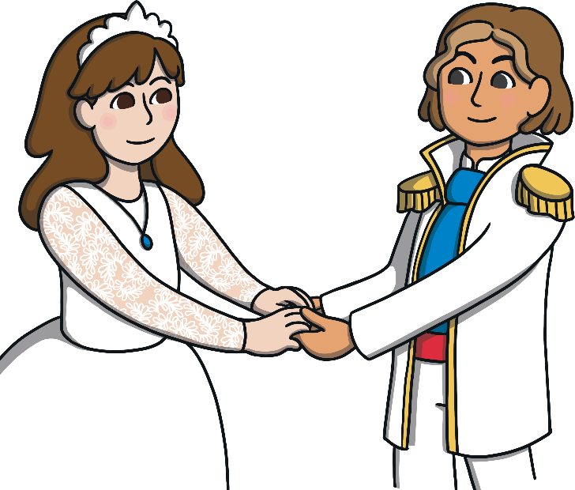
Name that story!
A witch puts a spell on a boy and turns him into a beast. He lives in a castle and falls in love with a beautiful girl.
It’s Beauty and the Beast!
Can you tell me anything else about the story?

Slide 12


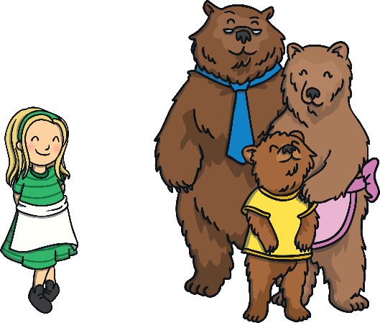



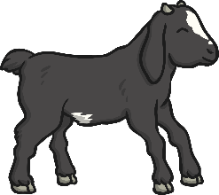
Can you remember some of the stories we named?

