Slide 1
An Interactive Drama Toolkit
Role-play Scene Supporting Slides
Heather Kate Molloy for Pamis

Slide 4
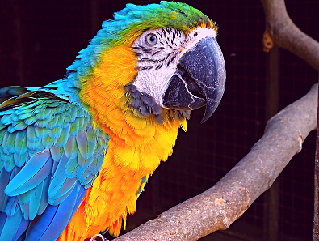

Slide 8
This Photo by Unknown Author is licensed under CC BY-SA

Slide 9
