Slide 1
Sensology
Exploring the Garden

Slide 2
Purpose
The purpose of Sensology is to develop body and sensory awareness. It should be a relaxing session in a quiet environment. Lighting can be low (if suitable) and any sensory lights can be turned on. Your child can either lie down or sit, depending on which they find more relaxing. Shared eye contact is encouraged during these sessions try and encourage your child you use their senses throughout the session!
Move steadily through the powerpoint, giving your child time to explore the resources and give reactions - encourage them to express their likes and dislikes for the things they explore. Relaxing music can be played on low in the background.

Slide 3
Say Hello- use a mirror
Encourage your child to look at themselves in the mirror. Begin by talking to them about the parts of the body they can see in the mirror (head, eyes, nose, ears etc) and then move on to point/tap to other parts of their body such as their arms, legs, hands, feet etc.
Sing Head, Shoulders, Knees and Toes with your child - patting the parts of their body along with the music. Alternatively, sing ‘One Little Finger’ with your child, following the actions with them.
Head, shoulders, knees and toes: https://www.youtube.com/watch?v=RuqvGiZi0qg
One Little Finger: https://www.youtube.com/watch?v=eBVqcTEC3zQ

Slide 4
Touch – use a bunch of leaves on a stem
Briefly introduce that we use our bodies and our hands to touch. Encourage your child to explore the feel of the leaves, comparing the difference between big and small and explore the stem that the leaves are attached to.
They can either explore with their hands, feet and draped over their body whilst tickling them with it. Give them chance to respond, explore and observe their reactions.

Slide 5
Smell- using flowers/plants
Introduce that we use our nose to smell, indicating to your child where their nose is (or asking them to show you themselves).
Encourage your child to smell a flower first and then you could some basil, mint or rosemary to compare (from a jar or fresh plant if you have one) let the child explore the different smells giving them time.
Encourage your child to express likes or dislikes for the scents by facial expressions, refusing or being vocal.

Slide 6
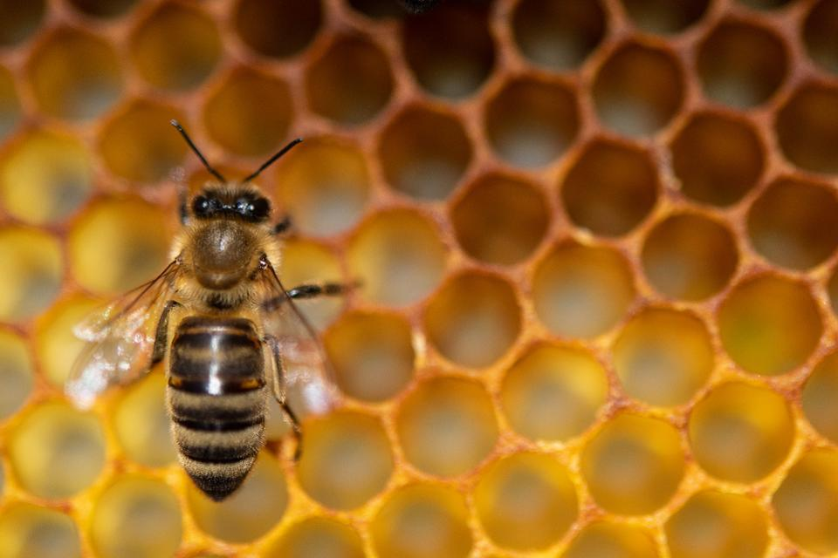
Taste- honey
introduce that we use our mouth to taste, indicating to your child where their mouth is (or asking them to show you themselves).
(I chose honey as it would be linked to bees you would see in the garden)
Offer your child a taste of Honey that you have readily available!
Encourage your child to express their likes and dislikes towards the food.

Slide 7
See – use shiny foil/material
Introduce that we use our eyes to see, indicating to your child where their eyes are (or asking them to show you themselves).
Show your child, shiny foil/material (if available). A torch light could also be shined onto the foil / shiny material to create a different pattern of light for your child to track and observe.
Observe you child’s responses.

Slide 8
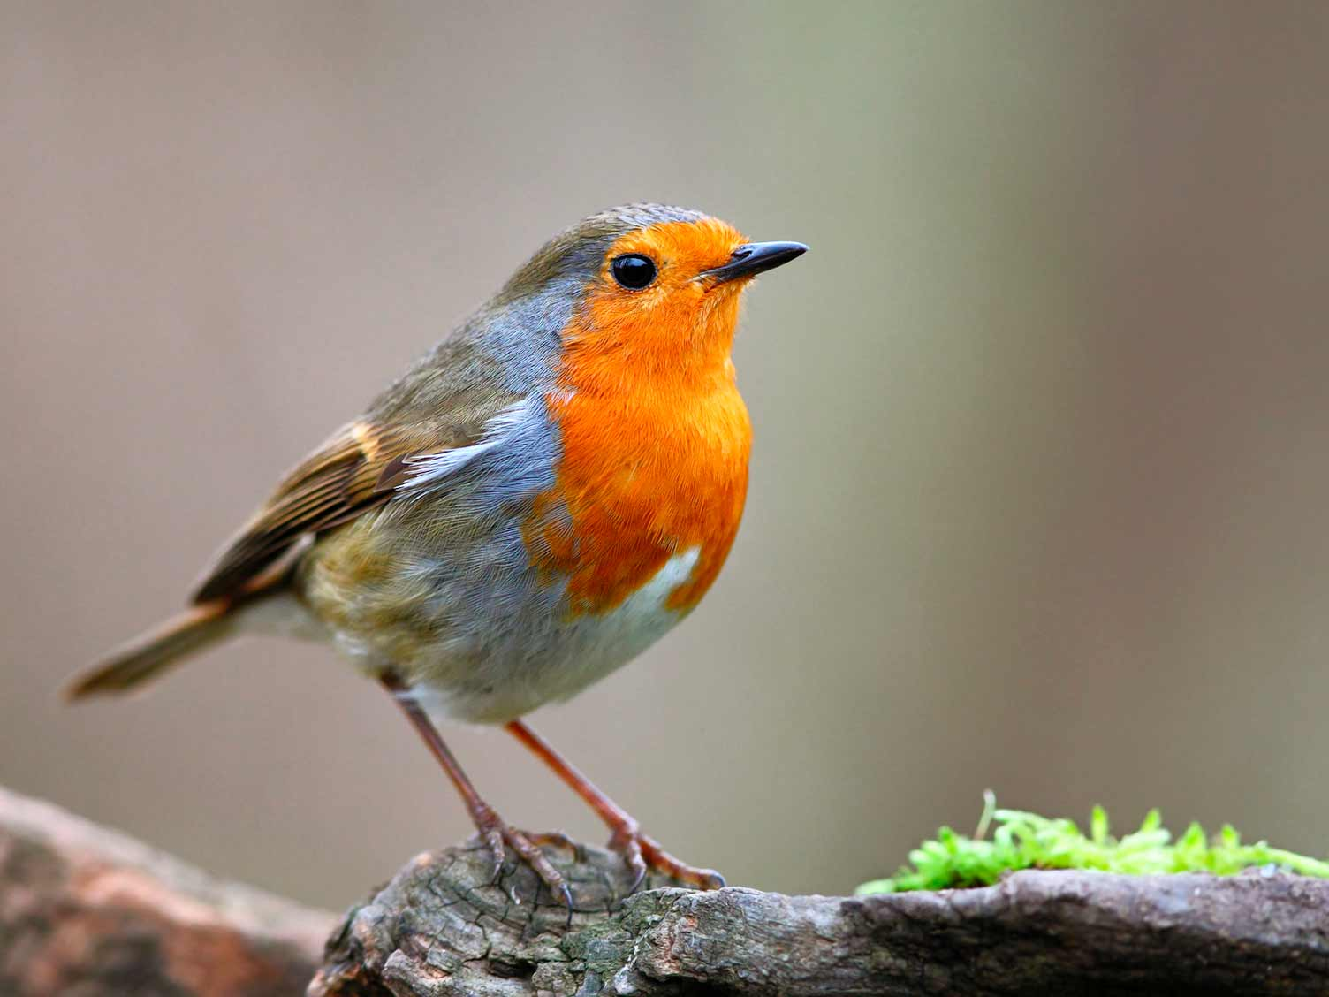
Hear- using the internet links
introduce that we use our ears to hear, indicating to your child where their ears are (or asking them to show you themselves). Listen to the sound clips below with your child.
Birds tweeting – https://youtu.be/rYoZgpAEkFs
Sounds of bees - https://youtu.be/-d3ABrrlkIs
Observe your child have they got a preference from the two videos? Give them chance to listen. Remember to be silent yourself to give them the full hearing of the sounds.

Slide 9
Relax
Relax with your child, listening to the music and perhaps giving them a massage. You could also blow bubbles for your child (if you have these available).
So ideas for relaxation music:
https://www.youtube.com/watch?v=WUXEeAXywCY&t=1489s
https://www.youtube.com/watch?v=5DiMoehAeOU&t=54s
https://www.youtube.com/watch?v=5HrkXT5Bc9E&t=1056s
We hope you and your child have enjoyed exploring and using their senses.

