Slide 2
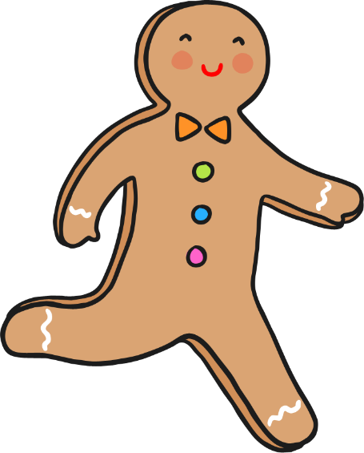
Name That Story!
A biscuit runs away and is chased by lots of people and animals. He tries to cross over a river with the help of a sneaky fox.
The Gingerbread Man

Slide 3
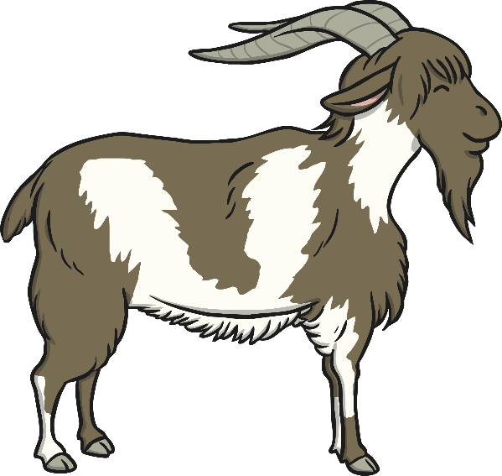
Name That Story!
Some hungry goats want some grass to eat and decide to cross over a little bridge.
The Three Billy Goats Gruff

Slide 4
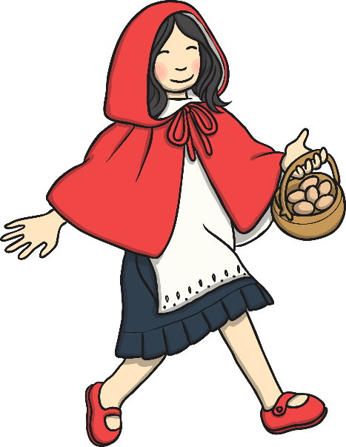
Name That Story!
A little girl visits her grandma - who looks rather different. She seems to have furry ears, big eyes and a long nose!
Little Red Riding Hood

Slide 5

Name That Story!
When some pigs leave home, they decide to build their own houses but a wolf pays them a visit!
The Three Little Pigs

Slide 6
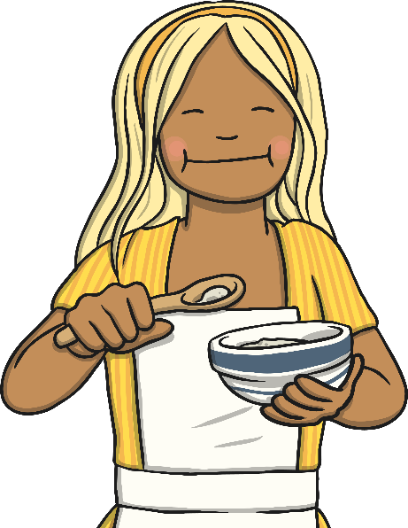
Name That Story!
A naughty little girl goes into a cottage she finds in the woods. She eats some food, breaks a chair and goes to sleep in a little bed, but soon the home owners come back!
Goldilocks and the Three Bears

Slide 7

Name That Story!
A girl leaves a prince’s palace at midnight but dropped a glass slipper!
Cinderella

Slide 8

Name That Story!
A little boy grows an enormous beanstalk, finds a giant’s castle and a rather special goose.
Jack and the Beanstalk

Slide 9

Name That Story!
A little girl is given a special cooking pot – it makes lots and lots of porridge!
The Magic Porridge Pot

Slide 10

Name That Story!
A man grows an enormous vegetable but needs lots of help to pull it up!
The Enormous Turnip

Slide 11
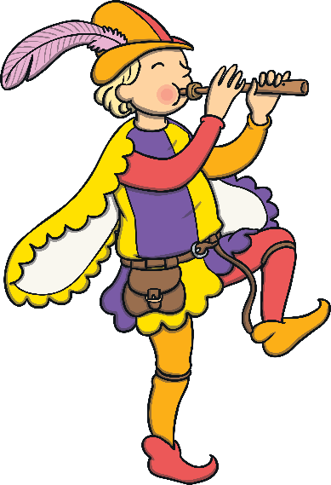
Name That Story!
A man plays a magic flute and rats and children follow him.
The Pied Piper

Slide 12

Name That Story!
A boy finds a magical lamp with a magical genie inside!
Aladdin

Slide 13

Name That Story!
A witch puts a spell on a boy and turns him into a beast. He lives in a castle and falls in love with a beautiful girl.
Beauty and the Beast

Slide 14
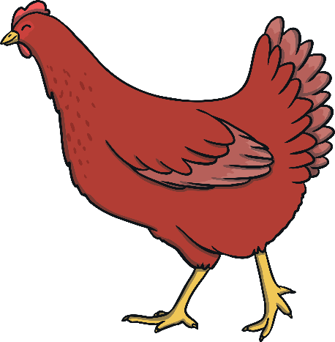
Name That Story!
A little hen plants and grows some wheat, grinds some flour and makes a loaf of bread without any help from the other animals until it is time for the bread to be eaten!
The Little Red Hen

Slide 15

Name That Story!
A fairy brings a toy boy puppet to life but strange things happen when the little boy lies.
Pinocchio

Slide 16
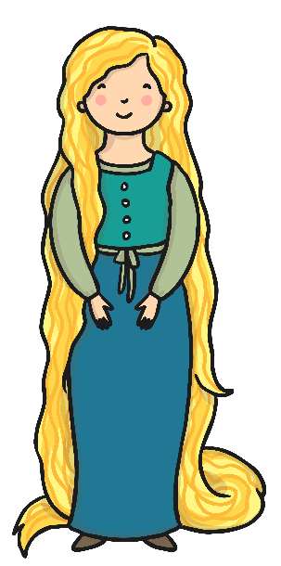
Name That Story!
A witch locks a girl in a tall tower. The girl’s hair grows longer and longer and a prince comes to visit the girl.
Rapunzel

Slide 17

Name That Story!
A mean fairy turns a prince into a frog!
The frog lives in a well and one day returns a lost golden ball back to a princess.
The Frog Prince

Slide 18
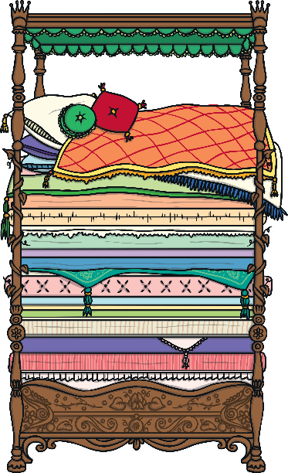
Name That Story!
A princess sleeps on a bed with 20 mattresses and quilts but hidden at the bottom is a tiny pea!
The Princess and the Pea

Slide 19
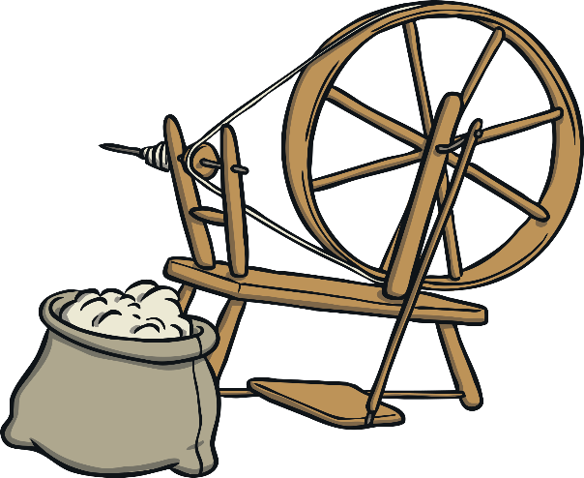
Name That Story!
A mean fairy says that when a girl reaches her 16th birthday she will prick her finger on a spinning wheel needle and fall into a deep sleep!
Sleeping Beauty

