Slide 1
An Interactive Drama Toolkit
Role-play Scene Supporting Slides
Heather Kate Molloy for Pamis

Slide 2
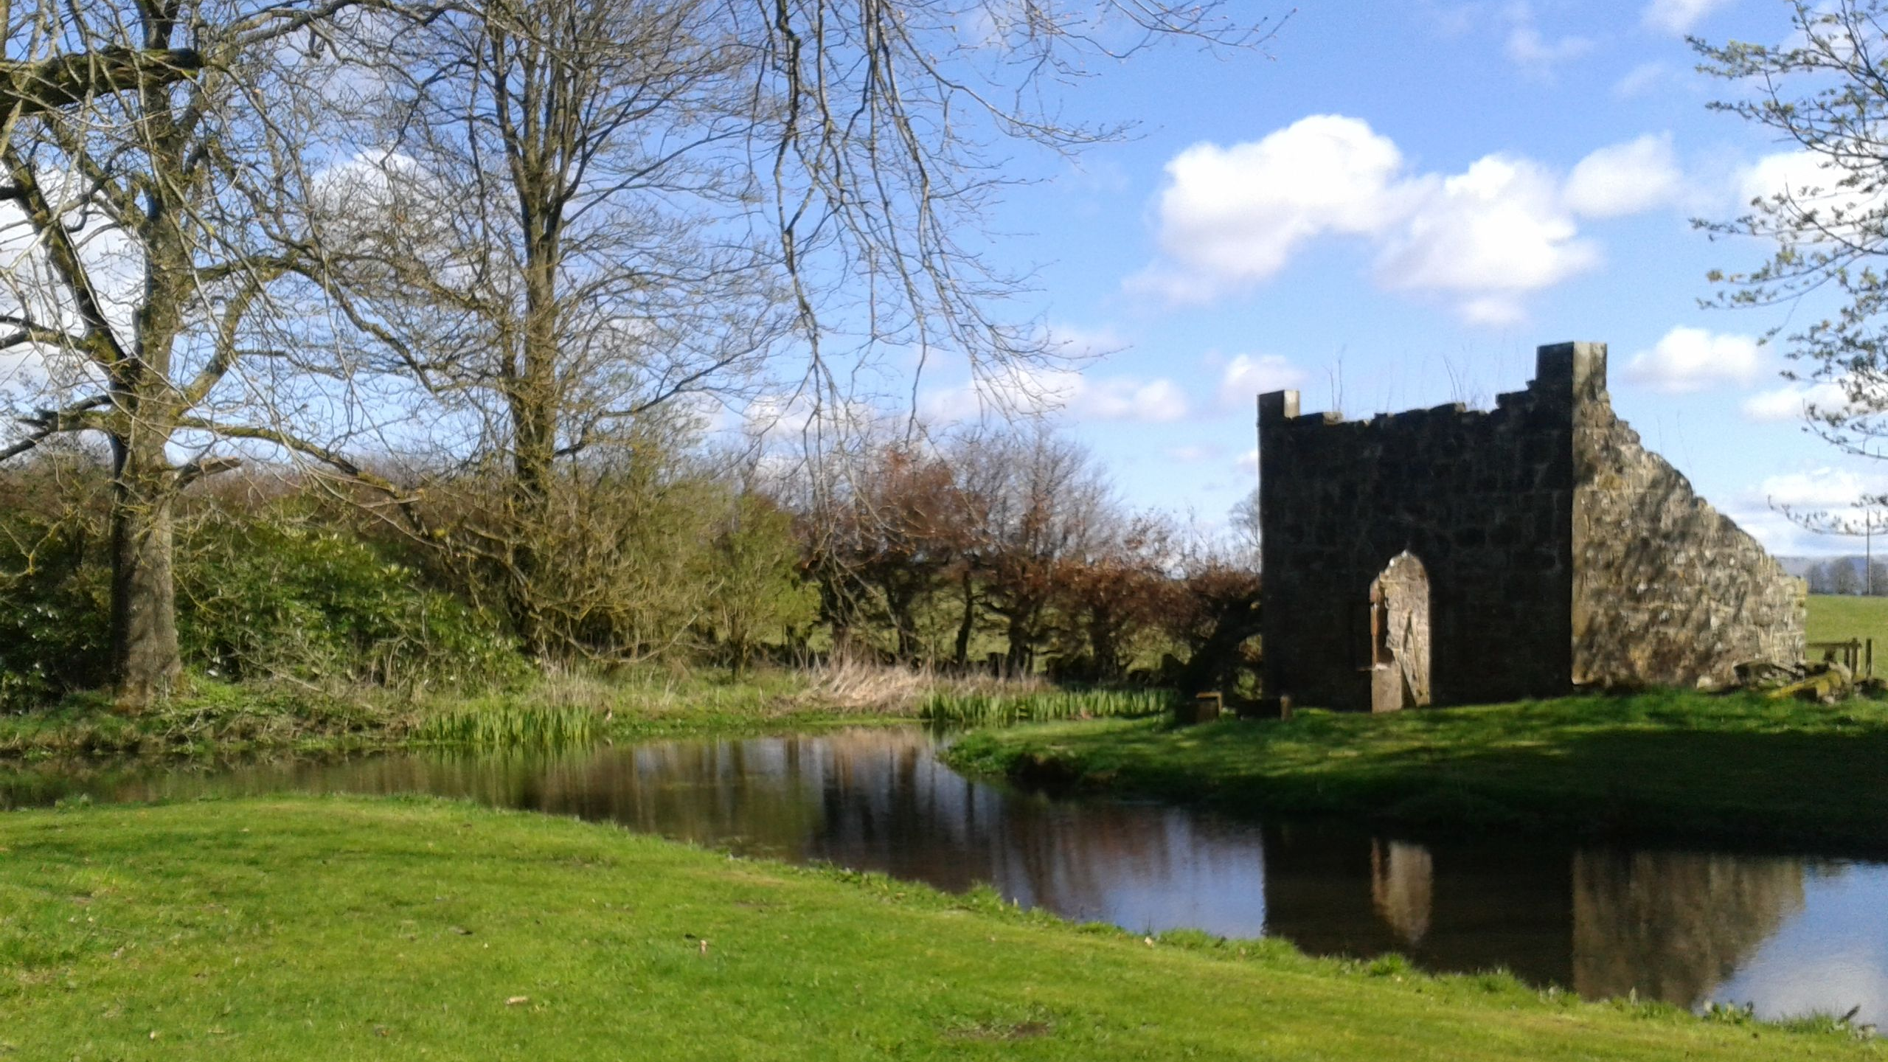

Slide 3
This slide is here for you to place a photograph of home or something that makes you feel at home.

Slide 4
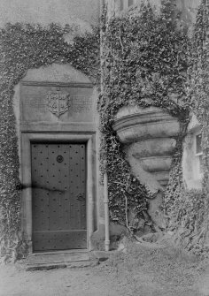

Slide 6
Freezing
Spell
3. SHOUT the magic words
‘EASY FREEZY ‘
1. POINT your wand
2. SHAKE IT 3 times

Slide 7
Turn into a Frog
3. SHOUT the magic words
‘OGGY OGGY FROGGY, OI, OI, OI’
1. POINT your wand
2. TAP IT 3 times

Slide 8
Dancing Spell
3. SING the magic words
‘IF YOU’RE HAPPY AND YOU KNOW IT, DANCE AROUND’
1. POINT your wand
2. WIGGLE IT 3 times

Slide 10
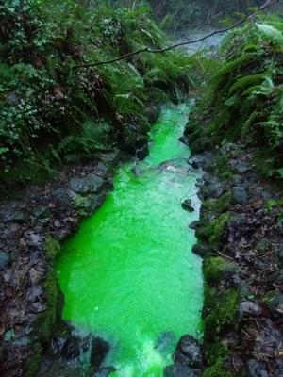

Slide 11
This Photo by Unknown Author is licensed under CC BY-SA-NC

